Slide 1
On OOK Waveform Specification
Date: 2018-03-05
Authors:

Slide 2
Introduction
In this presentation, we discuss what needs to be specified for on-off keying (OOK) symbols in the 802.11ba PHY specification to:
  Speed up the IEEE 802.11ba standardization process
  Allow different chip manufacturers to implement different options
We propose to specify the parameters and requirements that any WUR receiver needs to know and meet in order to demodulate the data and perform well

Slide 3


Demodulation of OOK signal at Wake-Up Radio
The wake-up radio (WUR) is a non-coherent radio based on energy detection
  It demodulates wake-up signal (WUS) by comparing the energy on two different durations within the coded OOK symbol duration
For demodulation, a WUR only needs to know the exact starting time and ending time of high power durations of the signal for each bit (“1” or “0”)
Low power
duration
High power
duration
Low power
duration
High power
duration
Low power
duration
High power
duration
e.g., Bit 1:
e.g., Bit 1:
$4$ us
$16$ us
High data rate (HDR)
Low data rate (LDR)

Slide 4
Aspects of the OOK waveform that do NOT need to be specified (1/3)
The WUR is a simple/low cost radio
The WUR is not expected to use specific values of the samples (in time or frequency domain) during the high/low power durations
  There is no need to specify the values of the samples and how they are generated

Slide 5
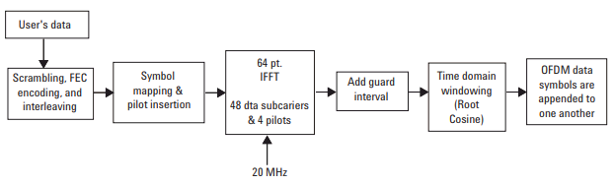
Aspects of the OOK waveform that do NOT need to be specified (2/3)
Specifying the sample values of the OOK waveform may be similar to specifying windowing coefficients used for OFDM signals, which has not been done in the 802.11 spec
  The windowing function is implementation dependent.
  It can be chosen freely as long as the out-of-band emission requirement is met.
  The receiver does not need to know it
[6]

Slide 6
Aspects of the OOK waveform that do NOT need to be specified (3/3)
Manchester coded OOK waveform can be implemented in several ways [1-5]
  Implementation 1: Store time domain coefficients
  Implementation 2: Store the IDFT output, then apply mask and windowing/filtering
  Implementation 3: Store a base sequence, then apply IDFT, mask and windowing/filtering
  ….
The performance (e.g., PER) depends on the receiver design and implementation
  A “reference receiver” design may be needed to complete the PHY specification for performance alignment

Slide 7
An Implementation of a Transmitter for WUR
Implementation dependent
Data rate
Information bits
Field Control
“0” OOK time-domain sequence (LDR)
“0” OOK time-domain sequence (HDR)
WUR-Data
“1” OOK time-domain sequence (LDR)
“1” OOK time-domain sequence (HDR)
WUR-PPDU
SYNC time-domain sequence (HDR)
WUR-Sync
SYNC time-domain sequence (LDR)
BPSK
Mark
BPSK-Mark
Legacy Preamble
IDFT
+CP
Windowing
/filtering
Legacy

Slide 8
Aspects of the OOK waveform that need to be specified
To allow different implementations of the OOK waveform and speed up the IEEE 802.11ba standardization process, we propose to:
  Specify timing related parameters for the “ideal OOK” symbols
    Any WUR implementation will need to know them
  Specify Tx requirements in time and frequency
    To ensure WUR and system will perform well
TX requirements @ output of RF:
Timing mask
Spectral mask
Minimum high-to-low energy ratio (HLER)
Nominal bandwidth
Others
Baseband
RF

Slide 9

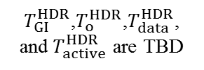

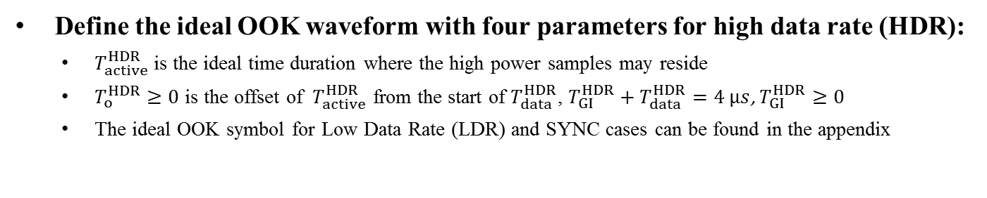



Timing Parameters of Ideal OOK Symbol
Define the ideal OOK waveform with four parameters for high data rate (HDR):
  $T_{active}^{HDR}$ is the ideal time duration where the high power samples may reside
  $T_{o}^{HDR}≥0$ is the offset of ${ T}_{active}^{HDR}$ from the start of $T_{data}^{HDR}$, $T_{GI}^{HDR}+T_{data}^{HDR}=\text{4 }μs$, $T_{GI}^{HDR}≥0$
  The ideal OOK symbol for Low Data Rate (LDR) and SYNC cases can be found in the appendix
Ideal OOK Symbol
$$T_{o}^{HDR}$$
$$T_{active}^{HDR}$$
Power
  $T_{GI}^{HDR}$,$T_{o}^{HDR}$,$T_{data}^{HDR}$, and${ T}_{active}^{HDR}$ are TBD
OOK Symbol @ output of RF
$$T_{GI}^{HDR}$$
$$T_{data}^{HDR}/2$$
$$T_{data}^{HDR}/2$$
* For low data rate data field and SYNC field, see Appendix slides

Slide 10



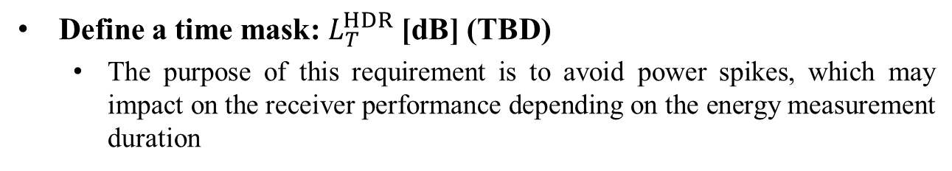

TX Requirement: Time Mask
Define a time mask: $L_{T}^{HDR}$ [dB] (TBD)
  The purpose of this requirement is to avoid power spikes, which may impact on the receiver performance depending on the energy measurement duration
Time mask
$$T_{o}^{HDR}$$
$$T_{active}^{HDR}$$
Power
$$L_{T}^{HDR}$$
$$T_{GI}^{HDR}$$
$$T_{data}^{HDR}/2$$
$$T_{data}^{HDR}/2$$
* For low data rate data field and SYNC field, see Appendix slides

Slide 11

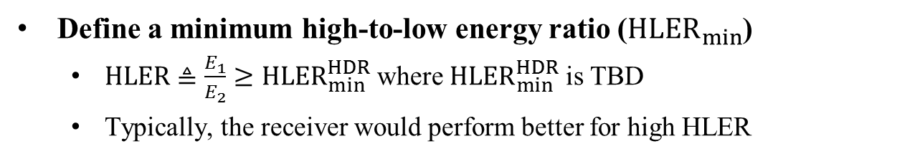




TX Requirement: HLER
Define a minimum high-to-low energy ratio (${HLER}_{min}$)
  $HLER≜\frac{E_{1}}{E_{2}}≥{HLER}_{min}^{HDR}$ where ${HLER}_{min}^{HDR}$ is TBD
  Typically, the receiver would perform better for high HLER
High-to-low energy ratio
$$T_{o}^{HDR}$$
$$T_{active}^{HDR}$$
$$T_{o}^{HDR}$$
$$T_{active}^{HDR}$$
Power
$$E_{1}$$
$$E_{2}$$
$$T_{GI}^{HDR}$$
$$T_{data}^{HDR}/2$$
$$T_{data}^{HDR}/2$$
* For low data rate data field and SYNC field, see Appendix slides

Slide 12
Other TX Requirements
Spectral Mask
  Can follow 11ac mask
Adjacent Channel Leakage Ratio (ACLR)
  To ensure the TX power is localized within 4 MHz bandwidth
  May need to be considered for FDM operation
Nominal bandwidth requirement
  4 MHz as agreed
Maximum PAPR
  Can be defined as a TX requirement if the group agrees that low PAPR is needed for the high duration of OOK symbols

Slide 13
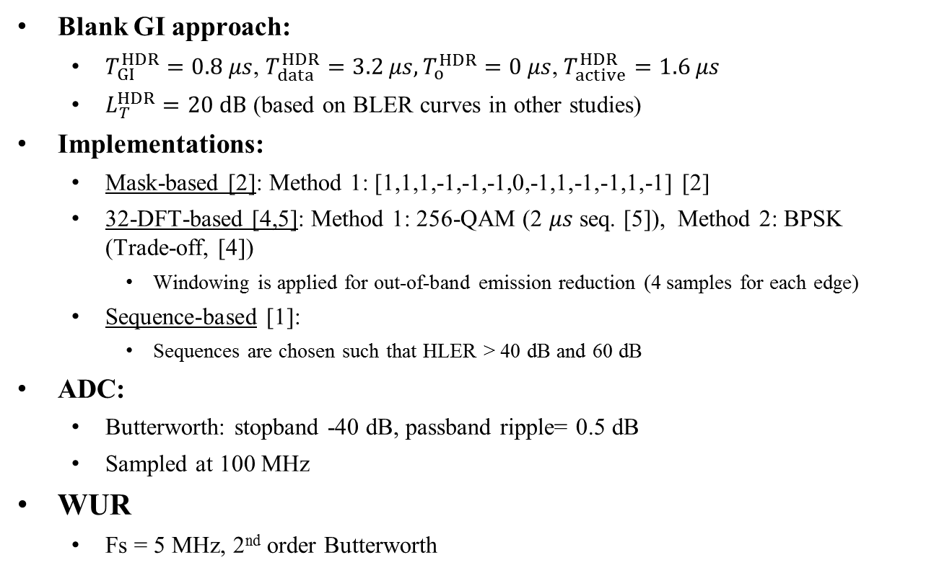
Numerical Analysis
Blank GI approach:
  $T_{GI}^{HDR}=0.8 μs$, $T_{data}^{HDR}=3.2 μs,T_{o}^{HDR}=0 μs$, $T_{active}^{HDR}=1.6 μs$
  $L_{T}^{HDR}=20 dB$ (based on BLER curves in other studies)
Implementations:
  Mask-based [2]: Method 1: [1,1,1,-1,-1,-1,0,-1,1,-1,-1,1,-1] [2]
  32-DFT-based [4,5]: Method 1: 256-QAM (2 $μs$ seq. [5]), Method 2: BPSK (Trade-off, [4])
    Windowing is applied for out-of-band emission reduction (4 samples for each edge)
  Sequence-based [1]:
    Sequences are chosen such that HLER > 40 dB and 60 dB
ADC:
  Butterworth: stopband -40 dB, passband ripple= 0.5 dB
  Sampled at 100 MHz
WUR
  Fs = 5 MHz, 2nd order Butterworth

Slide 14
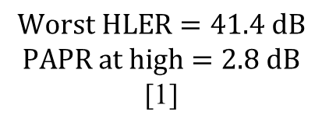
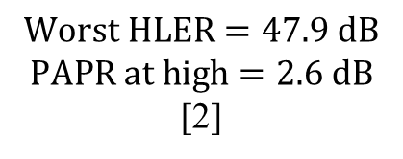
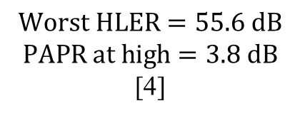
Comparison – Time
Logic 1
Logic 0
Logic 1
Logic 0
Logic 0
Logic 1
$$Worst HLER=47.9 dB$$
$$PAPR at high=2.6 dB$$
[2]
$$Worst HLER=55.6 dB$$
$$PAPR at high=3.8 dB$$
[4]
$$Worst HLER=41.4 dB$$
$$PAPR at high=2.8 dB$$
[1]
The results for 32-DFT-based (256-QAM) and sequence-based (HLER = 60 dB) are given in the appendix

Slide 15
Comparison – Spectral Emission
Masked-based [2]
32-DFT Based [5]
Sequence-based [1]
All schemes are complied with 11ac 20 MHz mask
  The results for the other schemes are given in the appendix
  Sequence-based approaches introduce a sharp decay in frequency, which may relax the hardware design for FDM’d wake-up radio signals

Slide 16
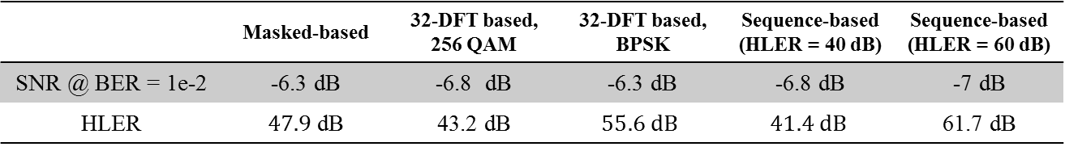
Comparison - BER (AWGN)
The performance difference among the schemes is 0.7 dB for BER = 1e-2
Observation: HLER and ACLR are effective in AWGN
 | Masked-based | 32-DFT based, 256 QAM | 32-DFT based, BPSK | Sequence-based (HLER = 40 dB) | Sequence-based (HLER = 60 dB)
SNR @ BER = 1e-2 | -6.3 dB | -6.8 dB | -6.3 dB | -6.8 dB | -7 dB
HLER | $47.9$ dB | 43.2 dB | $$55.6 dB$$ | $$41.4 dB$$ | 61.7 dB

Slide 17
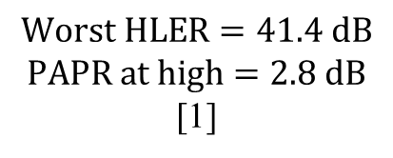
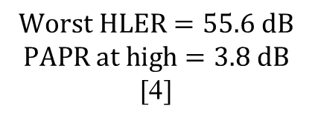
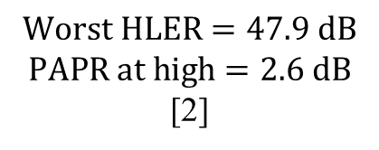
Comparison – Frequency
$$Worst HLER=47.9 dB$$
$$PAPR at high=2.6 dB$$
[2]
$$Worst HLER=55.6 dB$$
$$PAPR at high=3.8 dB$$
[4]
$$Worst HLER=41.4 dB$$
$$PAPR at high=2.8 dB$$
[1]
The results for 32-DFT-based (256-QAM) and sequence-based (HLER = 60 dB) are given in the appendix

Slide 18
Comparison - BER (Ch D)
The performance difference among the schemes is 0.7 dB for BER = 1e-2
Observation: Power distribution in frequency domain is effective
 | Masked-based | 32-DFT based, 256 QAM | 32-DFT based, BPSK | Sequence-based (HLER = 40 dB) | Sequence-based (HLER = 60 dB)
SNR @ BER = 1e-2 | 0.75 dB | 0.95 dB | 0.6 dB | 1 dB | 1.3 dB
PAPR | 2.6 dB | 1.5 dB | 3.8 dB | 2.8 dB | 4.4 dB

Slide 19
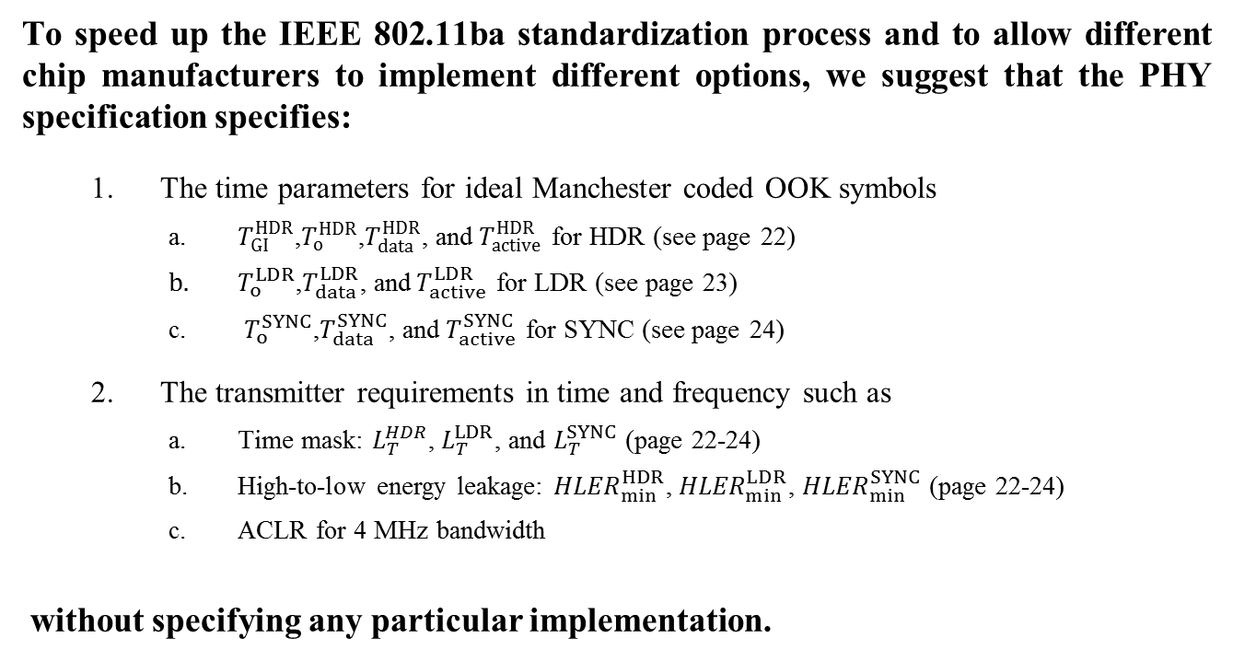
Conclusion
To speed up the IEEE 802.11ba standardization process and to allow different chip manufacturers to implement different options, we suggest that the PHY specification specifies:
  The time parameters for ideal Manchester coded OOK symbols
    $T_{GI}^{HDR}$,$T_{o}^{HDR}$,$T_{data}^{HDR}$, and$T_{active}^{HDR}$ for HDR (see page 22)
    $T_{o}^{LDR}$,$T_{data}^{LDR}$, and$T_{active}^{LDR}$ for LDR (see page 23)
    $T_{o}^{SYNC}$,$T_{data}^{SYNC}$, and$T_{active}^{SYNC}$ for SYNC (see page 24)
  The transmitter requirements in time and frequency such as
    Time mask: $L_{T}^{HDR}$, $L_{T}^{LDR}$, and $L_{T}^{SYNC}$ (page 22-24)
    High-to-low energy leakage: ${HLER}_{min}^{HDR}$, ${HLER}_{min}^{LDR}$, ${HLER}_{min}^{SYNC}$ (page 22-24)
    ACLR for 4 MHz bandwidth
without specifying any particular implementation.

Slide 20
References
[1] Alphan Sahin et al. “Optimizing OOK Waveform for High Data Rate WUS,” IEEE 802.11-17/1634r0
[2] Eunsung Park et al. “13-Length Sequence for OOK Waveform Generation,” IEEE 802.11-17/1613r2
[3] J. Suh et al. “17/376r0 Waveform Generation for Waveform coding”, IEEE 802.11 Tgba
[4] Vonod Kristem et al. “2 us OOK pulse for high rate,” IEEE 802.11-18/0097
[5] Miguel Lopez et al. “MC-OOK Symbol Design”, IEEE 802.11-18/479
[6] Agilent, “802.11a WLAN Signal Studio Software for the ESG-D/DP Series Signal Generators”
[7] IEEE Std 802.11-2016 - Specific requirements - Part 11: Wireless LAN Medium Access Control (MAC) and Physical Layer (PHY) Specifications

Slide 21
Appendix

Slide 22





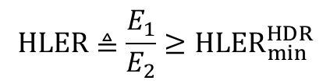




Aspects of the OOK waveform that need to be specified (high data rate)
$$T_{o}^{HDR}$$
$$T_{active}^{HDR}$$
$$T_{o}^{HDR}$$
$$T_{active}^{HDR}$$
Power
$$L_{T}^{HDR}$$
$$E_{1}$$
$$E_{2}$$
$$T_{GI}^{HDR}$$
$$T_{data}^{HDR}/2$$
$$T_{data}^{HDR}/2$$
$$HLER≜\frac{E_{1}}{E_{2}}≥{HLER}_{min}^{HDR}$$

Slide 23















Aspects of the OOK waveform that need to be specified (low data rate)
$$T_{data}^{LDR}/4$$
$$T_{data}^{LDR}/4$$
$$T_{data}^{LDR}/4$$
$$T_{data}^{LDR}/4$$
$$T_{o}^{LDR}$$
$$T_{active}^{LDR}$$
$$T_{o}^{LDR}$$
$$T_{active}^{LDR}$$
$$T_{o}^{LDR}$$
$$T_{active}^{LDR}$$
$$T_{o}^{LDR}$$
$$T_{active}^{LDR}$$
Power
$$L_{T}^{LDR}$$
$$E_{1}$$
$$E_{2}$$
$$E_{3}$$
$$E_{4}$$
$$T_{data}^{LDR}:16 μs$$
$$HLER≜\frac{E_{1}+E_{3}}{E_{2}+E_{4}}≥{HLER}_{min}^{LDR}$$

Slide 24











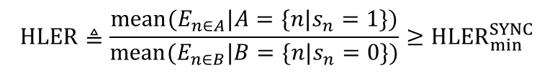





Aspects of the OOK waveform that need to be specified (Sync)
$$T_{data}^{SYNC}=2 μs$$
$$T_{data}^{SYNC}=2 μs$$
$$T_{data}^{SYNC}=2 μs$$
$$T_{data}^{SYNC}=2 μs$$
$$T_{o}^{SYNC}$$
$$T_{active}^{SYNC}$$
$$T_{o}^{SYNC}$$
$$T_{active}^{SYNC}$$
$$T_{o}^{SYNC}$$
$$T_{active}^{SYNC}$$
$$T_{o}^{SYNC}$$
$$T_{active}^{SYNC}$$
Power
$$L_{T}^{SYNC}$$
$$E_{1}$$
$$E_{3}$$
…
$$E_{2}$$
$$E_{4}$$
…
$$T_{o}^{SYNC}=0$$
$$HLER≜\frac{mean⁡(E_{n∈A}|A=\{n|s_{n}=1\})}{mean⁡(E_{n∈B}|B=\{n|s_{n}=0\})}≥{HLER}_{min}^{SYNC}$$
$$T_{active}^{SYNC}=2 μs$$
$$T_{s}^{SYNC}=2 μs$$
$s_{n}$ is the $n$th element of the SYNC sequence

Slide 25
Comparison – Spectral Emission

Slide 26
Comparison - Time
Logic 0
Logic 1
Logic 0
Logic 1
Logic 0
Logic 1
Logic 0
Logic 1
Logic 0
Logic 1

Slide 27
Symbol Power Distribution in Frequency

Slide 28


































Sequences-based Approach (1/2)
To generate logic 0/1 WFC OOK symbols, a single sequence is utilized in forward direction (as logic 0) and backwards direction (as logic 1) order [1]
Logic 0
sequence
Logic 1
sequence
Logic 0
OOK
Logic 1
OOK
Mapping
IDFT
(64)
$$x_{0}$$
$$x_{0}$$
Logic 1
$$d_{1}$$
$$d_{12}$$
$$x_{1}$$
$$x_{63}$$
$$d_{2}$$
$$d_{11}$$
$$x_{2}$$
$$x_{62}$$
$$d_{3}$$
$$d_{10}$$
…
Amplitude
$$d_{4}$$
$$d_{9}$$
Logic 1
sequence
$$d_{5}$$
$$d_{8}$$
t
$$d_{6}$$
$$d_{7}$$
Add GI
Logic 0
0
0
$$d_{7}$$
$$d_{6}$$
Logic 0
sequence
$$d_{8}$$
$$d_{5}$$
Amplitude
$$d_{9}$$
$$d_{4}$$
$$d_{10}$$
$$d_{3}$$
Data
…
t
$$d_{11}$$
$$d_{2}$$
$$0$$
$$T_{GI}$$
$$d_{12}$$
$$d_{1}$$
$$x_{62}$$
$$x_{2}$$
$$x_{63}$$
$$x_{1}$$
IDFT output

Slide 29
Sequences-based Approach (2/2)
HLER: 40 dB
HLER: 60 dB
[ 0.1403 + 0.1796i;...
0.5727 - 0.4512i;...
-0.6662 - 1.0136i;...
-1.1574 + 0.3627i;...
-0.4766 + 0.8448i;...
0.3086 + 1.1730i;...
1.0312 + 0.0000i;...
0
1.0295 + 0.0009i;...
-0.3075 - 1.1733i;...
-0.4779 + 0.8443i;...
1.1581 - 0.3604i;...
-0.6618 - 1.0165i;...
-0.5746 + 0.4492i;...
0.1382 + 0.1813i].';
[0.0000 + 0.0734i;...
0.3368 + 0.0000i;...
0.0000 - 0.8305i;...
-1.3567 + 0.0000i;...
0.0000 + 1.5182i;...
1.0227 + 0.0000i;...
0
1.0227 + 0.0000i;...
0.0000 - 1.5182i;...
-1.3567 + 0.0000i;...
0.0000 + 0.8305i;...
0.3368 + 0.0000i;...
0.0000 - 0.0734i].';
(leads to a real signal at the output of DFT)

Slide 30
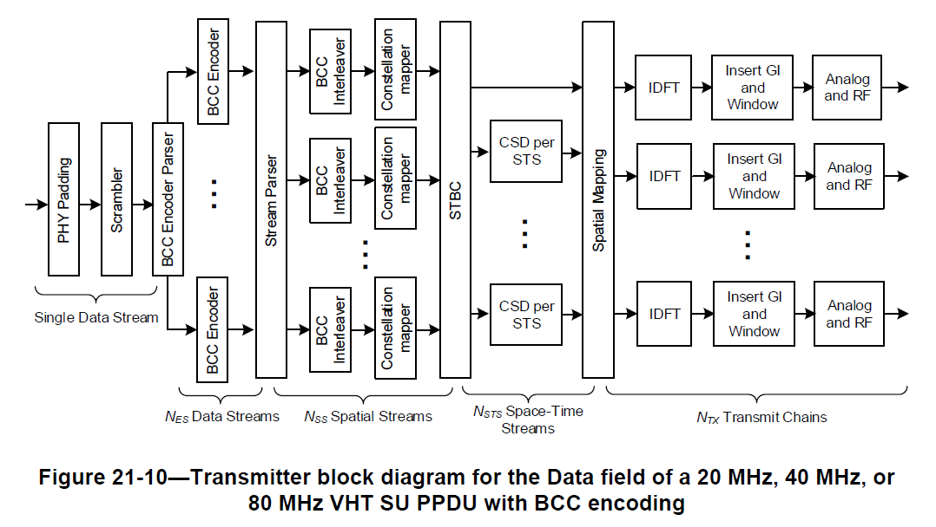
Windowing in 802.11-2016 [7]

