Slide 1
SU-MIMO BF for TDD SP
Date: 2018-03-02
Authors:

Slide 2
Introduction
The mmWave distribution network needs to support the SU-MIMO in order to achieve the requirement of this usage model.
The SU-MIMO beamforming protocol defined in the current draft is not suitable to the TDD SP.
Therefore, slight modification of SU-MIMO beamforming procedure is needed for TDD SP.

Slide 3
SU-MIMO BF in current draft
The SU-MIMO BF procedure is composed of SU-MIMO BF Setup subphase, SMBT subphase, and SU-MIMO BF Feedback subphase.
Each subphase shall be separated by an MBIFS.
The SU-MIMO BF Setup subphase has a process of handshaking.
The responder shall send a MIMO BF Setup frame to the initiator a SIFS following the reception of the MIMO BF Setup frame from the initiator.
The SU-MIMO BF Feedback subphase has a process of handshaking.
The responder shall send a MIMO BF Feedback frame to the initiator a SIFS following reception of a MIMO BF Feedback frame from the initiator.
The flow of subphases and the exchange of the MIMO BF Setup frame and the MIMO BF Feedback frame need to be adapted to suite the TDD SP where bidirectional transmission is prohibited in a TDD Slot.

Slide 4
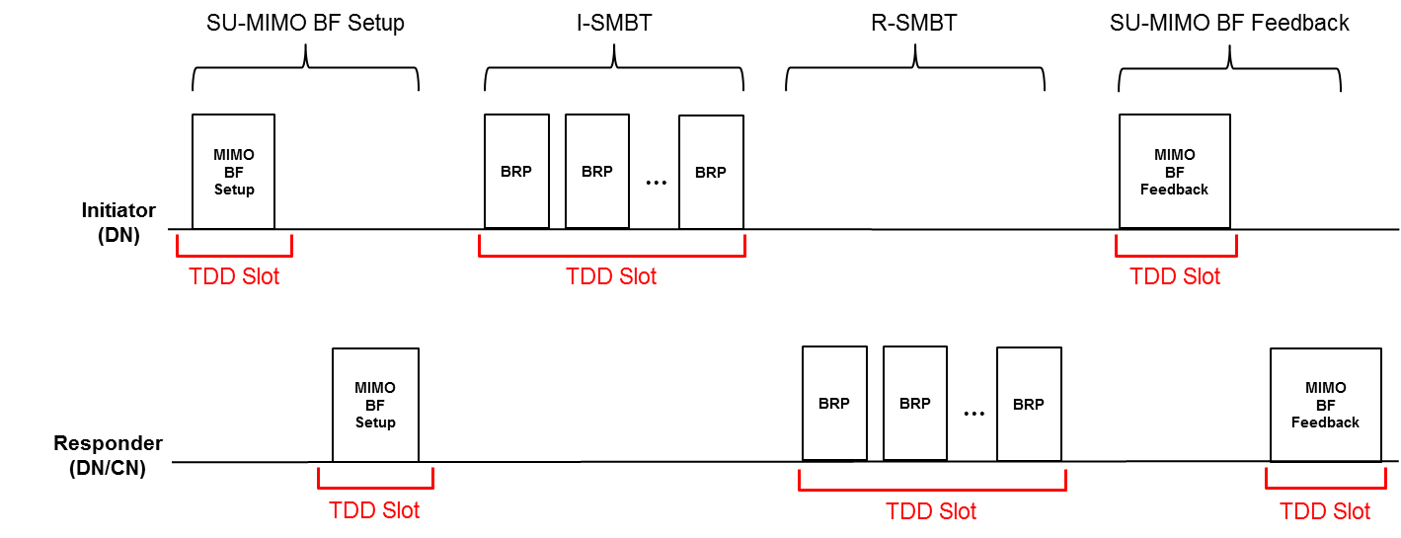
Proposed SU-MIMO BF for TDD SP (non-reciprocal)
Inter Subphase
The each subphase starts at the earliest TDD slot after completion of previous subphase.
Inner subphase
The responder shall send a MIMO BF Setup frame to the initiator at the earliest occurring TDD Slot that allows for its transmission after the reception of the MIMO BF Setup frame from the initiator.
The responder shall send a MIMO BF Feedback frame to the initiator at the earliest occurring TDD Slot that allows for its transmission after the reception of the MIMO BF Feedback frame from the initiator.

Slide 5
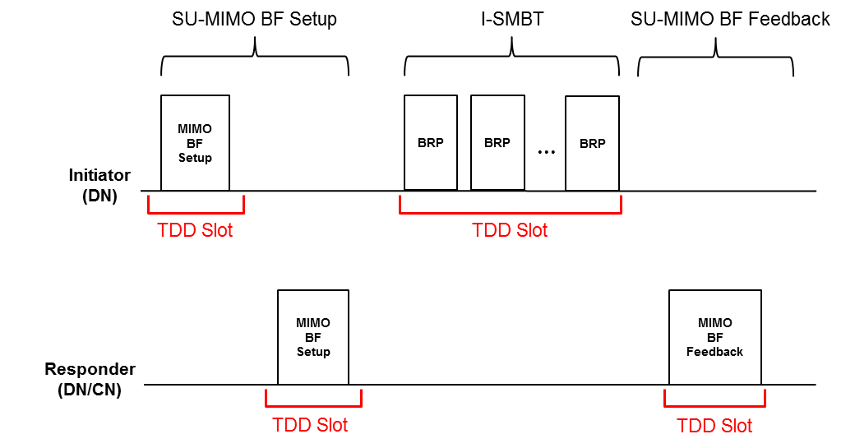
Proposed SU-MIMO BF for TDD SP (reciprocal)
Inter Subphase
The each subphase starts at the earliest TDD slot after completion of previous subphase.
Inner subphase
The responder shall send a MIMO BF Setup frame to the initiator at the earliest occurring TDD Slot that allows for its transmission after the reception of the MIMO BF Setup frame from the initiator.

Slide 6
Considerations on time cost
Each MIMO BF Setup frame needs a single TDD slot and it makes time cost increased.
It may not be a big problem if SU-MIMO BF is not performed frequently.
However, as the number of responders trying to perform SU-MIMO BF is increased, the time cost can be increased significantly.
E.g.) if 256 responders need to perform SU-MIMO BF, it needs 256 TDD RX slot for transmitting MIMO BF Setup frame.
We think this is an issue considering time cost and latency.

Slide 7
Simplification point
There are assumptions in TDD SP as following:
The STA joining the TDD SP can support antenna pattern reciprocity.
Initiator knows the number of RX sectors of responder.
Initiator knows the SISO BF result of responder.
If an initiator received TDD Route element from the responder, the initiator knows the result of TX/RX BF of responder due to antenna pattern reciprocity.
The initiator can decide the number of TRN subfields for responder’s receive AWV training based on received TDD Route element
Based on the above assumptions, the SU-MIMO BF procedure can be simplified.

Slide 8
Proposed SU-MIMO BF for TDD SP
We propose that transmission of SU-MIMO BF setup frame by a responder can be skipped.
The values of L-TX-RX field and the Requested EDMG TRN-Unit M field can be decided by an initiator based on assumption in TDD SP.
If SU-MIMO BF setup frame is not transmitted by responder, SU-MIMO BF Setup and I-SMBT subphases can be included in a single TDD slot.
So, we can save TDD RX slots in SU-MIMO BF Setup subphase.
However, the information carried by responder in SU-MIMO BF setup frame should be considered.
L-TX-RX field and the Requested EDMG TRN-Unit M

Slide 9
Simplified SU-MIMO Setup subphase
The information of the SU-MIMO setup frame transmitted by an initiator:
The number of transmit sector combinations for the initiator link
The L-TX-RX field and the Requested EDMG TRN-Unit M field
Not used in reciprocal SU-MIMO BF so we can use for responder’s receive AWV training.
The information of the SU-MIMO setup frame transmitted by a responder:
The number of transmit sector combinations for the responder link
→ Not used in reciprocal SU-MIMO BF (we can skip).
The L-TX-RX field and the Requested EDMG TRN-Unit M field.
This information can be included on the SU-MIMO setup frame transmitted by the initiator (we can skip).
The transmission of SU-MIMO BF setup frame by the responder can be skipped.

Slide 10
Proposed indication of SU-MIMO Setup frame
In the proposed SU-MIMO BF, the SU-MIMO BF Setup frame transmitted by the initiator should indicate the number of TRN subfields in order that the responder performs receive AWV training.
Field | Size (bits) | Meaning
Element ID | 8
Length | 8
Element ID Extension | 8
SU/MU | 1 | Sets to 1 to indicate SU-MIMO beamforming and sets to 0 to indicate MU-MIMO beamforming.
Non-reciprocal/Reciprocal SU-MIMO Phase | 1 | Sets to 1 to indicate the non-reciprocal MIMO phase and sets to 0 to indicate the reciprocal MIMO phase. This field is reserved when the SU/MU field is set to 0.
EDMG Group ID | 8 | Indicates the EDMG Group ID of target MU group. This field is reserved when the SU/MU field is set to 1.
Group User Mask | 32
DL/UL MU-MIMO Phase | 1 | Set to 1 to indicate downlink MIMO phase and sets to 0 to indicate uplink MIMO phase. This field is reserved when the SU/MU field is set to 1.
L-TX-RX | 8 | If TDD Beamforming field sets to 1, this field indicates the notified number of consecutive TRN-Units in which the same AWV is used in the transmission of the last M TRN subfields of each TRN-Unit. Otherwise if TDD Beamforming field sets to 0, this field indicates the requested number of consecutive TRN-Units in which the same AWV is used in the transmission of the last M TRN subfields of each TRN-Unit. This field is reserved when the SU/MU field is set to 0.
Requested EDMG TRN-Unit M | 4 | If TDD Beamforming field sets to 1, the value of this field plus one indicates the notified number of TRN subfields in a TRN-Unit transmitted with the same AWV following a possible AWV change. Otherwise if TDD Beamforming field sets to 0, the value of this field plus one indicates the requested number of TRN subfields in a TRN-Unit transmitted with the same AWV following a possible AWV change. This field is reserved when the SU/MU field is set to 0.
Link Type | 1 | Sets to 1 to indicate initiator link and set to 0 otherwise. This field shall be set to 1 when the SU/MU field is set to 0.
MIMO FBCK-REQ | 10 | Indicates channel measurement feedback requested for the link specified by the Link Type field.
TDD BF simplification | 1 | Sets to 1 to indicate that I-SMBT subphase starts immediately.
Reserved | 5

Slide 11
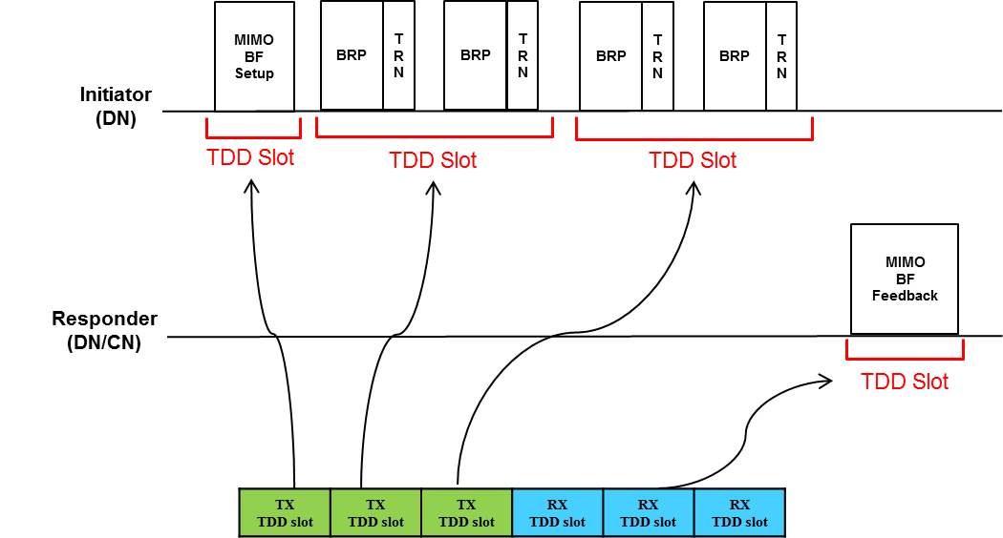
Flow of proposed SU-MIMO BF in TDD SP
The reciprocal SU-MIMO BF can be completed quickly.
Furthermore, as the number of responders trying to perform SU-MIMO BF is increased, the time cost can be reduced significantly.

Slide 12
Conclusion
Considering the restriction of simplex transmission in the TX and RX TDD slots, we propose the SU-MIMO BF adapted to suite the TDD SP.
Furthermore, we propose the simplified SU-MIMO BF that can be used optionally if the initiator want to use it.

Slide 13
SP
Do you agree to add the proposed SU-MIMO BF for TDD SP described in “11-18-0450-00-00ay-SU-MIMO BF for TDD SP” into the draft?
Y/N/Abstain

