Slide 1
Scheduled Multicast Wake-Up
Date: 2018-03
Authors:
Name | Affiliations | Address | Phone | email
Yunping(Lily) Lyu | Huawei | Nanjing, PRC |  | lvyunping@huawei.com
Roger Marks | Huawei | Denver, CO, USA |  | roger@ethair.net
Chenhe Ji | Huawei | Nanjing, PRC |  | jichenhe@huawei.com
Ross Yu | Huawei | Shenzhen, PRC |  | ross.yujian@huawei.com

Slide 2
Abstract
Need for Multicast Wake-up Operation has been agreed (SFD [1], 4.7.3).
  IEEE 802.11ba shall define a mechanism to wake up multiple WUR mode STAs (e.g., multi-user wake-up frame).
Some mechanisms [2,3] for multicast wake-up have been discussed previously.
This contribution proposes a scheduled way to wake up multiple users, so as to further save user power.

Slide 3
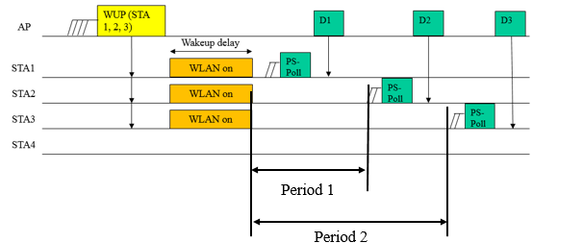
Multicast wake-up without scheduling
In [3], common Wake-up Completion Time (WCT) is specified in WUP. PS-Polls from multiple STAs are sent simultaneously. This mechanism is efficient, but the support of 802.11ax Multi-user uplink access (MUUA) by STAs is required.
In [3], STAs can send separate PS-Polls to implement multicast wake-up. Such STAs do not require MUUA support. But STA2 and STA3 waste power during Period 1 and Period 2.
Notes:
Case 1: Uplink MU is supported (17/0054r2)
Case 2: Uplink MU is not supported (17/0381r1)

Slide 4
Proposal
Scheduled multicast wake-up, without using MUUA.
AP sends multicast WUP, including the wake-up schedule for each STA.
STA wakes up just in time to start data transfer.
Duration of PCR on-time is reduced.
Compared to unicast, multicast WUP avoids halting progress during PCR wake-up transition.
WUP (STA 1, 2, 3)
D1
D2
D3
AP
Wakeup delay
STA1
PCR waking up
PS-Poll
STA2
PCR waking up
PS-Poll
STA3
PCR waking up
PS-Poll
STA4
Wake-up completion time (WCT)

Slide 5

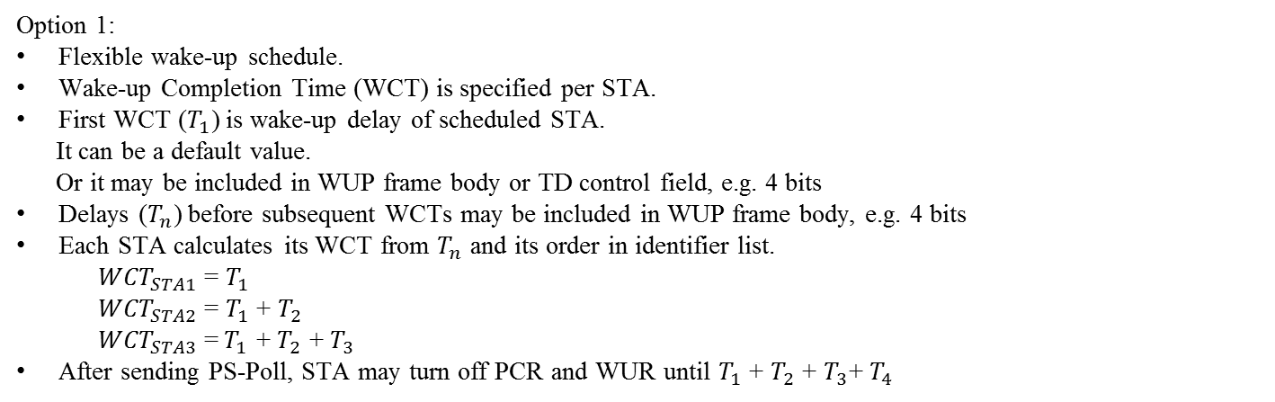



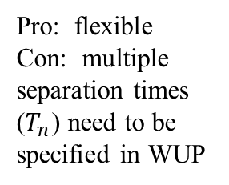
Scheduled Wake-up (Option 1/2)
Option 1:
Flexible wake-up schedule.
Wake-up Completion Time (WCT) is specified per STA.
First WCT ($T_{1}$) is wake-up delay of scheduled STA.
It can be a default value.
Or it may be included in WUP frame body or TD control field, e.g. 4 bits
Delays ($T_{n}$) before subsequent WCTs may be included in WUP frame body, e.g. 4 bits
Each STA calculates its WCT from $T_{n}$ and its order in identifier list.
  ${WCT}_{STA1}$ = $T_{1}$
  ${WCT}_{STA2}$ = $T_{1}$ + $T_{2}$
  ${WCT}_{STA3}$ =$T_{1}$ + $T_{2}$ + $T_{3}$
After sending PS-Poll, STA may turn off PCR and WUR until $T_{1}$ + $T_{2}$ + $T_{3}$+ $T_{4}$
WUP
(STA1,
STA2,
STA3)
TXOP
AP
D1
D2
D3
Pro: flexible
Con: multiple separation times ($T_{n}$) need to be specified in WUP
STA1
PS-Poll
STA2
PS-Poll
STA3
PS-Poll
$$T_{1}$$
$$T_{2}$$
$$T_{3}$$
$$T_{4}$$
WUR ON
PCR waking up
PCR ON
PCR & WUR OFF

Slide 6
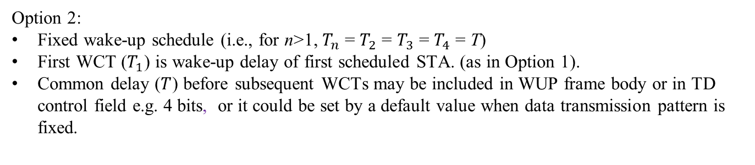
Specifying wake-up time (Option 2/2)
Option 2:
Fixed wake-up schedule (i.e., for n>1, $T_{n}$ = $T_{2}$ = $T_{3}$ = $T_{4}$ = T)
First WCT ($T_{1}$) is wake-up delay of first scheduled STA. (as in Option 1).
Common delay ($T$) before subsequent WCTs may be included in WUP frame body or in TD control field e.g. 4 bits, or it could be set by a default value when data transmission pattern is fixed.
Pros: fewer bits in WUP frame
Cons: not flexible; not suitable for STAs with different communication pattern with AP

Slide 7
Comparison to unicast wake-up
WUP
(STA1,
STA2,
STA3)
AP
D1
D2
D3
Multicast
STA1
PS-Poll
STA2
PS-Poll
STA3
PS-Poll
Unicast
AP
WUP
(STA1)
D1
WUP
(STA2)
D2
WUP
(STA3)
D3
STA1
PS-Poll
STA2
PS-Poll
STA3
PS-Poll
Time savings, vs. unicast

Slide 8
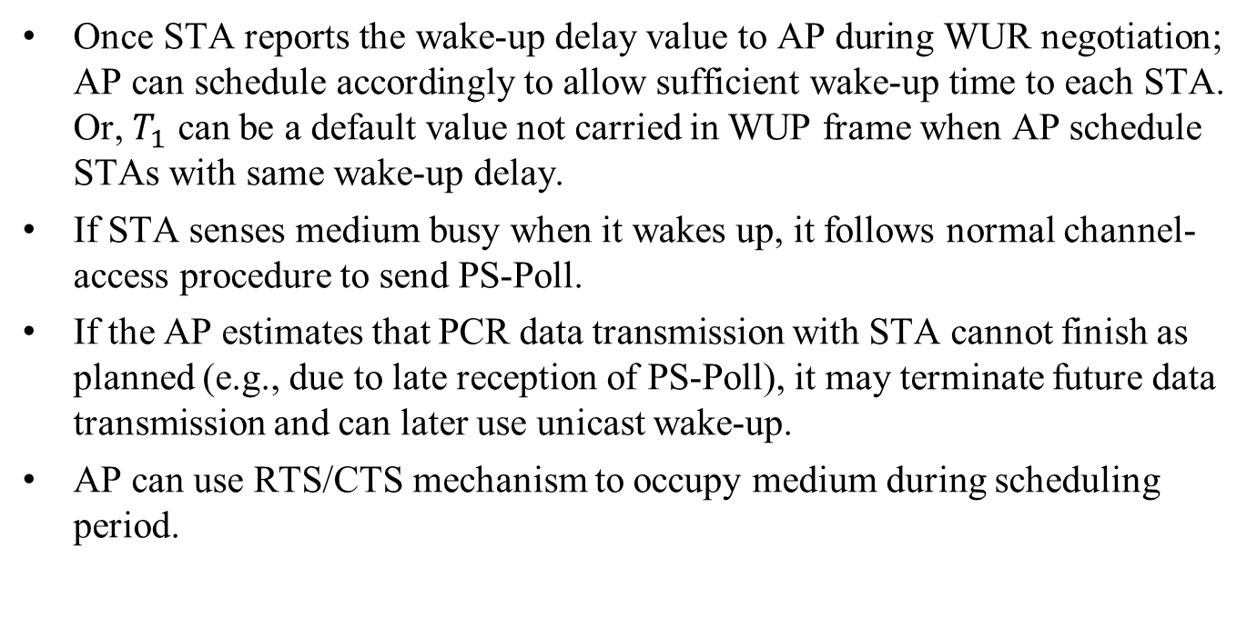
More considerations
Once STA reports the wake-up delay value to AP during WUR negotiation; AP can schedule accordingly to allow sufficient wake-up time to each STA. Or, $T_{1}$ can be a default value not carried in WUP frame when AP schedule STAs with same wake-up delay.
If STA senses medium busy when it wakes up, it follows normal channel-access procedure to send PS-Poll.
If the AP estimates that PCR data transmission with STA cannot finish as planned (e.g., due to late reception of PS-Poll), it may terminate future data transmission and can later use unicast wake-up.
AP can use RTS/CTS mechanism to occupy medium during scheduling period.

Slide 9
Reference
[1] 802.11-17/0575r9, Specification Framework for TGba
[2] 802.11-17/0054r2, WUR MAC issues
[3] 802.11-17/0381r1 WUR MAC issues follow-up

