Slide 1
Reflection measurements at 60GHz
Date: 2018-March-05
Authors:
Name | Company | Email
Alecsander Eitan | Qualcomm | eitana@qti.qualcomm.com
Rotem Zamir | Qualcomm | rzamir@qti.qualcomm.com
Amichai Sanderovich | Qualcomm | amichais@qti.qualcomm.com

Slide 2
Introduction
This submission presents results of lab measurements of the reflection from different materials at 60GHz band.
The goals of the measurements:
Measuring the reflection attenuation of different materials, in different angles
Developing a suitable model
Produce a material based reflection coefficient data-base

Slide 3
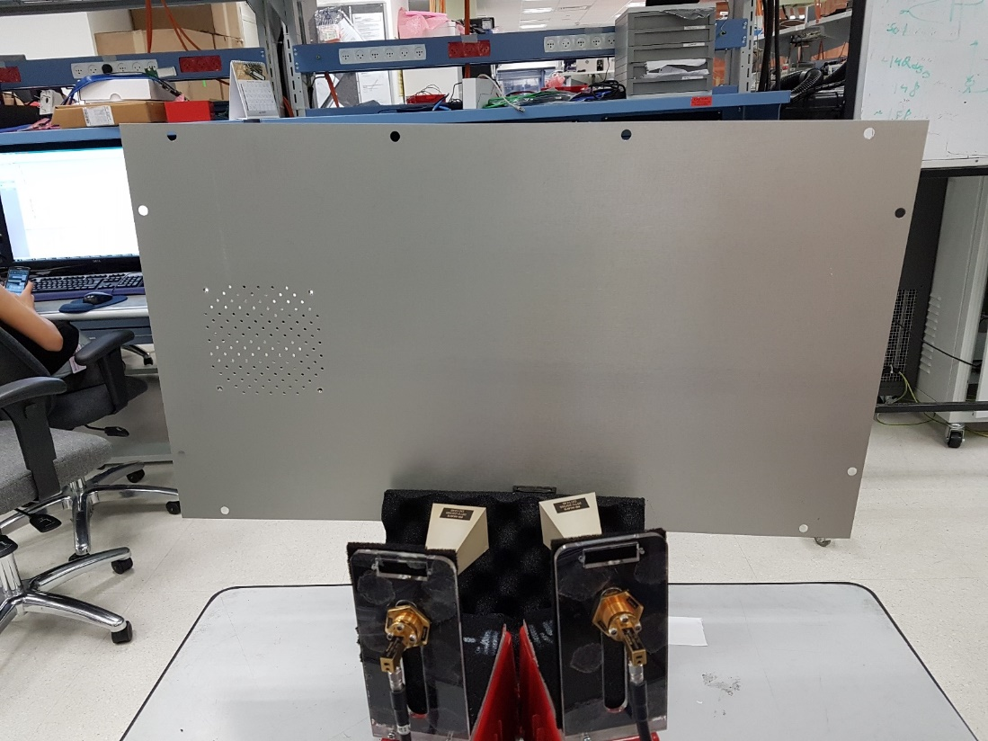
The Setup
2 Horn antennas, with 25dBi gain
VNA (R&S ZVA67)
2 vises
2 antenna-cable connectors
2 60G cables
2 metal stands for the antenna, covered with black absorber
2 plastic boxes (Legos)
Reflecting materials

Slide 4
The Setup Procedures and Experiment course
Calibrating the VNA for Pt of 10[dBm], including 60G cable loss
Drawing the angles on the table
Positioning the reflecting surface with the vises
Positioning the Tx&Rx Horns in the correct angles, each at distance 34 cm from the reflecting surface
Saving the data from the VNA – S21[dB] for frequencies between 57GHz and 70GHz

Slide 5
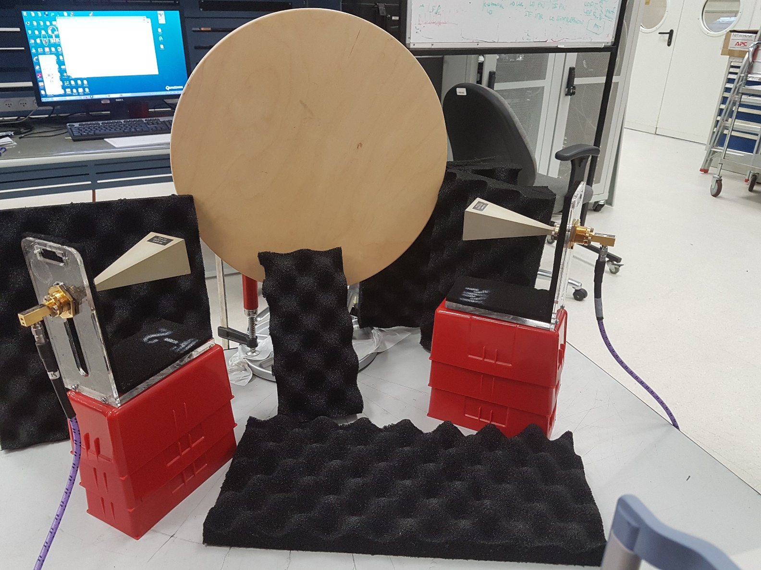
Setup pictures

Slide 6
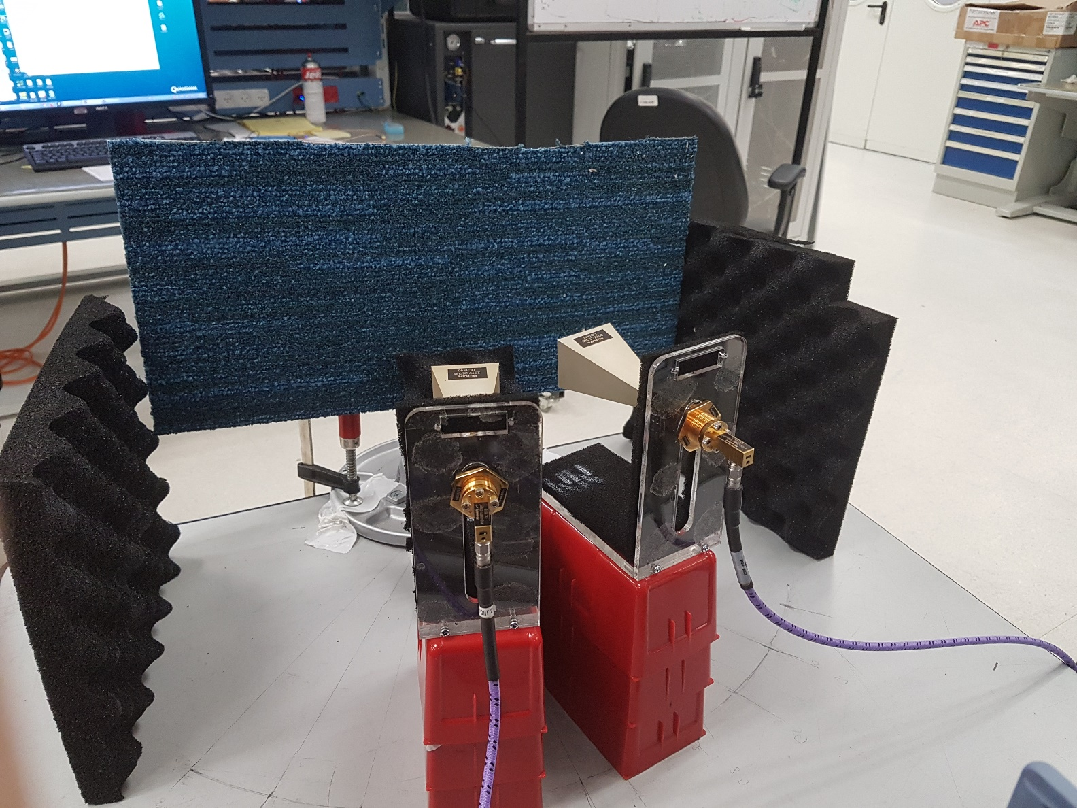
Setup pictures

Slide 7
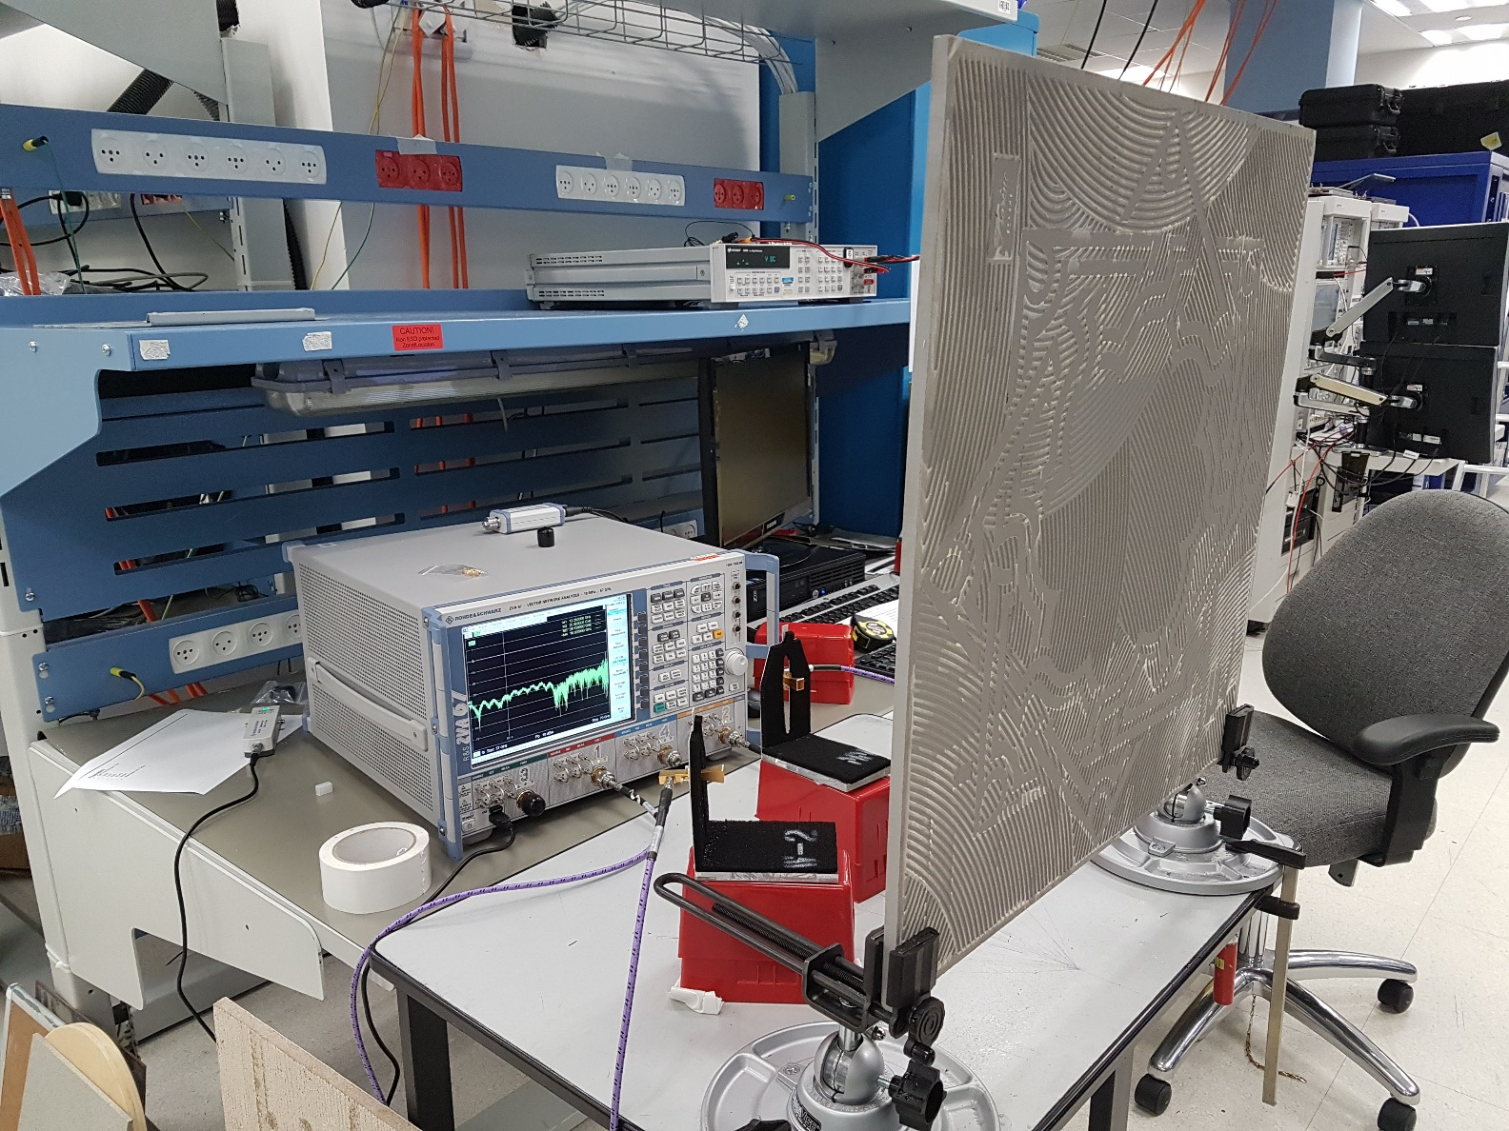
Setup pictures

Slide 8
Materials
Metal – a flat metal plate used for reference
Absorber – electric wave absorber sheet
Wood – plate of solid wood
Thick carpet – carpet with thick fibers, waved on synthetic platform, used for flooring.
Wallpaper – drywall plate covered with flower patterned wallpaper, used for home decoration
Cubical wall – plate of wall from a typical cubical office – a thin fabric covering a metal plate.
Parquet – a beam of typical parquet flooring for home.
Melamine – a beam of typical melamine used for tables (Ikea style).

Slide 9
Materials (cont)
Marble – used in home for kitchen worktop
Formica – a beam of Formica, used in house furnishing
Suspended Ceiling – typical office panel of suspended ceiling
ESD – a piece of ESD floor which can be found in labs
Drywall – a plate made of water resistant drywall
Ceramic – a ceramic tile used for flooring
Carpet – a piece of carpet used for office flooring. Short fibers, with a warp and weft pattern-like.

Slide 10
Analysis
Free-Space Path-Loss (FSPL): $FSPL\left[dB\right]=20∗\log_{10}{d\left[m\right]}+20∗\log_{10}{f\left[MHz\right]}−27.55$
Material attenuation calculated by: $Att\left[dB\right]=G1\left[dBi\right]+G2\left[dBi\right]−S21\left[dB\right]−FSPL(L1+L2)[dB]$

Slide 11
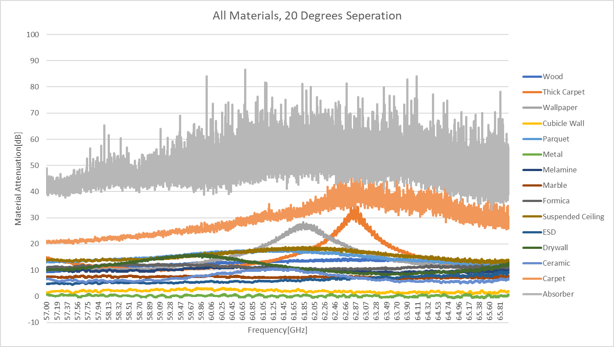
Results

Slide 12
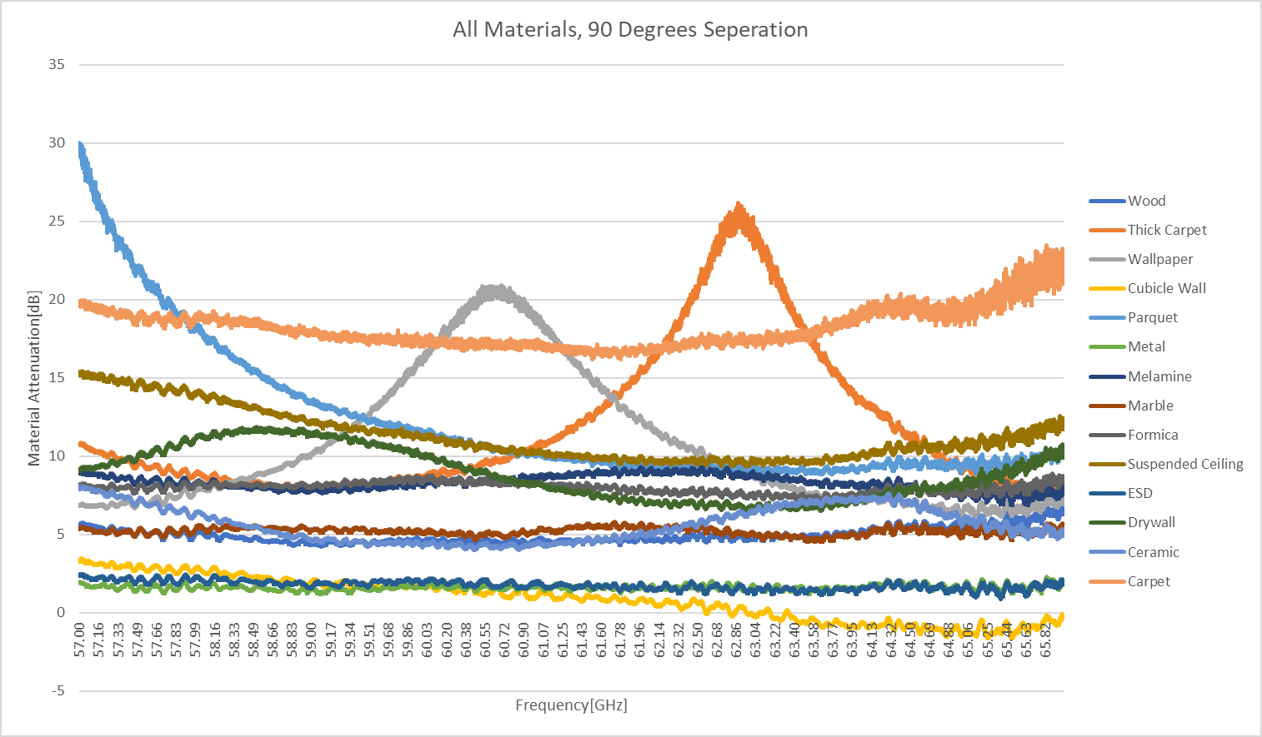
Results

Slide 13
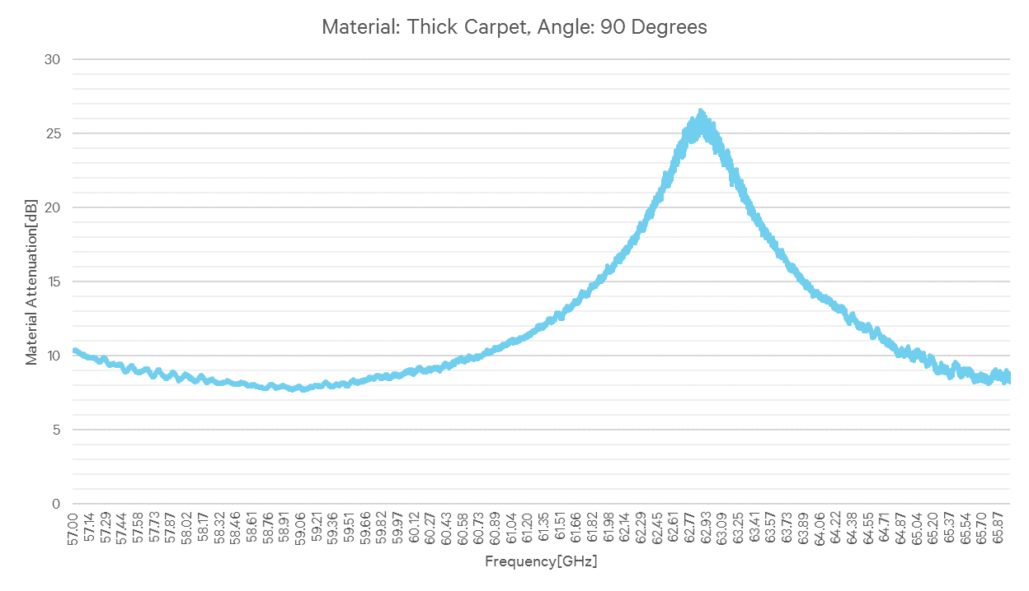
Results

Slide 14
Results

Slide 15
Results

Slide 16
Summary
In this presentation we detailed reflection measurements results at 60GHz.
The measurements show that most tested materials reflection loss is ~0..12dB.
The reflection loss is frequency dependent.
3 materials presented resonance behavior in frequency, and 2 materials presented resonance behavior in angle.
The results show that 60GHz modem should handle frequency selective reflections.

