Slide 1
Tone grouping size for hybrid beamforming feedback in OFDM mode
Date: 2018-03-05
Authors:

Slide 2
Introduction(1/2)
TGay has agreed that 11ay will support hybrid precoding.
Support for feedback for the OFDM PPDU is needed.
OFDM PPDU : Frequency domain precoder information
This presentation proposes OFDM feedback using compressed beamforming which is used in 11ac.
This presentation also proposes PER performance from link level simulation to decide Ng.

Slide 3
Introduction(2/2)
Performance of link level simulation is related to tone grouping element Ng and quantization bit $\left\{b_{φ},b_{ψ}\right\}$
We investigate variable value of Ng and quantization bits for feedback in OFDM mode
Ng : 1, 2, 4, 8, 16, 32
{$b_{φ},b_{ψ}$} : {6, 4}, {4, 2}
We deal with reduction in feedback overhead that occurs with larger Ng

Slide 4
Simulation Assumptions of SU-MIMO(1/2)
11ay CR channel model[1]
Single Channel (336 Data tones)
2Tx, 2Rx, 2 spatial streams
QPSK, ½ LDPC code
Compressed beamforming(802.11ac, SVD based)
MMSE receiver
Ng : 1, 2, 4, 8, 16, 32
$(b_{φ},b_{ψ})$ : (6, 4), (4, 2)

Slide 5
Simulation Assumptions of SU-MIMO(2/2)
Criterion on feedback tone indices
Edge tones should be used for channel estimation (Performance degradation due to extrapolation)
Data tone adjacent to DC tone should be used for channel estimation(subcarrier index : -2, 2)
All feedback tone except for edge tone should maintain $N_{g}$ interval
Example of feedback tone for Ng=4 in single channel [-177, -174,-170,-166,-162,-158,-154,-150,-146,-142,-138,-134,-130,-126,-122,-118,-114,-110,-106,-102,-98,-94,-90,-86,-82,-78,-74,-70,-66, -62,-58,-54,-50,-46,-42,-38,-34,-30,-26,-22,-18,-14,-10,-6,-2, 2, 6, 10, 14,18,22,26, 30,34, 38,42, 46,50,54,58,62,66 ,70,74,78,82, 86, 90, 94, 98,102,106,110,114,118,122,126,130,134,138,142,146,150,154,158,162,166,170,174,177]

Slide 6
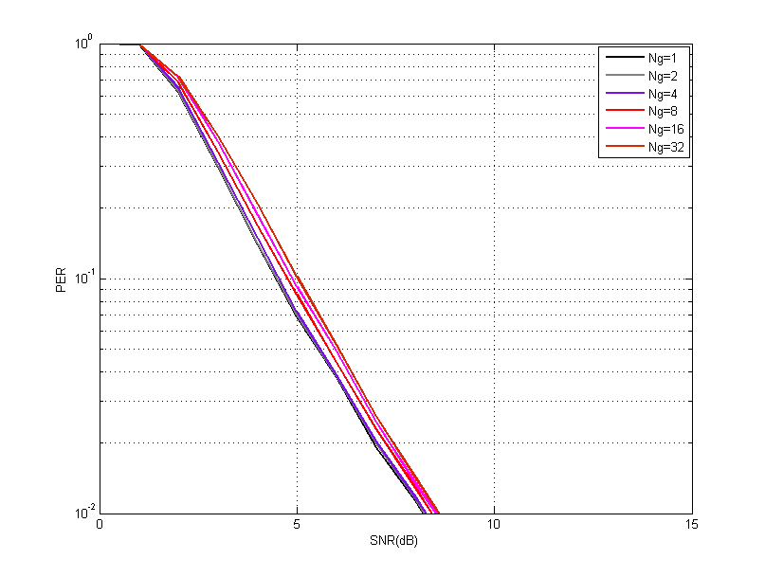
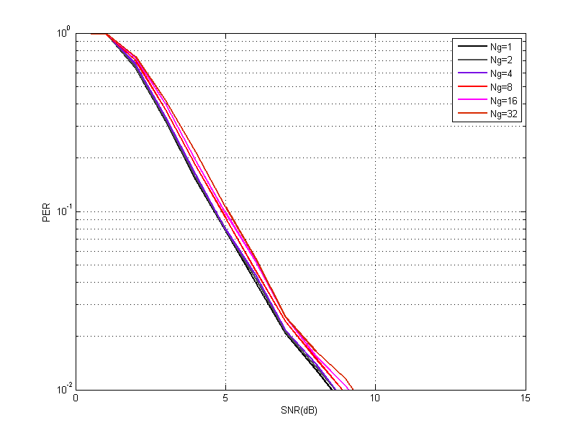
Simulation Results $\{b_{φ},b_{ψ}\}$ : {6, 4} $\{b_{φ},b_{ψ}\}$ : {4, 2}
Similar PER performance for Ng=1 and Ng=2
Ng=1 is not necessary
If compare Ng=4 to Ng =8, Ng=16 and Ng=32, 0.2dB , 0.35dB and 0.5dB PER performance loss respectively.

Slide 7
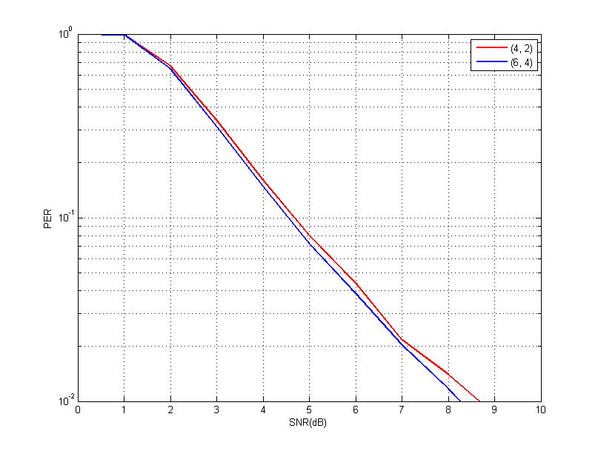
Simulation Results
PER loss between (4, 2) and (6, 4) quantization bits for all Ng
0.2 dB performance loss at 0.1 PER
0.4 dB performance loss at 0.01 PER

Slide 8
Overhead reduction
Compressed BF Report frame is not defined in 11ay, we calculate overhead based on VHT Compressed BF Report frame.
Header + FCS : 20bytes.
VHT MIMO control field : 3bytes
VHT compressed BF report : $({8∗Nss+Na(b}_{φ}+b_{ψ})$/2 $∗Ns)$ bits
MU Exclusive field : ($4∗Nss)$ bits
Overhead reduction
2 spatial streams, single channel, $\{b_{φ},b_{ψ}\}$ : {6, 4}
We can save 46%, 70%, 82%, 87% when comparing Ng =1 to Ng=2, Ng=4, Ng=8 and Ng=16, respectively

Slide 9
Conclusion
We investigate tone grouping parameter Ng and quantization bits for Hybrid BF feedback in OFDM
We show that 0.2dB , 0.35dB and 0.5dB PER performance loss with Ng=4 compared to Ng =8, Ng=16 and Ng=32, respectively.
We show overhead reduction
(4, 2) quantization have performance loss compared to (6, 4)
If we consider both performance loss and saturation of overhead reduction, it is desirable to set Ng to 2, 4 and 8
Proposal - 802.11ay shall support Ng $=$ 2, 4, and 8 for compressed BF feedback with (6, 4) quantization

Slide 10
Straw Poll #1
Do you agree with the following?
802.11ay spec shall support Ng $=$ 2, 4, and 8 for compressed BF feedback with (6, 4) quantization

Slide 11
References
[1] 11-16-1388-00-00ay-implementation-of-channel-models-for-ieee-802-11ay

