Slide 1
QoS mapping comment for 802.11md Letter Ballot
6 May 2018
Authors:
Name | Company | Phone | email
Jerome Henry | Cisco | +1 919 3922503 | jerhenry@cisco.com
Andrew Myles | Cisco | +61 418 656587 | amyles@cisco.com

Slide 2
The DSCP to UP mapping in 802.11-2016 should be updated to match current specification & practice
QoS mapping general principle
A mapping is required to map end-to-end QoS intent based on DSCP to a UP suitable for use over 802.11
802.11 QoS mapping situation
802.11-2016 defines an example DSCP to 802.11 UP mapping in 802.11-2016 Annex R
802.11 QoS mapping problem
The mapping in 802.11-2016 Annex R is inconsistent with current specification & practice
802.11 QoS mapping revision
802.11-2016 should be updated with a revised DSCP to 802.11 UP/AC mapping in Table R-2

Slide 3
A mapping is required to map end-to-end QoS intent based on DSCP to a UP suitable for use over 802.11
QoS is an end-to-end concept across an entire multi-hop network
DSCP is a commonly agreed upon mechanism in IP networks to communicate global QoS intent for a packet as it traverses a multi-hop network
There are 64 QoS labels possible with DSCP
802.11 User Priority (UP) is used to represent the QoS intent of a packet when it is transmitted over an 802.11 link
There are 8 QoS labels possible with 802.11e UP
A mapping is thus required between DSCP and 802.11 UP labels, that translates the end-to-end QoS intent into a suitable 802.11e UP label
It is vital that the 802.11 UP label should properly represent the end-end QoS intent on the local 802.11 link, and not contradict it

Slide 4
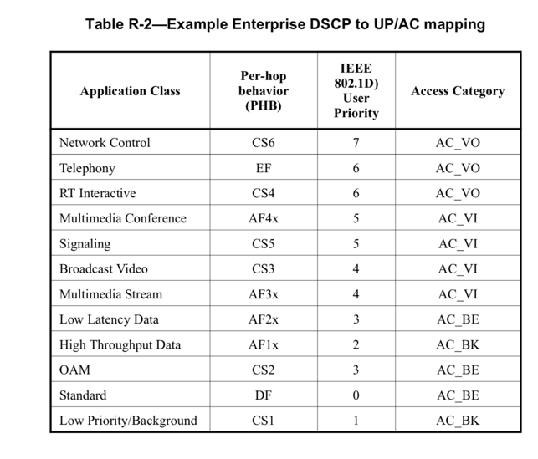
802.11-2016 defines an example DSCP to 802.11 UP mapping in 802.11-2016 Annex R
R.3.3 Example of QoS mapping from different networks
…
Table R-2 (Example Enterprise DSCP to UP/AC mapping) shows an example mapping based on application classes defined in IETF RFC 4594. Mapping between DSCP and UP can be done using Exception fields or by range. The use of DSCP Exception fields will map a DSCP to a UP according to Table R-2 (Example Enterprise DSCP to UP/AC mapping)
….

Slide 5
The mapping in 802.11-2016 Annex R is inconsistent with current specification & practice
Industry (in IETF) has spent many years developing consensus for QoS specification & practice …
… with RFC 8325 representing current “common ground” with respect to DSCP to UP mappings for Wi-Fi
The mapping in 802.11-2016 Table R-2 has diverged from the consensus for QoS specification and practice in recent years
“Application Class” naming in Table R-2 contradicts the commonly accepted industry classifications defined by RFC 4594
The mapping from DSCP to 802.11 UP and AC in Table R-2 contradicts the latest industry agreement documented in RFC 8325

Slide 6
Industry (in the IETF) has spent many years developing consensus for QoS specification & practice …
Some relevant IETF RFCs include:
RFC 2474 - Definition of the differentiated services field (DS field) in the IPv4 and IPv6 headers
RFC 2475 - An architecture for differentiated services
RFC 2597 - Assured forwarding PHB group
RFC 2983 - Differentiated services and tunnels
RFC 3086 - Definition of differentiated services per domain behaviors and rules for their specification
RFC 3140 - Per hop behavior identification codes (obsoletes RFC 2836)
RFC 3246 - An expedited forwarding PHB (obsoletes RFC 2598)
RFC 3247 - Supplemental information for the new definition of the EF PHB (expedited forwarding per-hop behavior)
RFC 3260 - New Terminology and Clarifications for Diffserv (updates RFC 2474, RFC 2475 and RFC 2597)
RFC 4594 - Configuration Guidelines for DiffServ Service Classes
RFC 5865 - A differentiated services code point (DSCP) for capacity-admitted traffic (updates RFC 4542 & RFC 4594)

Slide 7
… with RFC 4594 detailing the core common ground with respect to traffic type definition …
RFC 4594 uses a 12 class model:
“Traffic flowing in a network can be classified in many different ways. We have chosen to divide it into two groupings, network control and user/subscriber traffic. […] The network control traffic group can further be divided into two service classes. […] The user/subscriber traffic group is broken down into ten service classes to provide service differentiation for all the different types of applications/services.” [RFC 4594 section 2.1]
We recommend following the same classification and the same category naming convention, knowing that not all traffic types are included in a class name
e.g. “Real-Time Interactive service class is intended for interactive variable rate inelastic applications that require low jitter and loss and very low delay, such as interactive gaming applications that use RTP/UDP streams for game control commands, and video conferencing applications that do not have the ability to change encoding rates or to mark packets with different importance indications.” [RFC 4594 section 2.1]

Slide 8
… and with RFC 8325 representing current common ground with respect to mappings for Wi-Fi
Not all vendors apply the IETF recommendations for DSCP to traffic-class marking …
e.g., Microsoft suggests DSCP 40 for Voice
e.g., Cisco recommends CS3 for Signalling
etc.
… and as traffic mixes change, so do marking recommendations
Even at Layer 2, recommendations are evolving
e.g., UP 2 is not considered as best for BK anymore
However, RFC 8325 represents the current common ground for marking in context of Wi-Fi

Slide 9
“Application Class” naming in 802.11-2016 Table R-2 contradicts the commonly accepted classifications
Table R-2 classification (in priority order) |  | RFC 4594 classification (in priority order)
Network Control |  | Network Control
Telephony |  | Telephony
RT Interactive |  | Signaling
Multimedia Conference |  | Multimedia Conferencing
Signaling |  | Real-Time Interactive
Broadcast Video |  | Multimedia Streaming
Multimedia Stream |  | Broadcast Video
Low Latency Data |  | Low Latency Data
High Throughput Data |  | OAM
OAM |  | High Throughput Data
Standard |  | Standard
Low Priority/Background |  | Low Priority Data /Background
Note: naming & priority order differences shown in red

Slide 10
The DSCP to 802.11 UP and AC mapping in 802.11-2016 Table R-2 contradicts the latest industry agreement
Latest industry agreement
Application Class | PHB | Table R-2 mapping |  | RFC 8325 mapping
 |  | UP | AC | UP | AC
Network Control | CS6 | 7 | AC_VO | 7 | AC_VO
Telephony | EF | 6 | AC_VO | 6 | AC_VO
Signaling | CS5 | 5 | AC_VI | 5 | AC_VI
Multimedia Conferencing | AF4x | 5 | AC_VI | 4 | AC_VI
Real-Time Interactive | CS4 | 6 | AC_VO | 4 | AC_VI
Multimedia Streaming | AF3x | 4 | AC_VI | 4 | AC_VI
Broadcast Video | CS3 | 4 | AC_VI | 4 | AC_VI
Low Latency Data | AF2x | 3 | AC_BE | 3 | AC_BE
OAM | CS2 | 3 | AC_BE | 0 | AC_BE
High Throughput Data | AF1x | 2 | AC_BK | 0 | AC_BE
Standard | DS | 0 | AC_BE | 0 | AC_BE
Low Priority Data /Background | CS1 | 1 | AC_BK | 1 | AC_BK
Note: differences between Table R-2 and RFC 8325 highlighted in red

Slide 11
802.11-2016 should be updated with a revised DSCP to 802.11 UP/AC mapping in Table R-2 …
Application Class | Per-Hop Behaviour (PHB) | IEEE 802.11 User Priority | Access Category
Network Control | CS6 | 7 | AC_VO
Telephony | EF | 6 | AC_VO
Signaling | CS5 | 5 | AC_VI
Multimedia Conferencing | AF4x | 4 | AC_VI
Real-Time Interactive | CS4 | 4 | AC_VI
Multimedia Streaming | AF3x | 4 | AC_VI
Broadcast Video | CS3 | 4 | AC_VI
Low Latency Data | AF2x | 3 | AC_BE
OAM | CS2 | 0 | AC_BE
High Throughput Data | AF1x | 0 | AC_BE
Standard | DS | 0 | AC_BE
Low Priority Data /Background | CS1 | 1 | AC_BK
Note: differences between old and new Table R-2 highlighted in red

Slide 12
… and Table R-2 should be left as an informative reference
The industry recommendations (in slide 6) are based on a 12-class model
However, the recommendations also recognize the importance of flexibility to deal with specific circumstances
e.g. Scalpel guiding packets are technically OAM, but the guidance in the recommendations allows them to be implemented in another category, such as Telephony
This supports the idea that Table R-2 should be informative (not normative)
Additional support for this conclusion is that a similar mapping (for L3 to L2 on a wired medium) in IEEE 802.1Q Annex I is also informative

Slide 13
Suggested mapping in Table R-2 is consistent with 802.11ak model & can be basis for future discussions
802.1Q-2014 moves UP 2 from BK to EE (Excellent Effort, above BE)
This change aligns with RFC 4594 (one BK category)
However, most switching structures were built without UP2 > EE in mind
Support is limited for UP 2 treated as EE
The Industry needs to converge in the future on what traffic would fall in the EE category in this new model (convergence is not there yet)
Our suggestion is to not use the 802.1Q-2014 EE (UP2) into 802.11 at this time
This suggestion may change once recommendations for L3 are clearly defined
Until then UP2 is not used (no need for a second BK queue)
Note: both 802.1Q-2014 and 802.11ak define a model for queues, including UP 2; the non-use of EE in Table R-2 is consistent with this model, but does not make use of UP 2

