Slide 1
Replay Attack Detection Using LTF with Zero Prefix
Date: 2018-01-16

Slide 2
Introduction
To avoid the CP-replay attack, Apple proposed to use zero-padded waveform for channel estimation [1] and the motion has been passed in TGaz Orlando meeting.
The detailed design for the zero-padded LTF symbol need to be investigated, and as shown in Apple’s contribution [1], two possible solutions for the zero-padded waveform are:
  Option 1: Zero prefix + core symbol + zero postfix
    Linear convolution
    Need to redefine the FFT size and LTF sequence and may need more complicated channel estimation method
  Option 2: Zero prefix + core symbol
    Circular convolution
    Simpler for implementation, but may suffer to replay attack
In this submission, we propose an energy detector for option 2 for detecting the replay attack, and complexity analysis and simulation performance are provided.

Slide 3
Zero Padded Waveform Design (1)
Option 1:
Option 2:
0.8 us
0.8 us
0.8 us
3.2 us (64 Points FFT)
2.4 us
Zero
prefix
Core symbol
Zero
postfix
Zero
prefix
Core symbol
FFT window
Copy & Paste
FFT window1
FFT window2
Linear convolution
FFT window1: circular convolution
FFT window2: linear convolution

Slide 4
Zero Padded Waveform Design (2)
  Option 1: Zero prefix + core symbol + zero postfix
    May need to redefine the FFT size and LTF sequence
    Elements in LTF sequence have different amplitudes
    To prevent amplifying noise, MMSE estimator (high complexity) may be used for frequency domain channel estimation
  Option 2: Zero prefix + core symbol
    Overlap-add processing before FFT to transform time domain linear convolution to circular convolution
    Align with the current FFT size in 11ac or 11ax
    May suffer to replay attack
    Compatible with Option 1, if increase FFT window to length of zero prefix plus core symbol

Slide 5
Recap of Apple’s Replay Attack to Option 2
“Overlap-add” processing:
Subject to replay attack.
  Can be viewed as the dual of CP-replay attack.

Slide 6



LTF Sequence Subtraction in Time Domain
At receiver side, in time domain the effect of multipath channel is equivalent to delay and scale the Tx signal and sum the delayed-and-scaled signals together.
Assume the receiver has a perfect knowledge of the two-taps multipath channel, the LTF symbol can be subtracted out of the r(t) and only the additive noise is left:
r(t) $−$ h1 $×$ LTF(t $−$ τ1) $−$ h2 $×$ LTF(t $−$ τ2) = noise(t)
The receiver can obtain h1 and h2 through transforming the frequency domain channel estimation to time domain.
Copy & Paste
FFT window
1st path:
h1 $×$
Zero
prefix
Core symbol LTF (t)
Zero
prefix
Core symbol LTF (t)
τ1
r(t)=
Zero
prefix
Zero
prefix
2nd path:
h2 $×$
Core symbol LTF (t)
Core symbol LTF (t)
τ2
noise (t):

Slide 7



LTF Subtraction with Replay Attack
Assume the replay attack can generate a fake path h3
Within FFT window, after LTF subtraction, the noise plus interference will be left:
r’(t)= r(t)$−$ h3$×$LTF(t) $−$h1$×$LTF(t$−$τ1) $−$h2$×$LTF(t$−$τ2) = noise(t) $−$h3$×$LTF(t)
Copy & Paste
FFT window
1st path:
h1 $×$
Zero
prefix
Core symbol LTF (t)
Zero
prefix
Core symbol LTF (t)
τ1
2nd path:
h2 $×$
Zero
prefix
Core symbol LTF (t)
Zero
prefix
Core symbol LTF (t)
r(t)=
τ2
noise (t):
fake path:
h3 $×$
Replay attack

Slide 8
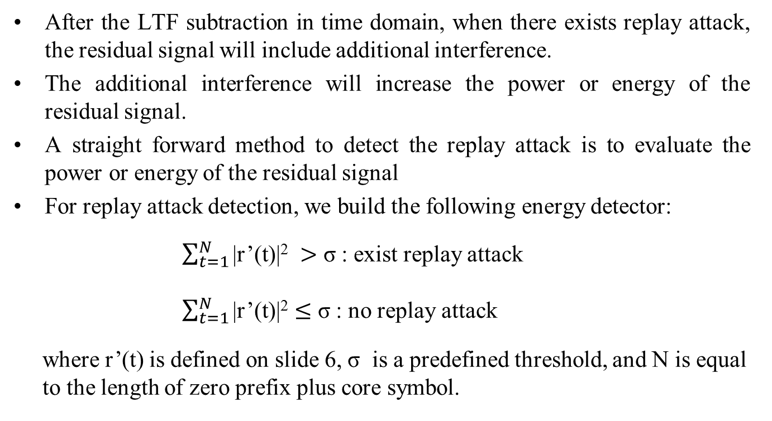
Detection of Replay Attack
After the LTF subtraction in time domain, when there exists replay attack, the residual signal will include additional interference.
The additional interference will increase the power or energy of the residual signal.
A straight forward method to detect the replay attack is to evaluate the power or energy of the residual signal
For replay attack detection, we build the following energy detector:
$\sum_{t=1}^{N}{\text{|}\text{r}\text{’(}\text{t}\text{)|2 }}>$ σ : exist replay attack
$\sum_{t=1}^{N}{\text{|}\text{r}\text{’(}\text{t}\text{)|2}}≤$ σ : no replay attack
where $\text{r}\text{’(}\text{t}\text{)}$ is defined on slide 6, σ is a predefined threshold, and N is equal
to the length of zero prefix plus core symbol.

Slide 9
Complexity Analysis for Energy Detector
To calculate the residual signal r’(t) shown in slide 6, we need first to transform the frequency domain channel estimation and LTF sequence to time domain using IFFT.
The existing FFT block can be reused for the IFFT computation.
New hardware or software is needed for the time domain LTF subtraction and energy calculation.
For 20MHz band, 1xLTF (64 points FFT) and 0.8us zero prefix (16 points), N=64+16=80. Except the two IFFT calculation, computation complexity for building the energy detector is:
1104 complex multiplications+1024 complex subtractions+79 complex additions
The computation complexity can be reduced by selecting a smaller N, for example, N=16 (the length of zero prefix ).
152 complex multiplications+136 complex subtractions+15 complex additions

Slide 10
Simulation Settings
Two-tapped delay channel model for simplicity
Single antenna for Tx and Rx
SNR=20dB, SIR=[0, 10, 15]dB
20MHz, 1xLTF (3.2us, 64 points FFT)+0.8us zero prefix
Attacker can perfectly copy the LTF symbol and replay it
10000 channel realizations or detector performance evaluation
N=80 and N=16 used for building energy detector

Slide 11
Channel Estimation with Replay Attack (1)
SIR=0dB indicates the attacker uses the same power level as transmitter for the replay attack.

Slide 12
Channel Estimation with Replay Attack (2)
When SIR=15dB, the fake 1st tap is significantly lower than the real 1st tap, and it’s almost impossible for the attacker to generate a valid 1st tap.

Slide 13
Time Domain LTF Subtraction (1)
When there is no replay attack, after LTF subtraction, there is only noise left in r’(t).

Slide 14
Time Domain LTF Subtraction (2)
When there exists replay attack, after LTF subtraction, the residual signal r’(t) will include interference.

Slide 15
Detection Performance of Energy Detector (1)
The window size for energy calculation is N=80
Set detection threshold σ to 0.73
The probability of detecting the replay attack is almost 1 for SIR=0, 10, 15 dB
The probability of detecting the ‘good’ channel as ‘bad’ is 10%.
Please note that this 10% false detected channel is the channel with high noise power, and discard this 10% channel can help to improve range accuracy.

Slide 16
Detection Performance of Energy Detector (2)
For low complexity, the window size for energy calculation is N=16
Set detection threshold σ to 0.17
The probability of detecting the replay attack is almost 1 for SIR=0, 10 dB
For SIR=15dB, there is 30% chance that the ‘bad’ channel can’t be detected. Please note this 30% channel can be detected when limit the amplitude of first tap at most 10dB lower than the maximum tap.
The probability of detecting the ‘good’ channel as ‘bad’ is 10%.

Slide 17
Conclusion
An energy detector is proposed for detecting the replay attack to the LTF with zero prefix.
Simulation results show that for SIR as high as 15dB, the probability of miss detecting the ‘bad’ channel is almost 0.
The complexity of the energy detector can be reduced through setting a smaller window for energy calculation or selecting the large enough taps for LTF subtraction.
Future work include evaluate the detection performance using the more realistic 11nD channel.

Slide 18
Reference
[1] M. Xu, J. Dogan, SK Yong, Q. Wang, K. Brogle, AJ Ringre, Zero-Padded Waveform for Secure Channel Estimation, doc.: IEEE 802.11-17/1378r2, Sept. 2017.

