Slide 1
MMWave Distribution Network Discovery
Date: 2018-01-18
Name | Affiliation | Address | Phone | Email
Mohamed Abouelseoud | Sony | 1730 N. First Street, San Jose CA 95112 | +1-408-352-4027 | Mohamed.Abouelseoud@sony.com
Kazuyuki Sakoda | Sony | 1730 N. First Street, San Jose CA 95112 | +1-408-352-4405 | kazuyuki.Sakoda@sony.com

Slide 2
Agenda
Introduction
Problem description
OOB discovery trigger: what is available in the spec?
Potential solution
Conclusion

Slide 3

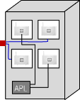




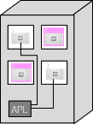
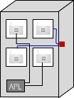

Introduction (1)
Small cell
Provider
Network
Wi-Fi AP
  WTTB
  Mesh WBH
Fiber PoP
(cabinet)
fiber
mmWave DN
mmWave link
  WTTH
Small cell
Use case c) WiFi AP / SC
Use case
a) WTTH
  WTTB
  WTTB
Use case
b) WTTB
  WTTH
Wi-Fi-AP
Alternative: Wireless inhouse
RGW
TDD mode is introduced for Distribution Network, it can be attractive even for consumer devices [2]
Home (indoors) distribution network like topology provides more reliable connections
New STA onboarding to a TDD-mode Distribution Network is triggered by OOB signaling [3]
If we consider to adopt TDD mode to consumer devices and use cases other than Usage Model 10 in [4], onboarding trigger procedure should be specified in the standard

Slide 4
Introduction (2)
Trigger sector sweep
New node Joining
No/reduced BHI
Need to reduce possible latency due to BHI and beamforming exchange
Exhaustive sector sweep beacon transmission every BI affects the latency and introduces interference
New node joining the network is an event that occasionally happens
Only perform the exhaustive sector sweep when a new node is joining the network

Slide 5
Introduction (3)
Why TDD-mode in consumer devices?
  Reduce latency by the removal of BHI
  Reduce channel blocking for beamforming by distributing the beamforming frames across the scheduled slots
  Add more flexibility for scheduling by controlling the slots structure and size

Slide 6


Problem description (1)
A new STA joining to an existing Distribution Network will take the following steps [3]:
  System Admin scans Bar-code of the new STA and transfer the information using out-of-band (OOB) signals
  The message is transferred to DMG STAs nearby through a controller
Controller
Provider
Network
  WTTB
STA A
Fiber PoP
(cabinet)
fiber
mmWave DN
mmWave link
STA B
New STA
  STA-A and New STA exchange beamforming frames, starts authentication and association
  STA-B and New STA repeats the same sequence
A proper discovery trigger signaling enables successful onboarding of a new STA to TDD mode network is needed to enable the use of TDD mode for consumer devices.

Slide 7
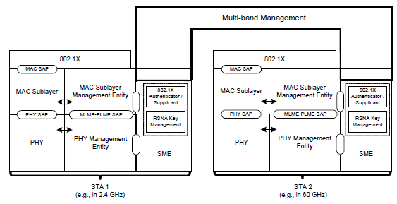
mmW discovery trigger: what is available in the spec (1)
802.11ad introduced Multi-Band operation
MB capability should allow off-60GHz signaling

Slide 8
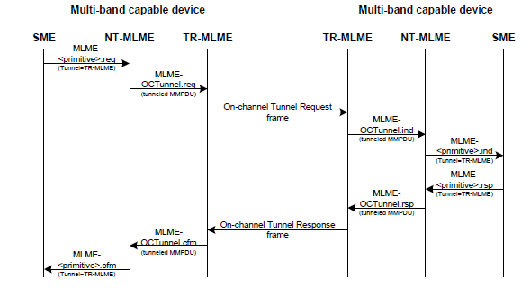
mmW discovery trigger: what is available in the spec (2)
Close look on Multi-Band operation
  Multi-band capable device can manage operation over more than 1 frequency band/channel
  MM-SME can share information among STAs in the same device
  RSNA security credentials can be shared among STAs in the same device
  FST can be set up if
  necessary
  OCT is available to
  carry 60GHz
  management messages
  via sub 6GHz

Slide 9
mmW discovery trigger: what is available in the spec (3)
It looks like there are plenty of tools to enable 60GHz discovery trigger using 802.11 protocols, if we can assume DMG STA is Multi-Band capable

Slide 10
Potential solution
Option 1:
  Define Public action frame exchange in sub-6GHz
  New STA transmits “Discovery Trigger Request Action” to neighboring STAs
  Neighboring STAs respond with “Discovery Trigger Response Action”, and kick the TX SLS equivalent signaling on the 60GHz channel
Option 2:
  Signal MB and “60GHz on-demand sector sweep” capabilities via Beacon/Probe Response in sub-6GHz
  Optional RSNA set up in sub-6GHz
  Use On-Channel Tunneling on the sub-6GHz channel to kick TX SLS equivalent signaling on the 60GHz
Option 3:
  Something else, there should be many other ways to make it happen

Slide 11
Conclusion
Discovery trigger scheme for TDD mode distribution network should be defined in the standard
Use of Multi-Band capability looks to be easy and feasible solution
2 options to enable discovery triggering leveraging existing Multi-Band capability are presented

Slide 12
Straw poll (1)
Do you think additional signaling for discovery triggering is needed for the TDD mode described in [*] to support consumer devices?
  Yes
  No
  Need more information
  Don’t care
[*] IEEE 802.11-17/1321r0 “Features for mmW Distribution Network Use Case”, Djordje Tujkovic, et.al

Slide 13
Straw poll (2)
Do you think the use of Multi-Band operation would be feasible approach for off-60GHz discovery signaling?
  Yes
  No
  Need more information
  Don’t care

Slide 14
Straw poll (3)
Which of the options described would you prefer?
  Option 1
  Option 2
  Need more information
  Don’t care

Slide 15
References
[1] Draft P802.11ay D1.0
[2] IEEE 802.11-18/194r1, “Distribution network use case for
consumer devices”, Kazuyuki Sakoda, et.al.
[3] IEEE 802.11-17/1321r0 “Features for mmW Distribution Network Use Case”, Djordje Tujkovic, et.al.
[4] IEEE 802.11-15/625r7 “IEEE 802.11 TGay Use Cases”, Rob Sun, et.al.

Slide 16
Backup
Discovery Trigger Action Frames

Slide 17
Backup
Sub-6GHz On-Channel Tunneling

Slide 18
Device Provisioning Protocol (DPP)
AP
New STA
Wi-Fi Alliance defined protocol
Provides a secure method for on- and off-boarding devices with limited user interface on a Wi-Fi network.
AP discovery and STA scanning are beyond what DPP is offering
DPP
Scanning
Authentication
Association

