Slide 1
MMWave Distribution Network Discovery
Date: 2018-01-13
Name | Affiliation | Address | Phone | Email
Mohamed Abouelseoud | Sony | 1730 N. First Street, San Jose CA 95112 | +1-408-352-4027 | Mohamed.Abouelseoud@sony.com
Kazuyuki Sakoda | Sony | 1730 N. First Street, San Jose CA 95112 | +1-408-352-4405 | kazuyuki.Sakoda@sony.com

Slide 2
Agenda
Introduction
Problem description
OOB discovery trigger: what is available in the spec?
Potential solution
Conclusion

Slide 3

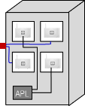




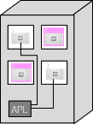
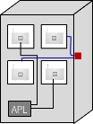

Introduction (1)
Small cell
Provider
Network
Wi-Fi AP
  WTTB
  Mesh WBH
Fiber PoP
(cabinet)
fiber
mmWave DN
mmWave link
  WTTH
Small cell
Use case c) WiFi AP / SC
Use case
a) WTTH
  WTTB
  WTTB
Use case
b) WTTB
  WTTH
Wi-Fi-AP
Alternative: Wireless inhouse
RGW
802.11ay D1.0 introduces TDD mode to accommodate Distribution Network, and they look to be attractive even for consumer devices [2]
New STA onboarding to a Distribution Network is triggered by OOB signaling [3]

Slide 4
Introduction (2)
Small cell
Provider
Network
Wi-Fi AP
  WTTB
  Mesh WBH
Fiber PoP
(cabinet)
fiber
mmWave DN
mmWave link
  WTTH
Small cell
Use case c) WiFi AP / SC
Use case
a) WTTH
  WTTB
  WTTB
Use case
b) WTTB
  WTTH
Wi-Fi-AP
Alternative: Wireless inhouse
RGW
If we consider to adopt TDD mode to consumer devices, onboarding trigger procedure should be specified in the standard
TDD mode should also be enabled outside the Facebook proposed DN
This presentation introduces approach to a potential resolution to CID1771

Slide 5


Problem description (1)
According to [3], a new STA joining to an existing Distribution Network will take the following steps:
  System Admin scans Bar-code of the new STA and transfer the information using out-of-band (OOB) signals
  The message is transferred to DMG STAs nearby through a controller (for example, STA-A, STA-B)
Controller
Provider
Network
  WTTB
STA A
Fiber PoP
(cabinet)
fiber
mmWave DN
mmWave link
STA B
New STA
  STA-A starts transmitting TX SLS equivalent signals
  The New STA receives SSW from STA-A and respond to it
  After beam training procedure, STA-A and new STA starts association & authentication process
  STA-B repeats the same sequence as 4. and 5. above

Slide 6
Problem description (2)
In the example in the previous slide, new STA, STA-A and STA-B need to understand the discovery trigger events
If we consider to apply TDD mode operation to consumer devices, discovery trigger event needs to be transferred among STAs using a standardized protocol
In other word, a proper discovery trigger signaling enables successful onboarding of a new STA to TDD mode network, even for consumer devices

Slide 7
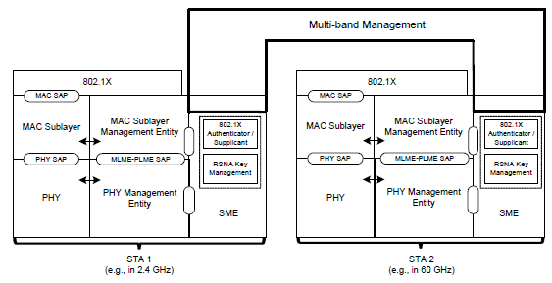
mmW discovery trigger: what is available in the spec (1)
802.11ad introduced Multi-Band operation
MB capability should allow off-60GHz signaling

Slide 8
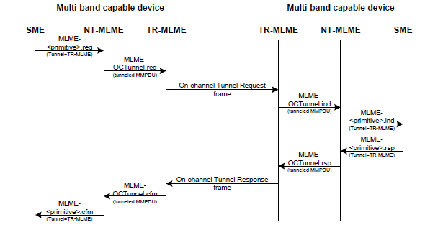
mmW discovery trigger: what is available in the spec (2)
Close look on Multi-Band operation
  Multi-band capable device can manage operation over more than 1 frequency band/channel
  MM-SME can share information among STAs in the same device
  RSNA security credentials can be shared among STAs in the same device
  FST can be set up if
  necessary
  OCT is available to
  carry 60GHz
  management messages
  via sub 6GHz

Slide 9
mmW discovery trigger: what is available in the spec (3)
It looks like there are plenty of tools to enable 60GHz discovery trigger using 802.11 protocols, if we can assume DMG STA is Multi-Band capable

Slide 10
Potential solution
Option 1:
  Define Public action frame exchange in sub-6GHz
  New STA transmits “Discovery Trigger Request Action” to neighboring STAs
  Neighboring STAs respond with “Discovery Trigger Response Action”, and kick the TX SLS equivalent signaling on the 60GHz channel
Option 2:
  Signal MB and 60GHz TDD capability via Beacon/Probe Response in sub-6GHz
  Use On-Channel Tunneling on the sub-6GHz channel to kick TX SLS equivalent signaling on the 60GHz
Option 3:
  Something else, there should be many other ways to make it happen

Slide 11
Conclusion
Discovery trigger scheme for TDD mode distribution network should be defined in the standard
Use of Multi-Band capability looks to be easy and feasible solution
2 options to enable discovery triggering leveraging existing Multi-Band capability are presented
A solution to this problem will solve CID1771

Slide 12
Straw poll (1)
Do you think additional signaling for discovery triggering is needed for the TDD mode described in [*] to support consumer devices?
  Yes
  No
  Don’t care
[*] IEEE 802.11-17/1321r0 “Features for mmW Distribution Network Use Case”, Djordje Tujkovic, et.al

Slide 13
Straw poll (2)
Do you think the use of Multi-Band operation would be feasible approach for OOB discovery signaling?
  Yes
  No
  Don’t care

Slide 14
References
[1] Draft P802.11ay D1.0
[2] IEEE 802.11-18/xxxr0, “Distribution network use case for
consumer devices”, Kazuyuki Sakoda, et.al.
[3] IEEE 802.11-17/1321r0 “Features for mmW Distribution Network Use Case”, Djordje Tujkovic, et.al.

Slide 15
Backup
Discovery Trigger Action Frames

Slide 16
Backup
MB and 60GHz TDD Capability Signaling via Probe Response

Slide 17
Backup
Sub-6GHz On-Channel Tunneling

