Slide 1
OFDM TRN subfield for Channel Aggregation
Date: 2018-01-15
Authors:

Slide 2
Introduction
In [1], SC TRN subfield for channel aggregation was proposed and determined by the number of TX chains per channel.
OFDM TRN subfield for channel aggregation is need to be optimized similar to SC TRN subfield
This presentation suggests OFDM TRN subfield for channel aggregation

Slide 3
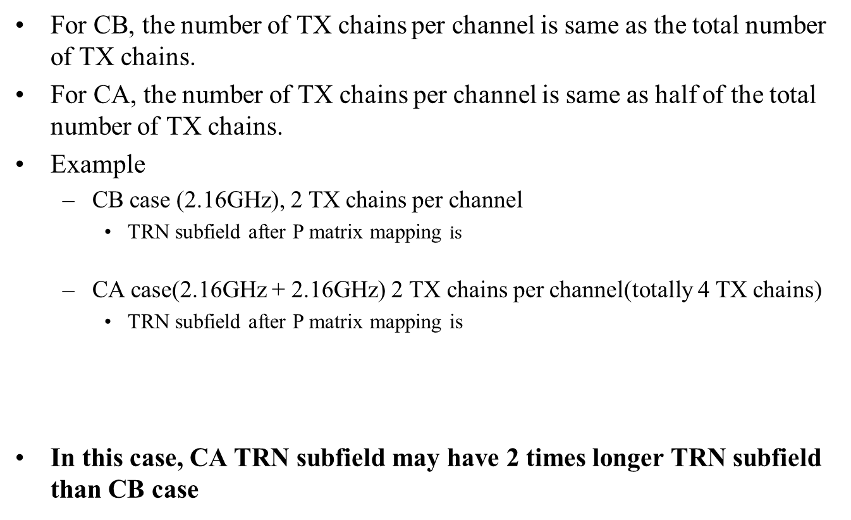
Example of current OFDM TRN subfield
For CB, the number of TX chains per channel is same as the total number of TX chains.
For CA, the number of TX chains per channel is same as half of the total number of TX chains.
Example
  CB case (2.16GHz), 2 TX chains per channel
    TRN subfield after P matrix mapping $is$
  CA case(2.16GHz + 2.16GHz) 2 TX chains per channel(totally 4 TX chains)
    TRN subfield after P matrix mapping is
In this case, CA TRN subfield may have 2 times longer TRN subfield than CB case

Slide 4
Proposed OFDM TRN subfield for CA(1/3)
We propose that P matrix of CA TRN subfield should be determined by the number of TX chains per channel.
Example
  CB case (2.16GHz), 2 TX chains per channel
    TRN subfield after P matrix mapping is
  CA case(2.16GHz + 2.16GHz) 2 TX chains per channel(totally 4 TX chains)
    TRN subfield after P matrix mapping is
    for channel 1
    for channel 2

Slide 5
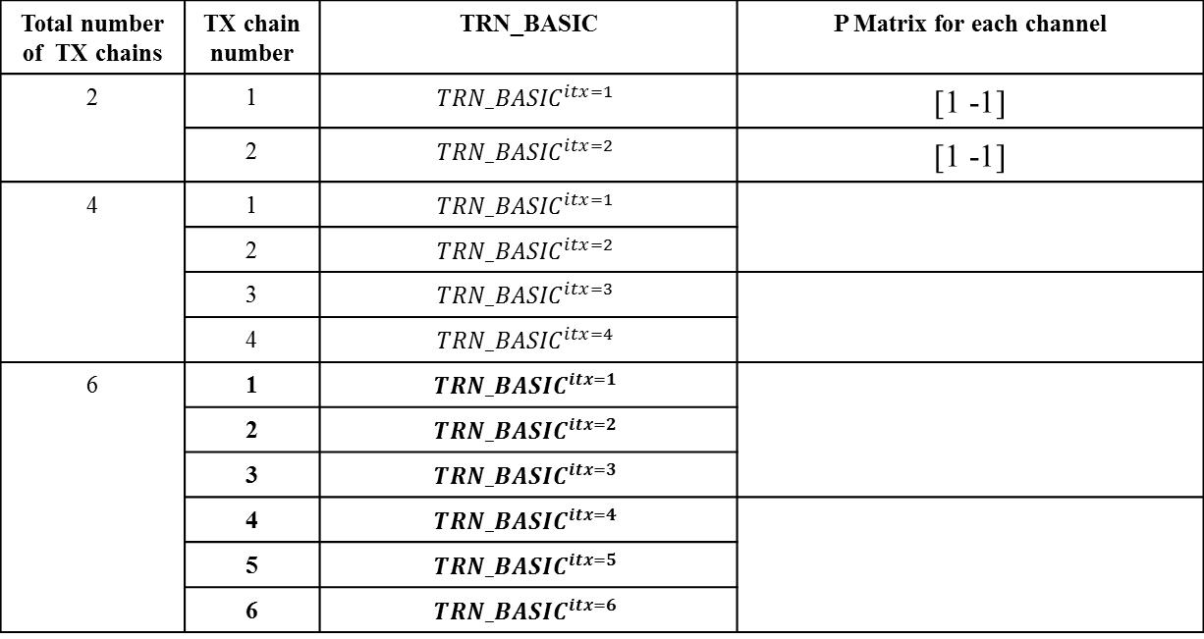
Proposed OFDM TRN subfield for CA(2/3)
Proposed P matrix for CA TRN subfield is as follows:
Total number of TX chains | TX chain number | TRN_BASIC | P Matrix for each channel
2 | 1 | $${TRN_BASIC}^{itx=1}$$ | [1 -1]
 | 2 | $${TRN_BASIC}^{itx=2}$$ | [1 -1]
4 | 1 | $${TRN_BASIC}^{itx=1}$$
 | 2 | $${TRN_BASIC}^{itx=2}$$
 | 3 | $${TRN_BASIC}^{itx=3}$$
 | 4 | $${TRN_BASIC}^{itx=4}$$
6 | 1 | $${TRN_BASIC}^{itx=1}$$
 | 2 | $${TRN_BASIC}^{itx=2}$$
 | 3 | $${TRN_BASIC}^{itx=3}$$
 | 4 | $${TRN_BASIC}^{itx=4}$$
 | 5 | $${TRN_BASIC}^{itx=5}$$
 | 6 | $${TRN_BASIC}^{itx=6}$$

Slide 6
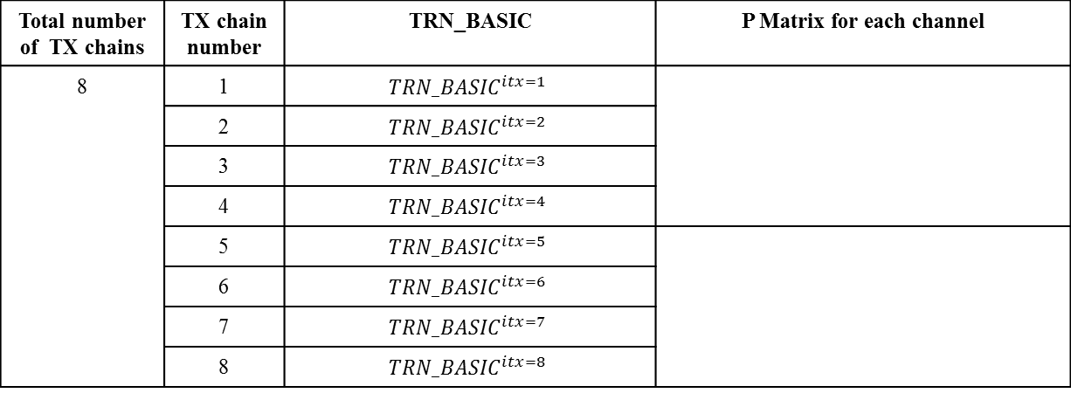
Proposed OFDM TRN subfield for CA(3/3)
Total number of TX chains | TX chain number | TRN_BASIC | P Matrix for each channel
8 | 1 | $${TRN_BASIC}^{itx=1}$$
 | 2 | $${TRN_BASIC}^{itx=2}$$
 | 3 | $${TRN_BASIC}^{itx=3}$$
 | 4 | $${TRN_BASIC}^{itx=4}$$
 | 5 | $${TRN_BASIC}^{itx=5}$$
 | 6 | $${TRN_BASIC}^{itx=6}$$
 | 7 | $${TRN_BASIC}^{itx=7}$$
 | 8 | $${TRN_BASIC}^{itx=8}$$
We can reduce length of OFDM TRN subfield in CA by 50% applying above P matrix with no channel measurement performance degradation.

Slide 7
Conclusion
We propose that P matrix of OFDM TRN subfield in CA should be defined by the number of TX chains per channel.
We can reduce OFDM TRN subfield in CA with half of current OFDM TRN subfield.

Slide 8
Straw Poll
Do you agree
  to accept the text in 11-18-197-00-00ay - Draft text for OFDM TRN subfield for Channel Aggregation?

Slide 9
References
[1] 11-17-1601-01-00ay-draft-text-for-ca-trn-subfield

