Slide 1
Distribution network use case for consumer devices
Date: 2018-01-13
Name | Affiliation | Address | Phone | Email
Kazuyuki Sakoda | Sony | 1730 N. First Street, San Jose CA 95112 | +1-408-352-4405 | kazuyuki.sakoda(at)sony.com
Mohamed Abouelseoud | Sony | 1730 N. First Street, San Jose CA 95112 | +1-408-352-4027 | Mohamed.Abouelseoud@sony.com

Slide 2
Agenda
Motivation
Recap on consumer device use cases
Key attribute
Additional consideration to the scenario considering real life environment
Device layout
Moving blockers
Potential approaches to overcome the challenges
Is TDD mode applicable to the use case?
Conclusions

Slide 3
Motivation
802.11ay use case document development started in 2015. The task group tries to capture potential usage of the 802.11ay technology
The use case document has expanded in 2017 to capture emerging use case that would broaden 802.11ay technology deployment
This presentation introduces additional consideration to consumer device use case reflecting real life usage, hoping broader 802.11ay technology adoption in consumer electronics market place

Slide 4
Recap on consumer device use cases (1)
802.11ay use case document [2] contains comprehensive list of use cases for next generation 60GHz communications
Usage Model 2 and 3 reflect typical usage and requirements for consumer applications
UM2: 8K UHD wireless transfer at Smart Home
UM3: AR/VR headsets and other high-end wearables

Slide 5
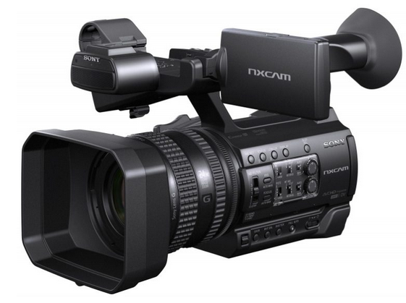
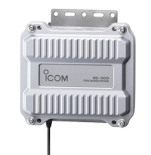
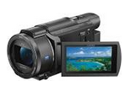
Recap on consumer device use cases (1’)
Another potential device that could leverage 60GHz communication is high definition video camera
Shoot the object at the camera and transfer it to a media controller immediately with very low latency

Slide 6
Recap on consumer device use cases (2)
Use case and requirement matrix is shown below
Use case | Application | Venue | Range | Bandwidth | Latency
UHD transfer | Video streaming | Indoor | 5-10m (~20m) | >Gbps | <5msec
VR headset | Video streaming | Indoor | 5-10m (~20m) | >Gbps | <5msec
Camera video transfer | Video streaming | Indoor/ outdoor | 10-50m | <Gpbs | <20msec

Slide 7
Key attribute
All of these application require high bandwidth AND low latency streaming capability
Need to cope with LOS/NLOS transmissions, including human blockage, and interference avoidance
Robustness is essential
Quick recovery from obstruction is essential
In many cases, need to cope with power limitation and heat problem

Slide 8
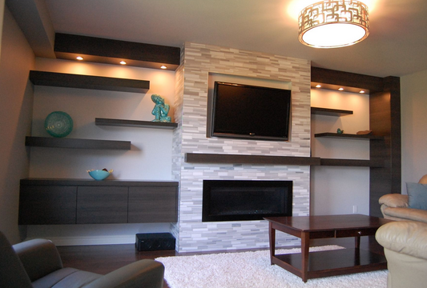
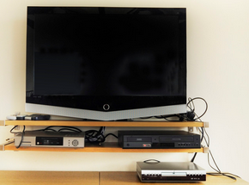
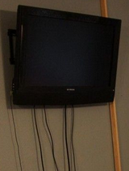
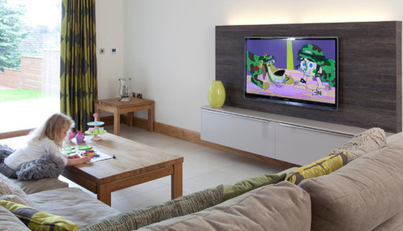
Additional consideration to the scenario considering real life environment (1)
UM2: UHD for display
The goal of UM2 is to eliminate or reduce ugly cables, and give users flexibility of device installation

Slide 9
Additional consideration to the scenario considering real life environment (2)
STB/Tuner might be located places where LOS signal cannot travel
STB/Tuner might be located behind sofa and/or humans

Slide 10
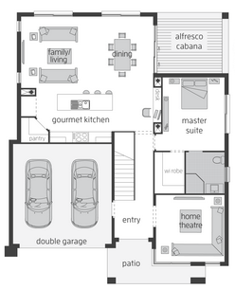
Additional consideration to the scenario considering real life environment (3)
Source
(STB)
Display and STB/Tuner might be located far away than we imagine
The value of UM2 is to give users flexibility of device installation
Sink
(Display)
Sink
(Display)

Slide 11
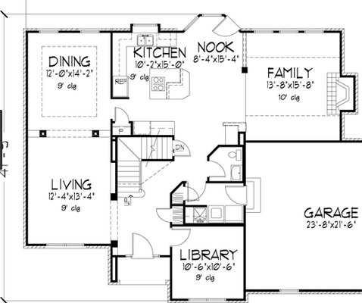
Additional consideration to the scenario considering real life environment (4)
Source
(STB)
Display and STB/Tuner might be located far away than we imagine
The value of UM2 is to give users flexibility of device installation
Sink
(Display)
Sink
(Display)

Slide 12
Additional consideration to the scenario considering real life environment (5)
UM3: VR headset
For now, game is the prominent application of VR
Assumes game console and VR headset are located in the same room
However, console and headset might not be in LOS or may suffer human blockage

Slide 13
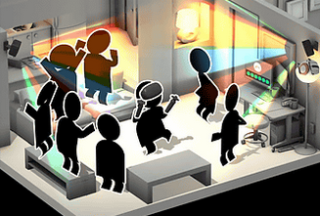
Additional consideration to the scenario considering real life environment (6)
Source
(Console)
Sink
(Headset)
Blockers
move
In general, distance between console and headset is not large, but we cannot guarantee LOS
Some VR application could be dealing multi play scenario

Slide 14
Potential approaches to overcome the challenges (1)
To gain robustness with blocker scenario, 802.11ay should provide more opportunity to leverage diversity effect
Proactive search of alternative path will make the streaming robust
MIMO could contribute gaining multi-path diversity
Distribution network could contribute gaining site diversity
Source
Sink

Slide 15
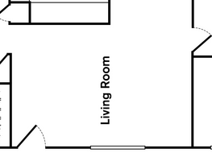
Potential approaches to overcome the challenges (2)
Example 1: MIMO could contribute to obtain multi-path diversity
Diffraction
3
LOS component
Sink
1
Source
2
Blocker
Reflection

Slide 16
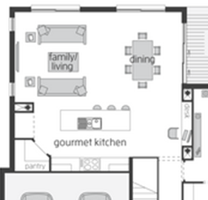
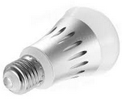
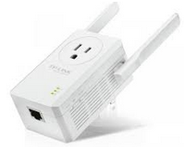
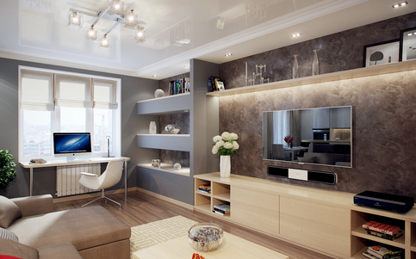
Potential approaches to overcome the challenges (3)
Example 2: Distribution network could contribute to obtain site diversity
DN
DN
Sink
(DN)
DN
DN
Source
(DN)
Source
(DN)
Sink
(DN)

Slide 17
Potential approaches to overcome the challenges (4)
To gain range extension, 802.11ay device should be able to leverage multi-hop capability
Distribution network enables such network topology
Source
Sink
DN

Slide 18
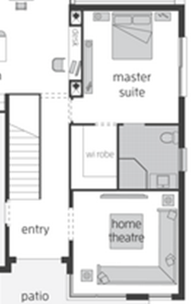
Potential approaches to overcome the challenges (5)
Example: Distribution network could contribute to obtain range extension
This capability could enable high-bandwidth Smart Home device deployment
Source
(DN)
DN
Sink
(DN)

Slide 19
Is TDD mode applicable to these use cases? (1)
The biggest motivation for consumer devices to use 60GHz is to meet both high bandwidth AND low latency requirement
Typically, < 5msec latency & jitter is the target
Big chunk of BHI should be eliminated
According to [3], with 255/32 sector configuration, BHI could occupy 8.4 msec, which is longer than latency target.

Slide 20
Is TDD mode applicable to these use cases? (2)
According to [4], TDD mode steady state would eliminate BHI
According to [5] and [6], SLS will be done within SP, and TDD mode channel access allows BF training signaling interleaved with data transfer
This is a nice feature for applications that require extremely low latency
Even knowing there are missing components with TDD mode, the approach is attractive for consumer device use cases

Slide 21
Conclusion
Revisited consumer device use cases and picked up key attribute
Latency, robustness, and transmission range are important for these use cases
802.11ay device should leverage diversity effect
MIMO contributes to multi-path diversity
Distribution network contributes to site diversity
802.11ay device should be extendable to multi-hop capability
Distribution network could enable room-to-room communication
802.11ay should enable 1 hop mesh topology so we can extend the network on top of it
TDD mode is attractive to meet latency requirement
Suggest to complete 802.11ay spec so that Distribution Network can be used by broader devices

Slide 22
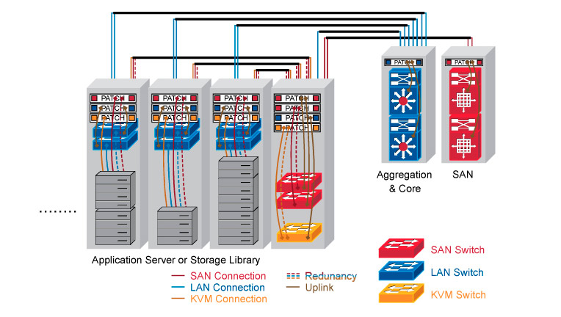
Annex
Usage Model 4 of [2] is Data Center scenario
High level requirement of Data Center looks to be quite close to the requirements described in this submission
Application:
The ToR switch can transmit /receive via the 11ay interface to reach the EoR switch through multiple hops. The EoR switch can reach the hub switch through the 11ay interfaces. The data being stored transfers at ~40 Gbps, disruption tolerance is <100msec, PER<10E-2 [1].
The data could traversal multiple hops (<=5) in order to reach the EoR switches, and the end to end Latency<50ms
E
F
D
C
B
A

Slide 23
References
[1] Draft P802.11ay D1.0
[2] IEEE 802.11-15/625r7 “IEEE 802.11 TGay Use Cases”, Rob Sun, et.al.
[3] IEEE 802.11-17/67r1 “Enhanced SLS BF flow for efficient AP-STA access in dense environment”, Alexander Maltsev, et.al.
[4] IEEE 802.11-17/1321r0 “Features for mmW Distribution Network Use Case”, Djordje Tujkovic, et.al.
[5] IEEE 802.11-17/1646r1, “Beamforming for mmWave Distribution Network”, Oren Kedem, et.al.
[6] IEEE 802.11-17/1679r0, “Beamforming protocol for mmWave Distribution Networks”, Djordje Tujkovic, et.al.

