Slide 1
Hybrid Beamforming Feedback in 802.11ay
Date: 2018-01-08
Authors:

Slide 2
Introduction
TGay has agreed that 11ay will support hybrid precoding for SU-MIMO and MU-MIMO [1]
Performance of hybrid precoding with the transmission and reception of EDMG Single Carrier Mode PPDUs has been shown in [2], and [3] and on EDMG OFDM PPDUs in [4].
  The results show gains of hybrid precoding over analog precoding in certain scenarios e.g. antenna configuration, transmit power.
To enable HBF in 802.11ay, a framework for the HBF protocol was agreed to in [7].
In this contribution, we present the details needed for HBF feedback including:
  OFDM Request Parameters
  OFDM Response Parameters
  Feedback Information and Feedback Frame Format

Slide 3
HBF Protocol Details
  The Hybrid Beamforming Protocol comprises the following phases
    Announcement Phase
    Sounding Phase
    Feedback Phase
  On completion of the HBF protocol, HBF transmission can take place
HBF protocol
Exp: Explicit
I: Initiator

Slide 4
Feedback Phase
  Feeds back HBF information needed by transmitter for HBF transmission.
  The Hybrid Beamforming information differs for SC vs OFDM PPDUs
    SC PPDU : Time domain information: precoder and/or channel
    OFDM PPDU : Frequency domain precoder information
  D1.0 supports Time domain feedback HBF in the SC PPDU mode
  Support for feedback for the OFDM PPDU is needed.
  This will need a mechanism for:
    OFDM Request Parameters
    OFDM Response Parameters
    Feedback Information and Feedback Frame Format

Slide 5
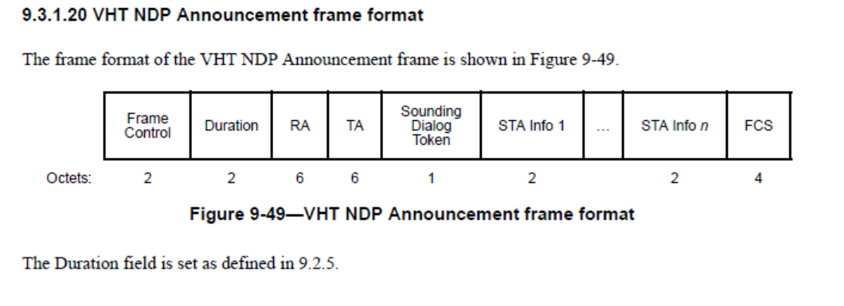
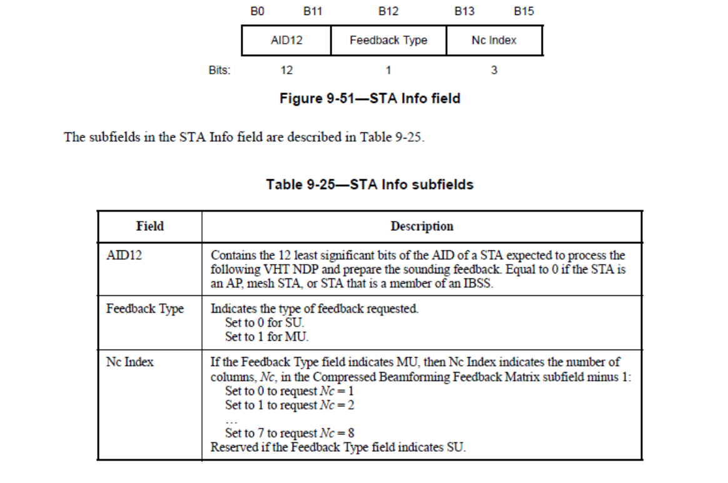
OFDM Request Parameters
VHT NDPA and subfields [6]
For 802.11ay, create signaling identical to 802.11ac
  Feedback Type to indicate feedback details
  Nc Index sent only if Feedback Type is set to MU
    a STA may decode at most 2 spatial streams so Nc index = 2
Parameters requested in the EDMG BRP Request element (9.4.2.255)

Slide 6
EDMG BRP Request element [8]
 | B0 B7 | B8 B15 | B16 B23 | B24 B31 | B32 B39 | B40 B50 | B51 B52 | B53 B56 | B57 B58
 | Element ID | Length | Element ID Extension | L-RX | L-TX-RX | TX Sector ID | EDMG TRN-Unit P | EDMG TRN-Unit M | EDMG TRN-Unit N
Bits: | 8 | 8 | 8 | 8 | 8 | 11 | 2 | 4 | 2
 | B59 | B60 | B61 B63 | B64 B66 | B67
 | TXSS-REQ | TXSS-INITIATOR | TXSS-PACKETS | TXSS-REPEAT | TXSS-MIMO
Bits | 1 | 1 | 3 | 3 | 1
 | B68 B73 | B74 B81 | B82 B84 | B85 | B86 | B87 | B88 | B89 95
 | BRP CDOWN | TX Antenna Mask | Comeback Delay | First Path Training | Digital BF Request | Feedback Type | Nc Index | Reserved
Bits | 6 | 8 | 3 | 1 | 1 | 1 | 2 | 6
Modify Reserved field to 6 bits to make number of bits divisible by 8
Table xx
Value | Meaning
0 | Nc = 1
1 | Nc = 2
2 | Reserved
3 | Reserved

Slide 7
EDMG BRP Request element
New Field Descriptions [8]
The Feedback Type field indicates the type of feedback requested. Set to 0 for SU and set to 1 for MU.
If the Feedback Type field indicates MU, then the Nc Index field indicates the number of columns, Nc, in the compressed beamforming feedback matrix minus 1 for HBF feedback in the EDMG OFDM PPDU mode. The interpretation of this field is defined according to Table xx.

Slide 8
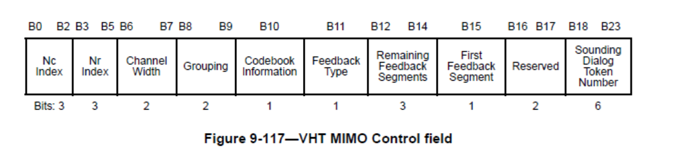
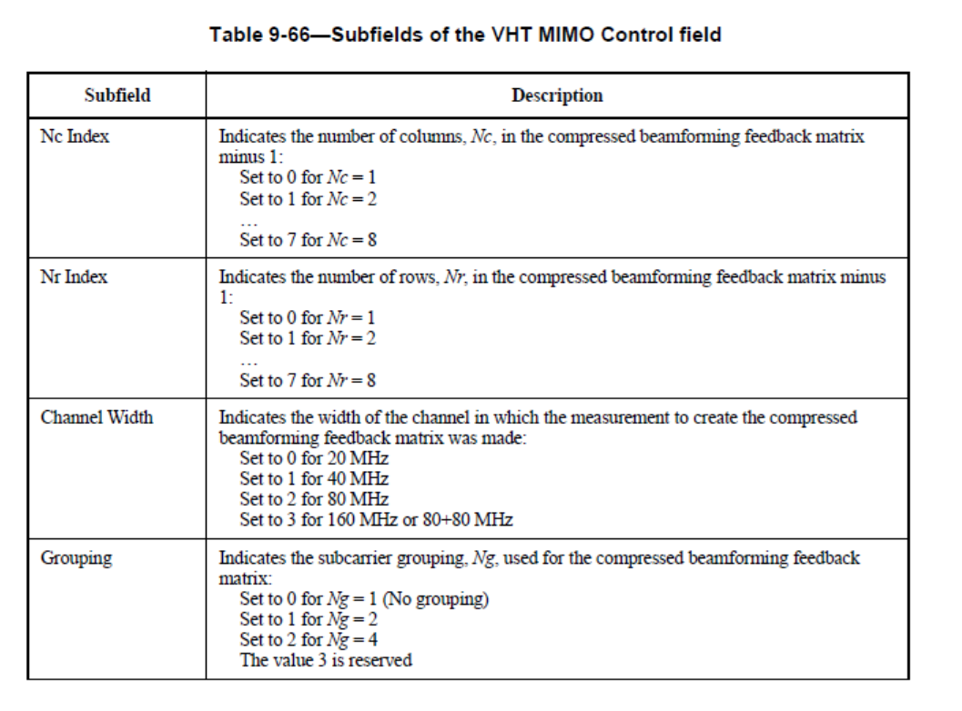
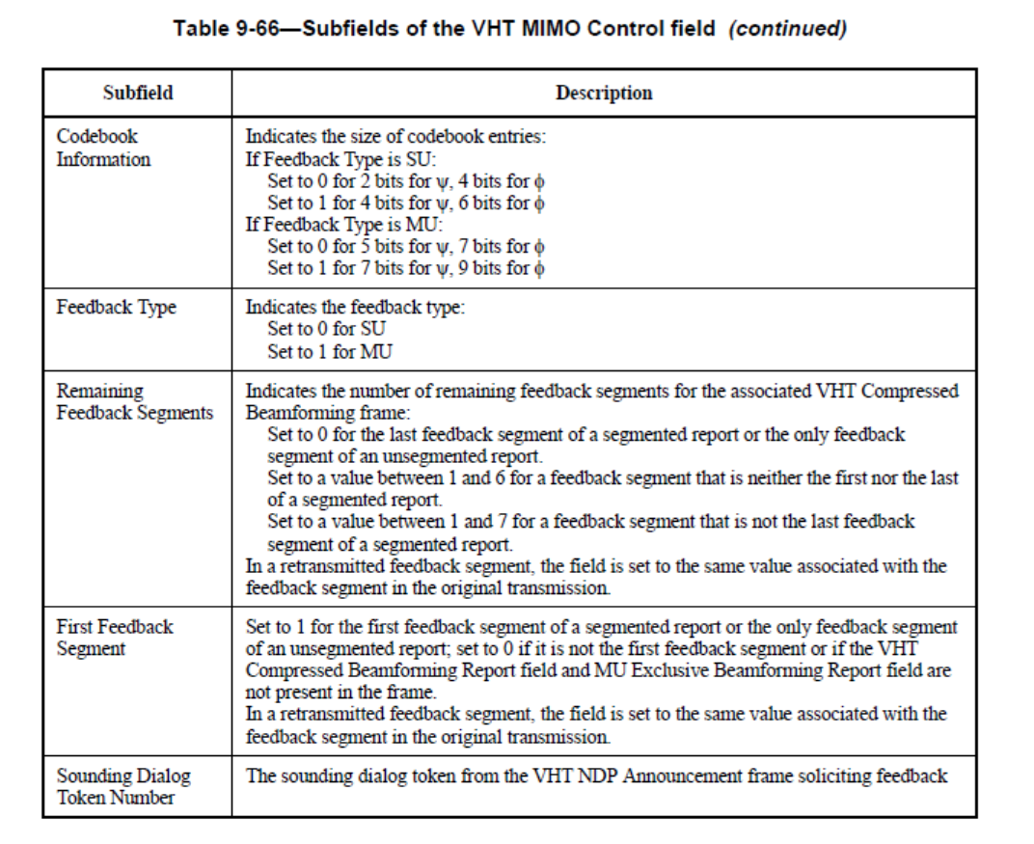
OFDM Response Parameters
VHT MIMO Control field and subfields [6]
Create new element to indicate the parameters of the feedback

Slide 9
Open Issues
  Tone Grouping - Grouping Ng and Number of subcarrier fields:
    Static Grouping size and values of Ng in 802.11ac :
      Ng = 1, 2 and 4
      Need to define other values (mandatory and optional)
  Coefficient Size: Quantization of angles:
      Quantization based on SU/MU parameter in 802.11ac:
      (bϕ / bᶲ) set to SU : 2 /4 and 4/6, MU: 5/7 and 7/9
      Need to define the corresponding values in 802.11ay given that the carrier frequencies, bandwidths (2.16 GHz vs 20 MHz) and the subcarrier spacings (312.5 kHz vs 4.957MHz) are different

Slide 10
Feedback Information and Frame Format
Information to be fed back
  Average SNR for each STS (in Channel Measurement Feedback Element)
  Beamforming Feedback Matrix indexed on sub-carrier (OFDM) or time domain tap (SC)
  Optional for MU: Differential SNR per stream for each 2Ng band (OFDM)
    MU Exclusive Beamforming Report Field
Need to create BF Feedback element to capture this information

Slide 11
Conclusion
In this contribution, we have discussed the details of the feedback for the feedback phase of the HBF protocol.
We have discussed the following:
  OFDM Request Parameters
  OFDM Response Parameters
  Feedback Information and Feedback Frame Format
We have defined parameters and signaling for the OFDM Request Parameters.

Slide 12
References
IEEE P802.11ay™/D1.0
L. Sun, et al, “Link Level Performance Comparisons of Open Loop, Closed Loop and Antenna Selection for SU-MIMO” 11-16/0911r1
K. Oteri et al, “Closed Loop SU-MIMO Performance with Quantized Feedback” 11-16/1446r0 .
K. Oteri, et, al, “Hybrid Beamforming for SC and OFDM Transmission in 11ay” 11-17/1533r1
A. Maltsev, et al, “Channel models for IEEE 802 11ay”, IEEE doc. 11-15/1150r4
IEEE 802.11-2016
K. Oteri, et. al, “Draft Text for Hybrid Beamforming Protocol Design Details”, 11-17/1692r1
K. Oteri, et. al., “Draft Text for OFDM Feedback Request”, 11-18/0193r0

Slide 13
Straw Poll 1
Do you agree to the following?
  802.11ay shall signal the Feedback Type and Nc Index fields for HBF feedback with the OFDM PPDU in the EDMG BRP Request Element as in 11-18/0193r0 “Draft Text for OFDM Feedback Request”.
Y/N/A

