Slide 1
Power Efficiency for Individually Addressed Frames Reception
Date: 2018-02-19
Authors:

Slide 2
Abstract
Currently, an AP wakes up a STA in Wake up radio (WUR) mode every time the AP obtains an individually addressed frame to the STA.
This submission allows non-AP STA to reduce power consumption and the number of waking ups by filtering unicast DL frames to which the AP will send a Wake Up frame to the STA.

Slide 3
Different Delay Requirements
Sometimes keep alive messages, emails and system updates may not have strict delay requirements
Traditional WLAN power save mechanisms have been tailored to infrequent waking ups and to deliver all messages in a single activation round
Simple IoT-devices may not be interested to receive only specific packets
A WUR has small power consumption enabling a battery-powered STA to receive by WUR more often
STA can be more available which shortens the wake up frame transmission delays
The power save benefit of WUR is compromised if the PCR is activated frequently

Slide 4
STA in WUR Mode May Have High Power Consumption
The non-AP STA in legacy power save controls how often it activates PCR
E.g. PCR may be activated every Beacon, or every 10th Beacon, i.e. PCR activation interval may be from 100 TUs up to 1000 TUs
The AP may send a wake-up frame as often as DL frame arrives to non-AP STA in WUR Mode
The AP may command PCR activation many times in a Beacon interval, i.e. PCR activation interval may be ~ 5 TUs
WUR shortens the PCR activation delay, but may cause high stand-by power consumption
The STA needs to have mechanism to control its power consumption

Slide 5
Proposal, Control the Frames that Wake Up the STA
A STA may setup a traffic filtering service to classify whether the AP sends a Wake Up frame when a DL frame is received
The STA can specify the frames to which it needs to immediately wake up and use more power efficient reception for other frames
The number of transmitted Wake Up frames is reduced
The AP may send a wake up frame to the STA only if the AP cannot buffer all frames to the STA in WUR mode

Slide 6
Traffic Filtering Service Overview
AP and STA can negotiate traffic filtering service (TFS) via TFS request and response frames
TFS is defined in IEEE 802.11v-2011
A STA can add traffic filters any time after association or delete filters at any time
An AP may delete filters if it executes the filter action (e.g. wakeup)
AP operations:
AP inspects DL traffic on behalf of STA which installed filter
An AP discards unmatched unicast traffic when TFS is enabled
An TFS Notify frame is delivered before the triggering frame if requested by the STA

Slide 7
Traffic Filtering Service (TFS) overview
802.11 defines traffic filtering service that allows STA to configure which frames it will receive
The filter patterns are delivered in TFS Request Element:

Slide 8
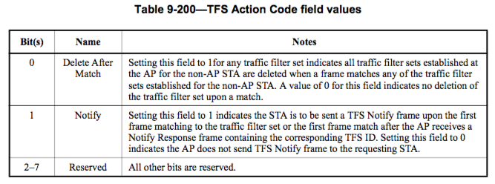
Traffic Filtering Service (TFS) overview
The TFS action code defines the AP actions when a frame matches a traffic filter set

Slide 9
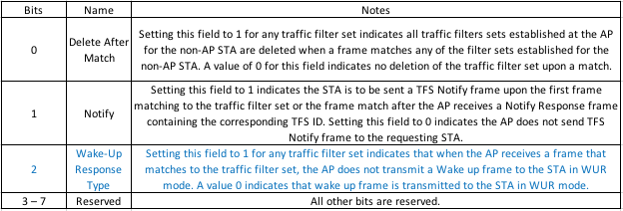
Traffic Filtering Service (TFS) Proposal
The TFS action code should control the wake-up frame transmission

Slide 10
Summary
This submission proposes to use TFS to filter undesired unicast frames and control whether a Wake-up frame is transmitted
The non-AP STA delay performance and stand-by power consumption are optimized for specific traffic types
The amount of transmitted Wake-up frames is reduced
The congestion and Wake Up frames transmission delay are mitigated

Slide 11
Straw poll
Do you agree to add to the 802.11ba SFD a text as shown below:
R.4.7.2.C: A STA and an AP may setup traffic filter sets to control the Wake Up frame transmission. The AP should not to send a Wake Up frame to a STA in WUR mode when the AP obtains a DL frame that matches one or more traffic filter sets that configure not to send a Wake Up frame.

