Slide 1
Power Efficiency for Individually Addressed Frames Reception
Date: 2018-01-13
Authors:

Slide 2
Abstract
Currently, an AP wakes up a STA in Wake up radio (WUR) mode every time the AP obtains an individually addressed frame to the STA.
This submission allows non-AP STA to reduce power consumption and the number of waking ups by filtering DL frames and configuring an immediate or power optimized response to a wake-up frame.

Slide 3
Different Delay Requirements
Sometimes keep alive messages, emails and system updates may not have strict delay requirements
Traditional WLAN power save mechanisms have been tailored to infrequent waking ups and to deliver all messages in a single activation round
Simple IoT-devices may not be interested to receive only specific packets
A WUR has small power consumption enabling a battery-powered STA to receive by WUR more often
STA can be more available which shortens the wake up frame transmission delays
The power save benefit of WUR is compromised if the PCR is activated frequently

Slide 4
STA in WUR Mode May Have High Power Consumption
The non-AP STA in legacy power save controls how often it activates PCR
E.g. PCR may be activated every Beacon, or every 10th Beacon, i.e. PCR activation interval may be from 100TUs up to 1000 TUs
The AP may send a wake-up frame as often as DL frame arrives to non-AP STA in WUR Mode
The AP may command PCR activation many times in a Beacon interval, i.e. PCR activation interval may be ~ 5 TUs
WUR shortens the PCR activation delay, but may cause high stand-by power consumption
The STA needs to have mechanism to control its power consumption

Slide 5
Traffic Filtering Service Overview
AP and STA can negotiate traffic filtering service (TFS) via TFS request and response frames
TFS is defined in IEEE 802.11v-2011
A STA can add traffic filters any time after association or delete filters at any time
An AP may delete filters if it executes the filter action (e.g. wakeup)
AP operations:
AP inspects DL traffic on behalf of STA which installed filter
An AP discards unmatched unicast traffic when TFS is enabled
An TFS Notify frame is delivered before the triggering frame if requested by the STA

Slide 6
Traffic Filtering Service (TFS) overview
802.11 defines traffic filtering service that allows STA to configure which frames it will receive
The filter patterns are delivered in TFS Request Element:

Slide 7
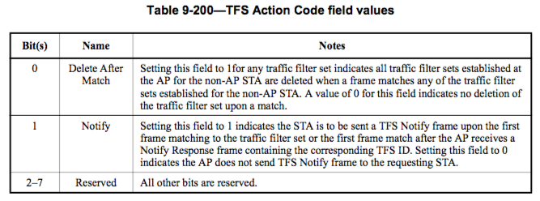
Traffic Filtering Service (TFS) overview
The TFS action code defines the AP actions when a frame matches a traffic filter set

Slide 8
Traffic Filtering Service (TFS) Proposal
The TFS action code should control the wake-up frame transmission

Slide 9
Signaling the Urgency in a Wake Up Frame
The wake-up frame may contain one bit indication whether AP requires immediate or power optimized wake-up
Value 1: The STA wakes up immediately to receive the frames
Value 0: The STA selects when it wakes to receive the frames
AP may transmit non-urgent wake up frame, if all DL frames meet the filtering criteria
Otherwise, the AP shall transmit a wake-up frame indicating immediate response to wake up frame

Slide 10
AP transmitting the Wake Up frames
AP should prioritize the transmission of the wake-up frames that indicate immediate response
AP may delay the transmission of the wake-up frame indicating power efficient response
An AP may use an implementation specific logic to retransmit wake-up frames indicating power optimized wake-up:
AP may retransmit the wake up frame indicating power optimized wake up after longer delay than wake-up frames indicating immediate wakeup
AP may transmit a wake up frame indicating immediate wake-up to ensure that STA is available

Slide 11
A power efficient response to a Wake Up Frame
When a Wake-up frame indicates a power efficient response, the STA selects when it activate PCR to receive the buffered frames
The STA has knowledge of buffered frames, so that it can send a PS-Poll or other indication to AP and receive the frames
For instance, a STA may receive the non-urgent frames:
When the STA receives group addressed frames
When the STA receives other frames
After a delay; more frames may accumulate to AP and STA receives them all at the same time
Immediately in the same way as in immediate response

Slide 12
Summary
This submission proposes to use TFS to filter undesired unicast frames and control whether immediate or power efficient response is required for the Wake-up frame
The non-AP STA has good delay performance and low stand-by power consumption
The power efficient response enables STA to receive non-urgent frames when the STA receives of other frames, e.g. the STA knows to fetch the individually addressed frames when the STA receives group addressed frames

