Slide 1
WUR Discovery Frame Content
Date: 2018-01-14
Authors:
Name | Affiliations | Address | Phone | email
Guoqing li | Apple |  |  | Guoqing_li@apple.com
Rojan Chitrakar | Panasonic
Taewon Song | LG
Roger Marks | Huawei
Kaiying Lv | ZTE
Liwen Chu | Marvell

Slide 2
Introduction
802.11ba has adopted Smart Scanning use cases into the Usage Model document, and the concept of WUR Discovery frame is also adopted to enable these use cases[1][2] [3]
There are two basic questions to answer in order to enable smart scanning:
What information is included in WUR Discovery frame to facilitate a STA to discovery nearby APs for efficient roaming and location services [4][5]
Which WUR channel(s) the STA should use to scan for WUR Discovery frame in order to efficiently discovery APs [3][6][7]
This contribution focuses on question 1, i.e., WUR Discovery frame format
This contribution summarizes the views of the various contribution on this use case [4-ZTE], and presents the agreement so far

Slide 3
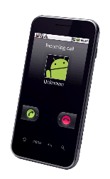
Recap on Usage Model x: Smart Scanning
Jan 2018
Use case 1: Ultra-low power location scan
Mobile devices sometimes scan through multiple channels for nearby APs, and use the measured Wi-Fi signal strength for improved location services. Scanning on main radio consumes higher power than WUR radio. In addition, scanning on main radio has the risk of conflicting with regular data exchange.
In WUR-facilitated location scan, the mobile device scans through the channels using the WUR receiver, and uses the signal strength measured from WUR packets received from adjacent APs to provide additional information to the location services on the mobile device. In other words, some of the location scan on main radio can be offloaded to WUR radio.
Because WUR consumes much less power than main radio, WUR facilitated location scan provides an ultra-low power location scan mechanism.
Use case 2: Ultra low power roam scan
Mobile devices sometime scan for roaming purposes. These roam scan sometimes is triggered when link quality degrades. These roam scan takes time because the scan is typically done on multiple channels, and on each channel the device either conducts active scan during which it sends a probe request and typically stays awake until it receives a probe response, or passive scan during which it dwells on each channel for at least a Beacon interval to receive a Beacon. As a consequence, scanning through multiple channels introduces roaming latency and consumes power. Sometimes, it runs into conflict with regular data exchange.
In WUR-facilitated roam scan, the mobile device passively scans through multiple channels using WUR, and collects basic information about nearby APs. The collected info can be used to facilitate the devices’ roaming decisions.
Because WUR consumes much less power than main radio, WUR-facilitated roam scan provides an ultra-low power roam scan. In addition, due to the low power operation, WUR scan can be performed quite frequently in the background, and thus roaming information can be readily available whenever needed, i.e., it reduces roaming latency.

Slide 4
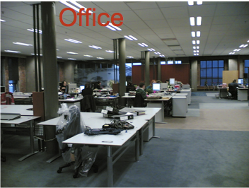
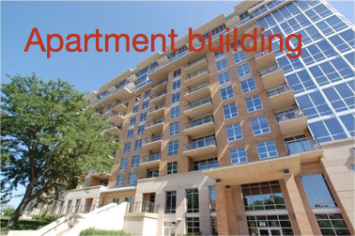
Roaming Scanning
There are different cases how WUR Discovery frame can be used for roaming purpose. For example
Initial discovery: when mobile device leaves a place, and arrives at another place which it may or may not have joined before. The STA can reply mostly on WUR to discover new APs in the transition period
Continuous discovery: for example, inside Hotel Irvine, after associating with “Hotel Irvine Wi-Fi”, the mobile device keep monitoring WUR and try to stay with this network
In both cases, the STA will mostly likely start with a set of previously associated SSIDs or try to stay with current SSID after association
In this case, the SSID information is very helpful to facilitate roaming scanning

Slide 5
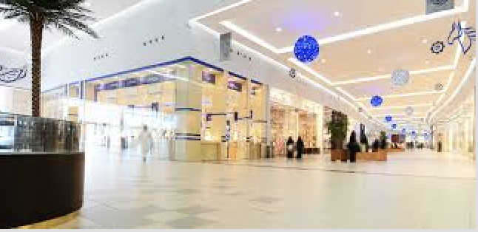
Roaming Scanning (cont.)
When a SSID is detected from WUR Discovery frame, but the STA has not associated with it before, the STA will needs to invoke the regular scan procedure using PCR to discover more info
In this case, having the PCR’s channel information is very helpful to speed up the scanning procedure on PCR

Slide 6
Location Scan
In location scan, AP identify and RSSI are mostly needed
WUR Discovery frame needs to carry the AP’s identify to help the STA discover its location

Slide 7
WUR Discovery Frame Structure
To minimize different modes of operation, we suggest including three mandatory information in WUR Discovery frame
AP’s identify, TBD bits
Either TX ID, or partial BSSID, or hashed BSSID
Compressed SSID, TBD bits
Partial SSID or hashed SSID
Channel information
2 octets as defined in baseline or compressed TBD bits
For future extension and other possible further optimizations, we suggest including two bits for reserved/optional bits

Slide 8
Summary
We summarized different scenarios that WUR Discovery frame is used to facilitate Smart Scanning [4-7]
For different scenarios, SSID, AP identify and Channel Info are very helpful
Therefore, we recommend including SSID info and Channel info and AP ID into WUR Discovery Frame
For future extension or further optimization, we also propose to include 2 bits as reserved/optional

Slide 9
For Question 2
[6] and [7] proposes that an AP may advertise WUR scanning info
As a result, after a user arrives at a location and associates with an AP, it can obtain more information from the PCR regarding the specific WUR operation used by the specific AP or SSID. The STA may store the discovery information and later recall it, even when PCR is ON
After obtaining such info, the STA can use WUR to perform targeted scan in the advertised discovery channel based on specific info such as compressed SSID.
[3] proposed to use a reduced number of possible WUR Discovery channels as “social channel”, which can be the set of channels for proposals in [6][7] to choose from
Further investigation on question 2 is needed

Slide 10
References
17-1386r7 Examining 802.11ba usage models for mainstream devices
17-29r7 WUR Usage Model Document
17-1608r7 WUR Discovery Frame for smart scanning
18-128r0 WUR Discovery Frame
18-134r0 Smart Scanning for WUR Discovery
17-1644r1 Further Considerations on Smart Scanning Usage Model
17-1619r2 Consideration on WUR Frame for Fast Scanning

Slide 11
SP1
Do you agree to include the following text to SFD:
WUR Discovery frame includes the following mandatory information:
Compressed SSID: size and compression method are TBD
PCR operation channel: TBD bits
AP Identifier: either partial BSSID, hashed BSSID or TXID, size and compression method TBD
Reserved/optional: 2 bits

