Slide 1
Discussion of (how to specify) some TX and RX requirements for 802.11ba
Date: 2018-03-04
Authors:

Slide 2
Abstract
When working on the PHY specification text, we realized we don’t have many agreements on TX and RX requirements
Within the small PHY group we seem to start to align our views!?
The purpose of this presentation is to report about what has been discussed and get feedback from the TG

Slide 3
Outline
Transmitter
  Spectrum mask
  Modulation accuracy
Receiver
  Receiver sensitivity
  Adjacent channel rejection
  Maximum input level

Slide 4
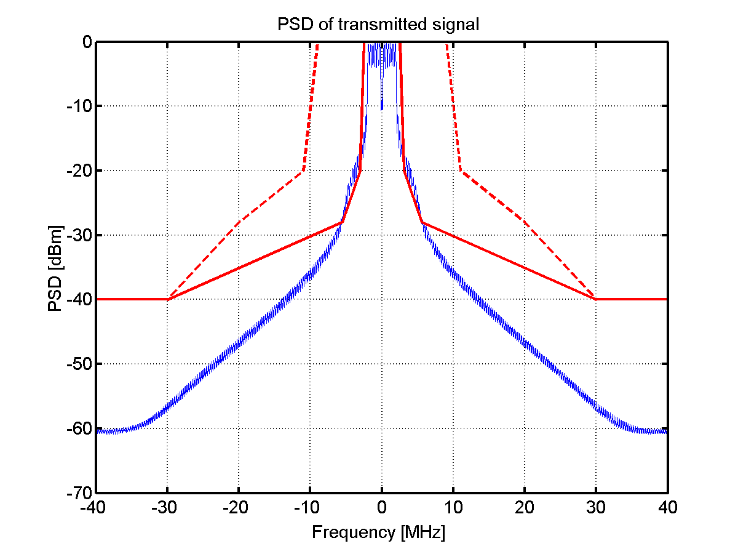
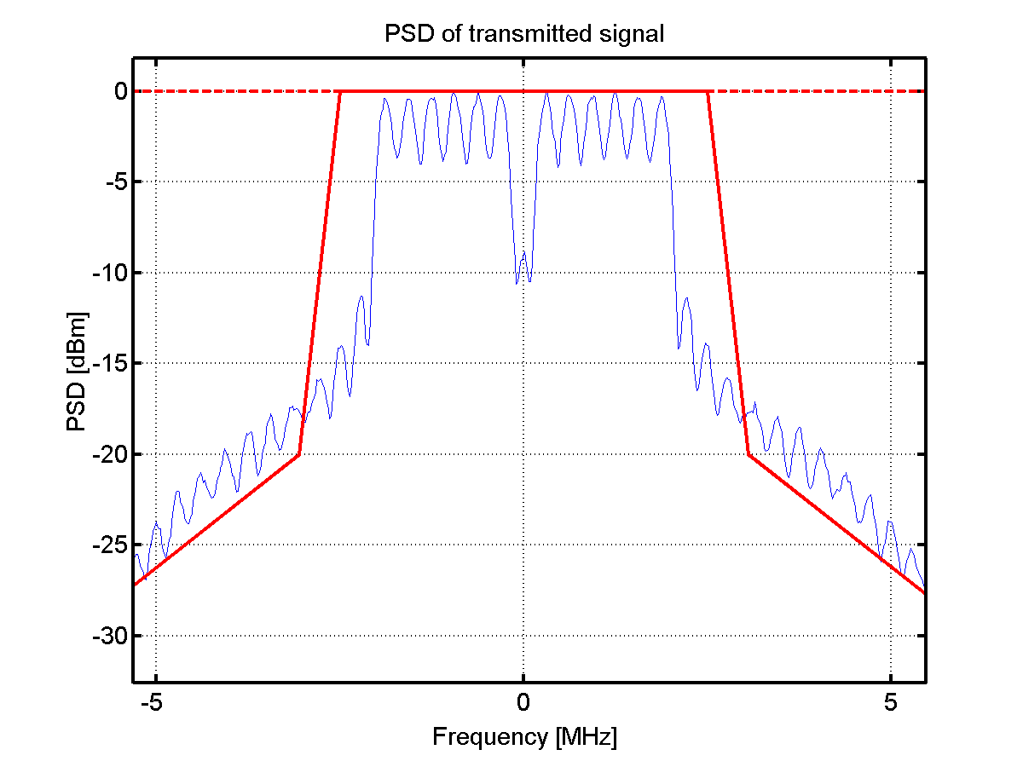
Transmitter: Spectrum mask
The first question is whether it suffice to fulfill the 20 MHz TX mask for the PCR – If the answer is yes, we are done…
The figures above are just for illustration (OBO = 3 dB, windowing applied (1 sample at 20 MHz))

Slide 5
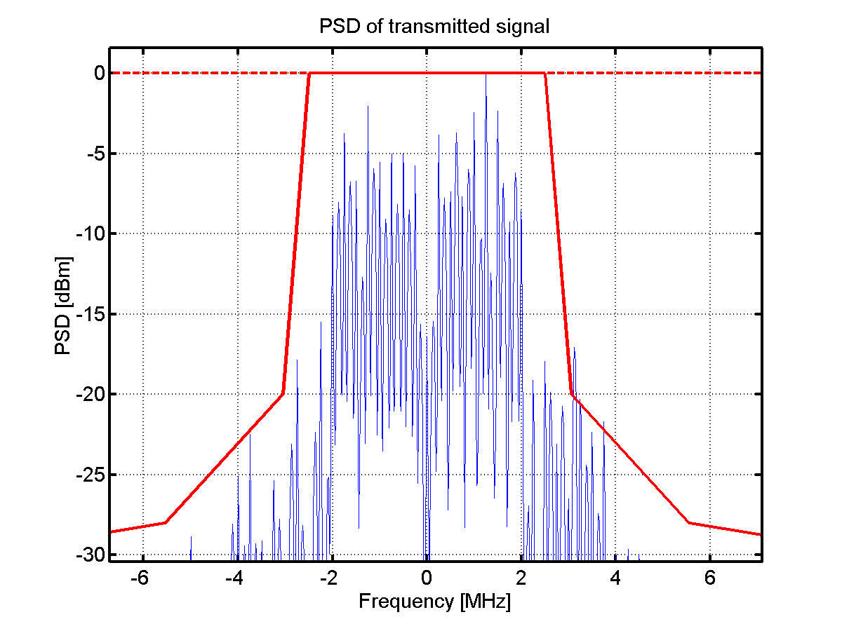
Transmitter: Spectrum mask
The spectrum becomes dependent on the selected waveforms selected for the ON part of the signal, above is one example
Should we have different spectrum masks for MCS0 and MCS1, or just one that should be fulfilled for both? MCS1 expected to generate wider spectrum
Details TBD once the waveforms are decided

Slide 6
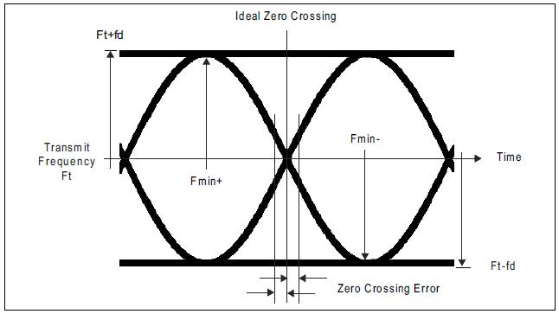
Transmitter: Modulation accuracy
This is where EVM is used in e.g. 802.11ac
Since the receiver is non-coherent, one may use a similar measure as is done to test an FSK transmitter, i.e., considering an ideal eye-diagram
The figure above is taken from the Bluetooth spec.

Slide 7
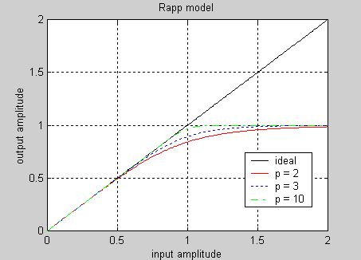
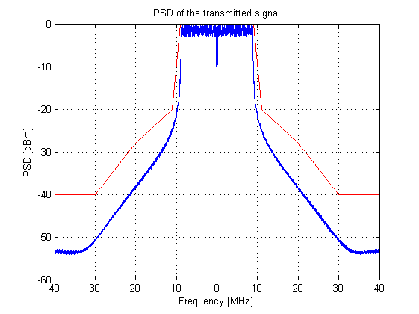
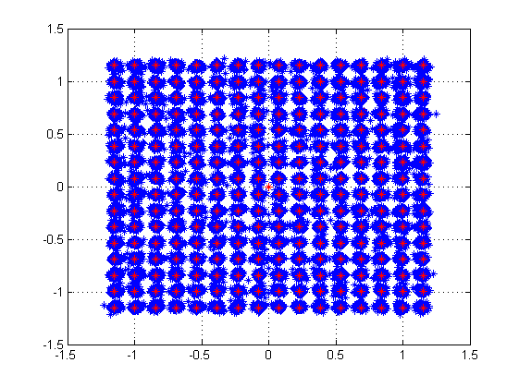
Methodology for TX evaluation - OFDM
Spectrum analyzer
OFDM
Shaping
PA
+
CSF
OFDM
SINR
WGN
For coherent demodulation, the modulation accuracy is typically specified by means of transmitted Error Vector Magnitude (EVM). Note that the EVM is representative for how well a receiver will work
The requirement on EVM is dependent on MCS. Essentially the EVM should be comparably small at the SNR where the MCS is expected to operate
In addition to the requirement on EVM, the spectrum of the transmitted signal should also fulfill the TX spectrum mask

Slide 8
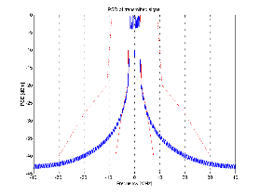
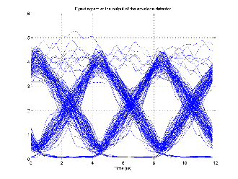
Methodology for TX evaluation - OOK
OOK
OFDM
Shaping
PA
+
CSF
Env. Det.
WGN
For OOK, the receiver is expected to be based on an envelope detector. A possibility is to test the modulation using an “ideal” receiver according to the Simulation Methodology document
White Gaussian noise is here added for the purpose to discuss reasonable requirements for the transmitter as the PA will not limit the accuracy as in case of EVM

Slide 9
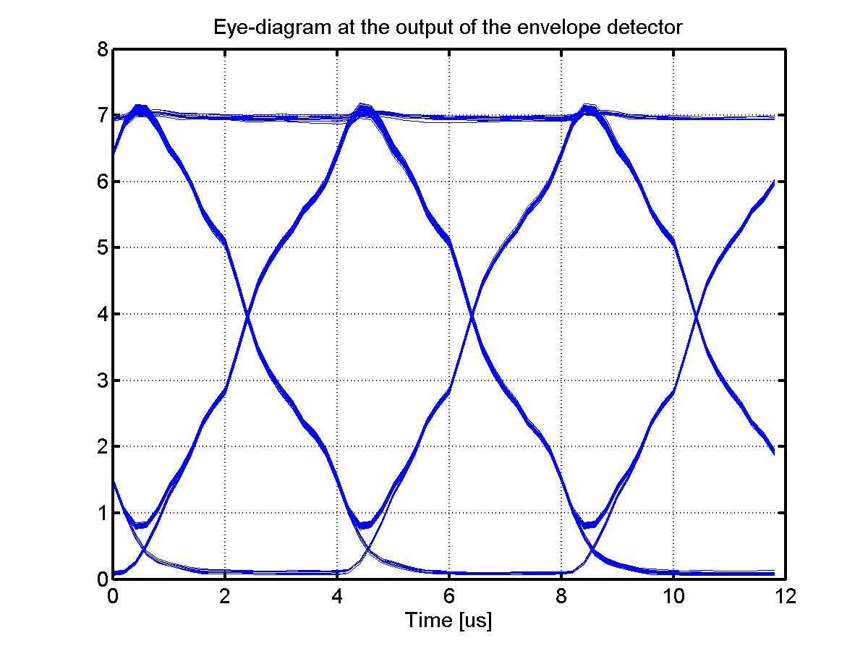
Transmitter: Modulation Accuracy
Possible requirements for modulation accuracy:
  Zero-crossing error (TBD us)
  Max eye-opening ( > TBD % of ideal eye-opening)

Slide 10
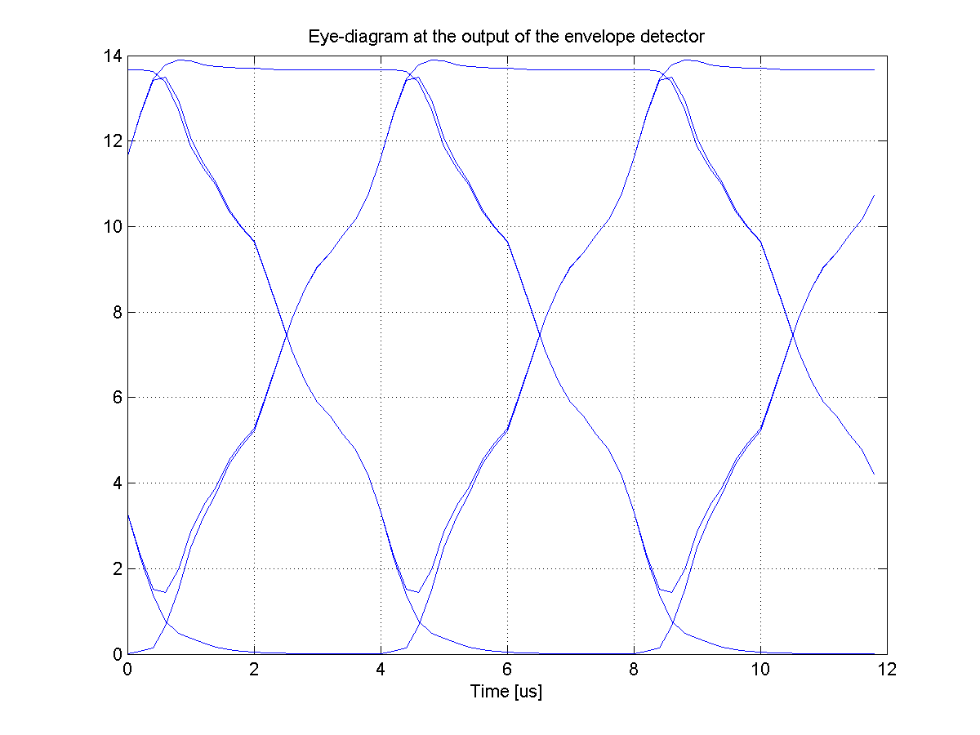
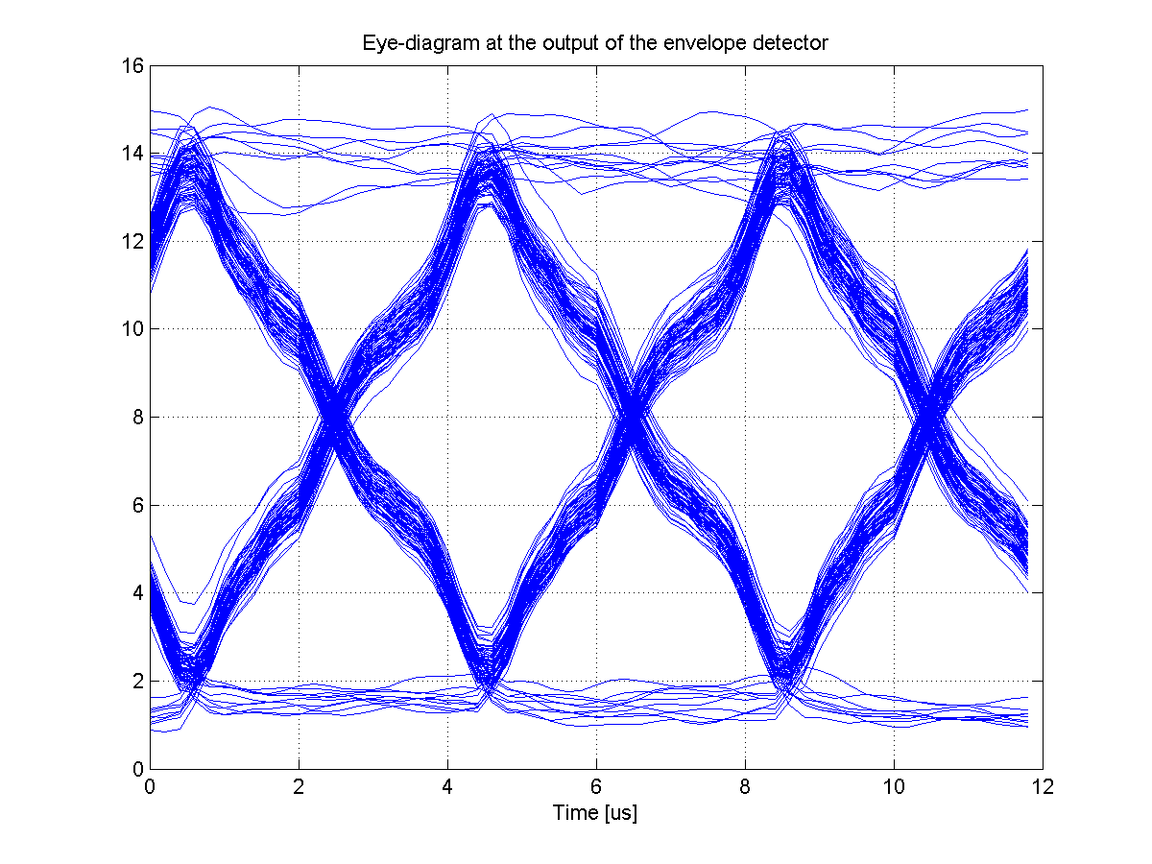
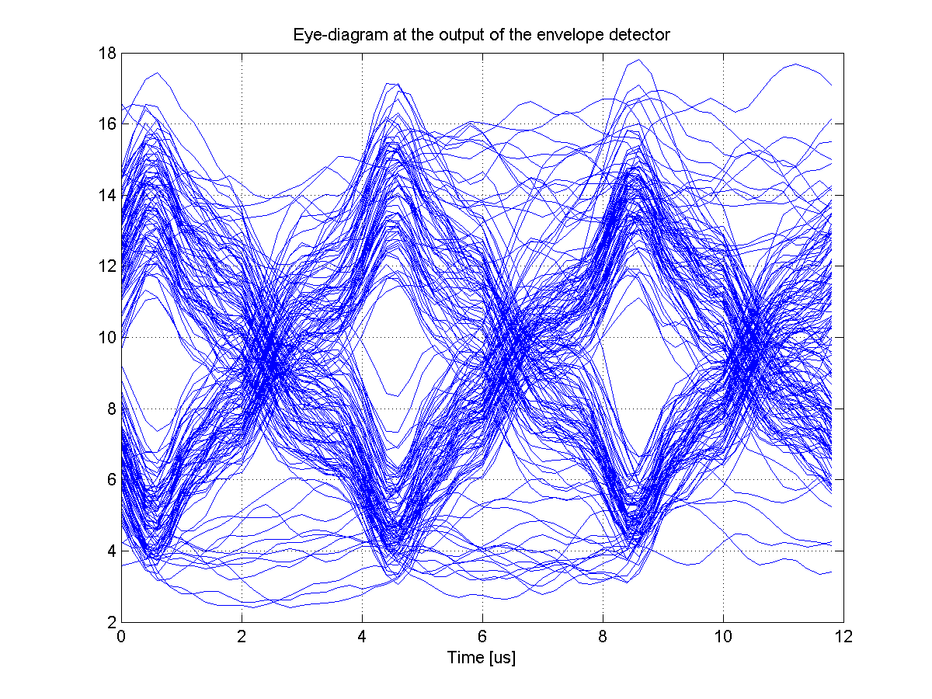
Simulation Results – Fixed sequence
SNR = 100dB
SNR = 10dB
SNR = 0dB
The specification should just ensure that TX imperfections only cause negligible receiver degradation
Say the receiver is operating at SNR = 0dB, then there is probably no need have an eye-diagram better than then one corresponding to 10 dB above

Slide 11
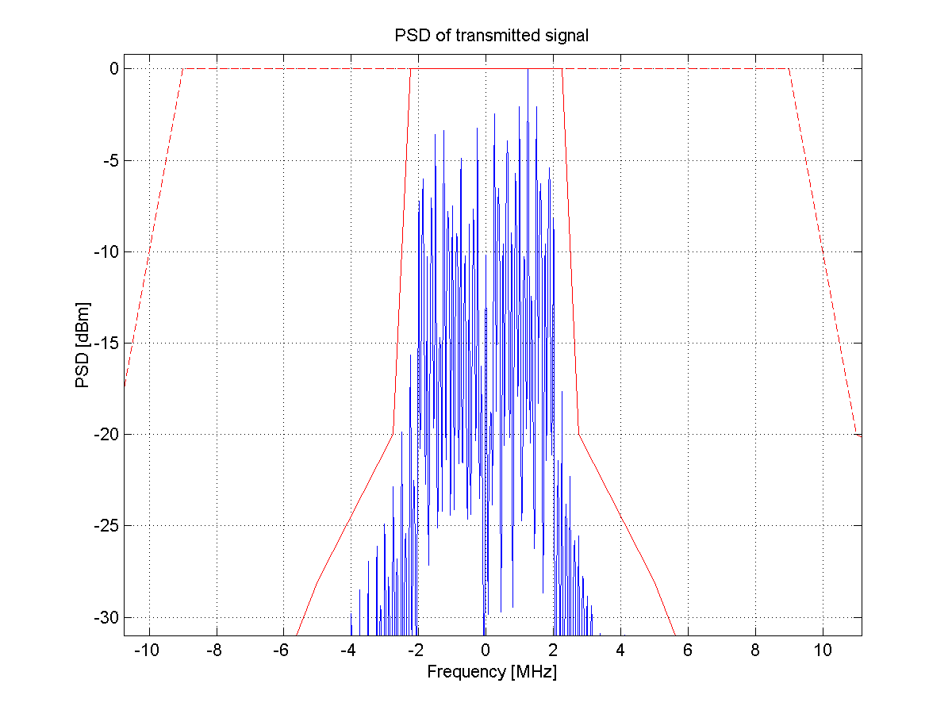
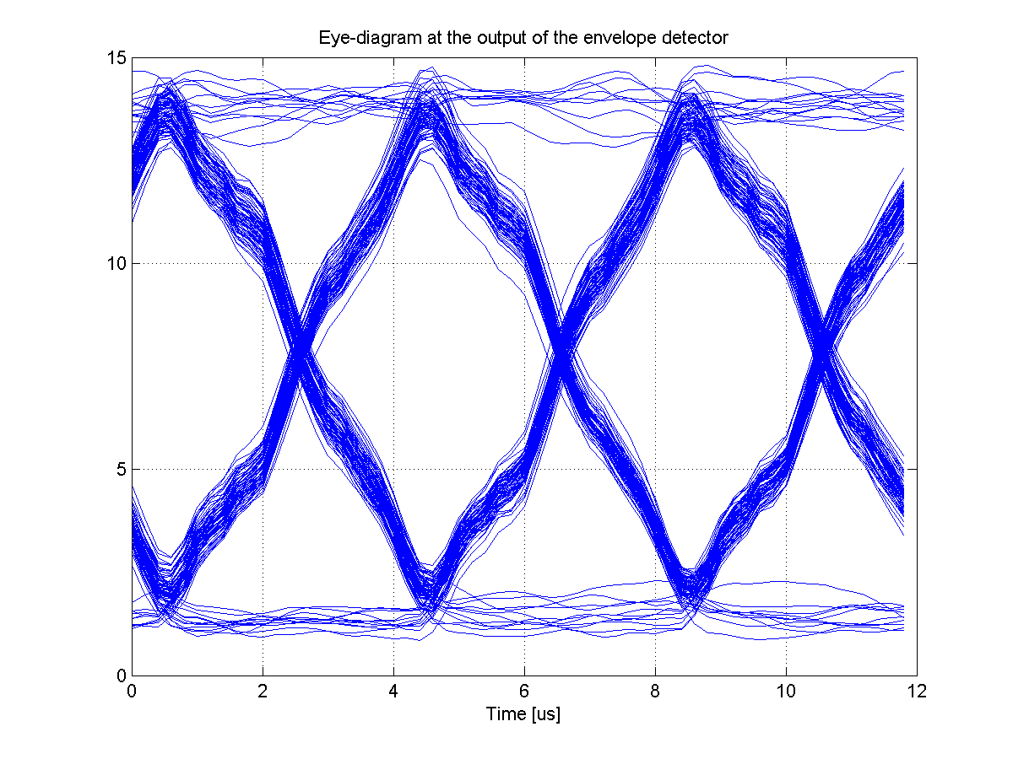
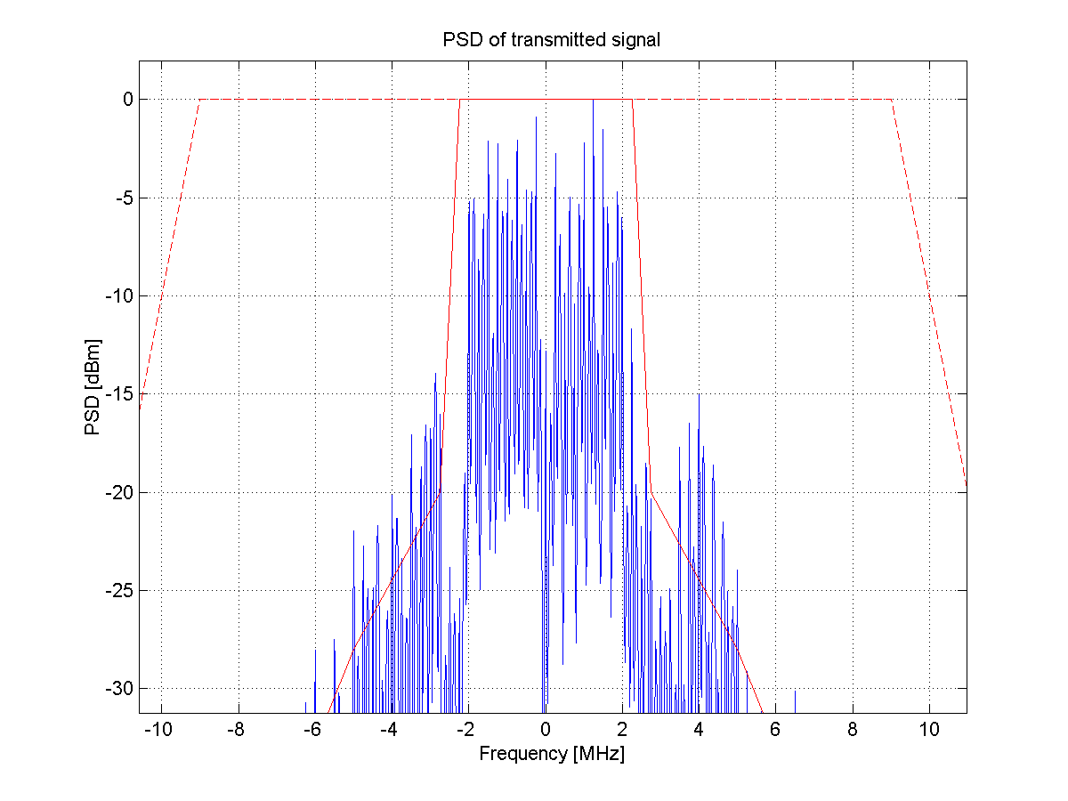
Simulation Results – Impact of PA OBO
OBO = 10dB
OBO = 0dB
Opposite to e.g. QAM, the PA saturation is good!
The reason is that the transmitted signal becomes closer to “ideal OOK”. At the cost of spectrum re-growth

Slide 12
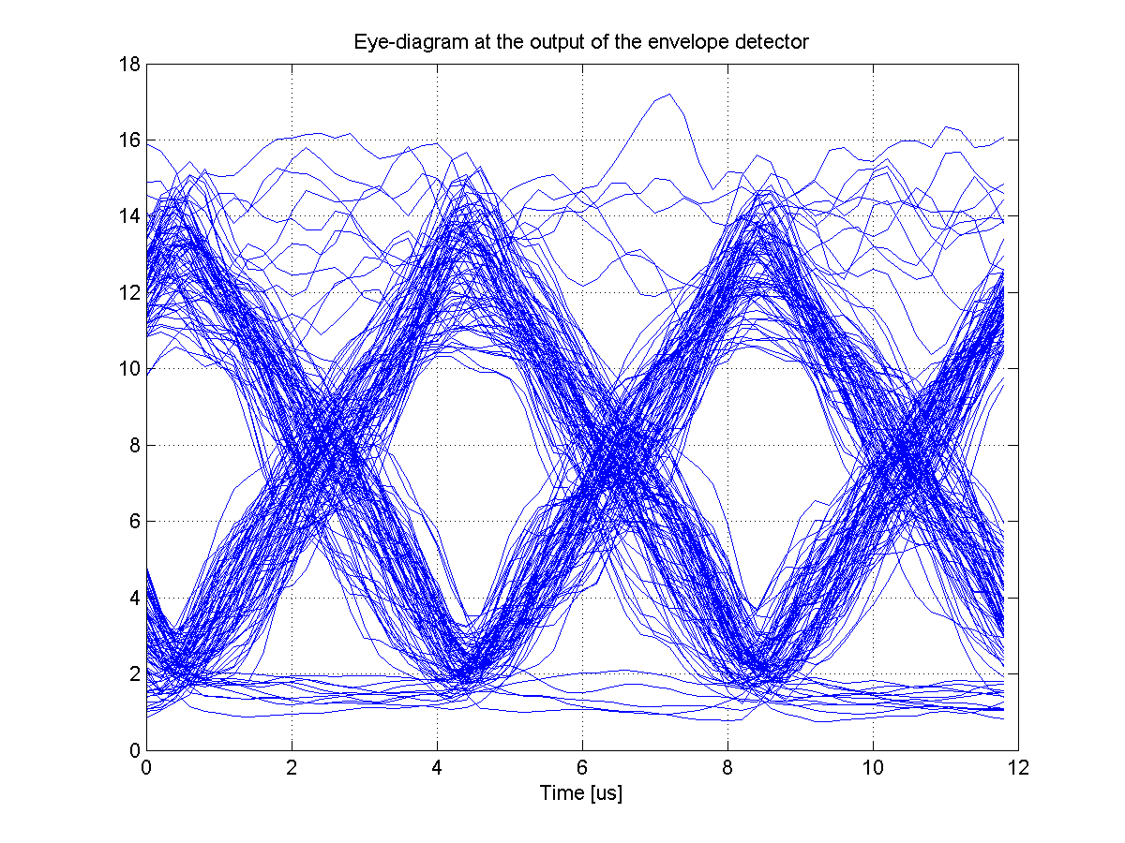
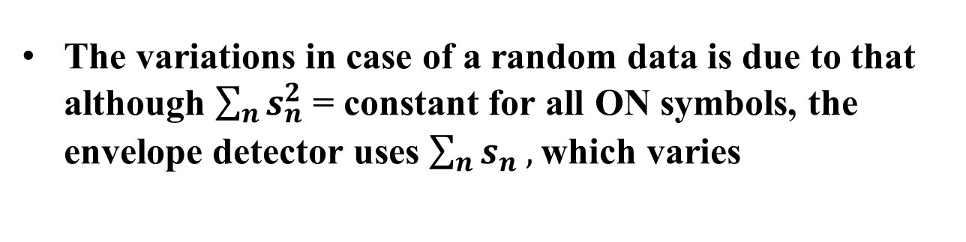
Simulation Results – Random data vs. fixed seq.
Fixed sequence
Random QPSK data
The variations in case of a random data is due to that although $\sum_{n}{s_{n}^{2}}$ = constant for all ON symbols, the envelope detector uses $\sum_{n}{s_{n}^{},}$which varies

Slide 13
Receiver: Sensitivity
According to the PAR “The WUR is a companion radio to the primary connectivity radio and meets the same range requirement as the primary connectivity radio“
Because of different regulatory rules in different regions of the world, the maximum allowed TX power may be different than that of the PCR [2]
To achieve the same range when the TX power is less for the WUR, a better sensitivity is required [2],[3]

Slide 14
Receiver: Sensitivity
The improved sensitivity has up until now been taken into account by, relative to the PCR, having a required SNR that is [3]
  12 dB lower in 2.4 GHz frequency band
  15 dB lower in 5 GHz frequency band
The PHY group feels that we should not require the same range, but should instead require the same sensitivity
  This would effectively test the demodulator and that the NF is not too high, but will not take a potential lower TX power into account

Slide 15
Receiver: Sensitivity
The good thing with specifying sensitivity is that
  It makes the specification “simpler”
  It is a relaxation, and therefore allows for that the WUR can be made more power efficient
The bad thing, at least according to me, is that it does not fulfil the spirit of the PAR

Slide 16
Receiver: Adjacent channel rejection
Also for ACR, different TX power may have an impact since the experienced SIR will differ as much as the TX powers
PCR: -70dBm
WUR:-77dBm
I: -55 dBm
PCR: 23dBm
WUR: 16dBm
PCR: SIR= -15dB
WUR:SIR=-22dB

Slide 17
Receiver: Adjacent channel rejection
Consider MCS0. PCR power is then set at -79dBm and interference level should be at least -63dBm with a working PCR (ACR should be at least 16dB)
If the received power is the same for the WUR, ACR = 16 dB would make sense also for WUR
If the required sensitivity is scaled with TX power, e.g. -89 dBm, ACR = 23dB makes sense for withstanding the same interference power
If the required sensitivity is -82, is seems we are back at -16dBm.
Effectively ACR is relaxed as much as sensitivity

Slide 18
Maximum input level
The 802.11 specification requires -30dBm
OOK would typically be less sensitive to compression in the front-end
Unless there is a use case that require more stringent requirements, the suggestion is to also have -30 dBm for the WUR

Slide 19
Straw Poll 1
Do you believe the transmitter spectrum mask should be the same as today used for 20 MHz 802.11ac (The alternative is one that is more matched to the 4 MHz wake-up signal)?
Y/N/A:

Slide 20
Straw Poll 2
Do you support the idea of specifying the transmitter accuracy by means of an eye-diagram? Exactly how is TBD, but a possibility would be to specify zero-crossings and max eye-opening as discussed in this presentation
Y/N/A:

Slide 21
Straw Poll 3
Do you believe only one sensitivity requirement should be specified, even if this means different relative sensitivities for the PCR and the WUR in different parts of the world?
Y/N/A

Slide 22
Straw Poll 4
If only one sensitivity requirement is specified, what is the number you prefer?
-82dBm/-86dBm/-89dBm/Something else/No opinion

Slide 23
Straw Poll 5
Assume that ACR is specified independent of what maximum TX power can be used. What do you believe the ACR for MCS0 should be?
16dB/20dBm/23dBm/Something else/No opinion

Slide 24
Straw Poll 6
Do you support that the maximum input level is the same as for the PCR, i.e., -30dBm?
Y/N/A

Slide 25
References
[1] S. Azizi et al. “A PAR Proposal for Wake-up Radio”, 11-16/1045r9
[2] S. Shellhammer and B. Tian, “Regulations and noise figure - Impact on SNR”, 11-17/0365r0
[3] S. Shellhammer and B. Tian, “WUR data rates”, 11-17/0990r2

