Slide 1
60GHz Propagation Analysis For Micro Hotspot Services in Stadium
Date: 2018-01-17
Authors:

Slide 2
Abstract
This contribution proposes a channel model for Micro Hotspot Access scenario in the stadium considering the reflected paths from surrounding spectators

Slide 3
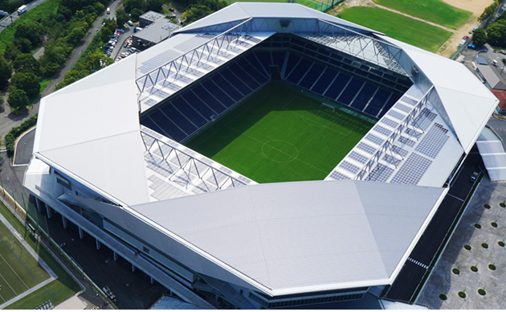
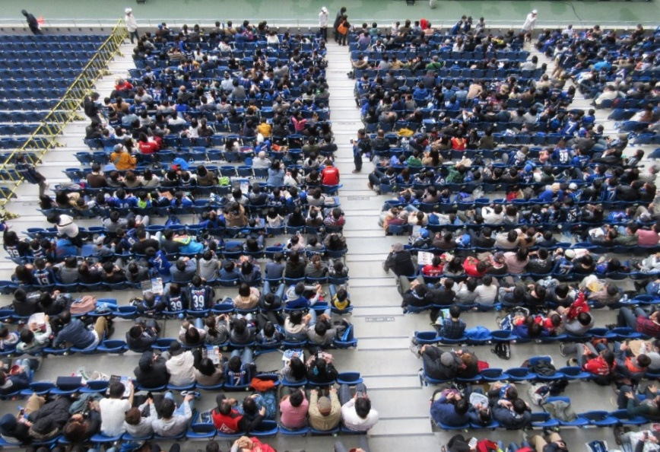
Introduction
Improvement of communication performance under dense user environment such as stadium
This contribution
  Provide information propagation characteristics for Hotspot access in stadium
  Multipath analysis caused by surrounding spectators

Slide 4
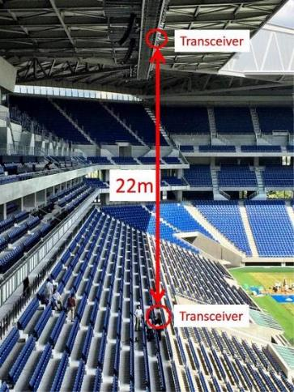
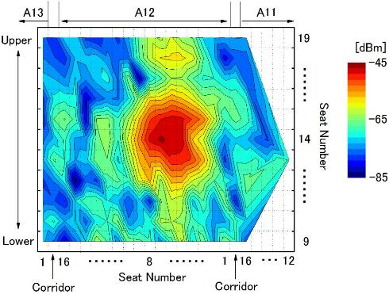
MMW hotspot scenario in stadium
High gain antennas create a very small hotspot in MMW

Slide 5
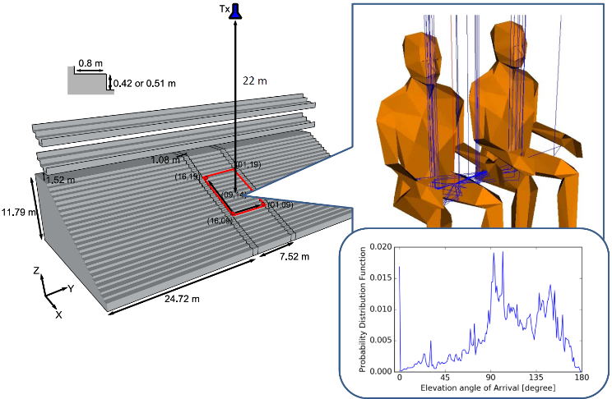
Multipath probability caused by spectators
If a spot includes plural seats within the service area, multipath reflection may be caused by the spectators.
->To identify the strength of reflection also measured and analyzed.
Y. Ohashi, et al, “Basic Analysis of Multipath Characteristics for Millimeterwave Wireless Communication in Dence User Environment”, IEICE Tech. Report, Electronics Simulations Technology(EST), Vol.115, No.434, EST2015-114, pp.147-152 (In Japanese)

Slide 6
Propagation Measurement

Slide 7
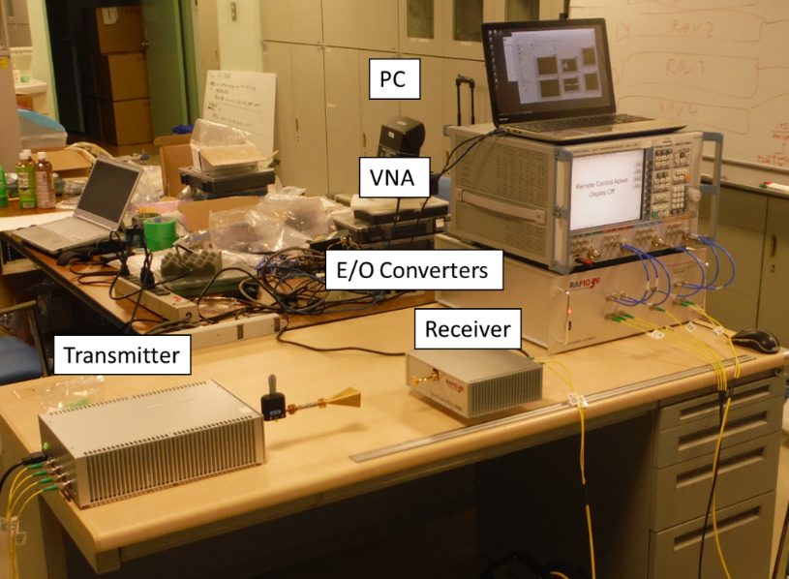
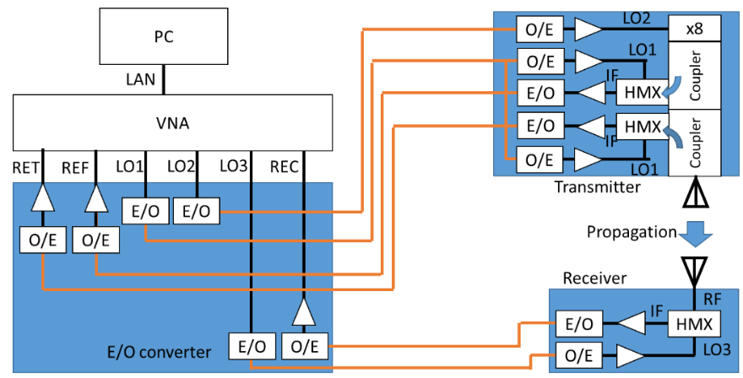
MMW Propagation Measurement System
Frequency: 57.01-65.99GHz
Power: 10 dBm
Tx/Rx antennas are extended by RoF
Dynamic Range: >100dB@100Hz IF BW
Range Resolution: 3.3 cm
One path two port Measurement: S11 & S21

Slide 8
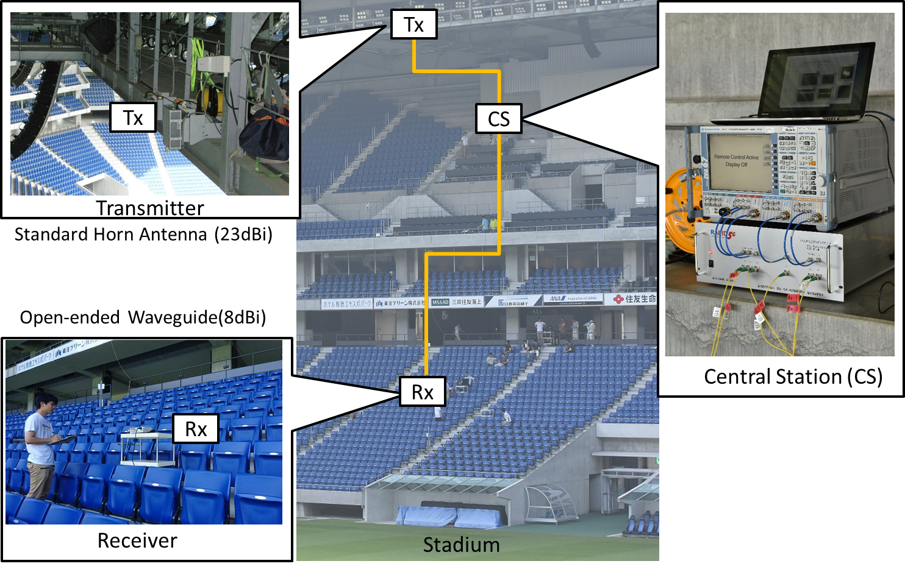
System Installation in Suita Stadium

Slide 9
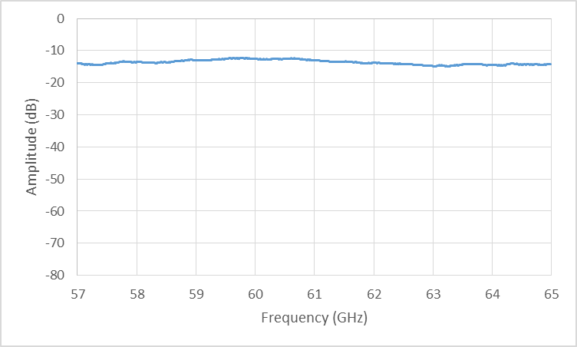
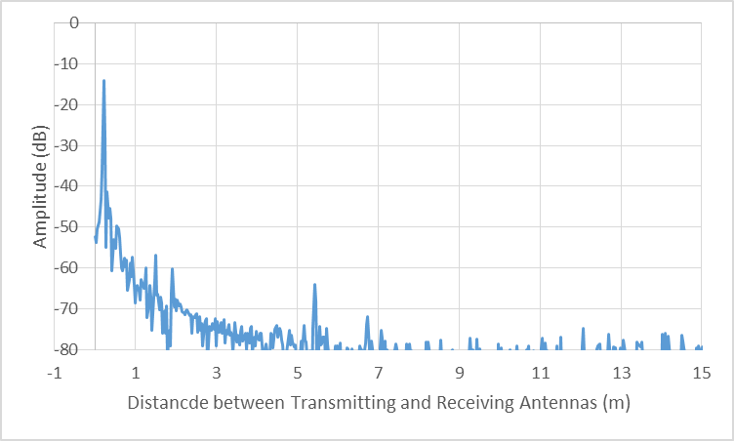
Distance Calculation for propagation
S21 measurements provide frequency response between Tx and Rx antennas.
S21 responses are transformed from frequency to time domain response.
The distance of propagation path is calculated by multiplying the speed of light to time response.
IFFT x c

Slide 10
Distribution of propagation distance and received power
Distance to the Seats
Received Power

Slide 11
Path Loss Analysis

Slide 12
Path loss calculation
All of the data shows the strong received power of direct path.
Peak values of received power are compensated by the directivity of antenna and attenuation for calibration
Measured results are plotted according to the position of the seats
Theoretical propagation losses are also calculated to compare to the measured results.

Slide 13
Measured antenna directivity and gain
Tx Antenna Gain
Rx Antenna Gain

Slide 14
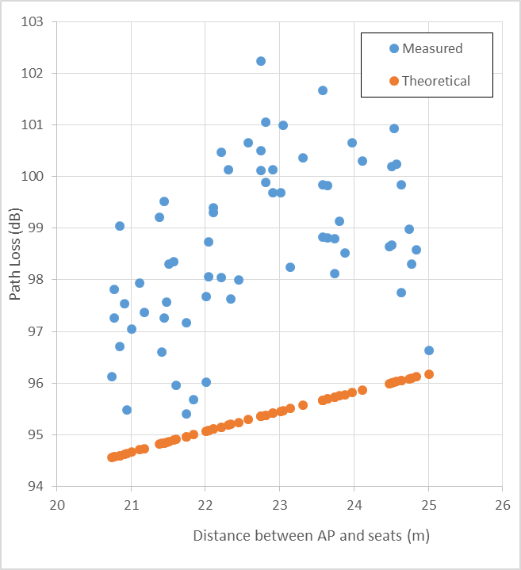
Path loss calculation results
Path loss at the seats
Measured results show slightly higher path loss than theoretical values.
-> We can assume the free space propagation

Slide 15
Multipath Analysis

Slide 16
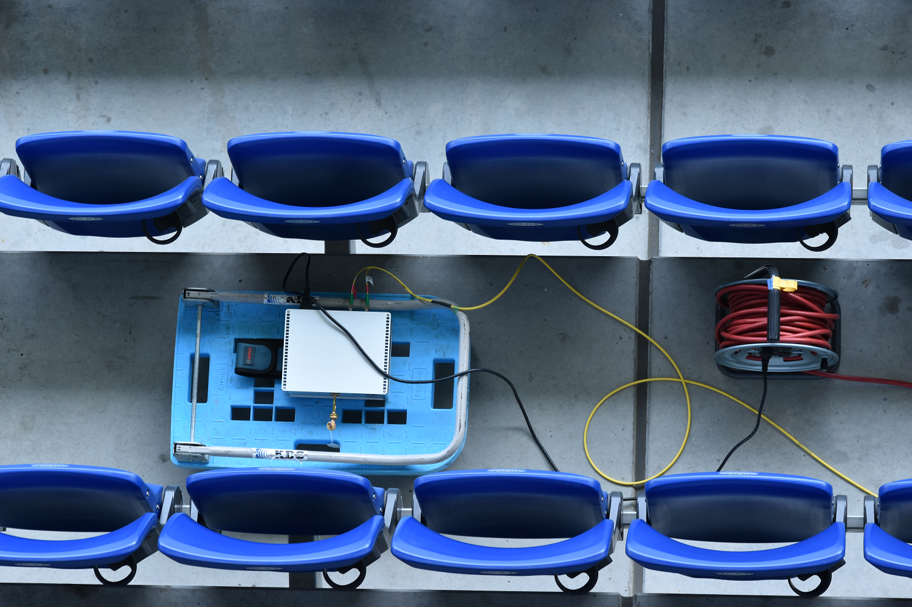
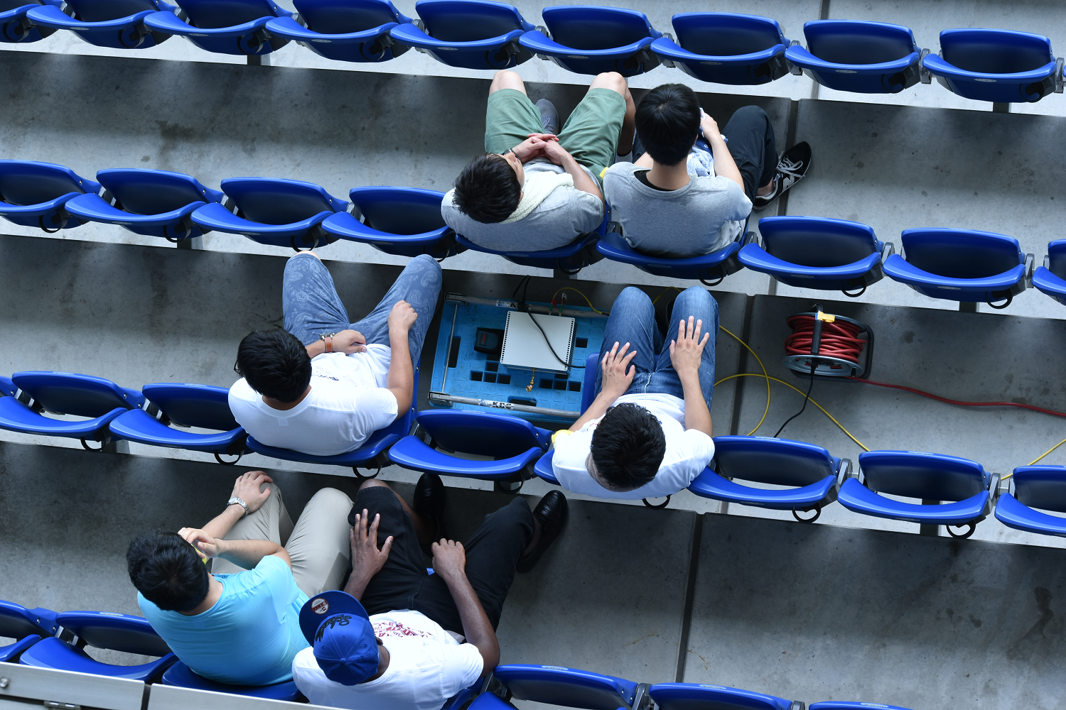
Influence of spectators
Measurement without Spectators
Measurement with Spectators
(Standing or Sitting)

Slide 17
Multipath measured by received power beneath transmitter (Seat #A12-18-7)
Reflection from Receiver Box
Direct Path
Reflection from the Cart

Slide 18
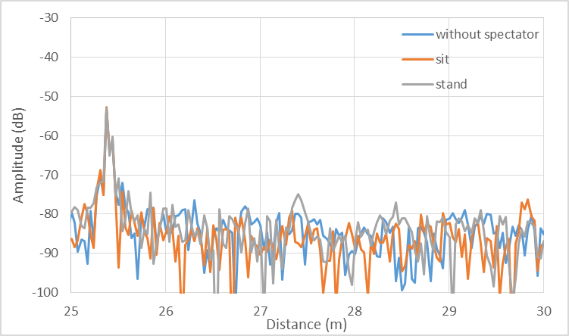
Multipath measured by received power at the edge of the block (Seat #A12-18-1)
Reflection from Receiver Box
Direct Path
Reflection from Spectators

Slide 19
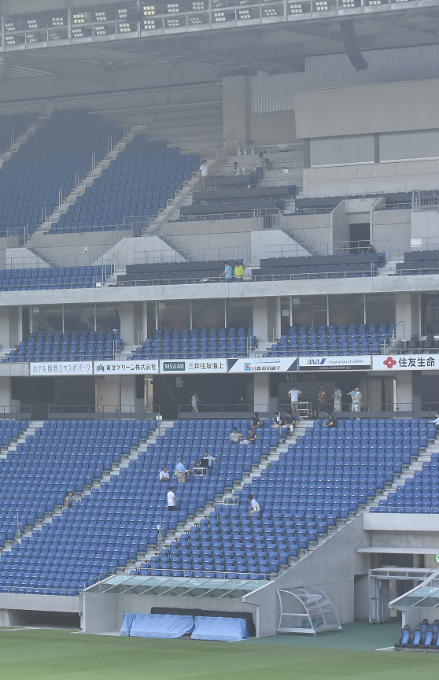
Summary
MMW propagation characteristics in the stadium were investigated.
MMW propagation measurement system with RoF was developed.
Field test results predict:
  The propagation condition in the stadium between ceiling and seats is complete LOS.
  Surrounding spectators won’t affect the propagation between the ceiling and seats.
The micro hotspot in the stadium is established without any influence of the surrounding spectators

Slide 20
Strawpoll 1
Do you think that a micro hotspot service would be prospective market of TGay?
Yes 32
No 0
Abstain 4

Slide 21
Strawpoll 2
Do you support to incorporate an article of this stadium propagation measurement to TGay channel model document?
Yes 21
No 0
Abstain 15

Slide 22
References
[1] Y. Ohashi, et al, “Basic Analysis of Multipath Characteristics for Millimeterwave Wireless Communication in Dence User Environment”, IEICE Tech. Report, Electronics Simulations Technology(EST), Vol.115, No.434, EST2015-114, pp.147-152 (In Japanese)
[2] Naruto Yonemoto, et al., “MMW Remote Antenna System of Vector Network Analyzer for Propagation Measurement in Stadium”, Proceedings on 2017 IEEE Conference on Antenna Measurements & Applications, TB3.3

