Slide 1
Sync Field Bit Duration
Date: 2018-01-12
Authors:

Slide 2
Abstract
At the November Session the Task Group decided on the general structure of the Sync Field
Two decisions are still open on the Sync Field design
  Duration of the Sync Field Bit: either 2 or 4 µs
  Specific bit sequence
Here we focus on the choice of the Sync Field Bit Duration
In a subsequent presentation we focus on the Specific Bit Sequence

Slide 3
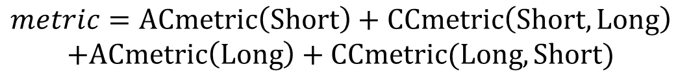
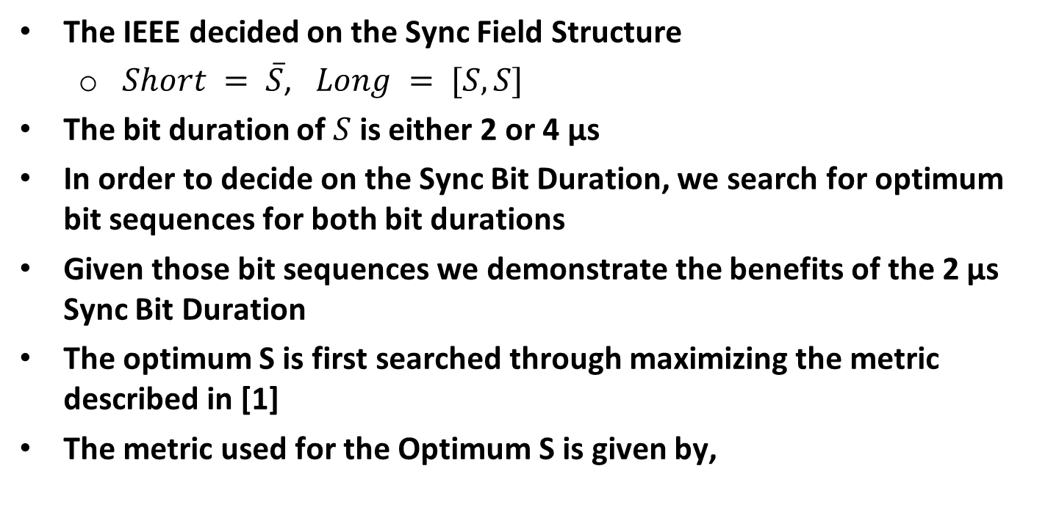
Introduction
The IEEE decided on the Sync Field Structure
  $Short = \overline{S}$, $Long = [S,S]$
The bit duration of $S$ is either 2 or 4 µs
In order to decide on the Sync Bit Duration, we search for optimum bit sequences for both bit durations
Given those bit sequences we demonstrate the benefits of the 2 µs Sync Bit Duration
The optimum S is first searched through maximizing the metric described in [1]
The metric used for the Optimum S is given by,
$$metric=ACmetric\left(Short\right)+CCmetric\left(Short, Long\right)$$
$$+ACmetric\left(Long\right)+CCmetric(Long,Short)$$

Slide 4
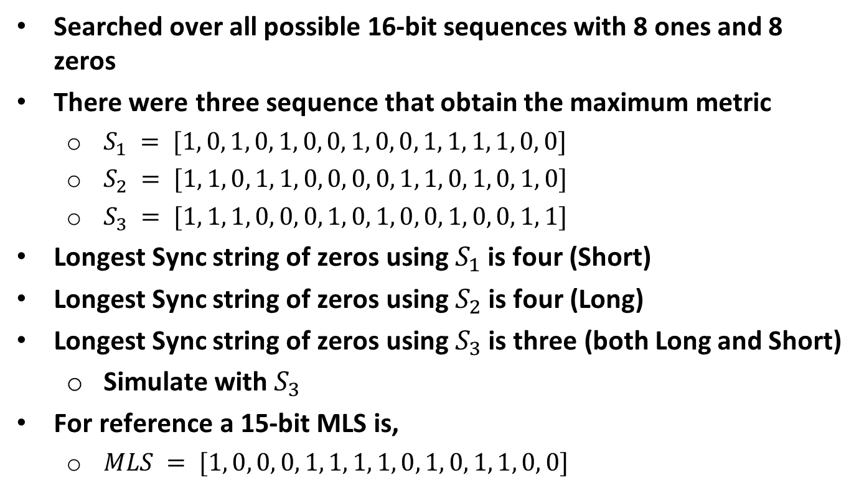
4 µs Sync Bit Duration
Searched over all possible 16-bit sequences with 8 ones and 8 zeros
There were three sequence that obtain the maximum metric
  $S_{1} = [1, 0, 1, 0, 1, 0, 0, 1, 0, 0, 1, 1, 1, 1, 0, 0]$
  $S_{2} = [1, 1, 0, 1, 1, 0, 0, 0, 0, 1, 1, 0, 1, 0, 1, 0]$
  $S_{3} = [1, 1, 1, 0, 0, 0, 1, 0, 1, 0, 0, 1, 0, 0, 1, 1]$
Longest Sync string of zeros using $S_{1}$ is four (Short)
Longest Sync string of zeros using $S_{2}$ is four (Long)
Longest Sync string of zeros using $S_{3}$ is three (both Long and Short)
  Simulate with $S_{3}$
For reference a 15-bit MLS is,
  $MLS = [1, 0, 0, 0, 1, 1, 1, 1, 0, 1, 0, 1, 1, 0, 0]$

Slide 5
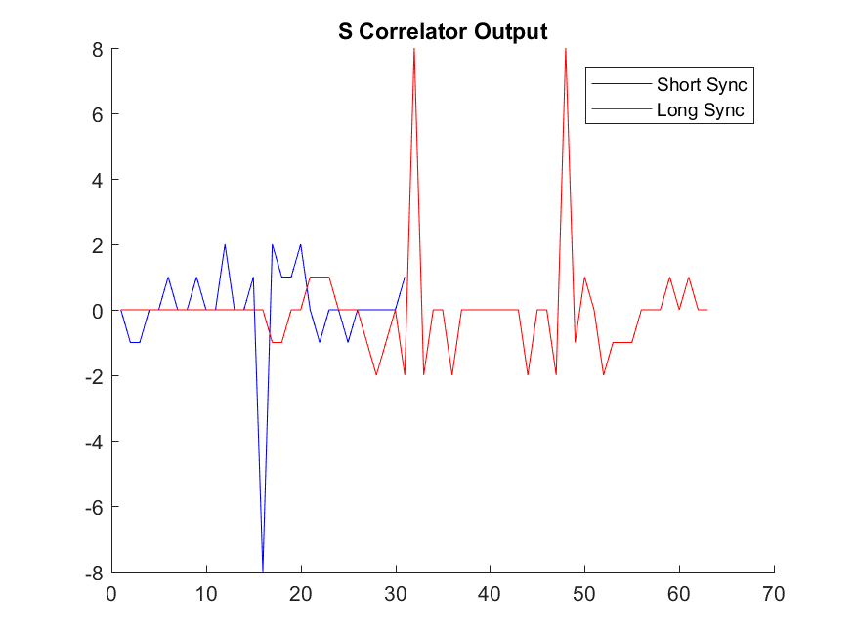

$S$ Correlator Output: $S = S_{1}$

Slide 6
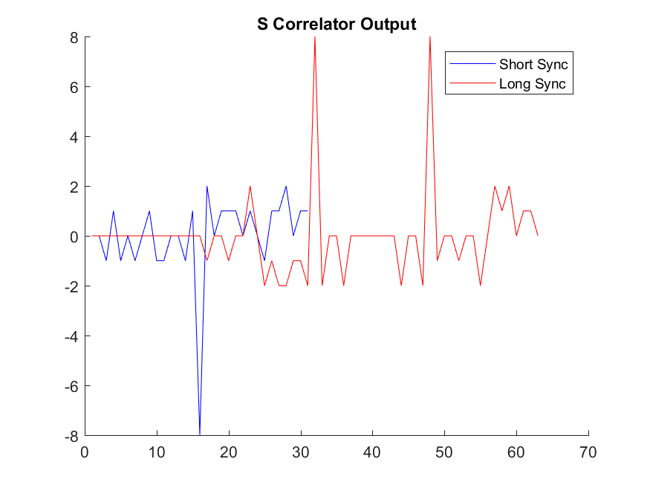

$S$ Correlator Output: $S= S_{2}$

Slide 7
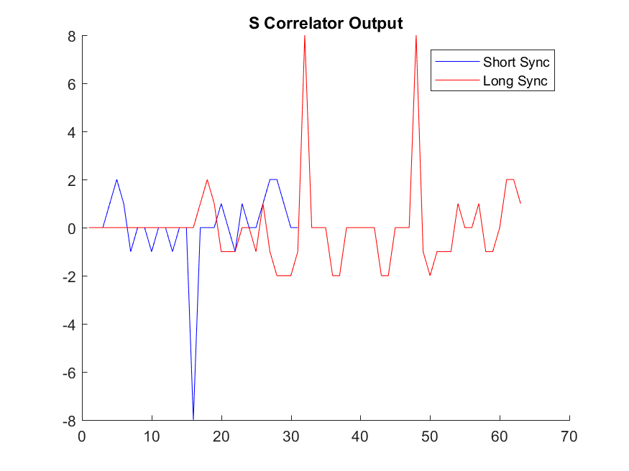

$S$ Correlator Output: $S =S_{3}$

Slide 8
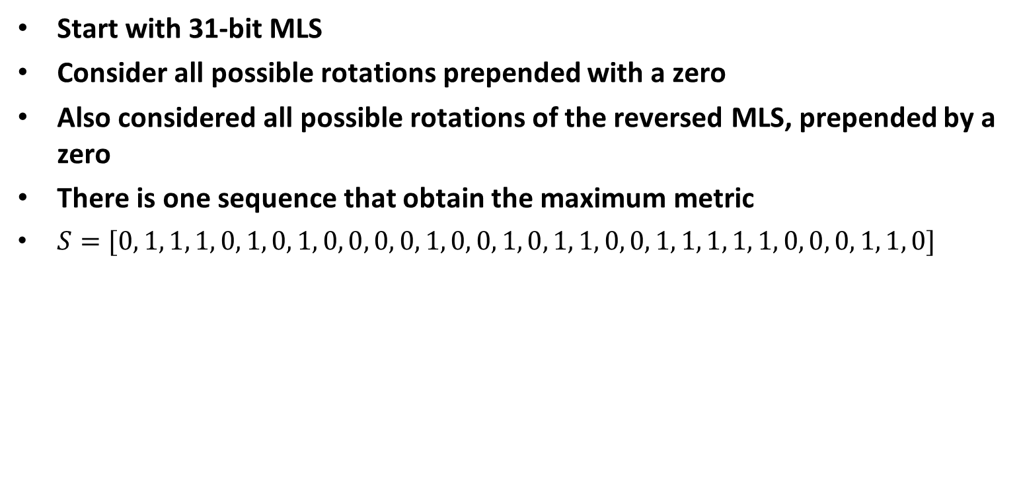
2 µs Sync Bit Duration
Start with 31-bit MLS
Consider all possible rotations prepended with a zero
Also considered all possible rotations of the reversed MLS, prepended by a zero
There is one sequence that obtain the maximum metric
$S=[0, 1, 1, 1, 0, 1, 0, 1, 0, 0, 0, 0, 1, 0, 0, 1, 0, 1, 1, 0, 0, 1, 1, 1, 1, 1, 0, 0, 0, 1, 1, 0]$

Slide 9
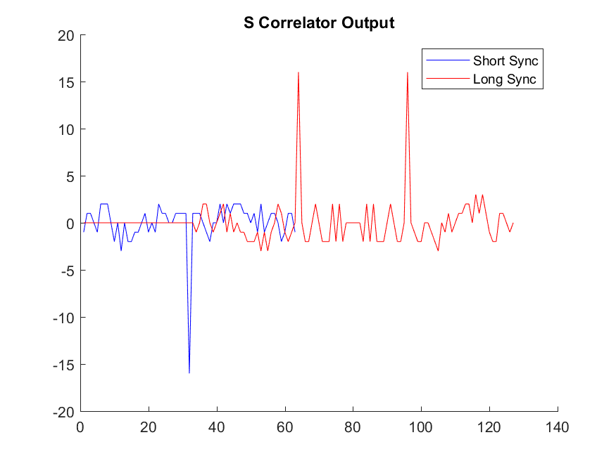

$S$ Correlator Output

Slide 10
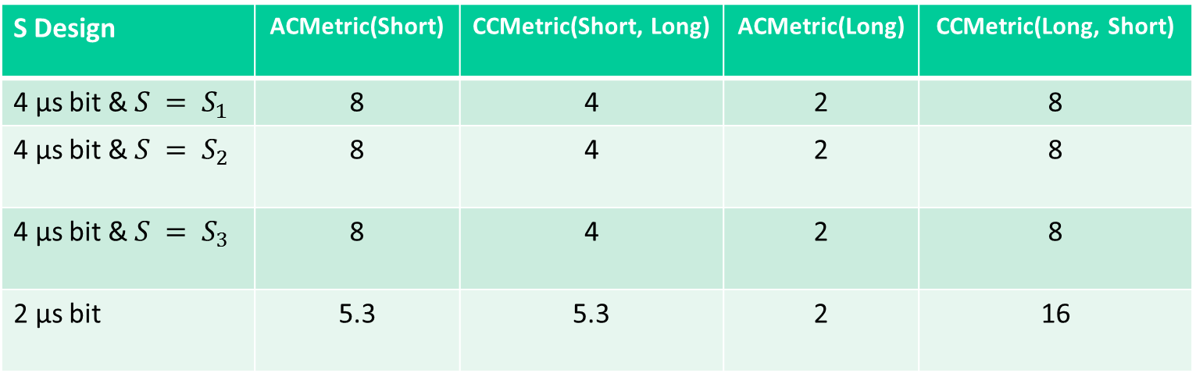
Summary – Correlation Metrics
S Design | ACMetric(Short) | CCMetric(Short, Long) | ACMetric(Long) | CCMetric(Long, Short)
4 µs bit & $S = S_{1}$ | 8 | 4 | 2 | 8
4 µs bit & $S = S_{2}$ | 8 | 4 | 2 | 8
4 µs bit & $S = S_{3}$ | 8 | 4 | 2 | 8
2 µs bit | 5.3 | 5.3 | 2 | 16
Larger correlation metrics are better

Slide 11
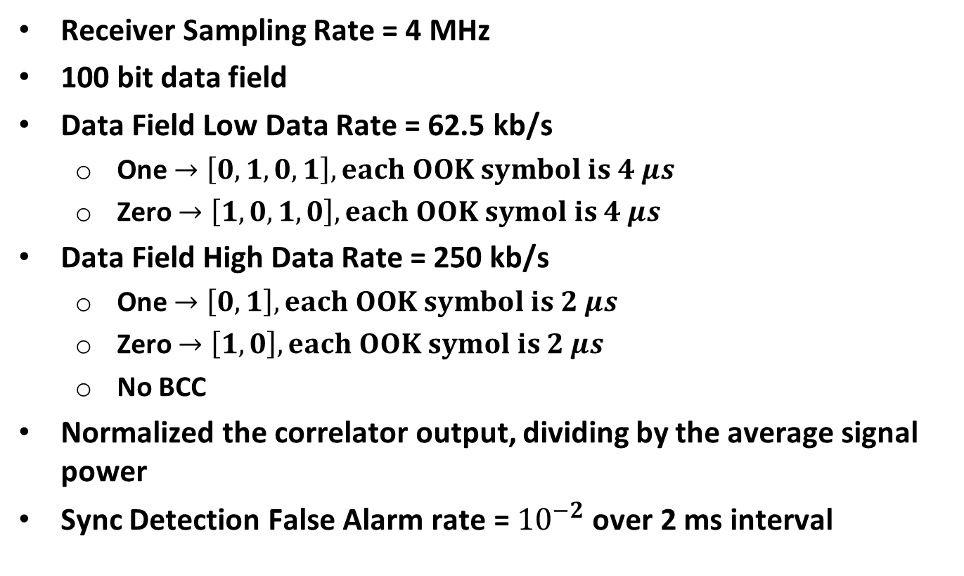
Simulations
Receiver Sampling Rate = 4 MHz
100 bit data field
Data Field Low Data Rate = 62.5 kb/s
  One $→\left[0,1,0,1\right], each OOK symbol is 4 μs$
  Zero $→\left[1, 0, 1, 0\right], each OOK symol is 4 μs$
Data Field High Data Rate = 250 kb/s
  One $→\left[0,1\right], each OOK symbol is 2 μs$
  Zero $→\left[1, 0\right], each OOK symol is 2 μs$
  No BCC
Normalized the correlator output, dividing by the average signal power
Sync Detection False Alarm rate = ${10}^{−2}$ over 2 ms interval

Slide 12
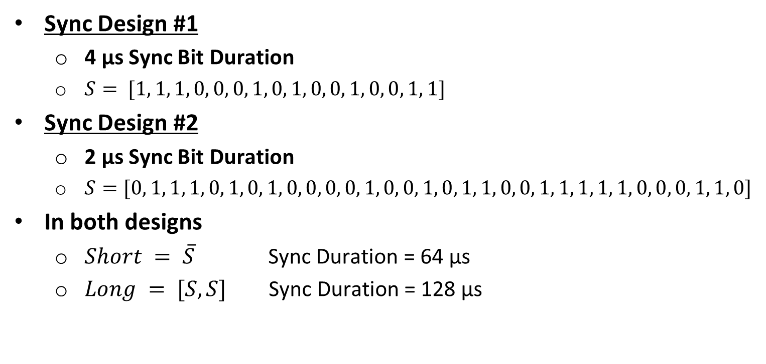
Simulations (cont.)
Sync Design #1
  4 µs Sync Bit Duration
  $S= [1, 1, 1, 0, 0, 0, 1, 0, 1, 0, 0, 1, 0, 0, 1, 1]$
Sync Design #2
  2 µs Sync Bit Duration
  $S=[0, 1, 1, 1, 0, 1, 0, 1, 0, 0, 0, 0, 1, 0, 0, 1, 0, 1, 1, 0, 0, 1, 1, 1, 1, 1, 0, 0, 0, 1, 1, 0]$
In both designs
  $Short = \overline{S}$ Sync Duration = 64 µs
  $Long = [S,S]$ Sync Duration = 128 µs

Slide 13
PER Sim – Low Rate, AWGN

Slide 14
PER Sim – High Rate, AWGN

Slide 15
PER Sim – Low Rate, Model D

Slide 16
PER Sim – High Rate, Model D

Slide 17
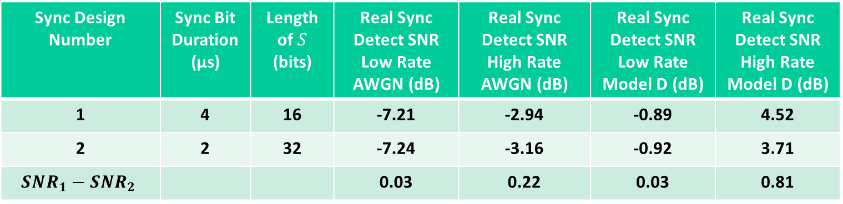
Simulation Summary
Sync Design Number | Sync Bit Duration (µs) | Length of $S$ (bits) | Real Sync Detect SNR Low Rate AWGN (dB) | Real Sync Detect SNR High Rate AWGN (dB) | Real Sync Detect SNR Low Rate Model D (dB) | Real Sync Detect SNR High Rate Model D (dB)
1 | 4 | 16 | -7.21 | -2.94 | -0.89 | 4.52
2 | 2 | 32 | -7.24 | -3.16 | -0.92 | 3.71
$$SNR_{1}−SNR_{2}$$ |  |  | 0.03 | 0.22 | 0.03 | 0.81
At the Low Data Rate the two designs are almost identical
At the High Data Rate, Sync Design #2 is measurably better
  Sync Design #2 may have better timing recover which matters more for the High Data Rate

Slide 18
Timing Recovery Analysis
Captured Timing Error during simulations for both designs
Plotted the CDF of the timing error to investigate the hypothesis that Design #2 has lower timing error

Slide 19
Timing Error CDF
Design #2, using the 2 µs bit duration, does indeed have lower timing error

Slide 20
Conclusions
The use of a 2 µs Sync Bit Duration provides better symbol timing recover than a 4 µs Sync Bit Duration, resulting in better PER performance
In the High Data Rate the 2 µs Sync Bit Duration provides 0.8 dB better performance than the 4 µs Sync Bit Duration
The performance for 2 and 4 µs Sync Bit Duration are similar in the Low Data Rate, since the Low Data Rate is less sensitive to timing errors

Slide 21
Straw Poll #1
Do you support using a 2 µs bit duration for the Sync Field?
Yes
No
Abstain

Slide 22
References
Steve Shellhammer, Bin Tian, and Lochan Verma, “Dual Sync Designs,” IEEE 802.11-17/1617r1, November 2017

