Slide 1
WUR Preamble Sequence Performance Evaluation
Date: 2018-01-12
Authors:
Name | Affiliation | Address | Phone | Email
Justin Jia Jia | Huawei |  |  | justin.jia@huawei.com
Ming Gan | Huawei

Slide 2
Introduction
Current SFD[1] defines the WUR preamble structure where
For high data rate: $\left[\overline{S}\right]$, where $\left[\overline{S}\right]$ is the complementary sequence of the basic preamble sequence S
For low data rate: $\left[S S\right]$
To simplify the WUR detector implementation,
A short local reference sequence for WUR signal detection (Correlation) is selected
only one correlator is required at the WURx side
$$Ref=2×S−1$$

Slide 3
Metrics
The correlations performed at WUR for high and low data preambles are:
$$Correltion\left\langle HighR\right\rangle =xcorr(\left[\overline{S}\right], Ref)$$
$$Correltion\left\langle LowR\right\rangle =xcorr(\left[S,S\right], Ref)$$
The metrics for the optimum S are defined as follows
Maximize the sum of negative high rate ACMetric and positive low rate ACMetric(sum of absolute values)
Maximize the absolute ACMetric for both high rate and low rate
Give the priority to the ACMetric of low rate under the same sum of absolute ACMetrics
where indicates the absolute value
$$ACMetric\left\langle HighR\right\rangle =\frac{Min(Correltion\left\langle HighR\right\rangle ) }{2ndLargest|Correltion\left\langle HighR\right\rangle |}$$
$$ACMetric\left\langle LowR\right\rangle =\frac{Max(Correltion\left\langle LowR\right\rangle )⁡}{2ndLargest|Correltion\left\langle LowR\right\rangle |}$$

Slide 4
Metrics Analysis
Multiple Auto/Cross-Correlation Metrics may be not necessary
It is impossible to have two sets of local reference sequence Refs at the correlator of the receiver
Data rates can be identified by the sign of output of correlator at the receiver side
It could be further enhanced by the number of peaks
Auto Correlation Metric can ensure the timing performance
The output sign of correlator in the numberator can be used to distinguish the two data rates
The absolute value of second largest peak in denominator is used for our metrics to avoid the timing error and false rate detection
A huge second largest peak with the same sign as the largest peak may cause timing error
A huge second largest peak with the opposite sign as the largest peak may cause false rate detection
In this contribution, we pick up three candidates of 32-bit-based basic sequence S1[3], S2[4], and S3 and evaluate their performance
S1 = [1 0 1 0 0 0 1 1 0 1 1 0 1 1 1 1 0 0 0 0 1 0 0 1 1 1 0 0 0 1 0 1];
S2 = [0 1 1 1 0 1 0 1 0 0 1 0 1 0 0 1 0 1 1 0 0 1 1 0 1 1 0 0 0 1 1 0];
S3 = [1 0 1 0 0 1 0 0 1 0 1 1 1 0 1 1 0 0 0 1 0 1 1 1 0 0 1 1 1 0 0 0];
Equal number of Ones and Zeros
Recommended
Sequence

Slide 5
Correlation Property of S1
Correlations at the receiver for S1:
Better performance for the high rate
ACMetric <HighR> | -8
ACMetric <LowR> | 4

Slide 6
Correlation Property of S2
Correlations at the receiver for S2:
ACMetric <HighR> | -3.2
ACMetric <LowR> | 4

Slide 7
Correlation Property of S3
Correlations at the receiver for S3:
ACMetric <HighR> | -5.3
ACMetric <LowR> | 8
Better performance for the low rate

Slide 8
Metrics for preamble sequence
Summary on Metrics comparison
S3 has the best performance for data rate, however, S1 performs best on high data rate
 | S1 | S2 | S3
ACMetric <HighR> | -8 | -3.2 | -5.3
ACMetric <LowR> | 4 | 4 | 8

Slide 9
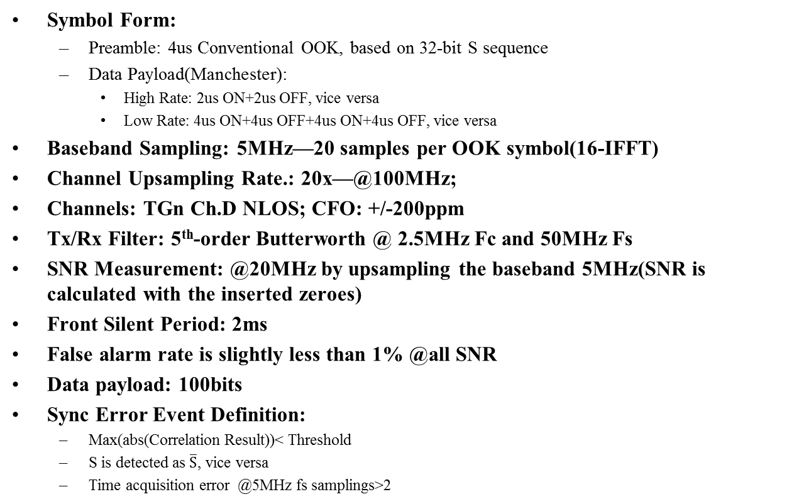
Simulation Settings[2]
Symbol Form:
Preamble: 4us Conventional OOK, based on 32-bit S sequence
Data Payload(Manchester):
High Rate: 2us ON+2us OFF, vice versa
Low Rate: 4us ON+4us OFF+4us ON+4us OFF, vice versa
Baseband Sampling: 5MHz—20 samples per OOK symbol(16-IFFT)
Channel Upsampling Rate.: 20x—@100MHz;
Channels: TGn Ch.D NLOS; CFO: +/-200ppm
Tx/Rx Filter: 5th-order Butterworth @ 2.5MHz Fc and 50MHz Fs
SNR Measurement: @20MHz by upsampling the baseband 5MHz(SNR is calculated with the inserted zeroes)
Front Silent Period: 2ms
False alarm rate is slightly less than 1% @all SNR
Data payload: 100bits
Sync Error Event Definition:
Max(abs(Correlation Result))< Threshold
S is detected as $\overline{S}$, vice versa
Time acquisition error @5MHz fs samplings>2
Packet Error Event Definition:
Max(abs(Correlation Result))< Threshold
S is detected as $\overline{S}$ , vice versa
Bit error >0

Slide 10
High Rate Sync Performance

Slide 11
High Rate PER Performance

Slide 12
Low Rate Sync Performance

Slide 13
Low Rate PER Performance

Slide 14
Summary
Through the simulation results and metrics analysis, we obtain
Low rate case: S3 outperforms S1 and S2 by about 0.3dB gain @1% PER, where S1 and S2 have similar overall PER performance
High rate case: S1 and S3 outperforms S2 by 0.53dB gain and 0.23 dB gain @1% PER, respectively
It is recommended to choose S3 since the performance in low data rate environment is more concerned.
 | Low Rate |  | High Rate |  | Maximum off duration
 | 1% PER | 10% PER | 1% PER | 10% PER
 | SNR | SNR | SNR | SNR
S1 | 6.03dB | 0.62dB | 8.87dB | 4.09dB | 8 us
S2 | 6.00dB | 0.63dB | 9.40dB | 4.13dB | 6 us
S3 | 5.70dB | 0.61dB | 9.17dB | 4.19dB | 6 us

Slide 15
Reference
[1] IEEE 802.11-17/0575r6,“Specification Framework for TGba”, Nov. 2017
[2] IEEE 802.11-17/0188r9, “Simulation Scenario and Evaluation Methodology”, Jul. 2017
[3]17/1636 r0 A Simple WUR Preamble Design
[4] 18/0123r0 Options for 32-bit S in Sync Field

Slide 16
Straw Poll
Do you support S3 to use to construct the short preamble sequence $[\overline{S}]$ and the long preamble sequence $[S S]$?
S3 = [1 0 1 0 0 1 0 0 1 0 1 1 1 0 1 1 0 0 0 1 0 1 1 1 0 0 1 1 1 0 0 0];
where the bit duration is 2 us.
Results: 11/0/21

