Slide 1
Secure WUR frames
Date: 2018-01-08
Authors:

Slide 2
Introduction
The general WUR frame format was defined in [1-6]
  Discussed and approved several details on field contents and frame types
In this presentation we continue discussions regarding security
  Authenticate WUR frames via message integrity code (MIC) as an optional procedure
  Define a Frame Check Sequence (FCS) that carries either MIC (for protected frames) or CRC (for unprotected frames)
MAC Header | Frame Body | FCS
 | Frame Control | Address | TD Control
Bits | 8 | 12 | 12

Slide 3
Purpose and Proposal
Ensure that WUR STAs are not woken up by an attacker
  Minimize probability that a frame sent by attacker causes STA to wake up
    False wake up of WUR STA would lead to waste of energy and initiate unnecessary interactions with AP
Proposal is a simple security protocol that
  Reuses the existing 802.11 crypto algorithms
    The underlying technology already exists (and for us to use it)
  Avoids CCMP-like signaling (8/16 Byte MIC, 8 Byte CCMP header, etc.)
    Transmitting info. in WUR frames is expensive (and for us the aim is to reduce incurring overhead)
  Maintains optional use of the functionality (i.e., can be used for certain WUR frames)
    Not all WUR frames need to be protected (e.g., pre-association WUR frames)
    Not all applications and/or implementations will require and/or support security of WUR frames
Post-association WUR frames can be:
  Unsecure: The FCS contains the CRC with hidden BSSID information
  Secure: The FCS contains the MIC with hidden BSSID information
How to signal that the FCS contains CRC or MIC?
  Either the Frame Control field of WUR frames contains a bit (dynamic signaling but requires a bit),
  Or negotiation during WUR setup (less dynamic but does not require bit in WUR frame)

Slide 4
WUR security design principles
MAC Header | Frame Body | FCS
CRC/MIC
TBD
Minimize the overhead in WUR frames incurred due to security
  1) Not using CCMP header, 2) Minimization of the MIC field size
Use existing crypto algorithm(s)
  Simplifies design by using existing components and mechanisms
Not using CCMP header
  Key ID not present (default value or update it over MR)
    Key ID might be updated (which is a rare event) using MR
  PN field is not present (use the TSF timer to perform its functionality)
    WUR STA maintains synchronization by tracking the TSF timer
      Certain WUR frames (including secure WUR frames) will contain partial TSF timer
Minimizing the size of the MIC field (from 8/16 bytes to 2-3 bytes)
  Only include a portion of the MIC in the FCS field of the WUR frame

Slide 5
Secure WUR frames (Transmit)
MAC Header | Frame Body | FCS
 | Frame Control | Address | TD Control
Bits | 8 | 12 | 12
MIC
TBD
An AP transmits a secure WUR frame to one or more WUR STAs
  With which AP has already security association (i.e., shares a key(s) over the MR (e.g., IGTK)
  Provided that the WUR STA(s) support reception/verification of secure WUR frames
A secure WUR frame contains
  A MIC in the FCS that is computed over the entire WUR frame
    And is generated based on the pre-shared key and the TSF timer
    The CMAC output is truncated to TBD bits: (MIC = Truncate-TBD(CMAC Output))
  A partial TSF timer in the TD Control field (at least 8 bits)
    This is a portion of the monotonically increasing counter
      E.g., partial TSF may consist of the 1 MSB of the 2 LSBs of the Timestamp
        Counter increases every 256 us and wraps around every 65636 ms
  Additional BSSID information can be hidden in the MIC [6]

Slide 6
Secure WUR frames (Receive)
MAC Header | Frame Body | FCS
 | Frame Control | Address | TD Control
Bits | 8 | 12 | 12
MIC
TBD
A WUR STA that receives a secure WUR frame
  Determines whether it is an intended receiver from the Address field
  Obtains the partial TSF from the TD Control field
    Shall construct the local TSF timer using the partial TSF and the locally stored TSF timer
      The update of the local TSF timer is based on a TBD method
        Method needs to address the issue of either internal clock drifting or replay attacks
    Since there might be drifting the local TSF timer will have certain LSBs of it truncated
  Shall detect a replayed frame comparing the constructed TSF and the local TSF
    A replayed frame occurs when the constructed TSF obtained from the received WUR frame is less than or equal to the value of the local TSF timer at the STA
    Constructed TSF timer is given as a parameter to the computation of MIC
  Computes MIC over entire WUR frame using pre-shared key and local TSF
    If computed MIC does not coincide with MIC of the frame then discard packet

Slide 7
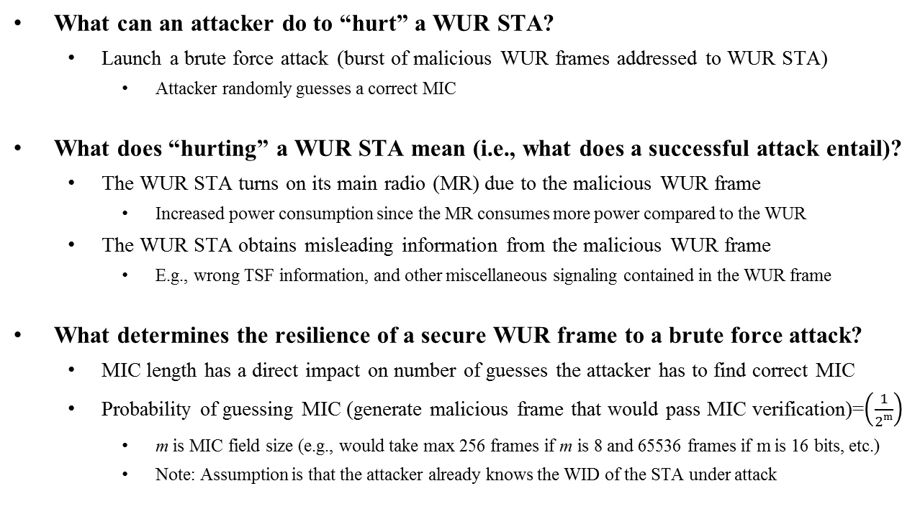
Security considerations
What can an attacker do to “hurt” a WUR STA?
  Launch a brute force attack (burst of malicious WUR frames addressed to WUR STA)
    Attacker randomly guesses a correct MIC
What does “hurting” a WUR STA mean (i.e., what does a successful attack entail)?
  The WUR STA turns on its main radio (MR) due to the malicious WUR frame
    Increased power consumption since the MR consumes more power compared to the WUR
  The WUR STA obtains misleading information from the malicious WUR frame
    E.g., wrong TSF information, and other miscellaneous signaling contained in the WUR frame
What determines the resilience of a secure WUR frame to a brute force attack?
  MIC length has a direct impact on number of guesses the attacker has to find correct MIC
  Probability of guessing MIC (generate malicious frame that would pass MIC verification)=$\left(\frac{1}{2m}\right)$
    m is MIC field size (e.g., would take max 256 frames if m is 8 and 65536 frames if m is 16 bits, etc.)
    Note: Assumption is that the attacker already knows the WID of the STA under attack

Slide 8
Summary
Larger MIC field size offers better protection of WUR frames
  However, this comes at the expense of increased overhead for WUR frames
    CL WUR frames are 4 Bytes and VL WUR frames are expected to not exceed 20 Bytes
  Design of FCS of WUR frames needs to account for these considerations as well
We propose optional protection of WUR frames
  The FCS field of these WUR frames carries a MIC field
  Reuse existing components from the MR’s crypto engine
    While minimizing over-the-air overhead

Slide 9
Straw Poll 1
Do you agree to authenticate WUR frames using message integrity check (MIC)?
  This procedure is optional

Slide 10
Straw Poll 2
Do you support to have a bit in the Frame Control field that indicates whether MIC or CRC is present in the FCS?

Slide 11
References
[1] 11-17/1004r4 Considerations on WUR frame format (A. Asterjadhi, et. al.)
[2] 11-17/1115r5 11ba wakeup frame format (L. Chu, et. al.)
[3] 11-17/977r4 Address structure in unicast wake-up frame (J. Kim, et. al.)
[4] 11-17/1008r0 Vendor Specific WUR Frame Follow up (P. Huang, et. al.)
[5] 11-17/1608r0 WUR Discovery Frame for Smart Scanning (G. Li, et. al.)
[6] 11-17/1645r3 WUR frame format follow up (A. Asterjadhi, et. al.)

