Slide 1
Submission of .11 to ITU-R WP 5D as an IMT-2020 5G RIT
Date: 2017-12-18
Authors:

Slide 2
Abstract
This contribution is initially intended for presentation to the IEEE 802.11 Advanced Access Network Interface (AANI) Standing Committee (SC) to facilitate discussion on what could be presented to the 802.11 WG in the January Interim meeting regarding IMT-2020 submission
The longer term intention of this document is to be presented to the IEEE 802.11 Working Group (WG) in the January meeting, discussing submission of the IEEE 802.11 technology (11ac/11ax in particular) to ITU-R/WP-5D as a candidate IMT-2020 Technology.

Slide 3
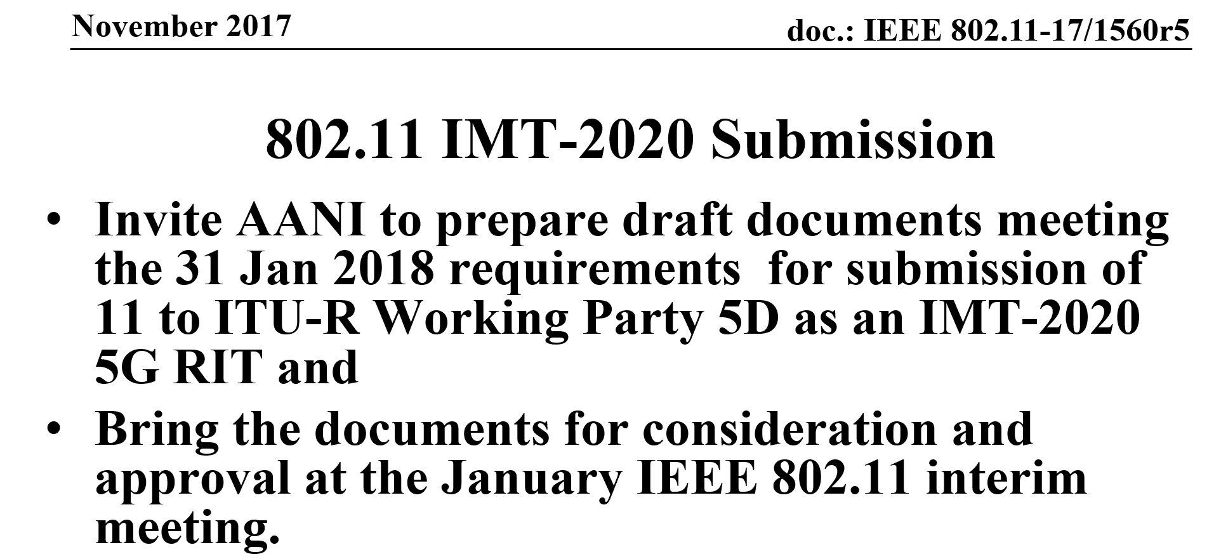
AANI-SC Work scope
Related to the ITU-R submission
The following Motion, that passed in the Nov 2017 meeting, prescribed the scope of the work that the AANI SC was invited to carry out

Slide 4
AANI SC Scope Discussion Summary
Based on email discussions and contributions to the AANI SC (contribution 11-17/1844r0 in particular), the group determined that:
  A submission of the magnitude originally suggested in the Nov Plenary (i.e. Filling the Initial Draft templates along with a self Evaluation) is not expected, and therefore not necessary.
It was considered beneficial to submit a document that would:
  Inform the ITU-R/WP-5D members that IEEE 802 will submit a (S)RIT as a candidate IMT-2020 technology
  Provide a high level overview of the IEEE 802 proposal.
  Provide a high-level time line of partial submissions leading to a fully compliant submission by the June 2019 IMT-2020 submission deadline

Slide 5
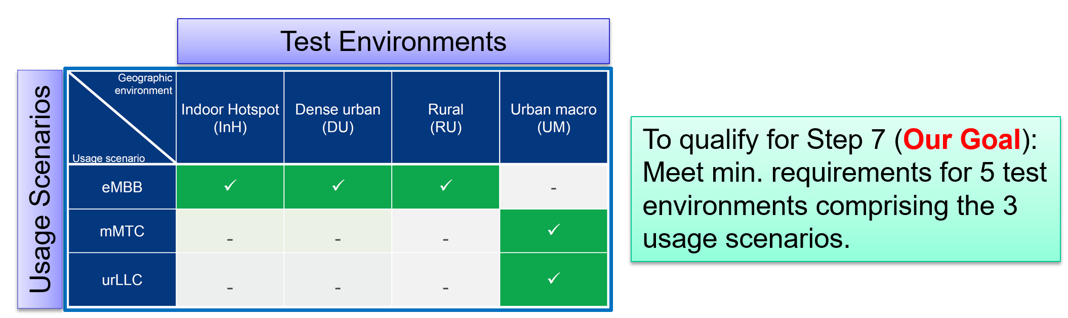
AANI SC Scope Discussion Summary (2)
AANI SC discussed that it would be beneficial to:
  Review the content of the various ITU-R documents relevant for the final submission in July 2019
  Discuss and determine set of IEEE 802.11 technologies that will satisfy the full set of IMT-2020 requirements
  Carry out work to ascertain the feasibility of qualifying for IMT-2020, which requires five test environments for 3 different usage scenarios

Slide 6
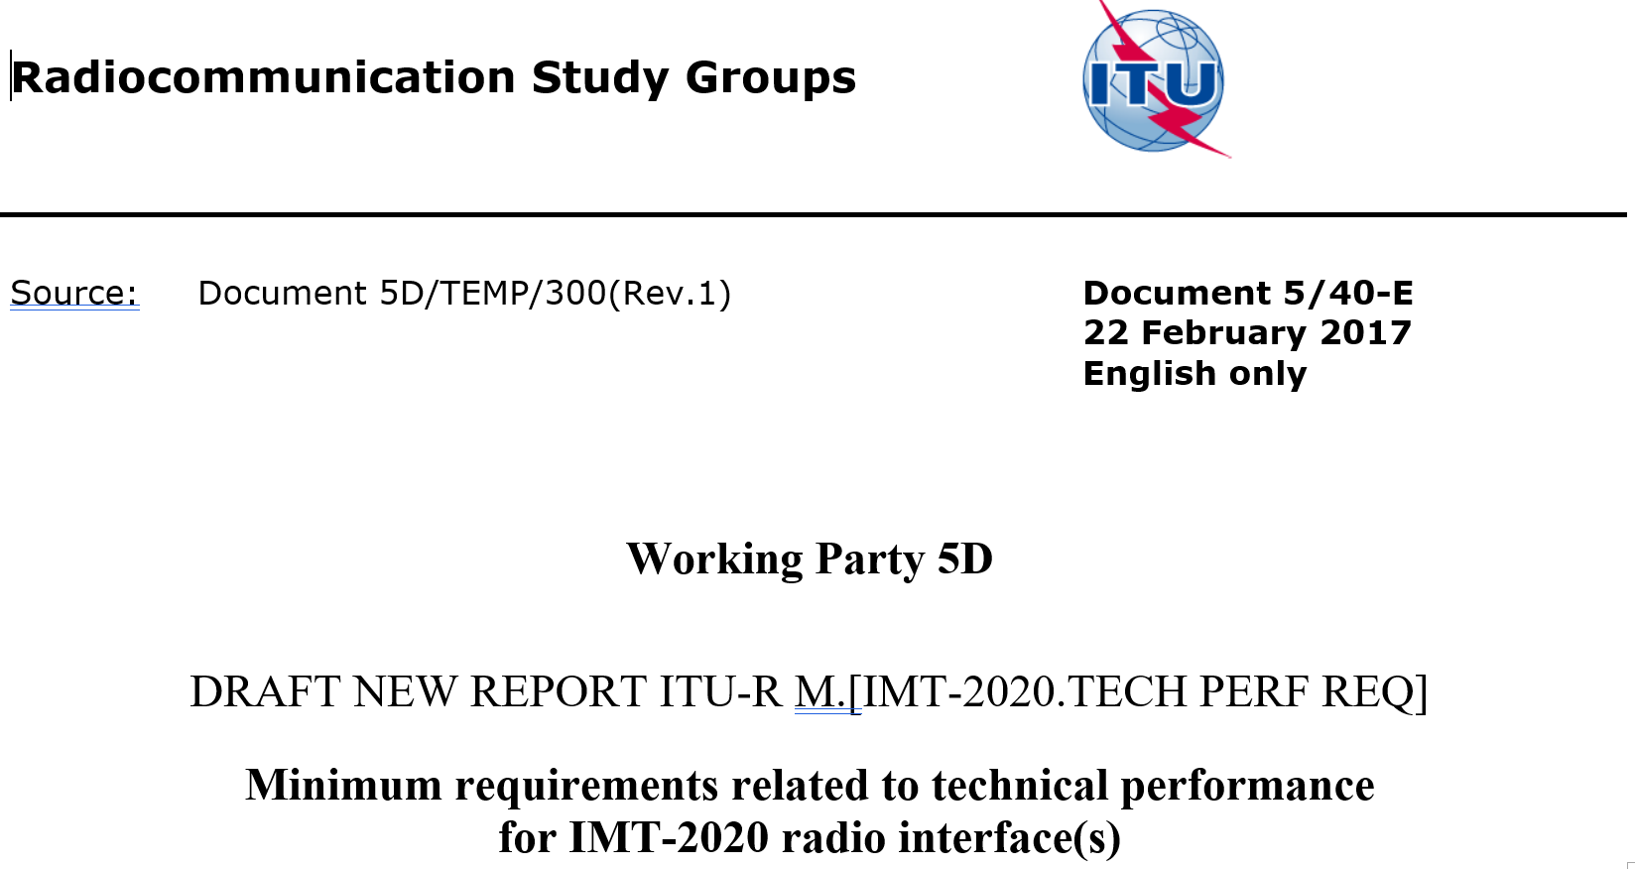
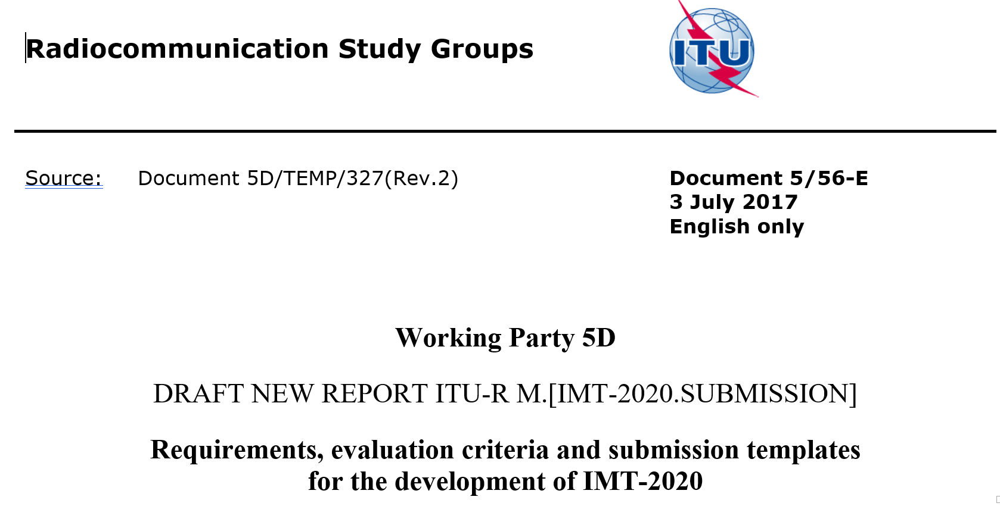
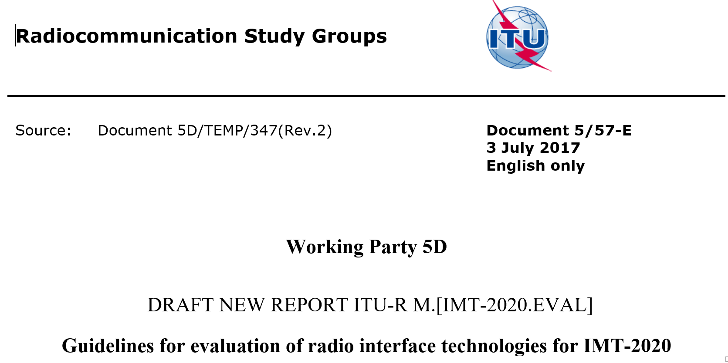
AANI-SC reviewed the WP-5D Documents related to IMT-2020 Submission Process
ITU-R Document 5/40-E
ITU-R Document 5/56-E
ITU-R Document 5/57-E
Min. Tech. Perf. Requirements Document
Submission Guidelines Document
Evaluation Guidelines Document

Slide 7
SUGGESTED ConfigurationS
Test Environment

Slide 8
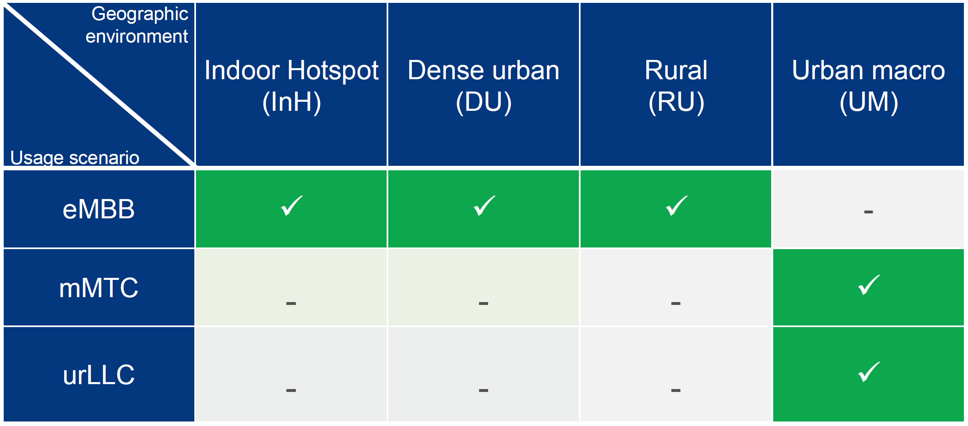
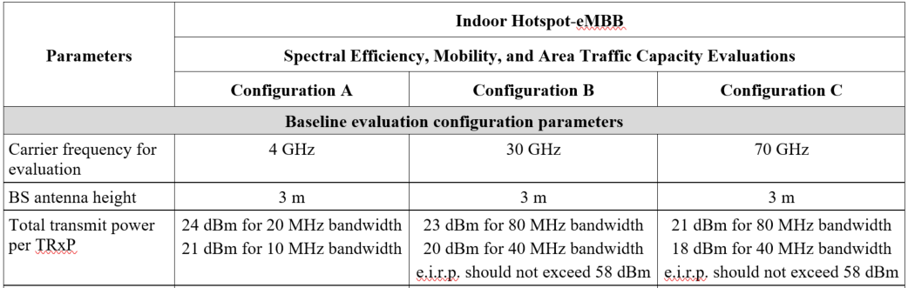
Usage Scenarios, Test Environments and Configurations
Test Environments
Usage Scenarios
Each test env. has multiple configurations (typically 3)
Configurations

Slide 9
Configuration for eMBB Indoor Hotspot
For the eMBB Usage Scenario, the Indoor Hotspot Test environment should be tested using Configuration B (30 GHz) for the IEEE 802 proposal
Additional Observations:
  Indoor hotspot is a typical deployment for 802.11ac and 802.11ax
  802.11 waveforms can be used at different carrier frequencies
    Products based on 802.11 waveforms in licensed bands are available today

Slide 10
Configuration for eMBB Dense Urban
For the eMBB Usage Scenario, the Dense Urban Test environment should be tested using Configuration B (30 GHz) for the IEEE 802 proposal
Additional Observations:
  802.11ax was specifically developed to service dense deployment environments

Slide 11
Configuration for eMBB Rural
For the eMBB Usage Scenario, the Rural test environment should be tested using Configuration B (4 GHz) and C (700 MHz) for the IEEE 802 proposal
Additional observations:
  Requirements could be met by 802.11ac/ax provided power levels are adjusted to the new bands

Slide 12
Configuration for mMTC Urban Macro
For the mMTC Usage Scenario, the Urban Macro Test environment should be tested using Configuration B for the IEEE 802 proposal

Slide 13
Configuration for URLLC Dense Urban
For the URLLC Usage Scenario, the Urban Macro Test environment should be tested using Configuration A (4 GHz) for the IEEE 802 proposal

Slide 14
Challenging REQUIREMENTS
High-Level Approach to Meeting the

Slide 15
“Seemingly challenging” requirements
Mobility Requirements (especially for Rural eMBB)
  4 GHz configuration: 3 km/h (indoor), 120 km/h (in-car) and 500 km/h (high-speed)
  Low mobility, large cell environment configuration : 3 km/h (indoor and pedestrian), 30 km/h (in-car) tested at 700 MHz
Range Requirements (especially for Rural eMBB)
  1732 m for sub-6 GHz (viz. 700 MHz and 4 GHz)
  6000 m for 700 MHz
Number of antenna elements per TRxP
  64 Tx/Rx elements for frequencies 1 GHz (viz. 700 MHz)
  256 Tx/Rx elements for frequencies above 1 GHz (viz. 4, 30, 70 GHz)
Spectral efficiency
Connection density
Reliability

Slide 16
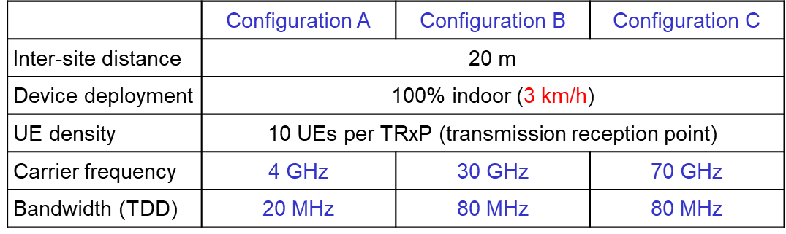
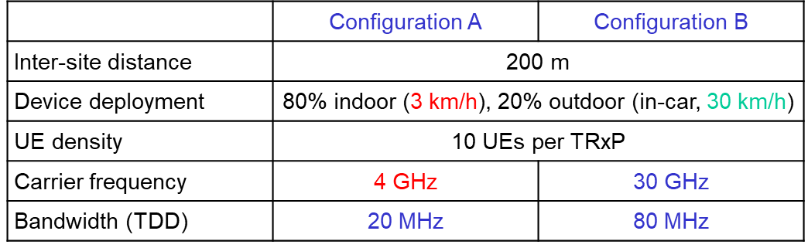
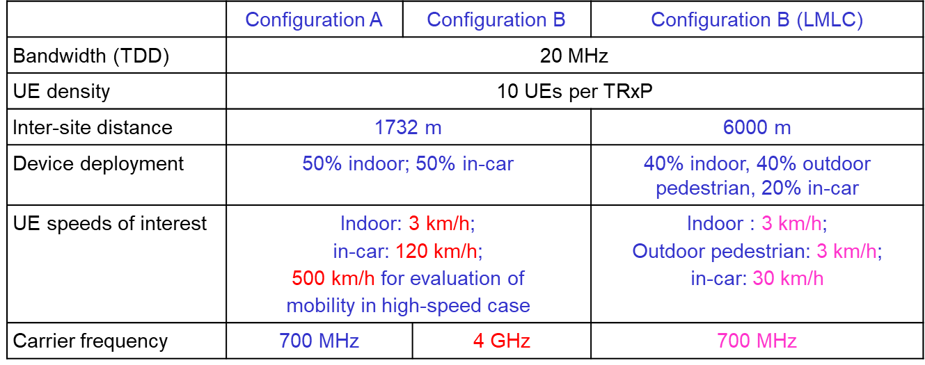
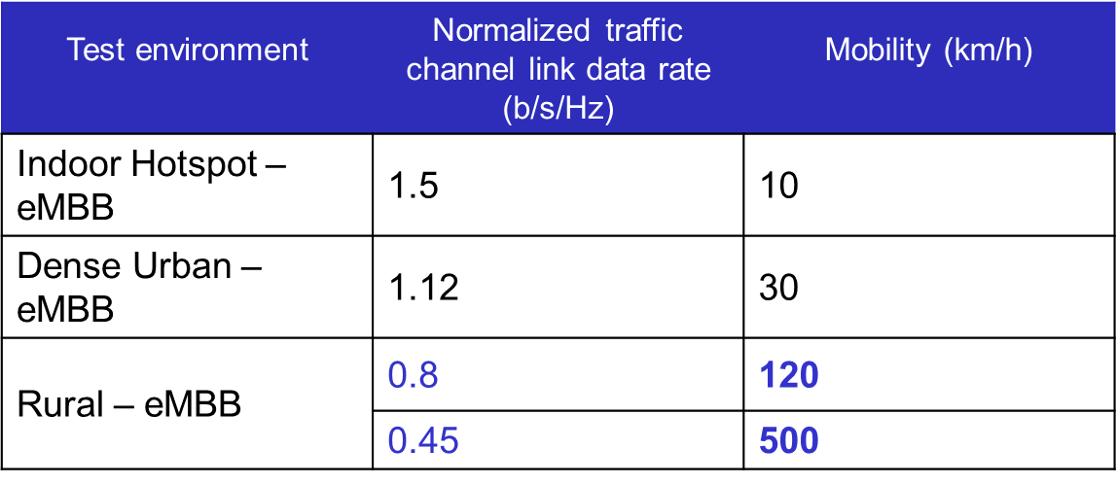
IMT-2020 Mobility Requirements for eMBB
Table 1: eMBB – Indoor Hotspot
Table 2: eMBB – Urban
Table 3: eMBB – Rural
Note: Spectral Efficiency Req.

Slide 17
Initial Mobility Effect Analysis - Motivation
Develop intuition on Doppler effects on performance of 802.11ac waveform w.r.t channel models in ITU-R.M2134 [1]
Focus on the OFDM-modulated VHT payload portion of 802.11ac packet
Provide impetus for further and more detailed studies by 802.11 members

Slide 18
IMT-2020 URLLC Requirements

Slide 19
IMT-2020 mMTC Requirements

Slide 20
Suggested SUBMISSION Timeline

Slide 21
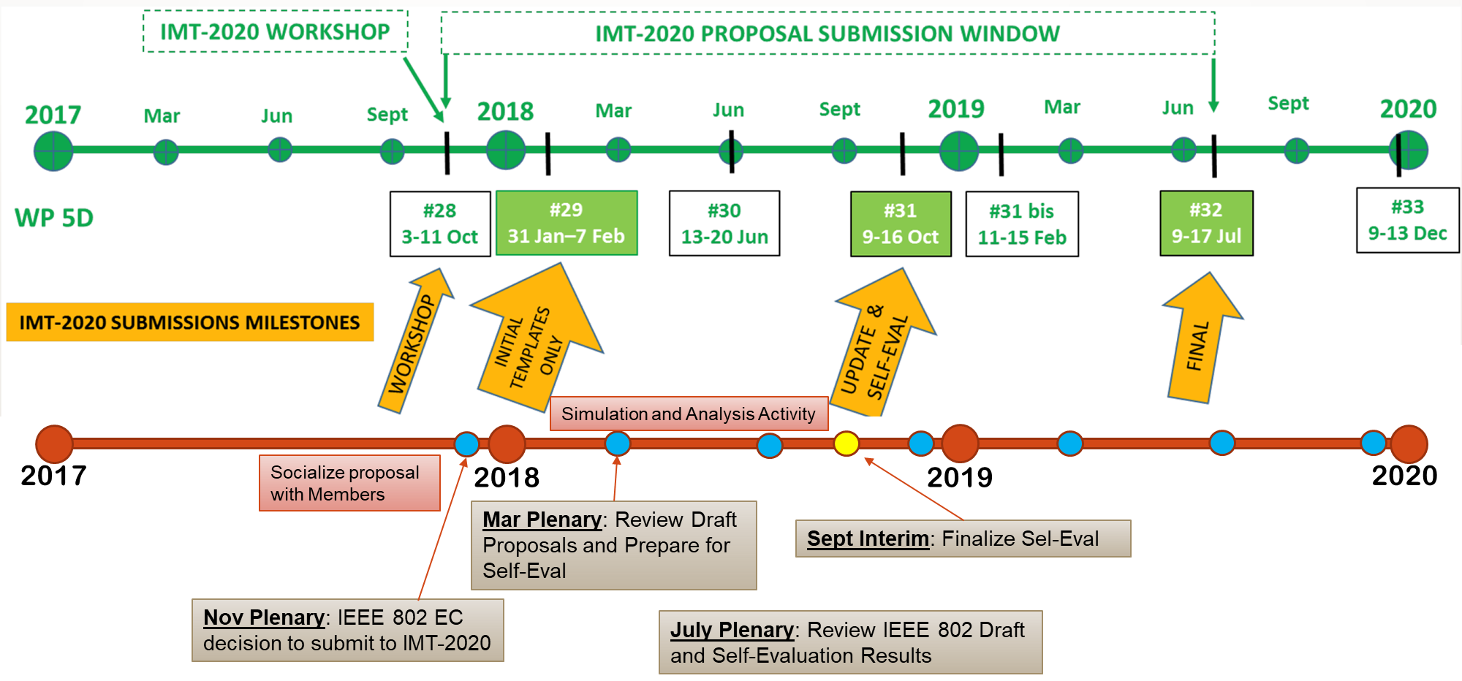
IMT-2020 Submission Timeline

Slide 22
Connecting to Next Generation Core

Slide 23
Interworking with 3GPP core
N3IWF = Inter-Working Function
NWu = Reference point between the UE and N3IWF for establishing secure tunnel(s) between the UE and N3IWF
Y1 = Reference point between the UE and the non-3GPP access (e.g. WLAN)
Y2 = Reference point between the Non-3GPP access and the N3IWF for the transport of NWu traffic
WLAN APs connects to the NG-Core through N3IWF (Inter-Working Function) as Non-3GPP access
Secure tunnel(s) are established between the UE and N3IWF so that control-plane and user-plane exchange between the UE and the 5G Core Network is done securely over untrusted non-3GPP access.

