Slide 1
Draft for ITU-R Submission
Date: 2017-12-18
Authors:

Slide 2
Contents
Statement of Intent
Overview of IEEE 802.11
802.11 candidate technologies
802.11ac, 802.11ax
Proposal Overview
Configuration Choice for the 5 test environments
IEEE 802 Submission Timeline
(Optional) IMT-2020 Requirements Analysis

Slide 3
Statement of Intent
IEEE 802 intends to submit a (S)RIT for consideration as a IMT-2020 Technology

Slide 4
IEEE 802.11 Introduction
IEEE 802.11 is a working group, responsible for writing Wireless Local Area Network (LAN) standards
802.11 operates under
The “Sponsor”: IEEE LMSC “LAN / MAN Standards Committee” – aka “802”
IEEE Computer Society
IEEE-SA Standards Board
Work in 802.11 is divided into various activities
Task groups – one per approved standard or amendment to be developed
Study groups or topic interest groups – the precursor to a task group that investigates marketability, feasibility and determines initial requirements
Various standing committee's responsible for ongoing work, such as “Architecture”

Slide 5
IEEE 802.11 Scope
Wireless local area networks
Generally use unlicensed spectrum
Exception for 802.11y: “lightly licensed”
Exception for TV whitespace
Deployments: Broadband network access, public venue access, sensor networks, mesh networks, automotive.
Present in these devices: laptops, phones, tablets, network infrastructure, home appliances, consumer electronics, healthcare devices

Slide 6
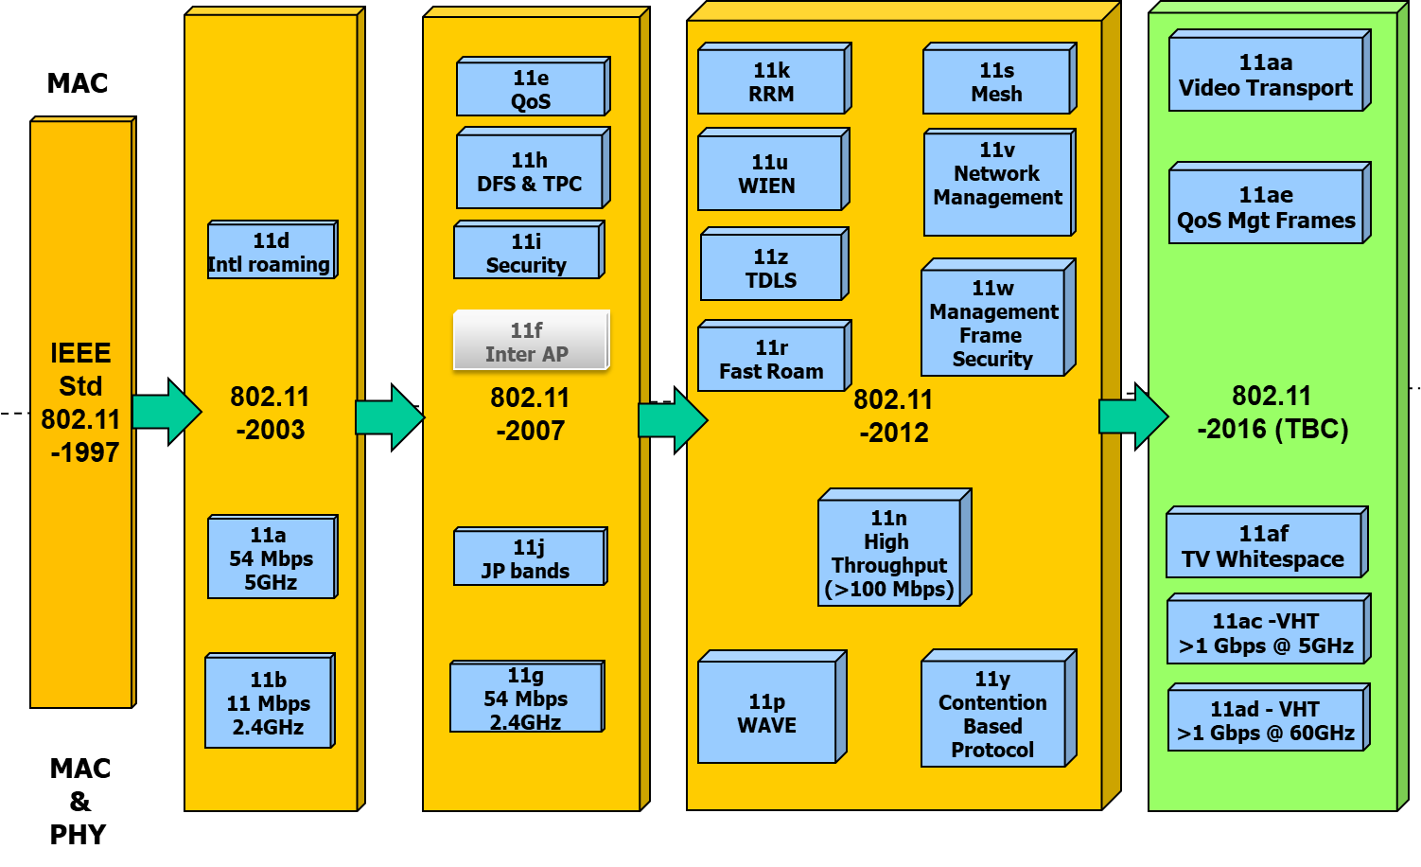
IEEE 802.11 Revisions
Replace slide with latest Official Version

Slide 7
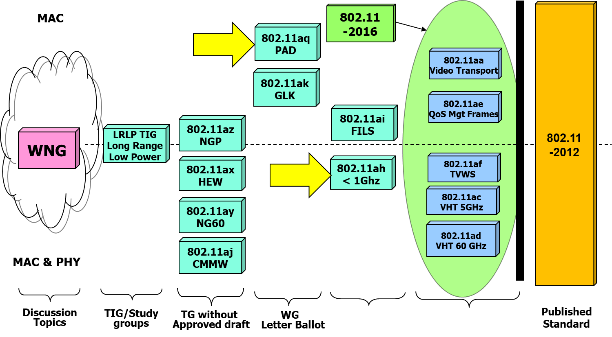
IEEE 802.11 Standards Pipeline
Replace slide with latest Official Version

Slide 8
IEEE candidate technologies for IMT-2020: 802.11ac
The 802.11ac amendment was published in 2013
Prevalent Wi-Fi technology today
Key features
20, 40, 80 and 160 MHz channels
Gigabit speeds
Defines MIMO up to 8 streams
Beamforming, Multi-user MIMO (up to 4 users)
Originally defined to operate in 5 GHz, but waveform could be used unchanged at other carrier frequencies
Deployed in residential, enterprise and operator markets

Slide 9
IEEE candidate technologies for IMT-2020: 802.11ax
The 802.11ax is under development
Draft 3.0 scheduled for May 2018
Final publication by end 2019
Key features (in addition to 11ac)
UL and DL OFDMA
UL Multi-user MIMO
Up to 8 MU-MIMO users
New power saving modes for mobile devices (TWT)
Midamble Training for enhance Doppler performance
Defined for both 2.4 GHz and 5 GHz operation, but waveform can be used unchanged at other frequencies

Slide 10
Proposal Overview (1)

Slide 11
Configuration for eMBB Indoor Hotspot
For the eMBB Usage Scenario, the Indoor Hotspot Test environment should be tested using Configuration B (30 GHz) for the IEEE 802 proposal
Additional Observations:
Indoor hotspot is a typical deployment for 802.11ac and 802.11ax
802.11 waveforms can be used at different carrier frequencies
Products based on 802.11 waveforms in licensed bands are available today

Slide 12
Configuration for eMBB Dense Urban
For the eMBB Usage Scenario, the Dense Urban Test environment should be tested using Configuration B (30 GHz) for the IEEE 802 proposal
Additional Observations:
802.11ax was specifically developed to service dense deployment environments

Slide 13
Configuration for eMBB Rural
For the eMBB Usage Scenario, the Rural test environment should be tested using Configuration B (4 GHz) and C (700 MHz) for the IEEE 802 proposal
Additional observations:
Requirements could be met by 802.11ac/ax provided power levels are adjusted to the new bands

Slide 14
Configuration for mMTC Urban Macro
For the mMTC Usage Scenario, the Urban Macro Test environment should be tested using Configuration B for the IEEE 802 proposal

Slide 15
Configuration for URLLC Dense Urban
For the URLLC Usage Scenario, the Urban Macro Test environment should be tested using Configuration A (4 GHz) for the IEEE 802 proposal

Slide 16
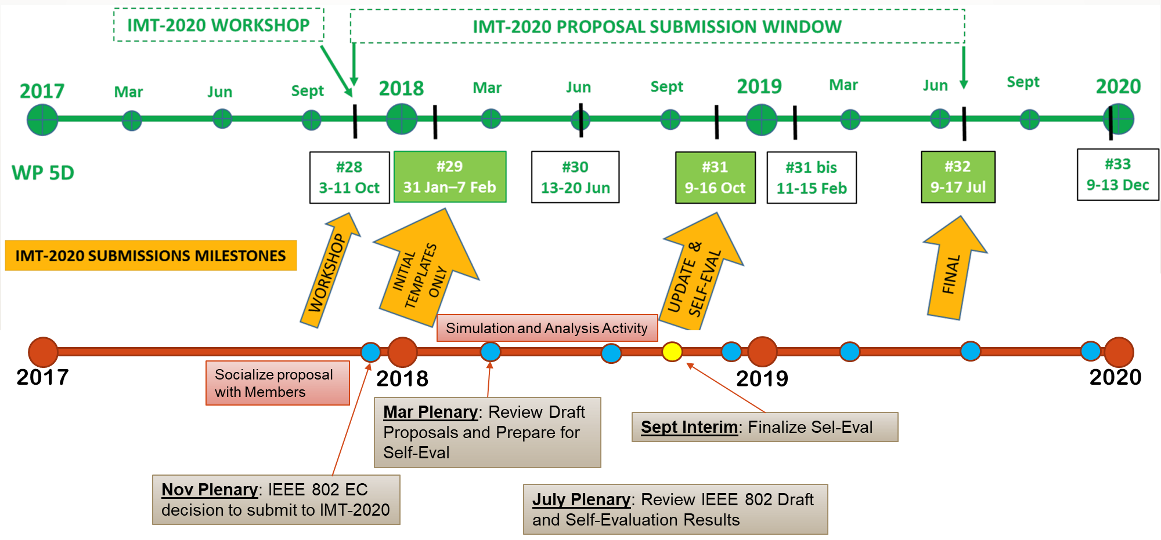
IMT-2020 Submission Timeline

Slide 17
IMT-2020 Requirements (1)

Slide 18
Appendix

Slide 19
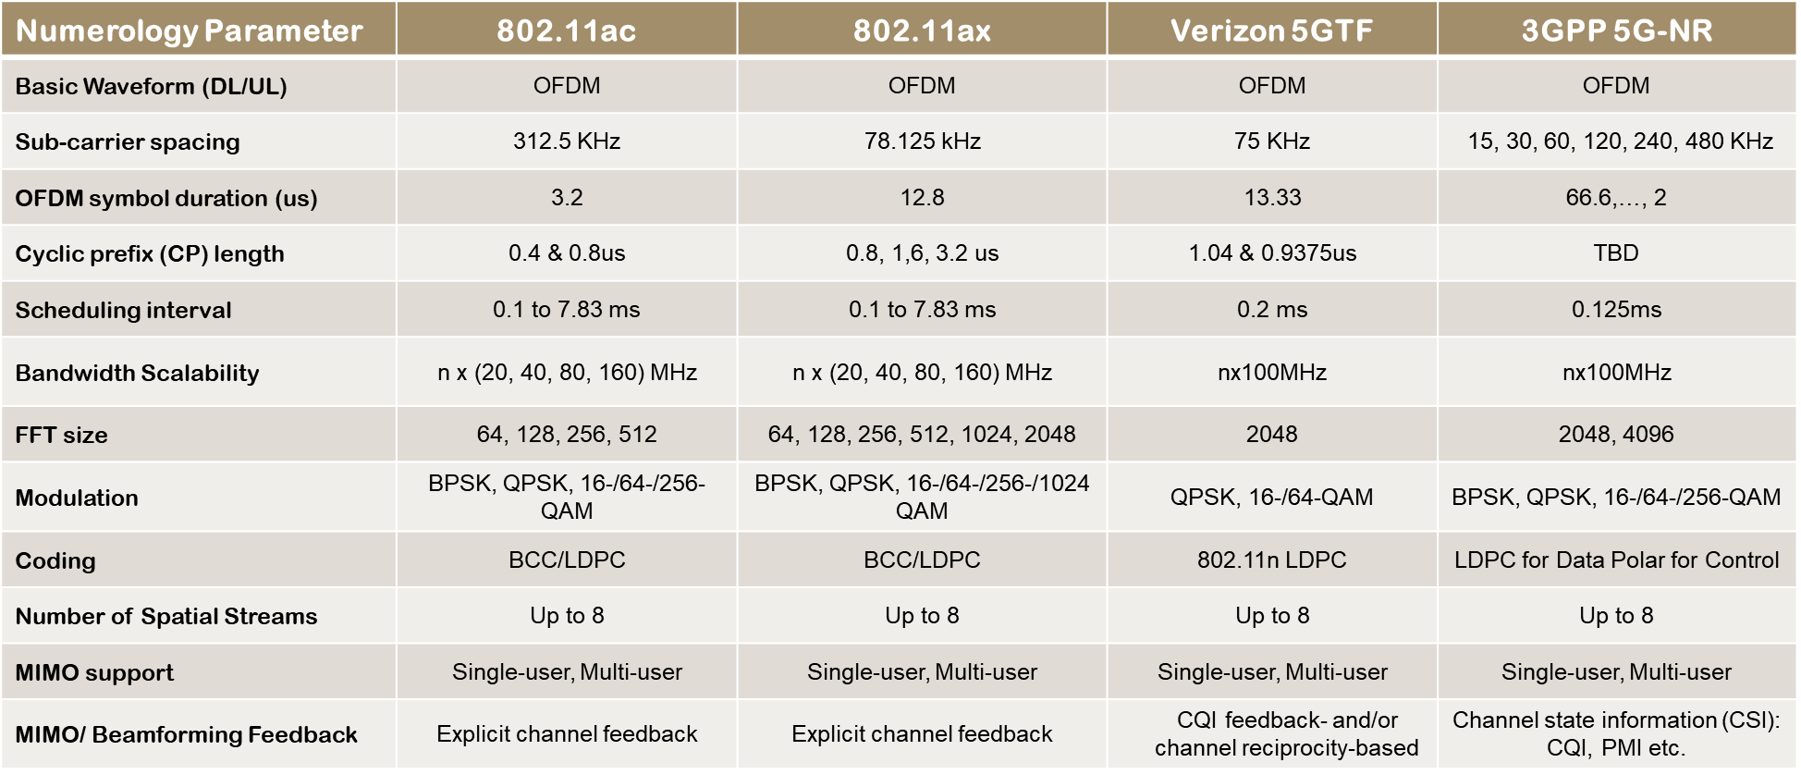
802.11 Waveforms vs. 5G Waveforms

