Slide 1
Draft for ITU-R Submission
Date: 2017-12-04
Authors:

Slide 2
Contents
Statement of Intent
Proposal Overview
Configuration Choice for the 5 test environments
IEEE 802 Submission Timeline
(Optional) IMT-2020 Requirements Analysis

Slide 3
Statement of Intent
IEEE 802 intends to submit a (S)RIT for consideration as a IMT-2020 Technology

Slide 4
Proposal Overview (1)

Slide 5
Configuration for eMBB Indoor Hotspot
For the eMBB Usage Scenario, the Indoor Hotspot Test environment should be tested using Configuration B (30 GHz) for the IEEE 802 proposal

Slide 6
Configuration for eMBB Dense Urban
For the eMBB Usage Scenario, the Dense Urban Test environment should be tested using Configuration B (30 GHz) for the IEEE 802 proposal

Slide 7
Configuration for eMBB Rural
For the eMBB Usage Scenario, the Rural test environment should be tested using Configuration B (4 GHz) and C (700 MHz) for the IEEE 802 proposal

Slide 8
Configuration for mMTC Urban Macro
For the mMTC Usage Scenario, the Urban Macro Test environment should be tested using Configuration B for the IEEE 802 proposal

Slide 9
Configuration for URLLC Dense Urban
For the URLLC Usage Scenario, the Urban Macro Test environment should be tested using Configuration A (4 GHz) for the IEEE 802 proposal

Slide 10
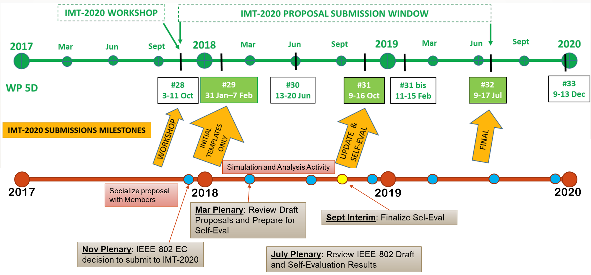
IMT-2020 Submission Timeline

Slide 11
IMT-2020 Requirements (1)

Slide 12
Appendix

Slide 13
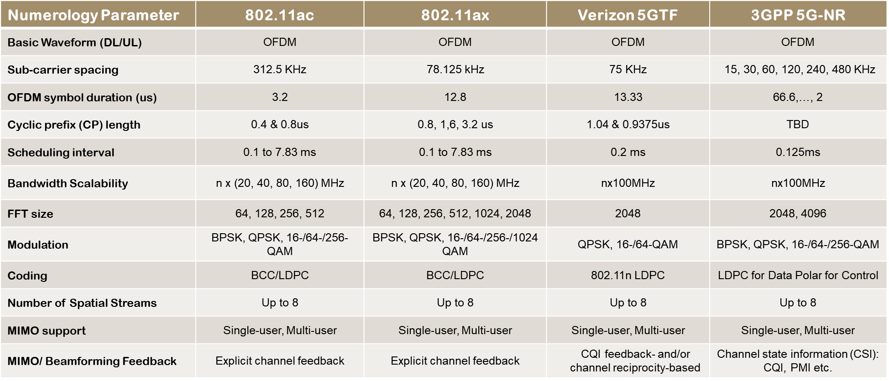
802.11 Waveforms vs. 5G Waveforms

