Slide 1
IMT-2020 Requirements and Thoughts on Submissions
Date: 2017-11-27
Authors:

Slide 2
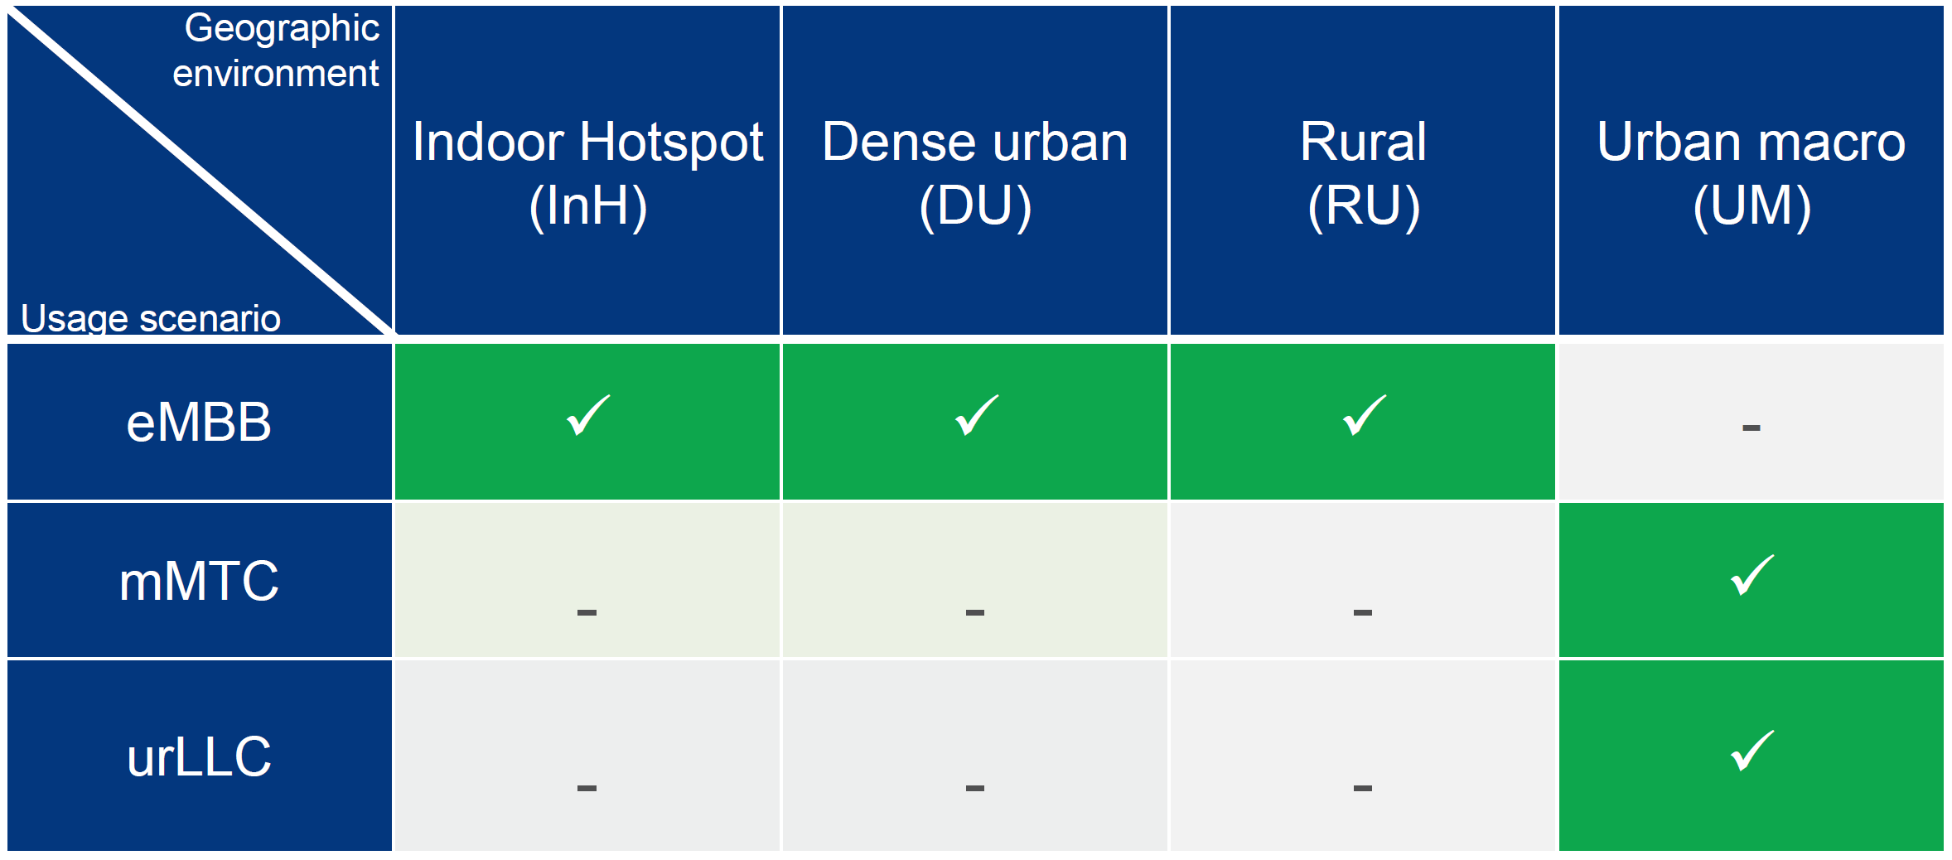
Usage Scenarios, Test Environments and Configurations
Test Environments
Usage Scenarios
Each test env. has multiple configurations (typically 3)
Configurations

Slide 3
Understanding the Qualification Requirements
Test Environments
To qualify for Step 7 (Our Goal):
Meet min. requirements for 5 test environments comprising the 3 usage scenarios.
Usage Scenarios
Interim milestone at step 3:

Slide 4
One Test Environment – One configuration!
For the cases when there are multiple evaluation configurations under the selected test environment, one of the evaluation configurations under that test environment can be used to test the candidate RITs/ SRITs. The technical performance requirement corresponding to that test environment is fulfilled if this requirement is met for one of the evaluation configurations under that specific test environment

Slide 5
Clustering the “seemingly challenging” requirements
Mobility Requirements (especially for Rural eMBB)
4 GHz configuration: 3 km/h (indoor), 120 km/h (in-car) and 500 km/h (high-speed)
Low mobilty, large cell environment configuration : 3 km/h (indoor and pedestrian), 30 km/h (in-car) tested at 700 MHz
Range Requirements (especially for Rural eMBB)
1732 m for sub-6 GHz (viz. 700 MHz and 4 GHz)
6000 m for 700 MHz
Number of antenna elements per TRxP
64 Tx/Rx elements for frequencies 1 GHz (viz. 700 MHz)
256 Tx/Rx elements for frequencies above 1 GHz (viz. 4, 30, 70 GHz)
Spectral efficiency
Connection density
Reliability
Deep dive presentations can be invited on meeting each of these requirements!

Slide 6
Some high-level remarks on meeting the requirements
11ac/ax waveform numerologies match the numerologies being considered for 5G applications
Number of spatial streams in 802.11ac/ax same as other 5G waveforms
MCS specifications in 802.11ac/ax is superior
Most requirements that can be met by other 5G waveforms can be met by 802.11 as well
Some requirements such as mobility will require a deeper analysis.
Range can be met with higher EIRPs that are allowed in the bands under discussion
When used outside the unlicensed bands, the 24/30 dBm EIRP restrictions do not apply!
Number of Tx/Rx antenna elements are not limited by the standard
Implementation dependent

Slide 7
Some thoughts on Contributions to IMT-2020
According to IMT 2020/2(Rev.1), the (S)RIT candidate submissions begin in Oct 2017 and the final submissions are due by June 2019.
Intermediate steps are outlined as well (e.g. beginning of independent evaluations in Jan 2018)
Opinions have been expressed that we are not required to share anything until June 2019.
It may be beneficial to prepare a submission summarizing:
IEEE 802’s intent to submit a 5G (S)RIT proposal
An overview of the how the proposal works
Configurations, for each of the 5 test environments, for which the proposal will be tested
Some high-level Analysis on how the proposal will meet the IMT-2020 requirements
Discussion on Immediate actions
Prepare a contribution along the lines discussed above for discussion in the Jan meeting (what gets submitted to the ITU can be debated F2F)
Continue to seek volunteers for the templates

Slide 8
Appendix

Slide 9
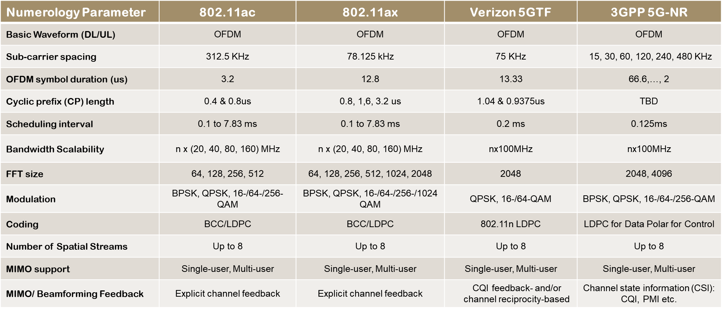
802.11 Waveforms vs. 5G Waveforms

