Slide 1
IMT-2020 Requirements Deep Dive – Part 1: Mobility
Date: 2017-12-04
Authors:

Slide 2
Clustering the “seemingly challenging” requirements of IMT-2020
Mobility Requirements (especially for Rural eMBB)
4 GHz configuration: 3 km/h (indoor), 120 km/h (in-car) and 500 km/h (high-speed)
Low mobility, large cell environment configuration : 3 km/h (indoor and pedestrian), 30 km/h (in-car) tested at 700 MHz
Range Requirements (especially for Rural eMBB)
1732 m for sub-6 GHz (viz. 700 MHz and 4 GHz)
6000 m for 700 MHz
Number of antenna elements per TRxP
64 Tx/Rx elements for frequencies 1 GHz (viz. 700 MHz)
256 Tx/Rx elements for frequencies above 1 GHz (viz. 4, 30, 70 GHz)
Spectral efficiency
Connection density
Reliability
Focus of this presentation

Slide 3
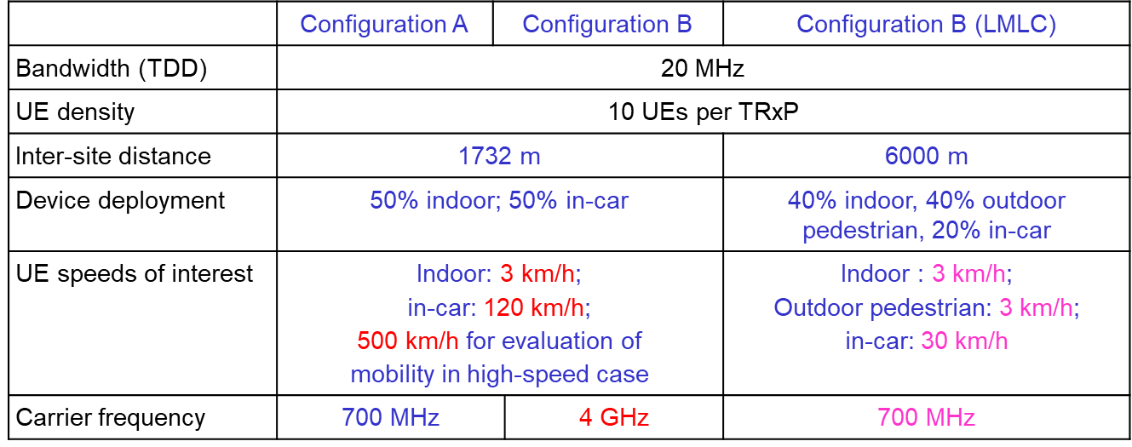
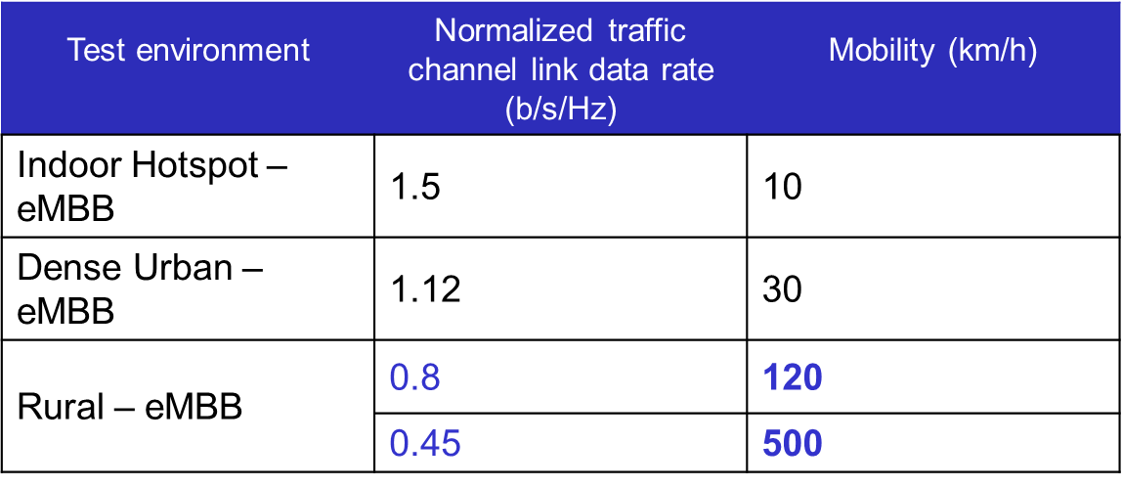
IMT-2020 Mobility Requirements for eMBB
Table 1: eMBB – Indoor Hotspot
Table 2: eMBB – Urban
Table 3: eMBB – Rural
Note: Spectral Efficiency Req.

Slide 4
Initial Mobility Effect Analysis - Motivation
Develop intuition on Doppler effects on performance of 802.11ac waveform w.r.t channel models in ITU-R.M2134 [1]
Focus on the OFDM-modulated VHT payload portion of 802.11ac packet
Provide impetus for further and more detailed studies by 802.11 members

Slide 5
Initial Mobility Effect Analysis – Methodology, 1/2
OFDM: $y\left(u\right)=x\left(u\right).\sum_{m=0}^{N−1}{hm}exp⁡(−j2.u.\frac{m}{N})$
y(u)/x(u): Rx/Tx samples on sub-carrier #u
h_{m}: Accumulated time-domain channel tap amplitudes over sampling interval m
For Doppler effect studies, sufficient to consider single sub-carrier
Consider sub-carrier u = 0
Frequency domain channel coefficient, $C=\sum_{m=0}^{N−1}{hm}$
Frequency domain channel coefficient “determinant” of performance
Time variation of C provides intuition into effects of Doppler on performance

Slide 6
Initial Mobility Effect Analysis – Methodology, 2/2

Slide 7
Results, 1/2
TDL-i
NLoS-only
Rayleigh taps
TDL-iv
LoS + NLoS
1 Rician (K ~ 13 dB) + Rayleigh taps
700 MHz
4 GHz

Slide 8
Results, 2/2
TDL-i
NLoS-only
Rayleigh taps
TDL-iv
LoS + NLoS
1 Rician (K ~ 13 dB) + Rayleigh taps
30 GHz

Slide 9
Summary
Preliminary analyses and results on the effect of Doppler w.r.t IMT-2020 eMBB scenarios were presented
802.11 members are encouraged to build upon these to generate more comprehensive analyses for submission to the IMT-2020 process

Slide 10
References
[1] Report ITU-R.2142, “Guidelines for evaluation of radio interface technologies for IMT-2020”, @ https://www.itu.int/md/R15-SG05-C-0057/en

Slide 11
Appendix

Slide 12
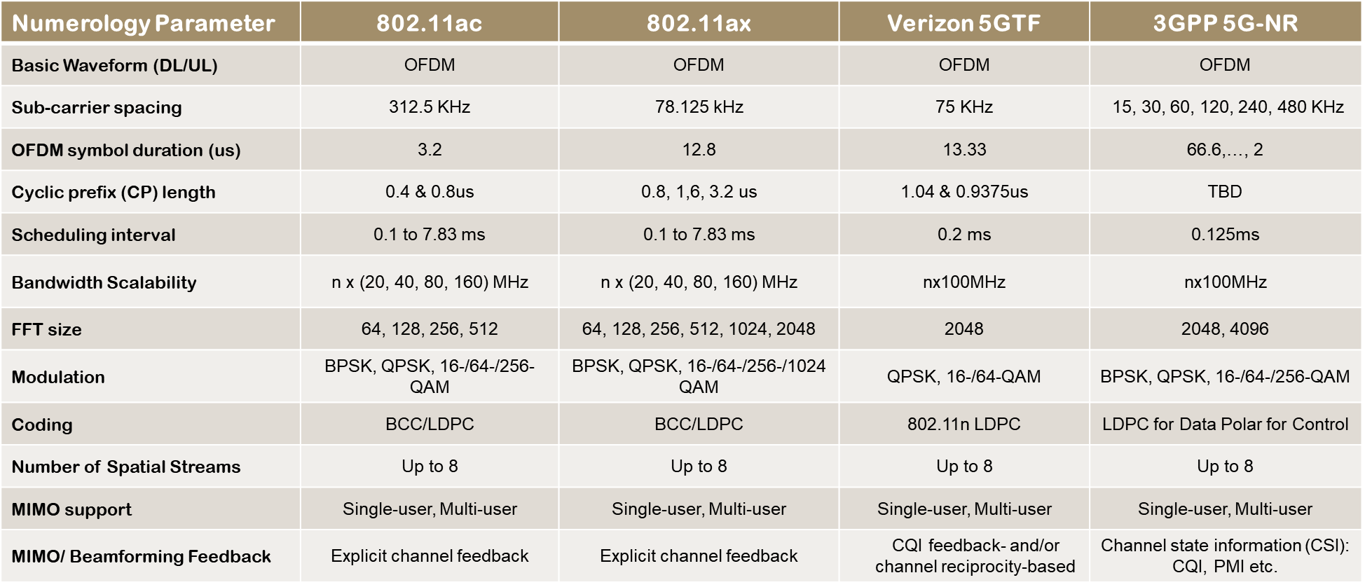
802.11 Waveforms vs. 5G Waveforms

