Slide 1
Protected LTF Using PMF in SU and MU Modes
Date: 2017-11-08
Authors:
Chittabrata Ghosh, Intel

Slide 2
Abstract
Nov 2017
doc.: IEEE 802.11-17/1770r0
In this presentation, we discuss about the LTF protection for both SU and MU ranging and its relation to the MAC security and security negotiation
Key exchange in negotiation phase
Randomization seed in measurement phase
Chittabrata Ghosh, Intel

Slide 3
Introduction
Nov 2017
doc.: IEEE 802.11-17/1770r0
In previous discussions we agree on the following:
The HEz and VHTz FTM modes, the fields over which range measurements are performed shall be protected against a VHT/HE Type B adversary attack.
For the purpose of PHY Security Mode, the field used for channel/ToA measurement shall not include any form of repetition in time domain or structure that is predictable.
In this submission we will review possibilities of signaling between iSTA and rSTA that enables LTF protection.
Chittabrata Ghosh, Intel

Slide 4
Existing Proposal 1: Exchanging Keys in UL and DL NDP [1]
Nov 2017
doc.: IEEE 802.11-17/1770r0
iSTA indicates Key 1 in UL NDP frame and rSTA indicates Key 2 in DL NDP frame
Existing proposal has following limitations:
Requires intended receiver to buffer the samples of the sounding (UL NDP and DL NDP) till results of the decoded key complete the entire Rx path:
Creates a bottle neck and large buffers at the receiver side.
Especially problematic for “Immediate RSTA” as LMR results generation now have shorter time (time is cut down by LTF processing time following the Key1 decoding).
Requirement to have a separate Rx path for key and sounding creates complexity
Limits ability to reuse existing baseband as the 802.11ax and 802.11ac sounding waveforms (DL NDP frame) does not include data field.
Ghosh Chittabrata, Intel

Slide 5
Existing Proposal 2: Inserting Keys in NDPA frame [1]
Nov 2017
doc.: IEEE 802.11-17/1770r0
rSTA indicates Key 1 and Key 2 in the NDPA frame
However, 802.11 control frames does not support encryption
Creates critical path at the receiver side between the decryption process (normally involved bit crunching) and likely to require the sounding waveform (UL NDP) samples to be buffered until the decryption process completes
Layer boundary violation (PHY needs to do decryption) to meet the timing constraints.
Hard on immediate RSTA that will need to decrypt prior to CE – not good for the technology and market.
Not replay attack protected – unlike PMF.
Chittabrata Ghosh, Intel
Notes:
With PMF a STA does not use the same PN twice, and continuously increasing Pn. Once Pn space is exhausted key refresh is done.
So its replay protected
In the above proposal the keys needs to keep changing – used only once.

Slide 6
Proposed Key Exchange in Negotiation and LTF Randomization in Measurement Phases in SU Mode
Nov 2017
doc.: IEEE 802.11-17/1770r0
Key exchange and establishment between iSTA and rSTA in the non-time critical negotiation phase reusing PMF scheme.
Initialization vector or Packet Number (PN) for both UL and DL in NDPA frame by the iSTA
The iSTA LTF sequence in UL NDP is derived out of the established key in negotiation phase and the UL PN in NDPA frame
The rSTA LTF sequence in DL NDP is derived out of the established key in negotiation phase and the DL PN in NDPA frame
PN is transmitted in the clear – no encryption in control frames.
PN selection follows same rules as PMF.
ISTA
RSTA
Negotiation/key exchange
NDPA (UL PN, DL PN)
UL NDP LTF = f(key, UL PN)
DL NDP LTF = f(key, DL PN)
LMR
Chittabrata Ghosh, Intel

Slide 7
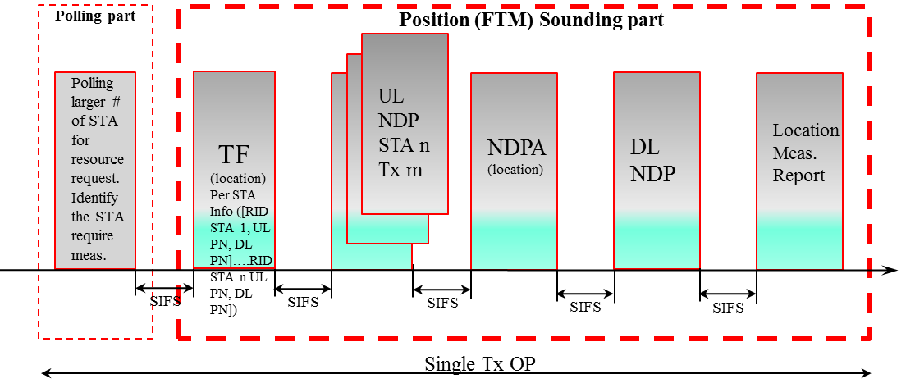
Option 1: UL and DL PNs in TF in MU Mode
Nov 2017
doc.: IEEE 802.11-17/1770r0
Same key exchange and establishment as SU between iSTA and rSTA in negotiation phase again reusing PMF scheme for key generation, establishment and refresh.
Initialization vector or Packet Number (PN) for both UL and DL are included in the Trigger frame transmitted by the RSTA
The iSTA LTF sequence in UL NDP is derived out of the established key in negotiation phase and the UL PN in TF frame for UL sounding.
The rSTA LTF sequence in DL NDP is derived out of the established key in negotiation phase and the DL PN in TF.
Chittabrata Ghosh, Intel

Slide 8
Option 2: UL PN in TF / DL PN in NDPA
Nov 2017
doc.: IEEE 802.11-17/1770r0
Same key exchange and establishment as SU between iSTA and rSTA in negotiation phase again reusing PMF scheme for key generation, establishment and refresh.
Initialization vector or Packet Number (PN) for UL in TF and for DL in NDPA frame by the iSTA
The iSTA LTF sequence in UL NDP is derived out of the established key in negotiation phase and the UL PN in NDPA frame
The rSTA LTF sequence in DL NDP is derived out of the established key in negotiation phase and the DL PN in NDPA frame
Polling part
Position (FTM) Sounding part
UL NDP
STA n
Tx m
Polling larger # of STA for
resource request.
Identify the STA require meas.
TF
(location)
Per STA Info ([RID STA 1, UL PN]….[RID STA n UL PN])
UL NDP
NDPA
(location)
Per STA Info ([RID STA 1, DL PN]….[RID STA n DL PN])
DL NDP
Location
Meas.
Report
SIFS
SIFS
SIFS
SIFS
SIFS
Single availability window
Chittabrata Ghosh, Intel

Slide 9
Advantages of the Proposed Mechanism of Key Exchange
Nov 2017
doc.: IEEE 802.11-17/1770r0
Security context negotiation and establishment using PMF in the unassociated mode already agreed for MAC level security
Extending PMY scheme for PHY level security and generation of LTFs are simple and straight forward
Use of Packet Number (PN) as a seed for LTF sequence/secured property generation allows use of control frames (NDPA or Trigger frame) avoiding encryption of control frames.
Inclusion of both the UL and DL PN in the preceding control frame allows for use of existing frame types and formats without the need of introducing a new frame format for the NDP (inclusion of PN without data field)
The Location Measurement Reporting (LMR) can still use the PMF protection that 11az expects to extend to the unassociated mode
Fits well to both SU and MU protect schemes
Chittabrata Ghosh, Intel
Notes:
Advantages:
Longer processing time available for sequence generation.
Extension to existing PMF scheme, reduces complexity for key generation, exchange and refresh protocol.
No encryption in control frame – uses same frame formats.

Slide 10
Summary
Nov 2017
doc.: IEEE 802.11-17/1770r0
In this contribution, we have presented the existing proposal on key exchange for PHY level security
We have proposed a new mechanism of key exchange by reusing the PMF scheme
The key exchange and establishment are executed in the negotiation phase
Initialization vector or PN for UL and DL are signaled in the measurement phase
In SU mode, the UL and DL PNs are indicated in the NDPA frame by the iSTA
In MU mode, the UL and DL PNs are either indicated in the Trigger frame in one option and in another option, UL PN indicated in TF and DL PN indicated in NDPA frame
Chittabrata Ghosh, Intel

Slide 11
Reference
Nov 2017
doc.: IEEE 802.11-17/1770r0
[1] 11-17-1726r0, “Secure ranging measurement,” Yongho Seok
Chittabrata Ghosh, Intel

