Slide 1
Further Scalable Location
Performance Analysis
Date: 2017-11-08
Authors:

Slide 2
General Simulation Procedure
Setup:
6 ASs in circle with 50 m radius
1 client
AS2 (x₂,y₂)
Unknowns:
AS clock offsets ν₁, ν₂, …, ν₆ (w.r.t. client clock, i.e. ν₀=0)
Client coordinates x₀,y₀
AS1
AS3
Client
(x₀,y₀)
Modeling of imperfections:
For simplicity
  Clock offsets ν_{i} =0 but unknown
  No clock drifts modeled
1 ns stdev Gaussian clock gitter
Abs of (1 m stdev Gaussian) multipath error
0.33 ns residual error when clock knowledge assumed
AS6
AS4
AS5

Slide 3
DToA Simulation Procedure
Not all transmissions depicted!
Measurements:
One transmission in each direction between each pair of ASs
Client listens to transmissions
AS2 (x₂,y₂)
AS1
AS3
Location estimation:
E.g. iteration with Newton’s method to solve for least squares solution to non-linear system of equations for measured DToAs.
When specified, showing average of 10 realizations of each client drop
Client (x₀,y₀)
AS4
AS6
AS to AS multipath error same in both directions.
AS5

Slide 4
CToA Simulation Procedure
Not all transmissions depicted!
Measurements:
One transmission in each direction between each pair of ASs
Client listens to transmissions
AS2 (x₂,y₂)
AS1
AS3
Location estimation:
E.g. iteration with Newton’s method to solve for least squares solution to non-linear system of TOD/TOA equations position.
When specified, showing average of 10 realizations of each client drop
For method using tracked clock knowledge, a first estimation of the clock offsets are computed from 10 realizations.
Client (x₀,y₀)
AS4
AS6
AS5

Slide 5
DToA and CToA w/o client tracking
Client outside circle
Multipath error
  Proxy - Abs of Gaussian
  MU-ranging protocol uses symmetric AS to AS multipath errors
‘Tracked’ clocks are initialized using average of 10 other measurements
CToA here outperforms DToA when NOT considering client position tracking.
Call in comment::

Slide 6
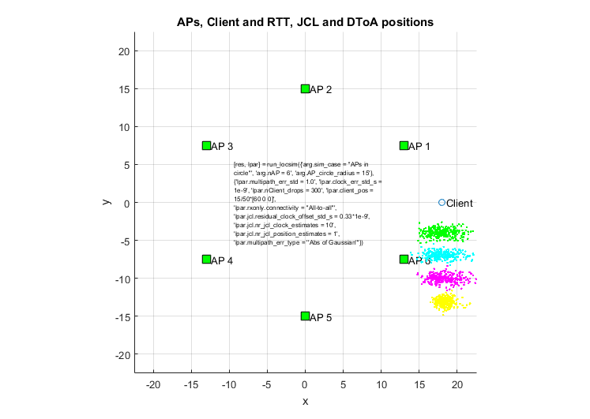
DToA and CToA w/o client tracking
CToA with tracked clocks

Slide 7
DToA and CToA with client tracking
Client outside circle
Multipath
  Proxy - Abs of Gaussian
  MU-ranging protocol uses symmetric AS to AS multipath errors
Client location ‘tracking’ modeled by averaging 10 measurements
‘Tracked’ clocks are initialized using average of 10 other measurements
DToA here outperforms (or equals) CToA when considering client position tracking.
Call in comment::

Slide 8
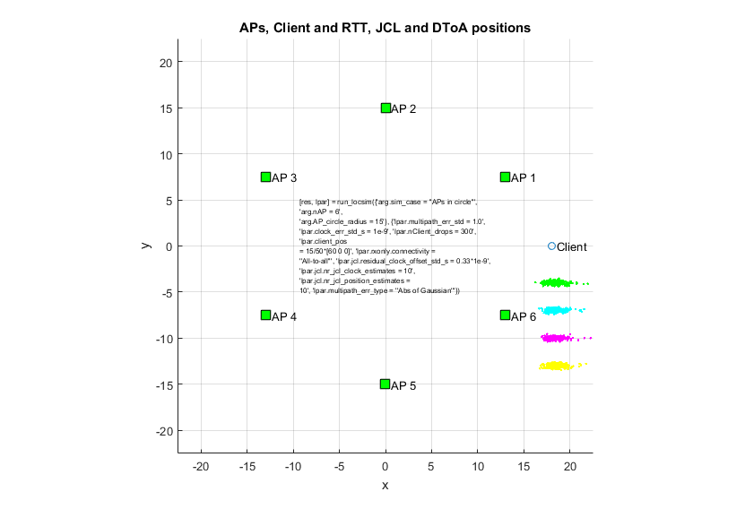
DToA and CToA with client tracking
Note elongated shape of location error also for ‘CToA’ with tracked clocks.

Slide 9
Thank You

Slide 10
Appendix

Slide 11
Newton’s method for solving non-linear equation
Solve equation:
x
x₁
x₃
x₂
etc.

Slide 12
Solving of non-linear system of equations
Non linear system of equations:
- solve for x*
Use Newton’s method for multiple variables:
Linearization:
where
Over-determined non-linear system of equation to solve for Δx:
Least squares solution for iterative step:
Iterate according to:

Slide 13
DToA
‘Differential Time-of-Arrival’
Location
See [1,2 and 3]

Slide 14
Propagation paths and time stamps
Illustrating timing diagram showing double sided feedback of time-stamps:
AP1
AP2
Client
UL MU NDP
t1
t2
t5
t3
DL NDP
t4
‘AP to STA feedback’
t2, t3
t6
t1, t4
‘STA to AP feedback’

Slide 15
Double-Sided Differential Distance Calculation
The client STA listens to the exchanges between the AP1 and AP2 and records the time t5 when it receives the UL MU NDP from AP2 and the time t6 when it receives the DL NDP from AP1.
The client also listens to the relayed t2 and t3 from AP1 and the relayed t1 and t4 in the feedback from AP2.
The differential distance between the client STA and AP1 vs. AP2 can now be calculated as follows:
  D_01 = [t6 – t5 – (t3 – t2 + T_12)] * c
  Using T_01 = [(t4 – t1) – (t3 – t2)]/2
  We get D_01 = [t6 – t5 – (t3 – t2 + 0.5*t4 – 0.5*t1 – 0.5*t3 + 0.5*t2)]*c
  Or finally:
Note that the above expression for the differential distance D_12 does not depend on the ToF, T_12, between AP1 and AP2. Thus this method of calculating D_12 is insensitive to LOS obstructions between AP1 and AP2.
D_12 = [t6 – t5 – 0.5*t3 + 0.5*t2 – 0.5*t4 + 0.5*t1]*c

Slide 16
DToA Location Estimation Calculations
In two dimensions with 3 APs:
R_{ij}
Unknowns:
Client coordinates x₀,y₀
2 unknowns
AP1
AP2
t₁
DTOF₁₂ = t6 – t5 – 0.5*t3 + 0.5*t2 – 0.5*t4 + 0.5*t1
t₂
t₄
t₃
Client
(x₀,y₀)
t₅
t₆
Equations:
Differential ToF equations
  DToA₁₂ = (R₀₁-R₀₂)/c
  DToA₁₃ = (R₀₁-R₀₃)/c
  DToA₂₃ = (R₀₂-R₀₃)/c
3 equations
R₀₂(x₀,y₀)
Solve for location, e.g. with Newton iterations – described in following slides.
AP3
(x₃,y₃)

Slide 17
Solving of non-linear system of equations
Non linear system of equations:
- solve for x*
Use Newton’s method for multiple variables:
Linearization:
where
Over-determined non-linear system of equation to solve for Δx:
Least squares solution for iterative step:
Iterate according to:

Slide 18
Our derivatives
To simplify the equations, measure time in light seconds - the distance light travels in one second.

Slide 19
Iterative solution for client position (x₀,y₀)
Step calculation. LS solution to:
Note: Time in units of light seconds
Iterations:

Slide 20
Joint Clock Offsets and
Client Location Estimation
See [4,5 and 6]

Slide 21
Joint Clock Offsets and Client Location and Estimation Calculations
We are here using the CToA method [4,5 and 6] only to do joint AP clock offset and client position estimation. We are not modeling nor tracking any drift in the clocks. We are not using the Kalman filter approach for the calculations described in [4,5 and 6] here.

Slide 22
Joint Clock Offsets and Client Location Estimation
In two dimensions with 3 APs:
R_{ij}
Unknowns:
AP clock offsets ν₁, ν₂ and ν₃ (w.r.t. client clock, i.e. ν₀=0)
Client coordinates x,y
5 unknowns
AP1
TOD₁
AP2
TOA₂
Client
(x₀,y₀)
Equations:
AP to AP propagations:
  TOA_{i} − ν_{i} = TOD_{j} - ν_{j} + R_{ij}/c
AP to client propagations:
  TOA₀ = TOD_{j} - ν_{j} + R_{0j}(x,y)/c
9 equations
R₀₂(x₀,y₀)
TOA₀
Solve for location, e.g. with Newton iterations – described in following slides.
AP3
(x₃,y₃)

Slide 23
Solving of non-linear system of equations
Non linear system of equations:
- solve for x*
Use Newton’s method for multiple variables:
Linearization:
where
Over-determined non-linear system of equation to solve for Δx:
Least squares solution for iterative step:
Iterate according to:

Slide 24
Our derivatives
To simplify the equations, measure time in light seconds - the distance light travels in one second.

Slide 25
Iterative solution for client position (x₀,y₀)
Step calculation. LS solution to:
Note: Time in units of light seconds
Iterations:

Slide 26
References

Slide 27
References
[1] “Client Positioning using Timing Measurements between Access Points”, Erik Lindskog, Naveen Kakani, Raja Banerjea, Jim Lansford and Jon Rosdahl, IEEE 802.11-13/0072r1.
[2] “A Low Overhead Receive Only Wi-Fi Based Location Mechanism”, Erik Lindskog, Hong Wan, Raja Banerjea, Naveen Kakani and Dave Huntingford, Proceedings of the 27th International Technical Meeting of The Satellite Division of the Institute of Navigation (ION GNSS+ 2014), Tampa, Florida, September 2014, pp. 1661-1668.
[3] “Passive Location”, Erik Lindskog, Naveen Kakani and Ali Raissinia, IEEE 802.11-17/0417r0.
[4] “Scalable Location Protocol”, Erik Lindskog, Naveen Kakani and Ali Raissinia, IEEE 802.11-17/0417r0.
[5] “High-Accuracy Indoor Geolocation using Collaborative Time of Arrival (CToA) - Whitepaper”, Leor Banin, Ofer Bar Shalom, Nir Dvorecki, Yuval Amizur, IEEE 802.11-17/1387r0.
[6] “Collaborative Time of Arrival (CToA)”, Ofer Bar Shalom, Yuval Amizur, Leor Bani, IEEE 802.11-17/1308r0.
[7] “Scalable Location Performance”, Erik Lindskog, Naveen Kakani and Ali Raissinia, IEEE 802.11-17/1372r1.
[8] “CToA Protocol Analysis”, Ofer-Bar Shalom, Yuval Amizur, Leor Banin and Nir Dvorecki, IEEE 802.11-17/1309r0.

