Slide 1
Usage Model: Short Range Underwater Light Communications
Date: 2017-11-07
Authors:

Slide 2
Motivation
Acoustic communications for underwater:
  Advantage: Long link range, widely-used technology
  Disadvantage: Low data rate (the associated bandwidth is in the order kilohertz), large latency (due to the propagation speed of sound), costly and bulky (due to the transduces), may harm marine life
RF communications for underwater:
  Advantage: May be useful on the sea surface, highly tolerant to water turbulence
  Disadvantage: Short range due to conductive transmission medium (i.e., salinity), bulky devices as they can operate at extra low frequencies (~30-300 Hz)
Light communications (LC) for underwater:
  Advantage: High-data rate (<Gbps), low latency, low cost (e.g., LEDs, PDs), small-form factor
  Disadvantage: Moderate link ranges (~in order of meters), may be affected from scattering
LC provides the highest data rate, the lowest link delay, and the lowest implementation costs as compared RF and acoustic communications for short range under water links [1].

Slide 3
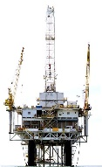
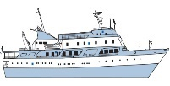
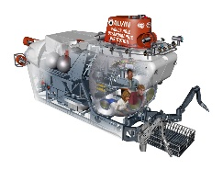



Use Cases
A submarine (as an AP) may provide high date rate LC links to the divers
The divers may use their apparatus to communicate with each other while pushing high-data rate video to the submarine and to each other’s apparatus [4]
An oil platform may be equipped LC APs and communicates with LC STAs (e.g., divers and UUVs) with low-latency for maintenances purposes
A ship may acquire data through a sensor mesh equipped with LC devices
A diver may acquire sensor information through devices equipped with LC
A UUV may be controlled remotely over internet by LC mesh network
A UUV may feed the acquired sensory information to an underwater buoy equipped with LC AP by using high-date rate LC links to Internet
Oil platform
LC AP
(1)
(4)
(3)
LC STA
(2)
Sensor mesh/relays
Internet
(7)
(5)
(6)
LC AP
Distributed mesh
Underwater buoy
UUV = Unmanned Underwater Vehicle

Slide 4
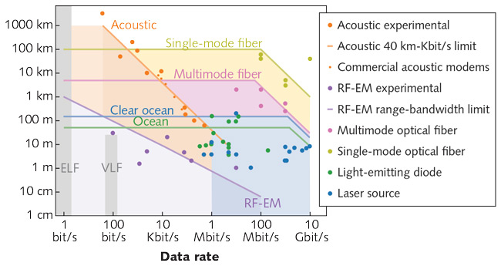
Traffic Conditions and Environment
Traffic Conditions:
Blue-green light propagates better as compared to other colors in underwater (around wavelength of 450 nm for clear, deep water, and shifted more towards green for coastal water)
Solar radiation may impact the transmitter and receiver design (Near ultraviolet may be better choice)
Multipath dispersion from scattering may be negligible until operating at more than 1 Gbit/s data rates [3]
The demonstrated data rate range varies between 1-100 Mbit/s with LEDs
Environment:
Clear ocean waters (<150-200 m )
Ordinary ocean waters (<50-75 m)
Coastal waters/Turbid harbor water
Shallow waters (e.g., rivers, lakes)
Short range underwater light communications

Slide 5
References
[1] Z. Zeng, S. Fu, H. Zhang, Y. Dong and J. Cheng, "A Survey of Underwater Optical Wireless Communications," in IEEE Communications Surveys & Tutorials, vol. 19, no. 1, pp. 204-238, Firstquarter 2017.
[2] Monia Ghobadi et. al, “ProjecToR: Agile Reconfigurable Data Center Interconnect”, Proceedings of the 2016 conference on ACM SIGCOMM 2016 Conference, August 22-26, 2016, Florianopolis, Brazil
[3] John Muth (North Carolina State University), “Free-space Optical Communications: Building a 'deeper' understanding of underwater optical communications”, May 10, 2017 http://www.laserfocusworld.com/articles/print/volume-53/issue-05/features/free-space-optical-communications-building-a-deeper-understanding-of-underwater-optical-communications.html
[4] https://www.youtube.com/watch?v=Zu-1-X7pwec

