Slide 1
Proposed Usage Models for IEEE 802.11 Light Communication Study Group
Date: 2018-01-18
Authors:

Slide 2
Abstract
A number of use cases for Light Communications (LC) were proposed in submissions [1-7] and discussed within the Light Communication Topic Interest Group (LC-TIG).
Potential usage models are expected to be further studied and explored as part of the effort to develop PAR and CSD for LC SG. It also could be useful for forming a usage model baseline document for future Task Group (TG).
This submission summarizes those use cases to highlight the advantages of LC and attempts to provide a baseline for further study and discussion.

Slide 3
Revision history
r0: initial version
r1: add detailed information for usage model 1b, 3, and 4

Slide 4
General Advantages of Light Communications
LC uses large amount of unregulated optical spectrum worldwide : no license fees and free to use.
No mutual interference with radio frequency bands. Electromagnetic Interference（EMI） free and safe for human health.
LC has very small cell therefore it can be densely deployed to achieve relative high network capacity (especially for downlink) and high accurate positioning. Interference among neighboring LC cells is potentially limited depending on the field of view (FOV) of lighting infrastructure and can be handled using various approaches [12-13].
Relative security and less interference from adjacent rooms : Compared to RF signals, light does not pass through walls, only covers confined and visible light illuminated area.
Ubiquitous LED lighting and its infrastructure can be reused for LC.

Slide 5
Usage Models Classified by Application Scenarios
1 | EMI sensitive area deployment | a | Hospital and health care
 |  | b | Industrial and manufacturing floor Automations
2 | Positioning and navigation services | a | Positioning and navigation in large buildings and underground spaces
 |  | b | Automatic guided vehicles
3 | Localized information service
4 | LC internet/intranet access

Slide 6
Terminology
Usage Model – A usage model is the combination of all the things below; not to be confused with a use case which is the specific set of steps to accomplish a particular task.
Pre-Conditions – Initial conditions before the use case begins.
Environment – The type of place in which the network of the use case is deployed, such as home, outdoor, hot spot, enterprise, metropolitan area, etc.
Application – A source and/or sink of wireless data that relates to a particular type of user activity. Examples are streaming video and VoIP.
Traffic Conditions – General background traffic or interference that is expected while the use case steps are occurring. Overlapping BSSs, existing video streams, and interference from cordless phones are all examples of traffic conditions.
Use case – A use case is task oriented. It describes the specific step-by-step actions performed by a user or device. One use case example is a user starting and stopping a video stream.

Slide 7
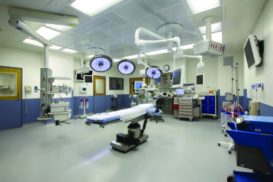
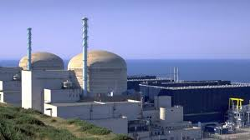
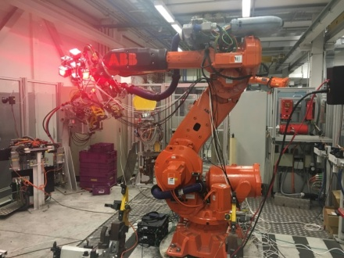
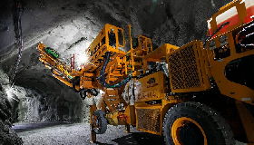
Usage Model 1: EMI Sensitive Area Deployment
Radio Frequency (RF) communications, such as 2.4/5GHz WLAN or cellular network, are prohibited in environments that are particular sensitive to EMI such as hospital, mining, nuclear power plant, manufacturing floor, etc. where may be equipped with many precision electronic instruments/equipment and require a EMI free environment. [14-15]
LC does not cause any mutual interference with other RF technologies and is safe for human health. Therefore LC is very suitable to be deployed to provide higher operating efficiency and better user experience in EMI sensitive environments where radio radiation is not allowed.
Hospital
Nuclear plant
Industrial robot
Underground mining

Slide 8
Usage Model 1a: Hospital and Healthcare Applications
Pre-Conditions
RF communication is prohibited for EMI issue. LC is deployed to provide wireless connectivity with higher diagnostic efficiency and better patient experience.
Environment
Hospital operating theater and MRI room usually are in the range of 30~60 m² equipped with multiple LC enabled instruments and equipment.
Multiple LC-APs are deployed on the room ceiling to provide multiple light links for a robust connectivity in case a single line-of-sight link is blocked.
Applications
LC is used to establish wireless data links between medical instruments and equipment, transmit medical multimedia and diagnostic information for telemedicine system; or wirelessly control medical equipment.
Provide network access when doctors use portable diagnostic devices.
Traffic Conditions
No interference caused by RF radiation from electronic
instruments.
Both uplink and downlink are using LC.
High QoS and high reliability are required.
Use Case
Doctors enter operating theater, turn on the LC enabled lights and medical equipment.
Doctors can interact with each other using multimedia tele-presence when treating a patient. Instruments can communicate with each other wirelessly by using LC.
Doctors finish the treatment, then turn off the lights and medical instruments.

Slide 9
Usage Model 1b: Industrial and manufacturing floor Automations
Pre-Conditions
RF communication may be restricted for EMI issue. Thus LC could be deployed to provide wireless connectivity for multiple industrial tasks.
Environment
Communications are within a large steel building, industrial or automated work cell area, which may be tens or hundreds of square meters or more, equipped with industrial robots and/or equipment etc. The environment is very electrically noisy, spark-gap noise (electric motors, etc.) or other technologies (RFID, RTLS, etc.).
Applications
All types of information are transmitted by LC. Large variances in data transfer size, time sensitivity, and reliability for multiple tasks, for examples:
Operating program transmission, instructions/control signals transmission between industrial robot and control computer/center.
Real-time surveillance video/audio transmission .
Machine-to-machine communications, robotic material handling requires high reliability but is less time sensitive.
Remote database access/storage.
Traffic Conditions
Both uplink and downlink are using LC.
High QoS and high reliability are required. Low latency (<5 ms is enough for >95% of all use cases.)
Multiple LC modules are deployed on the robot/equipment and at room ceiling/walls to provide multiple light links for a robust connectivity in case any line-of-sight link is blocked.
Use Case
An industrial robot is powered on and ready for operation.
Operating instructions are transmitted to the robot wirelessly via LC.
The robot is working according to the instructions.
Streaming of real-time feedback information and/or video monitoring are transmitted to control center also via LC.
The robot finishes the task and then is ready for the next one.

Slide 10
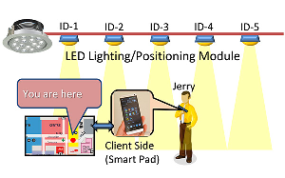
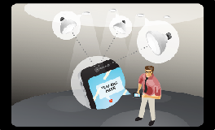
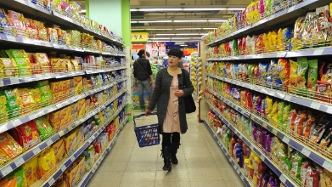
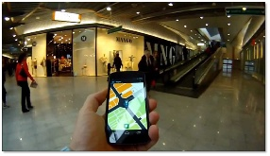
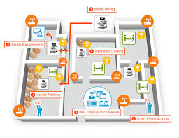
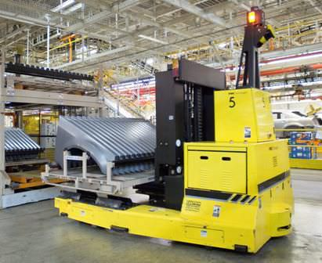
Usage Model 2: Positioning and Navigation Services
High density of light fixtures and LC-APs allow highly precise localization of users and paths, e.g. centimeter level accuracy for indoor positioning. This enables the provision of navigational directions for people within indoor places, such as transportation center, shopping mall, underground spaces, etc., where there is no or too week RF signal for positioning purpose.
LC also can be used for automatic guided vehicle to deliver goods in warehouse, etc.
Other applications: personnel item, vehicle or asset tracking, smart city, smart building, etc.
Indoor Positioning
Retail store
Shopping mall
Asset tracking
Automatic guided vehicle system

Slide 11
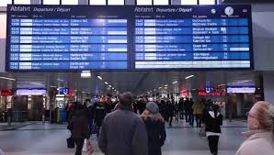
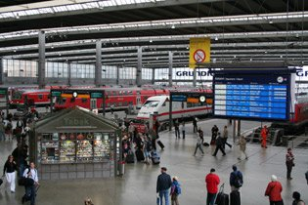
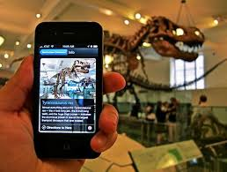
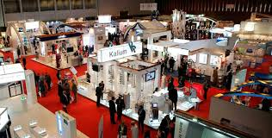
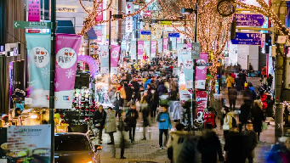
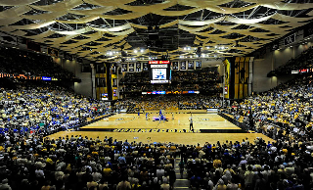
Usage Model 3: Localized Information Service
Localized information services may include:
Broadcast information for local service, for example, ticket/departure/arrive information at airport, railway station, etc.
Deliver promotion information, advertisement in text or video/audio, coupon to costumers in shopping mall or retail store etc.
Transmit location information to an app which triggers local service.
Push important event notification or disaster alert/warning to public.
Show detailed narration, explanation, back ground knowledge/information when people move to a specific spot in a museum or at an exhibition center, etc. for a self-guided tour.
Transmissions can be bidirectional or unidirectional downlink only.
Airport
Railway station
Museum
Exhibition
Commercial district
Arena

Slide 12
Usage Model 3: Localized Information Service
Pre-Conditions
The lighting infrastructure in public places is able to send localized information or a web link that could provide useful information to high density LC users. The localized information sent by LC can be updated via wired or wireless technologies. User can access the information by scanning the LC enabled light with a smart phone.
Environment
The lighting infrastructure could be LED spotlights, ambient lights, digital billboard. Communication distance varies from few centimeters to few tens of meters.
Applications
Museum or exhibition information broadcast, video, audio 100 Mb/s.
Information for augmented reality (AR) application (e.g., Pokemon GO).
Traffic Conditions
Potential interference from surrounding environments such as sunlight or artificial-light.
Interference with overlapping networks such as other LC lights.
Both uplink and downlink are using LC.
Use Case
Visitors are visiting a museum, each exhibit is illuminated by a spotlight that keeps sending pre-recorded information about the contents of the exhibit.
When a visitor moves to the next exhibit, the corresponding information will be automatically displayed on the user’s navigator.

Slide 13
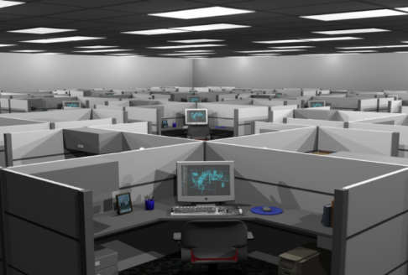
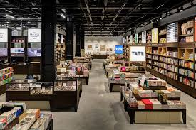
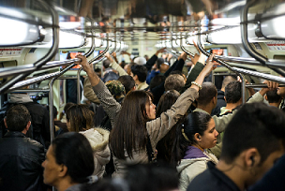
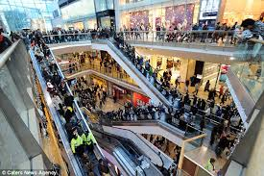
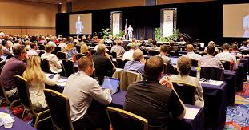
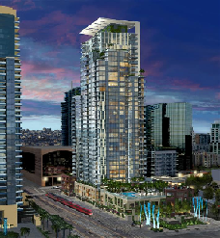
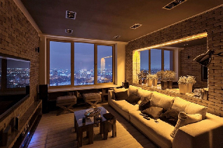
Usage Model 4: LC Internet/Intranet Access
LC-APs can be densely co-deployed with RF-APs to provide relative high capacity, reliable and secure wireless connectivity for internet/intranet access and various bandwidth consuming applications, as a complement to cellular or RF based WLAN for data offloading in high density environments, especially for downlink traffic. Today downlink internet/intranet traffic is several orders higher than uplink traffic.
Utilizing existing illumination infrastructure and flexible work/retail space connected through LC enable cost reductions for enterprises and retailers when modifying or refitting the space.
Enterprise
Retail space
Public transportation
Shopping mall
Conference hall
Dense apartment building

Slide 14
Usage Model 4: LC Internet/Intranet Access
Pre-Conditions
High density users access Internet through LC.
Environment
The environment may include conference rooms, small offices, transportation hubs and dense apartment buildings. The environments are very complex and may suffer severe RF interference. Each LC AP may serve 10 devices in ~ 4m² area. The inter- LC AP distance is in the range of 1~2m. Lighting level of 300 lux is recommended.
Applications
Video based applications: VOD, Contents Downloading; VHD highly compressed (1000 Mb/s) : 60% of users
Internet access: email, twitter, web surf, IM. (100 Mb/s): 30% of users
VPN applications; Contents (picture) uploading; Internet access: email, twitter, web surf, IM. (20 Mb/s): 10% of users
Traffic Conditions
Both uplink and downlink are using LC.
Interference between LC APs belonging to the same managed ESS due to very high density deployment.
Interference between LC APs belonging to different managed ESS due to the presence of multiple operators.
Potential interference from surrounding environments such as sunlight or artificial-light.
Use Case
Users connect to LC hotspots, perform a mixture of applications, including VOIP calls, FTP, Internet access, video conference.
Some users are in mobility (e.g., walking in the conference room).

Slide 15
References
11-17-0023-09-00lc-lc-tig-draft-report-outline.docx
11-17-0125-01-00lc-short-overview-of-light-communication.ppt
11-17-0166-00-00lc-technical-topics-for-iot-iol-internet-of-lights-based-lifi-occ-technology.pptx
11-17-0168-01-00lc-occ-and-lifi-based-light-communication-for-5g-revolution.pptx
11-17-0497-01-00lc-light-communication-use-cases.pptx
11-17-0584-00-00lc-light-communication-retail-use-cases.pptx
11-17-0625-00-00lc-overview-on-lc-use-cases.pptx
11-16-0137-04-00az-ngp-use-case-document.pptx
11-17-1048-04-00lc-lc-for-802-11-pdf.ppt
11-07/2988r3 “Wi-Fi Alliance (WFA) VHT Study Group Usage Models”, Andrew Myles, Rolf de Vegt
11-13/0657r6 “Usage models for IEEE 802.11 High Efficiency WLAN study group (HEW SG) – Liaison with WFA”, Laurent Cariou
M. Rahaim and T. D. C. Little, "Interference in IM/DD optical wireless communication networks," IEEE/OSA Journal of Optical Communications and Networking, vol. 9, no. 9, pp. D51-D63, 2017.
N. Chi and J. Shi, "Investigation on overlapping interference on VLC networks consisting of multiple LEDs," ICT Express, vol. 1, no. 2, pp. 63-66, 2015/09/01/ 2015.
P. M. Mariappan, D. R. Raghavan, S. H. E. Abdel Aleem, and A. F. Zobaa, "Effects of electromagnetic interference on the functional usage of medical equipment by 2G/3G/4G cellular phones: A review," Journal of Advanced Research, vol. 7, no. 5, pp. 727-738, 2016/09/01/ 2016.
M. Periyasam and R. Dhanasekaran, "Electromagnetic interference on critical medical equipments by RF devices," in 2013 International Conference on Communication and Signal Processing, 2013, pp. 78-82.

