Slide 1
Broadcast Service on WLAN
Date: 2017-11-06
Authors:

Slide 2
Abstract
This presentation describes a proposal of broadcast service on WLAN.

Slide 3
Motivation
Many people need common information at specific locations, such as
Live comments at a stadium,
Explanation at a tourist attraction,
Timetable at a train station,
Floor plan at a shopping mall, or
Emergency information.
We call them “local information” in this presentation.
Currently people need to do the following actions.
Search web site.
Get the local information by unicast traffic.
These actions waste channel time/bandwidth.
Broadcasting local information on WLAN can reduce per user bandwidth.

Slide 4
Broadcast Service on WLAN
WLAN is a suitable medium for local broadcasting service, but it is not used.
Radio wave is suitable for broadcasting based on its nature.
Anyone can listen in the range.
Frequently changed information, such as vacant space at a parking lot, can be reflected in real time.
IEEE802.11 WLAN has broadcast mechanism (group address)
Unlicensed
Locality
Low cost
Currently used broadcasting services on WLAN, such as YouTube Live, Facebook Live
Application layer broadcasting
It is composed of many independent unicast streams in a single BSS.
The occupied bandwidth is proportional to the number of participating users.
The current model suffices if users are distributed world-wide, but works highly inefficiently when they are located in a small area.

Slide 5
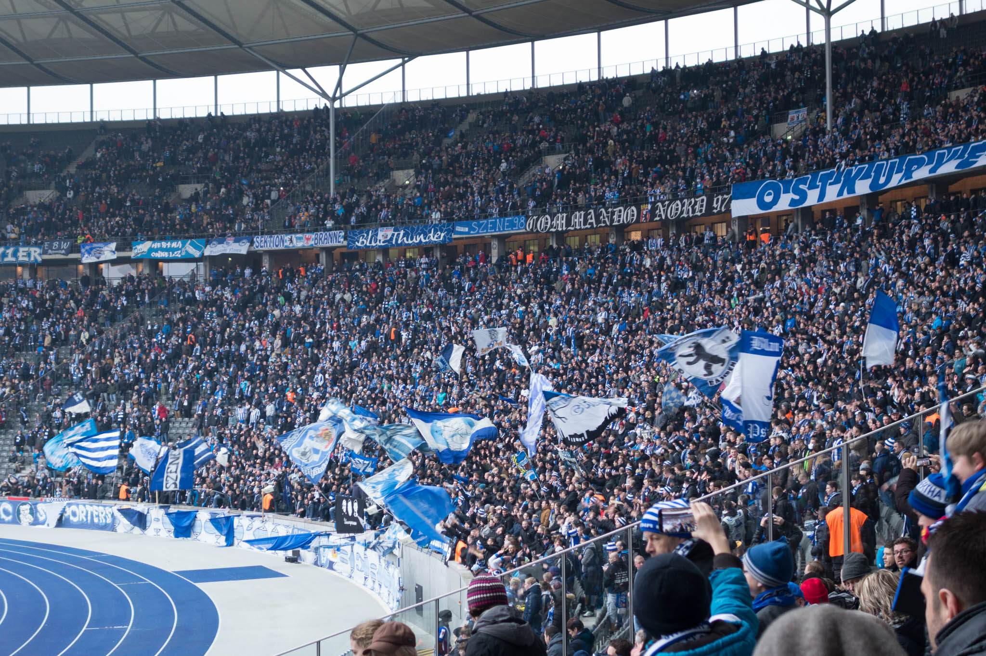
Use Case 1 (Audio Guidance)
AP
Train
STA
Anyone in stadium, museum or zoo who has a smartphone can listen audio guidance/comments without additional hardware.
Multiple logical channels can be used. Multilingual broadcasting can be supported on a single radio channel.
Of course, any type of data can be broadcast, such as video, text, HTML…

Slide 6
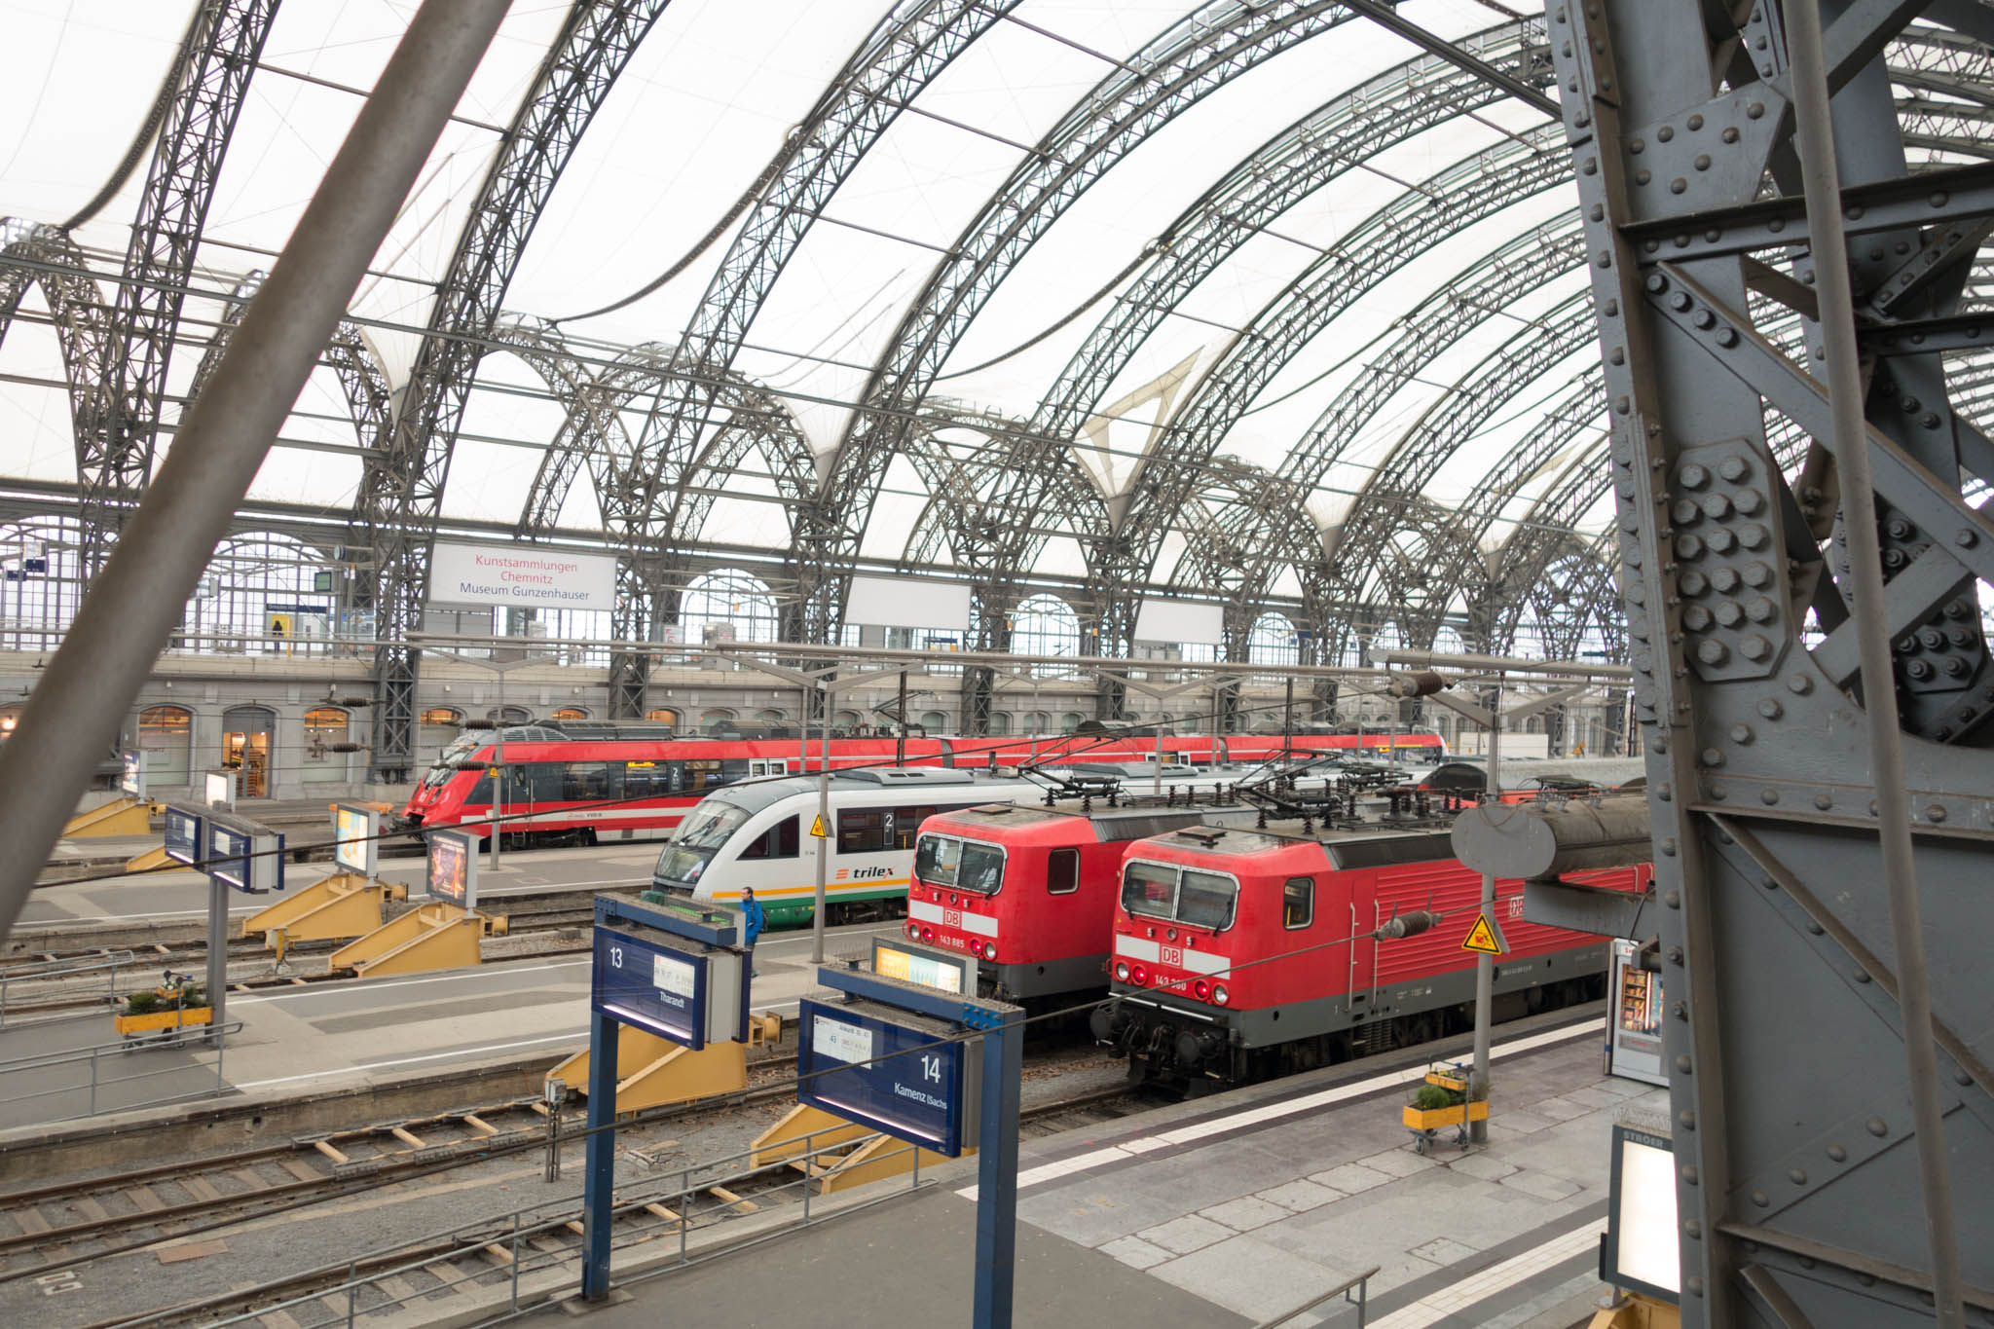
Use Case 2 (Floor Guide, Timetable, Advertisement)
AP
Train
STA
Smartphone
Digital Signage Device
Anyone in a shopping mall, conference venue like here, who has a smartphone can see the floor guide on their device.
Anyone in a train station who has a smartphone can see the timetable on their device.
Digital signage device in the area can show the same information.

Slide 7
Use Case 3 (Emergency Information)
Broadcasting infrastructure can be used for distributing emergency information such as:
Evacuation guidance in case of fire.
Earthquake warning.
Food information in a shelter.

Slide 8
Use Case 4 (Sensor Data Collection)
Sensors can broadcast their data.
Assume to collect sensor data periodically.
If association is not required, sensors transmit just data frames periodically.
This means periodical data collection by broadcast may reduce sensor power consumption.
Data Collector
Data Collector
Sensor
Sensor
Sensor
Sensor
Periodical Data
Association
Data Collector
Data
Data
Sensor
Sensor
By existing standard
By broadcast

Slide 9
What to Consider
Security
Transmitters have to be authenticated by receivers.
Encryption should be optionally supported.
Session Establishment
Simplify the session establishment.
QoS
For broadcast frames.
For other frames.
Application Selector
Identify the type of contents (text, audio, video...) to select application.

Slide 10
Security Requirements
To prevent fake information distribution, the source of information shall be identified.
Because of dense deployment in the assumed use cases, the fake AP causes a disruption of the services.
Every broadcast frame shall be authenticated by the receivers.
Encryption may be optional.
Most broadcasting contents are considered as public and preferred to be widely distributed.
But private broadcast service should be supported.

Slide 11
Current Broadcast Security on WLAN
Required to join GTKSA.
GTK and Key RSC are shared by EAPOL-key or, in case of 802.11ai, Key Delivery element in Association Response.
Current GTKSA uses AES, a kind of “Symmetric-key algorithm”.
An AP and non-AP STAs in a GTKSA shares the same GTK and Key RSC/TSC.
The AP encrypts broadcast frames by using the GTK and the Key TSC.
The non-AP STA decrypts broadcast frames by using the GTK and the Key RSC.
This means “Any STAs which can decrypt broadcast frames can produce encrypted broadcast frames”.
So a malicious user can produce fake broadcast frames.
The receivers can NOT check the integrity of broadcast frames.
AP
Encrypt
(GTK, TSC)
AP
Mac address spoofing
STA
STA
STA
malicious
STA
Decrypt
(GTK, RSC)
STA
Decrypt
(GTK, RSC)
Decrypt
(GTK, RSC)
STA
Encrypt
(GTK, RSC)
Decrypt
(GTK, RSC)
Decrypt
(GTK, RSC)

Slide 12
Public Key Based Frame Authentication
AP
STA
To prevent fake AP issue, use public key.
Public key algorithms are high cost.
It should be combined with shared key algorithm.
Every frame shall have an authenticator to provide per frame authentication.
Limit the receivers by the existing GTKSA mechanism
Encrypt the key and data by GTK.
Or, create new mechanism.
Public Key
Data + Authenticator
Data + Authenticator
Data + Authenticator
Data + Authenticator
Data + Authenticator
AP
STA
Establish GTKSA
encrypt(Key)
encrypt(Data + Authenticator)
encrypt(Data + Authenticator)
encrypt(Data + Authenticator)
encrypt(Data + Authenticator)
encrypt(Data + Authenticator)

Slide 13
Session Establishment
AP
STA
In case of not using encryption, the required security can be provided without existing Authentication/Association.
Other negotiations in existing Association are not required in broadcast services.
All parameters are decided only by the AP.
This may cause state machine modification and/or new broadcast data frame definition.
In case of using encryption, existing Authentication/Association can be used for establishing GTKSA.
If the AP and the STAs can share the key, existing Authentication/Association may be omitted even in case of using encryption.
Public Key
Data + Authenticator
Data + Authenticator
Data + Authenticator
Data + Authenticator
Data + Authenticator
AP
STA
Establish GTKSA
encrypt(Key)
encrypt(Data + Authenticator)
encrypt(Data + Authenticator)
encrypt(Data + Authenticator)
encrypt(Data + Authenticator)
encrypt(Data + Authenticator)

Slide 14
QoS Considerations
QoS for broadcast frames
In general, the loss rate of broadcast frame is higher than unicast frame.
Broadcast does not have ACK mechanism.
Existing 802.11 uses BCC/LDPC.
Is required stronger FEC/Interleaving algorithm?
Consider to apply 802.11aa GCR mechanism.
In this case, association to AP is required.
QoS for other .11 frames
How much bandwidth can be used for broadcasting?
Define limit of bandwidth?
Adaptive control?
Consider to apply 802.11aa OBSS management.

Slide 15
Higher Layer Support
Broadcast service on WLAN is used only between an AP and STAs.
Routing is not required.
IP is not required.
Broadcast service on WLAN is one-way service from an AP to STAs.
Flow control, such as TCP is not required.
To simplify the protocol, application layer will locate just above the IEEE802.11 layer.
IEEE802.11 should define application selector such as RTP, MIME.
IEEE802.11 header
Application selector
Application data
Expected frame format

Slide 16
Conclusion
Broadcast service on WLAN can improve user experience.
For broadcast service on WLAN, the following works are required.
Frame authentication mechanism
State machine modification
QoS
Application selector
It’s time to start work for broadcasting
Because we can assign “IEEE802.11bc” for broadcasting!

Slide 17
Comments & Questions

Slide 18
Straw poll
Do you support to form study group for “broadcast service on WLAN”?
Yes:
No:
Don’t care:
Need more info:

