Slide 1
Multi-TID Aggregation for 11ay
Date: 2017-11-06
Authors:

Slide 2
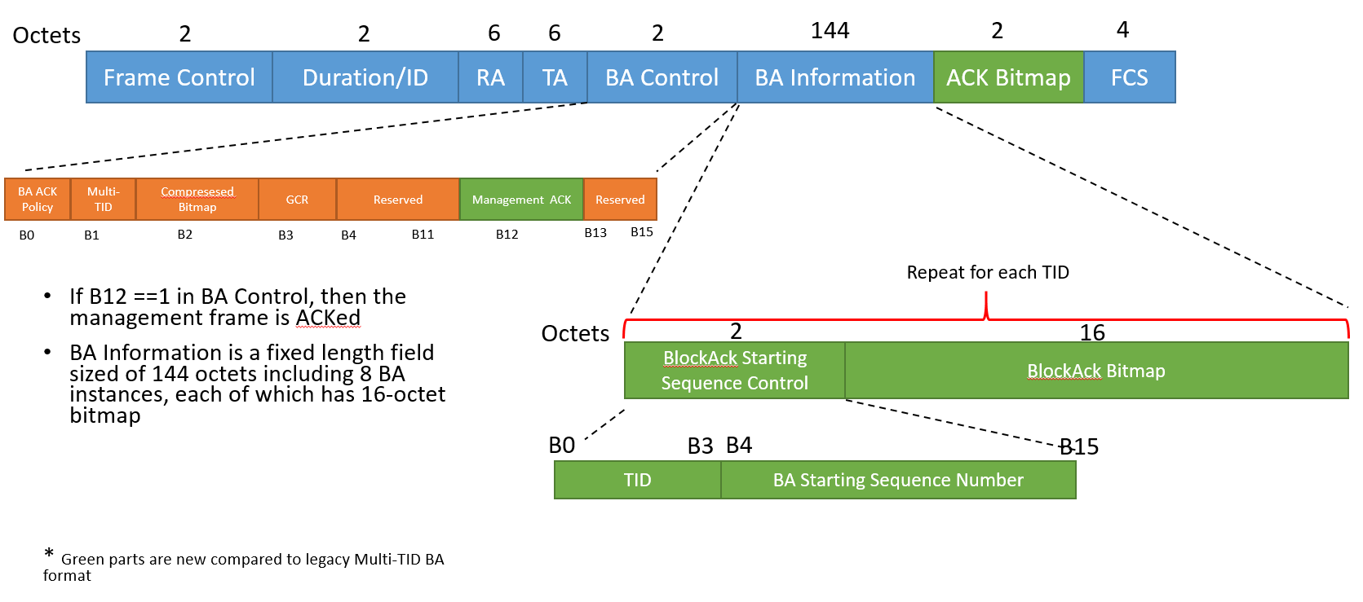
Introduction
Since the draft D0.1, the Multi-TID BA design changes a lot compared with the Spec Framework Document but is more in accordance with 11ax design
The fixed length (1024-bit) bitmap for 8 TIDs is replaced with variable length bitmap for each TID
The ACK bitmap for possible single MPDU that does not have a BA session setup is accidently dropped

Slide 3
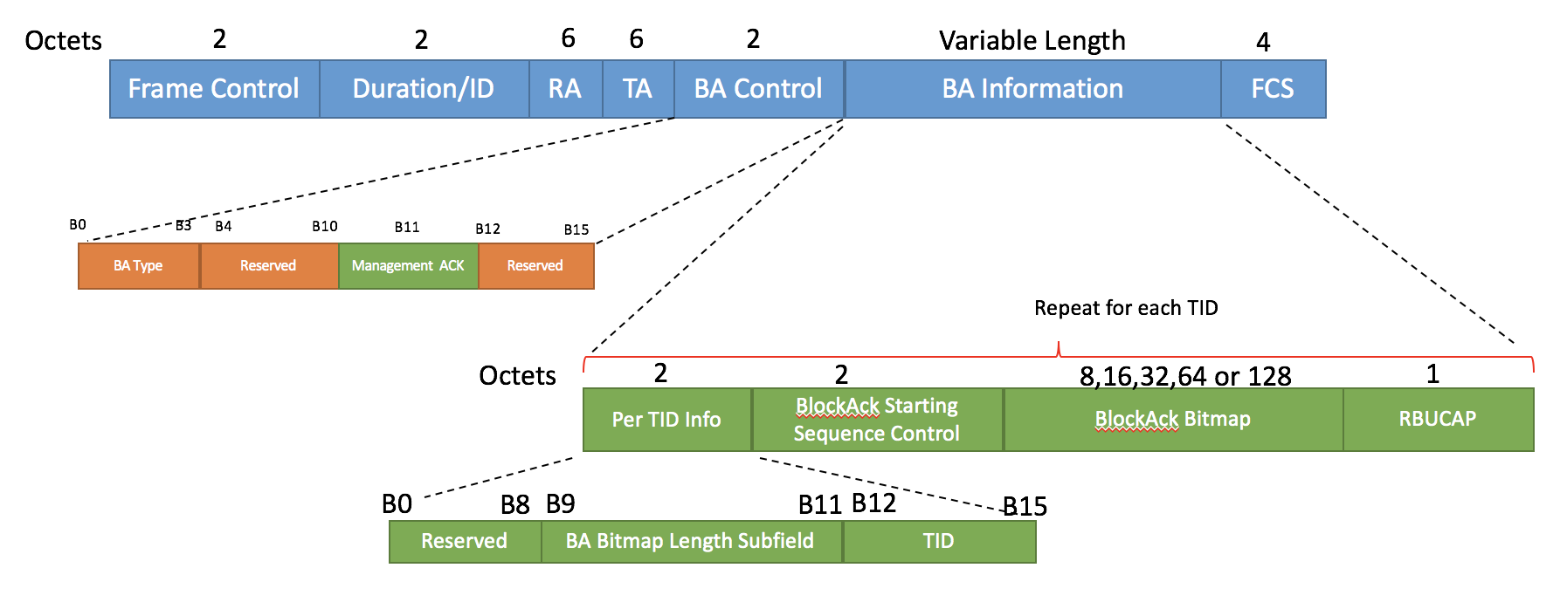
Latest Multi-TID BA Format

Slide 4
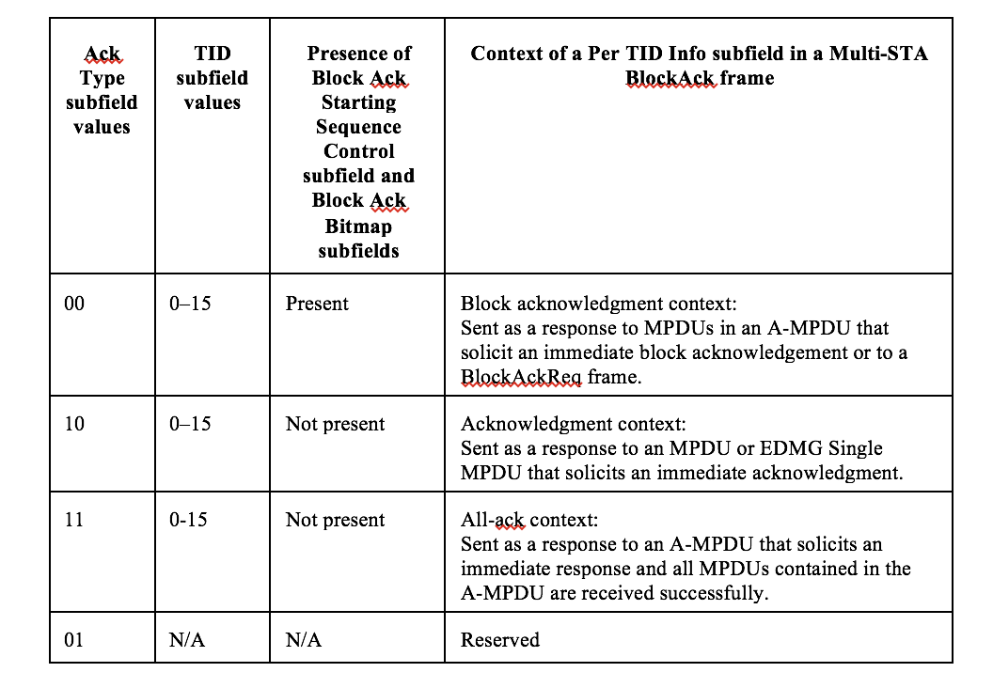
Enabling the ACK for Single MPDU in an Multi-TID Aggregation
Further modification to “Per TID Info” subfield
B0
B6
B7
B8
B9
B11
B12
B15
Reserved
Ack Type
Block Ack Bitmap Subfiled Length
TID

Slide 5
Aggregation Rules
A multi-TID A-MPDU transmitted in an EDMG SU PPDU may contain an MPDU or EDMG Single MPDU that solicits an immediate acknowledgment of any TID.

Slide 6
Straw Poll
Do you agree to to add the enhancement of Multi-TID BA design shown on Slide 4 and Slide 5 to current spec draft?
Y
N
A

Slide 7
Reference
[1] Multi-TID aggregation for 11ay, https://mentor.ieee.org/802.11/dcn/16/11-16-0932-00-00ay-multi-tid-aggregation-for-11ay.pptx
[2] Spec Framework for Tgay, https://mentor.ieee.org/802.11/dcn/15/11-15-1358-08-00ay-specification-framework-for-tgay.doc

