Slide 1
Enabling Frame Body Capture Effect
Date: 2017-11-06
Authors:
Name | Affiliation | Address | Phone | Email
Evgeny Khorov | IITP RAS; NRU HSE |  |  | khorov@frtk.ru
Alexey Kureev | IITP RAS
Ilya Levitsky | IITP RAS

Slide 2
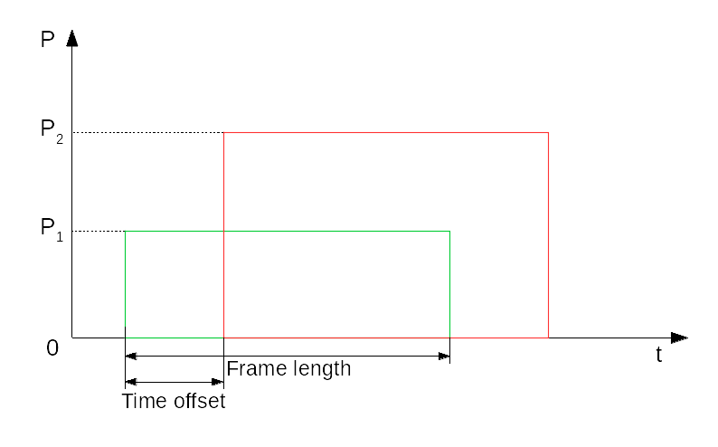
Problem
In dense deployment, it may happen that a stronger frame from own BSS arrives when a STA is already synched to a weaker frame (e.g. from an alien BSS)
Power
time

Slide 3
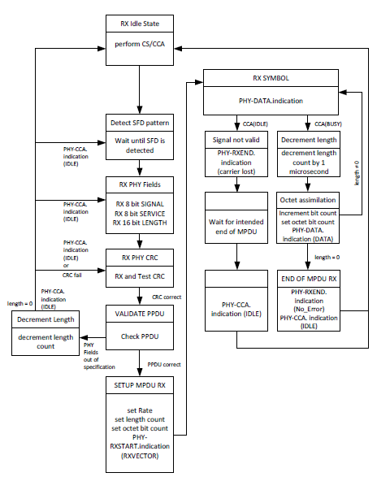
Receive State Machine (DSSS PHY)
In the event that a change in PHYCS or PHYED would cause the status of CCA to return to the IDLE state
before the complete reception of the MPDU, as indicated by the PHY LENGTH field, the error condition
shall be reported to the MAC using a PHY-RXEND.indication(CarrierLost) primitive. The CCA of the
DSSS PHY shall indicate a busy medium for the intended duration of the transmitted packet.

Slide 4
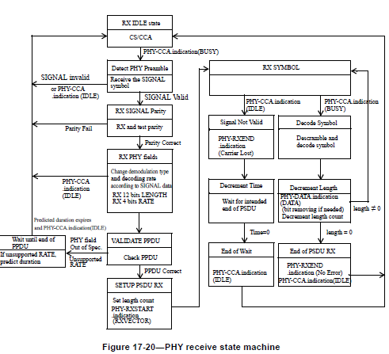
Receive State Machine (OFDM)

Slide 5
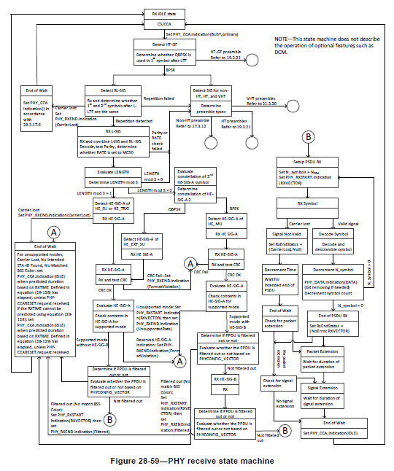
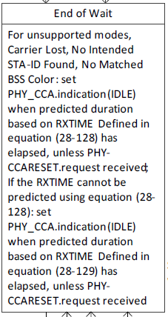
Receive State Machine (11ax)
The same happens here

Slide 6
Consequences
Power
time
In this case, both frames will be lost:
The green one will be lost because of huge interference
The red lime will be lost because the receiving STA was synched to the green frame
However, at least red frames could be received

Slide 7
Testbed
We evaluated behavior of off-the-shelf devices in this scenario with the following testbed

Slide 8
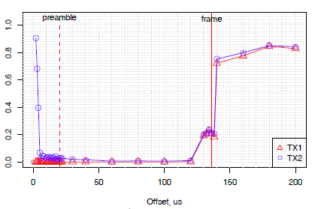
Frame Body Capture Effect IS NOT Present
Frame receive ratio
Both frames are lost

Slide 9
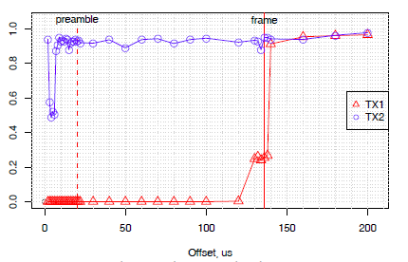
Frame Body Capture Effect Is Present
Stronger frame is
correctly received
Frame receive ratio
This is not aligned to the standard

Slide 10
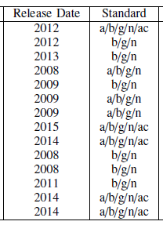
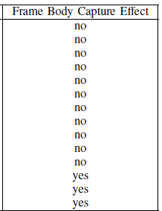
Real Devices Analyses
Vendors and Device names are hidden
Some devices support the feature

Slide 11
Conclusion
Allowing switching to a stronger frame is fruitful since give an opportunity to a STA to receive at least one frame in case of overlapped frames.
This feature is currently implemented in some devices.
This feature is not allowed by the standard.
We need to allow this feature.
In case of a stronger frame arrive, a STA may switch to this frame, operating as if the weaker frame were not received.

Slide 12
Straw Poll
Do you agree that 802.11 should allow switching to a stronger frame during frame body of a weaker one
Y
N
A

Slide 13
Motion
- Do you agree to add the following para to the end of Sections 15.3.7, 16.2.6, 17.3.12, 19.3.21, 20.9, 21.3.20, 23.3.19 (all entitled ‘PHY receive procedure’)?
It may happen that several frames overlap and a stronger frame starts later than the weaker one. To allow reception of at least the stronger frame, at any state of the PHY receive state machine, the STA can perform detection of a new frame start and switch to a new frame with higher power.
Y
N
A

