Slide 1
Unsolicited Block ACK Extension
Date: 2017-11-06
Authors:

Slide 2
Abstract
This presentation describes a proposal for simplifying the establishment of Block ACK agreements. It has already been incorporated into 802.11ay Draft 0.8, but is applicable to other 802.11 devices as well.

Slide 3
Motivation (1)
The establishment of Block Ack agreements can create overhead and does not scale well for a large BSS
Prior to sending A-MPDU frames with Block Acknowledgement, stations must exchange management frames (ADDBA Request/ADDBA Response) to establish an agreement per receiver station and per TID
With 100 stations in a BSS and 16 TIDs per STA, that is a total of 1600 agreements
With static TIDs [0-7] and 32 stations, that is still 256 agreements
To sustain links with high throughput and to support roaming, an AP must halt data transmission to establish the block ack agreement using ADDBA management flow.
Each Block ACK agreement requires HW and SW resources at both the transmitter and receiver
A-MPDU scheduler, scoreboard, and reorder buffer

Slide 4
Motivation (2)
The 802.11ay solution to minimize the management frame exchanges
Use Unsolicited Block ACK Establishment
To limit use of HW resources
Do not aggregate for all TIDs and/or stations
Use of DELBA and ADDBA later as neede

Slide 5
Motivation (3)
Reorder buffer issues
Reorder buffer cause frames to stay in the queue for a longer time and thus adds latency
Buffers in the reorder buffer must wait to be in in order acked and thus can’t be released
These buffers can’t be used for other traffic <TA-TID>
This creates a burden, especially for lower cost devices

Slide 6
Unsolicited Block Ack Agreement
Why do we need the setup and teardown process? Is there a way to eliminate it and still be able to use BA agreements?
MPDU<->ACK does not require Agreement
A-MPDU<->BACK can have an unsolicited (implicit) agreement
The idea is to have the transmitter send A-MPDUs and receive block ack as if it sent a single MPDU and received an ACK
Need to address 2 issues:
Re-order buffer
Scoreboard

Slide 7
Solution (Receiver Buffers)
Treat the reorder buffer the same we treat the score board for partial state
Scoreboard keeps a scratch pad for the BA to follow the partial/full state
Reorder buffer only lives while receiving from the same <TA,TID> combination
Once the TA/TID is changed (or end of a TxOp/Service Period):
Frames are flushed from the first unacked frame
This allows the receiver to free up its buffer resources, pushing the queuing back to the transmitter

Slide 8
Solution (Transmitter)
At the beginning of a new TXOP/Service Period
Receiver may have flushed frames from the first un-acked frame
Transmitter can
just transmit the frames from the first unacked and continue, or
Or, the transmitter can send a BAR and get the status of the block ack agreement

Slide 9
Block Ack Parameter Set Element
This element is the main element exchanged in the ADDBA Req/Resp agreement
The Receiver values are the values that take place in case they are lower that the transmitter
Proposal
Unsolicited Block ACK Extension element added to the Probe (REQ/RESP), Association/Re-association (REQ/RESP) and in the information response frame if a direct STA to STA communication is needed.

Slide 10
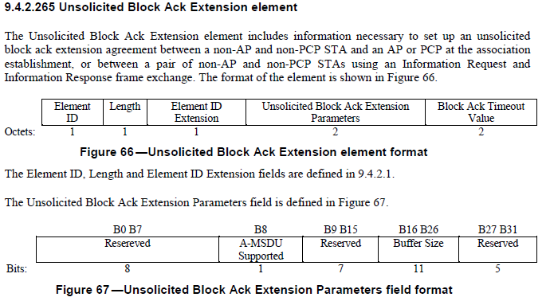
Frame Formats (from 802.11ay)

Slide 11
From 802.11ay (2)

Slide 12
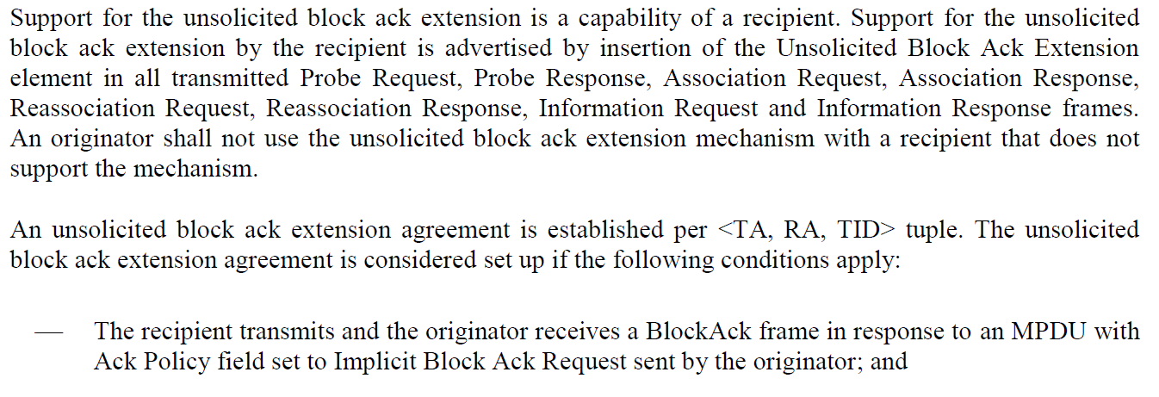
From 802.11ay (3)

Slide 13
Summary of Benefits
No Need for Negotiation (No ADDBA Req/Resp)
Always able to send frames using A-MPDU
Receiver will always accept the frames
Same resources shared across all TA and TIDs
No need to manage or implement load balancing and dynamic allocation of agreements
No need for buffering at the AP with multiple stations/streams

Slide 14
References
IEEE 802.11ay Draft 0.8

