Slide 1
Contention Based UL-OFDMA Random Access without back-off
Date: 2017-11-5
Authors:
Name | Affiliation | Address | Phone | Email
Hongyan Li | Xidian University | 2 South Taibai Road, Xi’an Shaanxi, 710071, P.R.China | +86-13709218225 | hyli@xidian.edu.cn
Ronghui Hou |  |  |  | rhhou@xidian.edu.cn
Xiaoyao Ma |  |  |  | str2num_mxy@126.com

Slide 2
Introduction
Following the research status of the next generation WLAN, we regards the research of OFDMA based multiple access and the design of prototype system as the focus and try to solve the problem of channel access and transmission in dense deployment scenarios to achieve higher spectral efficiency and better regional throughput.
In this contribution,
an enhanced OFDMA multiple access scheme is proposed.
The comparison is shown in the simulation.

Slide 3
Contention Based UL-OFDMA Random Access without back-off
Step 1: AP send a UA-Trigger frames in each subchannel simultaneously to inform stations of uplink transmission.

Slide 4
Contention Based UL-OFDMA Random Access without back-off
Step 2 : Once received UA-Trigger frame, All the stations select a time-frequency resource block to transmit an UA-response frame to request uplink access.

Slide 5
Contention Based UL-OFDMA Random Access without back-off
Step 3:
-AP receives UA-Response frames and counts the number of uplink transmission stations.
-According to the number of uplink-stations , AP sends Trigger frame in each subchannel to allocate time-frequency resource to uplink-stations.

Slide 6
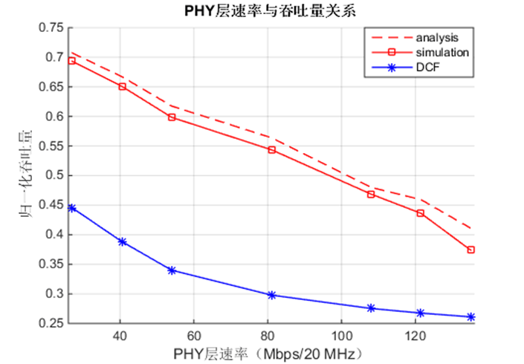
Simulation
Comparison between current DCF and UL-OFDMA random access.
Our method can increase the throughput by 73.33% compared to current DCF.
Parameter | Value
Num of STA | The num of sta increment from 40 to 120 by 20.
Num of sub-channel | 8
Num of slots | 10
Bandwidth of sub-channel | 20MHz
Bandwidth | 160MHz
Normalized Throughput
PHY Rate (Mbps/ 20MHz)

Slide 7
Conclusion
In this presentations, we introduce a method called Contention Based UL-OFDMA Random Access without back-off to improve the network’s performance in dense scenario.
Performance of UL-OFDMA Random Access without back-off and DCF has been compared.

