Slide 1
Phase Hopping Modulation
Date: 2017-11-6
Authors:

Slide 2
Introduction
  Draft IEEE802.11ay D0.8 [1] includes OLSM-PH (Open Loop Spatial Multiplexing with Phase Hopping)[2][3] as OLSM in OFDM.
This contribution proposes parameters of OLSM-PH for OFDM and a change of the draft text.

Slide 3
MCS in OLSM-PH for OFDM
    First of all, we discuss average throughput. Regarding average throughput, we consider the following points:
    - Basically, the same modulation orders are adopted.
    - X [bit/slot] keeps enough granularity where X is average throughput.
    - Modulation sets are selected without large difference of modulation
    orders.
    Therefore, we propose average throughput as 2, 4, 6, 8 and 12 [bit/slot] in OLSM-PH for OFDM. In OLSM-PH for OFDM, (SQPSK,SQPSK), (QPSK,QPSK), (QPSK,16QAM) , (16QAM,QPSK), (16QAM,16QAM) and (64QAM,64QAM) as modulation sets is supported.
    *1 slot is composed of 2 symbols (=1 [symbol/streams] x 2 [streams]).

Slide 4
The motion passed regarding OLSM-PH for OFDM
  The contribution of [3] proposed OLSM-PH with precoding as OLSM and the following motion has been passed.
  Do you agree to modify the following in clause 6.1 of the SFD:
  “For EDMG OFDM mode, the 11ay specification shall define SU EDMG PPDU transmission with and without phase hopping. An EDMG STA may support transmission and reception of SU EDMG PPDU with phase hopping. In this mechanism, the following apply:
  - Precoding may be used
  - The period of phase hopping is TBD.”
  This contribution discusses and proposes parameters (i.e. precoding matrices, period of PH and so on) in OLSM-PH for OFDM.

Slide 5
Relationship between PH and interleaving
    We propose that PH block is disposed before symbol interleaver operated in 16QAM and 64QAM. In this case, PER performance is improved in LOS environments, because an effect of phase hopping is obtained (i.e. each CW has equivalent number of each phase rotation).

Slide 6
Proposed PH period (1/4)
Regarding CW length (672= 2⁵x3x7) of non-punctured codes, the contribution of [2] obtained the following result regarding PH period in vertical encoding.
- PER performances with PH periods of 7, 8, 16, 32 and 64 are close.
By the way, Draft P802.11ay D0.8 [1] defines DMG 7/8 codes with CW length 624(=2⁴x3x13) and 1248(=2⁵x3x13) for 7/8 transmission.
Regarding these points, PH period is set to 8.
The following slides discuss initializing scheme with PH period 8.

Slide 7
Proposed PH period (2/4)
The relationship between PH period (=8) and CW length in vertical encoding is shown when CW lengths are 672 and 624 (i.e. short code).
Table 1: The number of required symbols when 1CW with 624 and 674 bits is transmitted.
 | PH period 8
 | CW length 672 | CW length 624
(SQPSK,SQPSK) | 336 symbols =42 periods | 312 symbols =39 periods
(QPSK,QPSK) | 168 symbols =21 periods | 156 symbols =19.5 periods
(QPSK,16QAM) | 112 symbols =14 periods | 104 symbols =13 periods
(16QAM,16QAM) | 84 symbols =10.5 periods | 78 symbols =9.75 periods
(64QAM,64QAM) | 56 symbols =7 periods | 52 symbols =6.5 periods
The number of yellow cell is 3.

Slide 8
Proposed PH period (3/4)
The relationship between PH period (=8) and CW length in vertical encoding is shown when CW lengths are 1344 and 1248 (i.e. long code).
Table 2: The number of required symbols when 1CW with 1248 and 1344 bits is transmitted.
 | PH period 8
 | CW length 1344 | CW length 1248
(SQPSK,SQPSK) | 672 symbols =84 periods | 624 symbols =78 periods
(QPSK,QPSK) | 336 symbols =42 periods | 312 symbols =39 periods
(QPSK,16QAM) | 224 symbols =28 periods | 208 symbols =26 periods
(16QAM,16QAM) | 168 symbols =21 periods | 156 symbols =19.5 periods
(64QAM,64QAM) | 112 symbols =14 periods | 104 symbols =13 periods
There are one cell in PH period 8.

Slide 9
Proposed PH period (4/4)
Regarding treatment in yellow cell, we propose that PH is reset in the beginning of each codeword in all modulation cases supported in 30.6.6.3.9.
Example : (QPSK,QPSK) with CW length 624
    19.5 periods
    CW_{#1}
    CW_{#2}
    Stream#1
    CW_{#1}
    CW_{#2}
    Stream#2
Phase[0]
Phase[3]
Reset
Phase[0]
*PH value is expressed as Phase[i] where i=0,1,…,7.

Slide 10
Proposed precoding matrices (1/3)
    The contribution of [4] proposed additional SU-MIMO EDMG-Header-A fields to indicate whether precoding is applied or not, and the related motion has been passed. The principle to define precoding matrices is as follows.
    (SQPSK,SQPSK) : Same matrix as DCM
    (QPSK,QPSK) : Hadamard matrix
    (QPSK, 16-QAM) : A matrix to obtain maximal capacity
    (16-QAM,16-QAM), (64-QAM,64-QAM) : Hadamard matrix

Slide 11
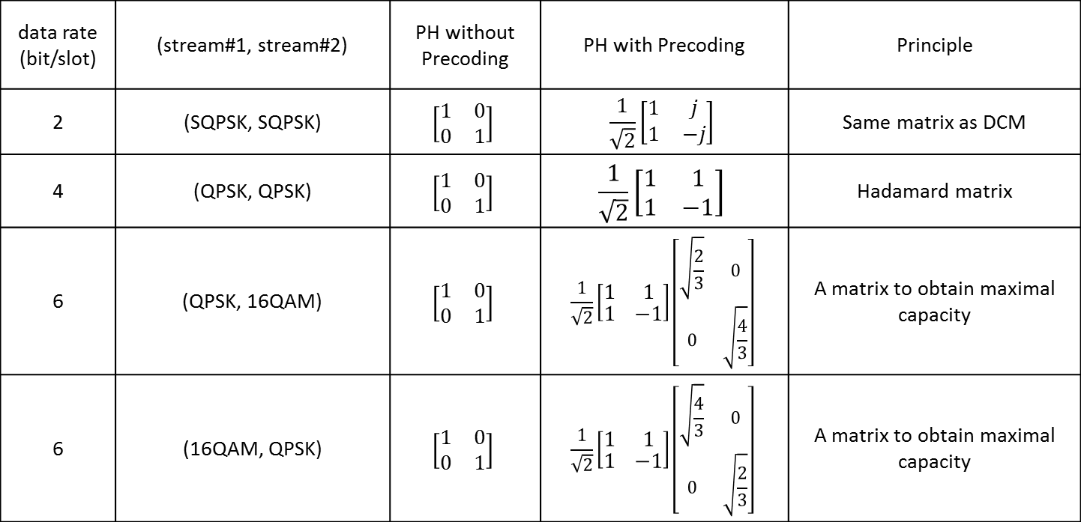
Proposed precoding matrices (2/3)
data rate (bit/slot) | (stream#1, stream#2) | PH without Precoding | PH with Precoding | Principle
2 | (SQPSK, SQPSK) | $$\left[\begin{matrix}1 & 0 \\ 0 & 1\end{matrix}\right]$$ | $$\frac{1}{\sqrt{2}}\left[\begin{matrix}1 & j \\ 1 & −j\end{matrix}\right]$$ | Same matrix as DCM
4 | (QPSK, QPSK) | $$\left[\begin{matrix}1 & 0 \\ 0 & 1\end{matrix}\right]$$ | $$\frac{1}{\sqrt{2}}\left[\begin{matrix}1 & 1 \\ 1 & −1\end{matrix}\right]$$ | Hadamard matrix
6 | (QPSK, 16QAM) | $$\left[\begin{matrix}1 & 0 \\ 0 & 1\end{matrix}\right]$$ | $$\frac{1}{\sqrt{2}}\left[\begin{matrix}1 & 1 \\ 1 & −1\end{matrix}\right]\left[\begin{matrix}\sqrt{\frac{2}{3}} & 0 \\ 0 & \sqrt{\frac{4}{3}}\end{matrix}\right]$$ | A matrix to obtain maximal capacity
6 | (16QAM, QPSK) | $$\left[\begin{matrix}1 & 0 \\ 0 & 1\end{matrix}\right]$$ | $$\frac{1}{\sqrt{2}}\left[\begin{matrix}1 & 1 \\ 1 & −1\end{matrix}\right]\left[\begin{matrix}\sqrt{\frac{4}{3}} & 0 \\ 0 & \sqrt{\frac{2}{3}}\end{matrix}\right]$$ | A matrix to obtain maximal capacity
    QPSK
    16QAM
    16QAM
    QPSK

Slide 12
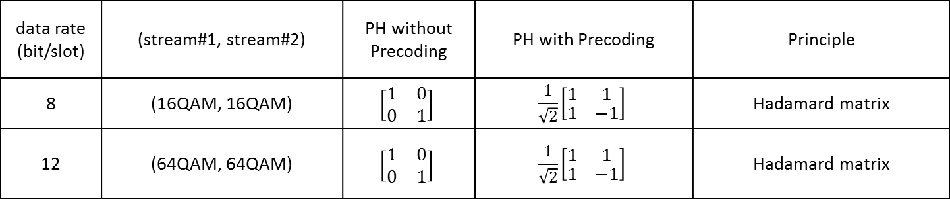
Proposed precoding matrices (3/3)
data rate (bit/slot) | (stream#1, stream#2) | PH without Precoding | PH with Precoding | Principle
8 | (16QAM, 16QAM) | $$\left[\begin{matrix}1 & 0 \\ 0 & 1\end{matrix}\right]$$ | $$\frac{1}{\sqrt{2}}\left[\begin{matrix}1 & 1 \\ 1 & −1\end{matrix}\right]$$ | Hadamard matrix
12 | (64QAM, 64QAM) | $$\left[\begin{matrix}1 & 0 \\ 0 & 1\end{matrix}\right]$$ | $$\frac{1}{\sqrt{2}}\left[\begin{matrix}1 & 1 \\ 1 & −1\end{matrix}\right]$$ | Hadamard matrix

Slide 13
Discussion of performance
  The contributions of [2][3] showed that OLSM + PH scheme has an advantage for performance in LOS environment. In addition, the following results were obtained.
  - Performance with non-precoding + PH in (SQPSK,SQPSK), (QPSK,QPSK), (16QAM,16QAM)
  and (64QAM,64QAM)
  - Performance with Hadamard precoding + PH in (QPSK,QPSK), (16QAM,16QAM)
  and (64QAM,64QAM)
  - PER performances with PH periods of 7 and 8 are close
  Therefore, PER performances at the following cases in LOS environment are discussed.
  - (SQPSK,SQPSK) with precoding(/non-precoding) + PH
  - (QPSK,16QAM) with precoding/non-precoding + PH

Slide 14

Simulation conditions
    MIMO* :Comparison of precoding/no precoding with/without PH
    Period of PH is 8.
    Phase change matrix :
    * Vertical encoding is adapted
    Modulation sets : (SQPSK,SQPSK),(QPSK,16QAM)
    Channel model : LOS model #1 (See Appendix)
    α=-5dB
    (α is power attenuation coefficient of cross-link terms)
    FEC : 11ad LDPC codes (Codeword size=672 bits)
    Detection : MLD(Maximum Likelihood Detection),
    MMSE (Minimum Mean Square Error)
$$\left[\begin{matrix}1 & 0 \\ 0 & e^{j}\frac{3π×\left(k mod 8\right)}{4}\end{matrix}\right]$$

Slide 15
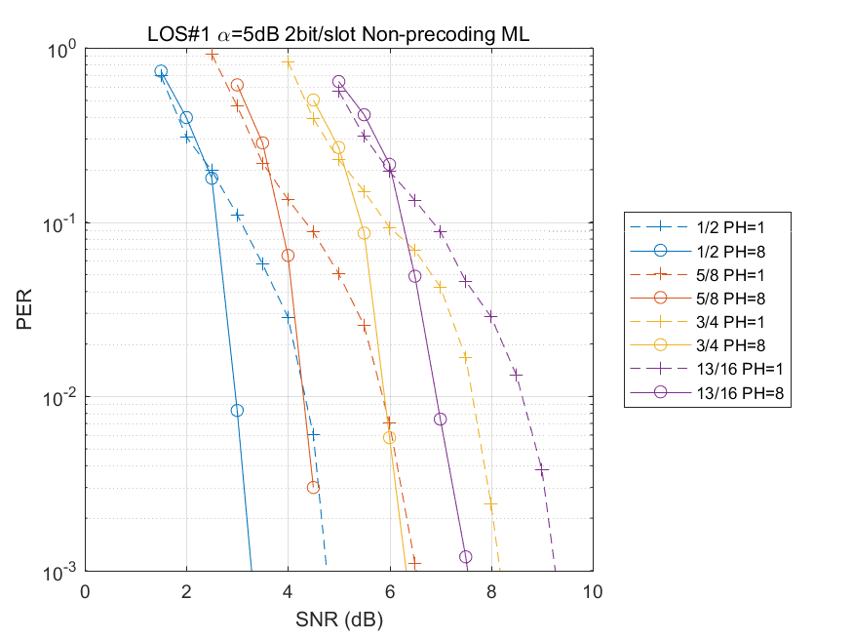
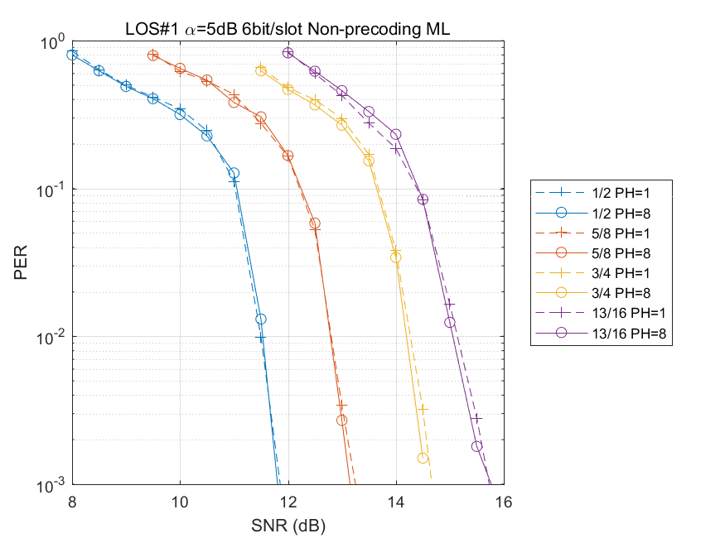
(1)Comparison: no-precoding with/without PH (LOS #1: α=-5dB; MLD)
    (SQPSK,SQPSK)
    (QPSK,16QAM)
PH has gain

Slide 16
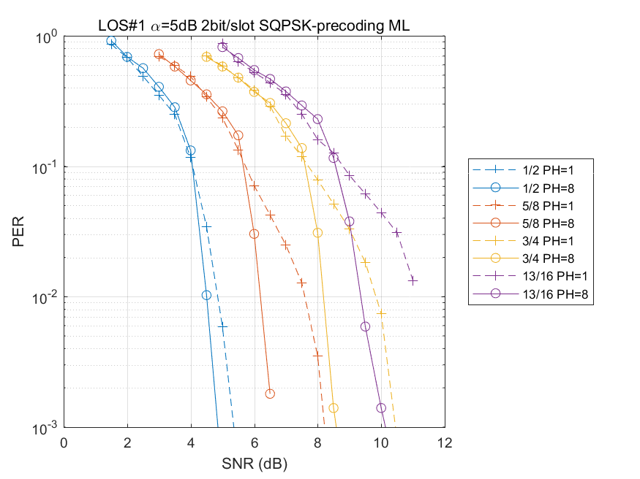
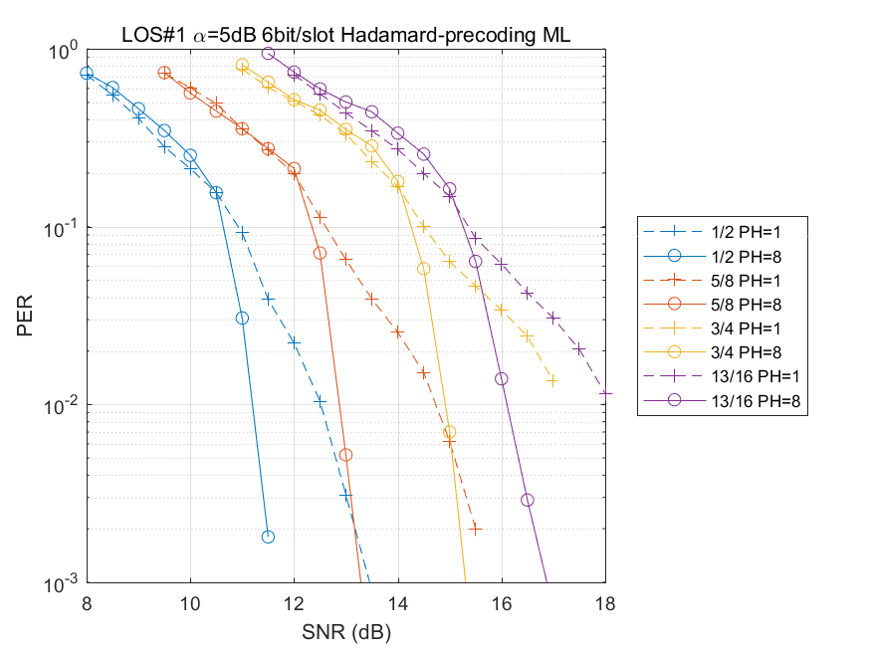
(2)Comparison: precoding with/without PH (LOS #1: α=-5dB; MLD)
    (SQPSK,SQPSK)
    (QPSK,16QAM)
In both non-precoding and precoding cases, PH has gain when using MLD.

Slide 17
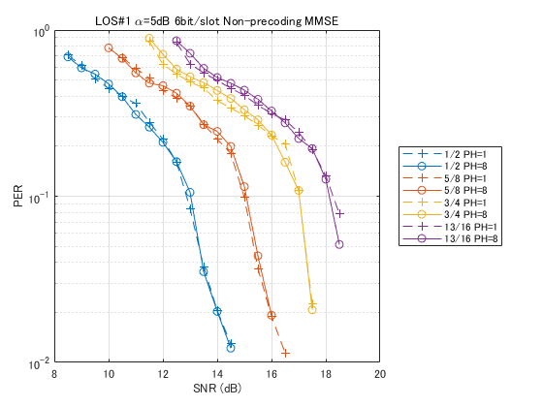
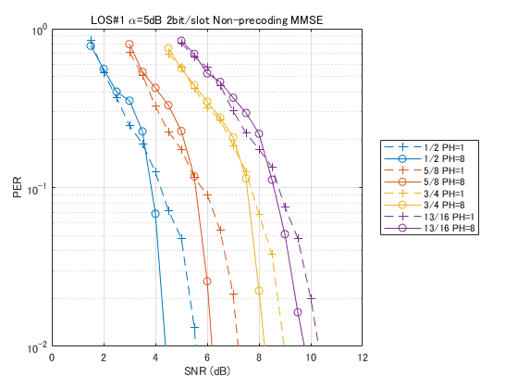
(3)Comparison: no-precoding with/without PH (LOS #1: α=-5dB; MMSE)
    (SQPSK,SQPSK)
    (QPSK,16QAM)

Slide 18
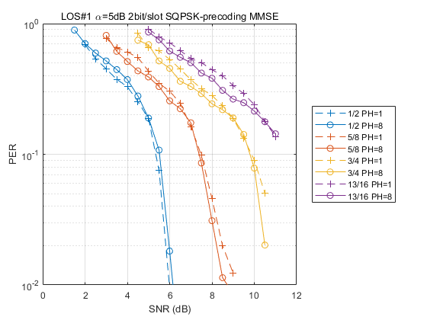
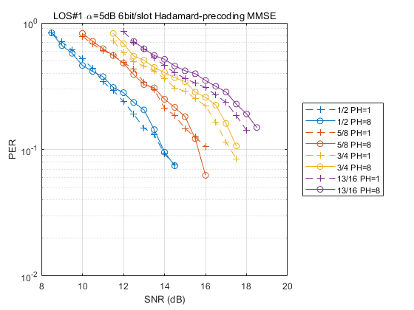
(4)Comparison: precoding with/without PH (LOS #1: α=-5dB; MMSE)
    (SQPSK,SQPSK)
    (QPSK,16QAM)
In MMSE case, there are several cases that PH has gain.

Slide 19

Simulation conditions
    MIMO* : Comparison of precoding/no precoding with PH
    Period of PH is 8.
    Phase change matrix :
    * Vertical encoding is adapted.
    Modulation sets : (SQPSK,SQPSK), (QPSK,16QAM)
    Channel model : LOS model #2 (See Appendix)
    α=0dB (α is power attenuation coefficient of cross-link terms.)
    β=-5dB, -10dB (β is coefficient of gain difference in transmitter and receiver.)
    FEC : 11ad LDPC codes (Codeword size=672 bits)
    Detection : MLD, MMSE
$$\left[\begin{matrix}1 & 0 \\ 0 & e^{j}\frac{3π×\left(k mod 8\right)}{4}\end{matrix}\right]$$

Slide 20
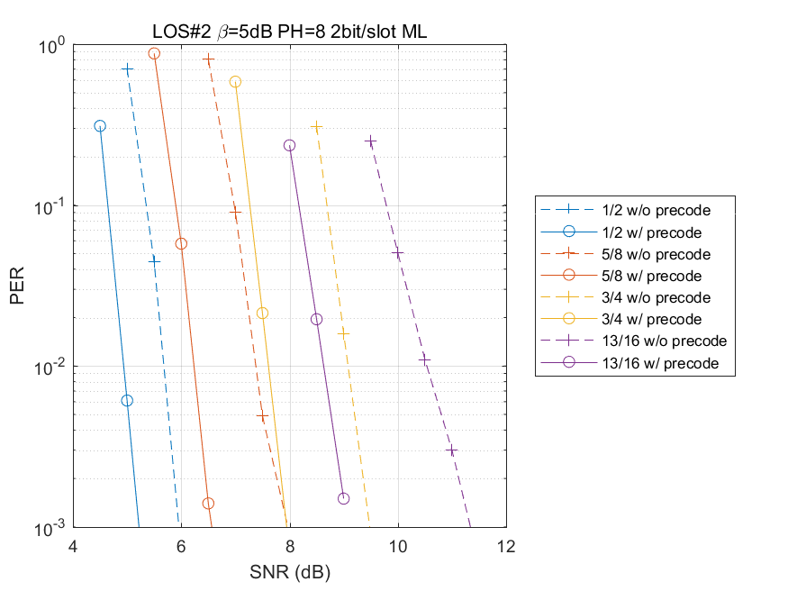
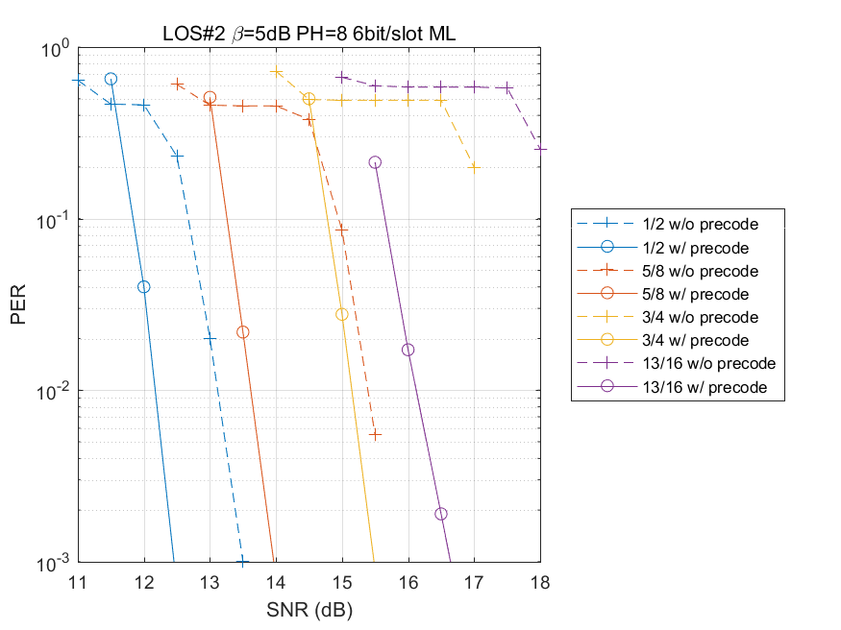
(1)Performances with power imbalance (LOS #2: β=-5dB; MLD)
    (SQPSK,SQPSK)
    (QPSK,16QAM)
Precoding + PH has large gain

Slide 21
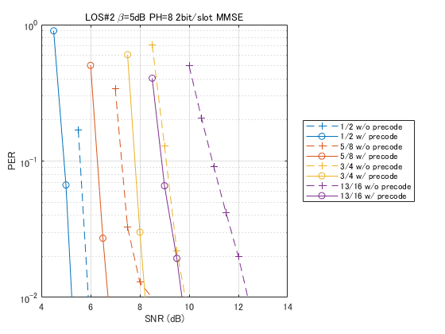
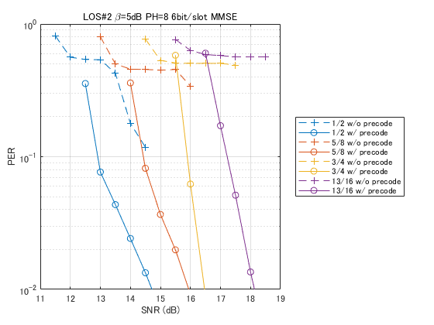
(2)Performances with power imbalance (LOS #2: β=-5dB; MMSE)
    (SQPSK,SQPSK)
    (QPSK,16QAM)
In UEP case, performance with precoding + PH is better.

Slide 22
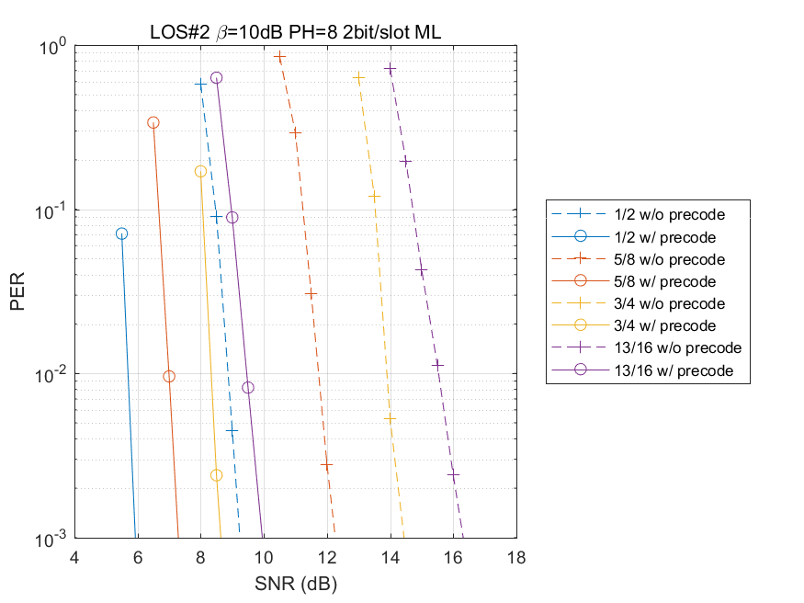
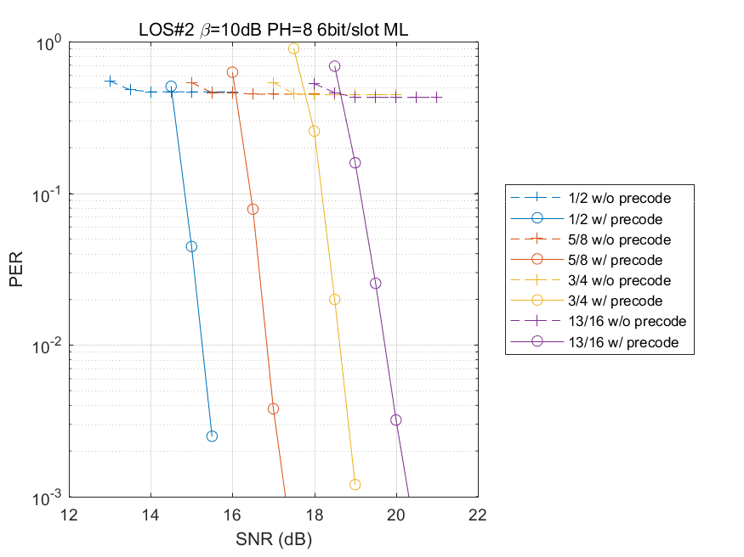
(3)Performances with power imbalance (LOS #2: β=-10dB; MLD)
    (SQPSK,SQPSK)
    (QPSK,16QAM)
Precoding + PH has large gain

Slide 23
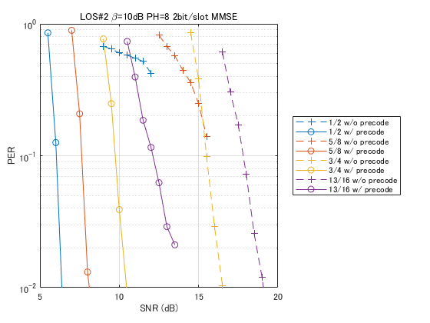
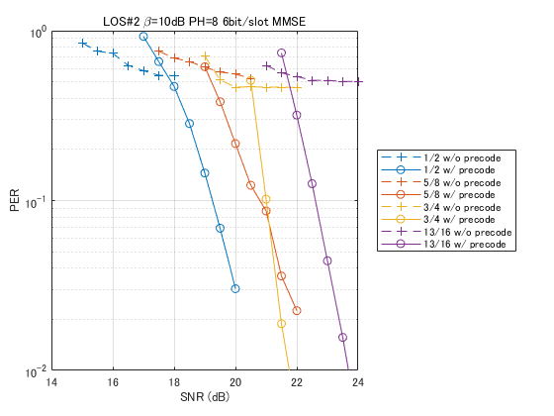
(4)Performances with power imbalance (LOS #2: β=-10dB; MMSE)
    (SQPSK,SQPSK)
    (QPSK,16QAM)
In UEP case, introducing precoding + PH is useful.

Slide 24
Summary
Following parameters in OLSM-PH for OFDM are proposed.
Average throughput of 2, 4, 6, 8 and 12 [bit/slot] is supported.
PH block is disposed before symbol interleaver operated in 16QAM and 64QAM.
PH period is set to 8.
A PH reset scheme is proposed.
Precoding matrix for OLSM-PH is proposed (See slides 11 and 12).

Slide 25
References
Draft P802.11ay_D0.8
11-16-0669-01-00ay-open-loop-spatial-multiplexing-with-phase-hopping-for-11ay
11-16-0959-00-00ay-open-loop-spatial-multiplexing-with-phase-hopping-for-11ay
11-16-1444-00-00ay-edmg-phy-headers-for-open-loop-spatial-multiplexing-in-su-mimo
11-16-0388-00-00ay-performance-analysis-of-open-loop-su-mimo-receivers-for-ieee-802-11ay

Slide 26
Appendix

Slide 27
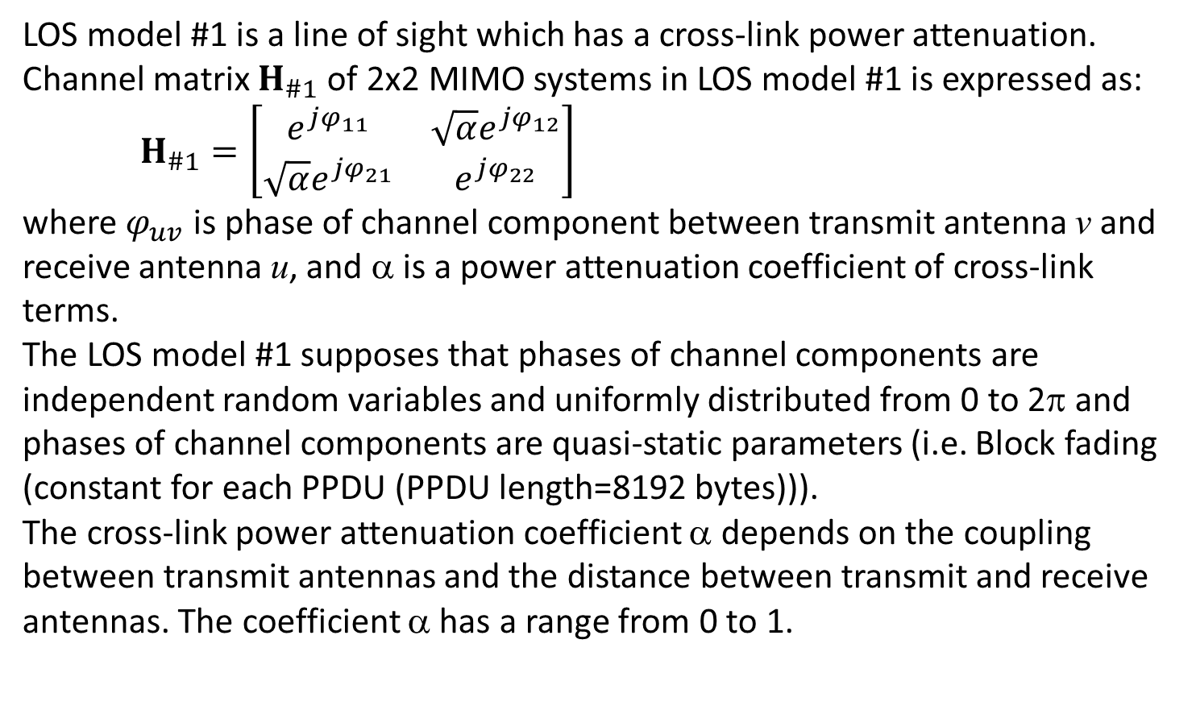
LOS Model #1 [5]
    LOS model #1 is a line of sight which has a cross-link power attenuation. Channel matrix $H_{\#1}$ of 2x2 MIMO systems in LOS model #1 is expressed as:
    $H_{\#1}=\left[\begin{matrix}e^{jφ_{11}} & \sqrt{α}e^{jφ_{12}} \\ {\sqrt{α}e}^{jφ_{21}} & e^{jφ_{22}}\end{matrix}\right]$
    where $φ_{uv}$ is phase of channel component between transmit antenna v and receive antenna u, and α is a power attenuation coefficient of cross-link terms.
    The LOS model #1 supposes that phases of channel components are independent random variables and uniformly distributed from 0 to 2π and phases of channel components are quasi-static parameters (i.e. Block fading (constant for each PPDU (PPDU length=8192 bytes))).
    The cross-link power attenuation coefficient α depends on the coupling between transmit antennas and the distance between transmit and receive antennas. The coefficient α has a range from 0 to 1.

Slide 28
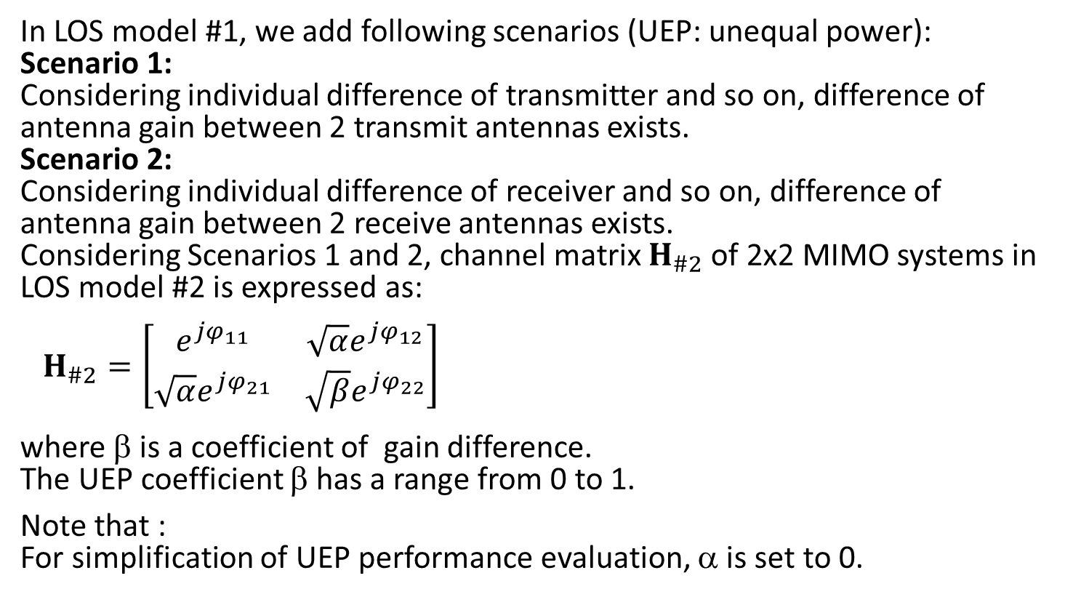
LOS Model #2 [3]
    In LOS model #1, we add following scenarios (UEP: unequal power):
    Scenario 1:
    Considering individual difference of transmitter and so on, difference of antenna gain between 2 transmit antennas exists.
    Scenario 2:
    Considering individual difference of receiver and so on, difference of antenna gain between 2 receive antennas exists.
    Considering Scenarios 1 and 2, channel matrix $H_{\#2}$ of 2x2 MIMO systems in LOS model #2 is expressed as:
    $H_{\#2}=\left[\begin{matrix}e^{jφ_{11}} & \sqrt{α}e^{jφ_{12}} \\ {\sqrt{α}e}^{jφ_{21}} & {\sqrt{β}e}^{jφ_{22}}\end{matrix}\right]$
    where β is a coefficient of gain difference.
    The UEP coefficient β has a range from 0 to 1.
    Note that :
    For simplification of UEP performance evaluation, α is set to 0.

