Slide 1
Two-sided LMR Feedback between AP and STA
Date: 2017-11-07

Slide 2
Introduction
For privacy reasons STA to AP location reporting feedback is optional and on consensual basis (REVmc FTM).
In the previous TGaz meeting two-sides (bi-directional) LMR feedback has been discussed [1].
The current design of 11az focuses on the single-side LMR feedback (AP2STA), and to enable two-sides LMR feedback, new feature need to be developed.
In this submission, we propose detailed design for two-sided LMR feedback regarding negotiation indication, measurement resource allocation and LMR exchange sequence.

Slide 3
Consideration for Two-sided LMR (1)
Privacy considerations:
For privacy reasons STA to AP location feedback is optional (REVmc FTM).
STA can choose whether or not report its LMR to AP.
AP behavior based on STA’s response is implementation/usage dependent and out of scope of std. (e.g. asset tracking, within trusted network).

Slide 4
Consideration for Two-sided LMR (2)
Design consideration:
Different STAs have different computation resources, hence TOA calculation delay is different. UL allocation needs to be aligned to results availability at STA side.
STA is most cases power conscious, additional report should have minimal additional PWR implication.
Minimize number of sequences for development simplicity – preferably one sequence with minimal number of changes from the mainstream sequence:
Shorter standard development
Simpler development
Easier test plan development and testing

Slide 5
Consideration for Two-sided LMR (3)
Design consideration (cont.):
Results for client side used for user experience, and results for AP side less so (latency is not as important).
However the STAs’ LMR computation capability varies, which makes STAs’ LMR ready time different and a resource allocation method need to be designed to enable AP to solicit LMR from multiple STAs efficiently.

Slide 6
Consideration for Two-sided LMR (4)
SU vs. MU design considerations:
Preferably similar iSTA time constraints exist between SU and MU operation modes.
iSTA is responsible for medium reservation using NDPA.
rSTA is responsible for medium reservation using TF.

Slide 7
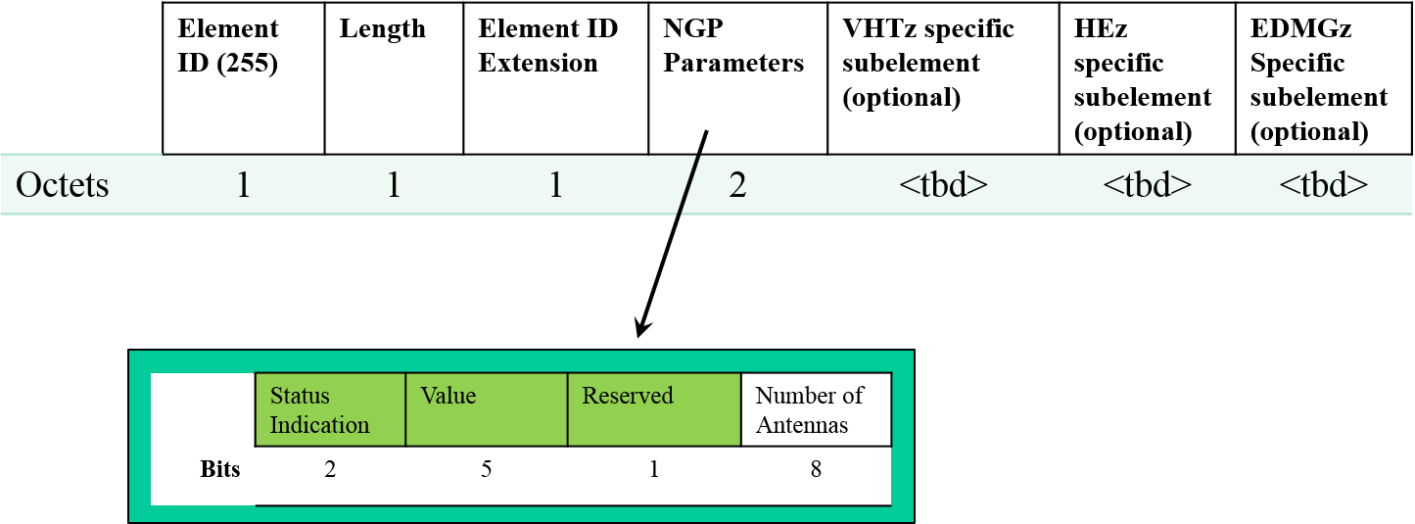
Negotiation for Two-sided LMR Feedback
The reserved bit in the NGP parameter element can be used to indicate the STA2AP LMR feedback
In the iFTMR frame, the STA can use this bit to indicate whether it’s willing to report its LMR information to AP.
The STA can also indicate its LMR feedback type in HEz specific subelement:
Immediate (LMR in the same availability window as measurement)
Delayed (LMR for the measurement in previous availability window )
In the iFTM frame, this bit can be used by AP to notify STA whether the AP will request the STA’s LMR report.

Slide 8
Rule for STA’s Resource Request
Design for simplicity:
If a two-sided LMR is negotiated, STA may perform respond to poll asking for a new measurement round N only if measurement ToA/ToD for measurement round N-1 are available.
For two-sided LMR, AP allocates UL resource in the same availability window for STA2AP LMR (power efficiency).
STA2AP LMR type: STA1 and STA3 (immediate ), STA2 (delayed)
Notes:
Not focus on negotiation

Slide 9
Two-sided LMR Exchange Sequence
Trigger frame for LMR report can be aggregated with the AP2STA LMR frame for high efficiency, and this trigger frame allocates resource for STA2AP LMR frame.
Existing 11ax operation
After receiving the HE MU PPDU that carries trigger frame and AP2STA LMR frame, the STA responses with HE TB PPDU which includes STA2AP LMR frame.

Slide 10
Two-sided LMR Exchange Sequence (cont.)
If STA2AP LMR frame is lost – do we need retransmissions?
Retransmission requires a more complex sequence in the availability window.
AP can reduce intervals between availability windows to compensate LMR latency due to disallowing retransmission.

Slide 11
Conclusion
In negotiation phase, an indication bit is defined to enable the AP and STA to negotiate the STA2AP LMR feedback.
For the two-sided LMR feedback, a resource request rule for STA is proposed to simplify the AP’s resource allocation for STA2AP LMR transmission.
Efficient LMR exchange sequence is designed to enable two-sided LMR feedback between AP and STA.

Slide 12
Reference
[1] Chittabrata Ghosh and Jonathan Segev, MU Measurement and Feedback Scheduling, doc.: IEEE 802.11-17/1455r1

