Slide 1
LOS Determination
Date: 2017-11-06
Authors:

Slide 2
Problem
Range and angle measurements are expected to rely on LOS (Line of Sight) path which is useful for single link positioning
  Single link positioning is an important selling point for 60GHz
  Determination of ToF is affected by LOS/NLOS conditions
Recently Qualcomm proposed that First Path is used for LOS beamforming training [1]
In that proposal when the feature is supported the first path strength is reported and the beamforming is done using the first path feedback
The main issue with this solution is lack of assurance in agreement of the first path and the LOS path, i.e., the first received path may correspond to a NLOS rather than the LOS path

Slide 3
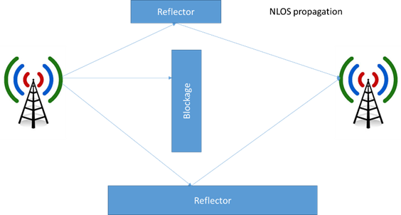
Example NLOS
First Path
Second Path

Slide 4
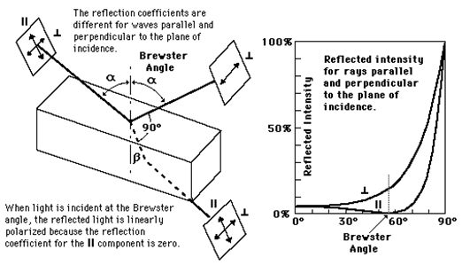
Physics
http://hyperphysics.phy-astr.gsu.edu/hbase/phyopt/polref.html From the laws of physics results that in order to determine if a particular wave was affected by a reflection (NLOS), one could observe the changes in polarization while the LOS path does not change the polarization.
Examples of the impact of reflections on the signal strength for various polarizations are provided in [2]

Slide 5
Solution
Perform a BRP-based beamforming training that will be look for the first path strength changes under different polarizations.
Send the same sequence (at the same power) with changed polarizations a few times in beamforming training
Compare the strength of first path for different polarizations
If first path is invariant with polarization then it can be concluded that the measured first path is the LOS path.

Slide 6
Possible draft changes needed
Capability field to support LOS beamforming
Request of TRN polarization change for LOS determination
Indication of the polarization change in the current transmission (for consecutive TRN repetitions)
Indication of when it is used is within FTM frames – defined by 11az.
Possible exchange information about polarization capabilities between TX and RX nodes

Slide 7
Straw polls
“Do you agree 802.11ay to support the concept of LOS determination using multiple polarizations transmissions of the same TRN sequence?”

Slide 8
References
[1] 2017 TECH-Qualcomm-056-LOS-beamforming
[2] Alexander Maltsev, et. al. “Impact of Polarization Characteristics on 60-GHz Indoor Radio Communication Systems” IEEE ANTENNAS AND WIRELESS PROPAGATION LETTERS, VOL. 9, 2010

