Slide 1
Distance aware wake-up operation
Date: 2017-11-05
Authors:

Slide 2
Abstract
This presentation discusses about problem of unnecessary wake-ups in distance aware services and proposes two new WUR use cases for usage model document [2]

Slide 3
Motivation
Currently a WUF addressed to a STA (or STAs) in AP range triggers wake-up of STA’s PCR [1]
  However, sometimes waking-up STAs’ PCR within AP’s whole range may be unnecessary
  A distance met between AP and STA can be an important factor for some services
We believe that there are new use cases that would benefit distance aware WUR (DAW) operation in terms of power consumption
  In following slides two use cases are presented

Slide 4
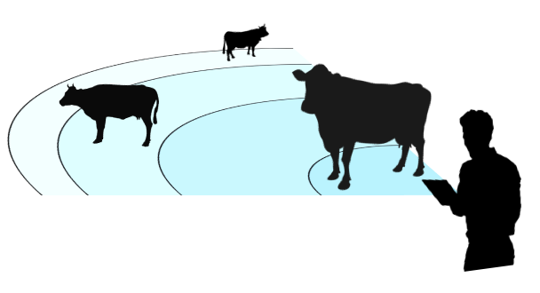
Use case: cattle farm
Sequence of events:
  Farmer John walks around his cattle farm with his tablet checking how his cows are doing. The cows wear WUR+WiFi capable sensors. When John is near to a cow, only data from the sensors close to the tablet is pulled up to John. While checking sensor data John can also visually examine the cow.
New WUR requirements:
  WUR to support PCR wake-up based on distance between AP and STA

Slide 5

Use case: Streaming with high resolution
Sequence of events:
  There is a number of WUR+Wi-Fi capable 8k displays in a conference venue for attendee use. The idea is that attendees can use their smart phones to show videos about their new not publicly available product ideas to potential customers. When attendee’s smart phone is close enough to any of the displays, wake-up of Wi-Fi happens and high resolution video streaming between the display and smart phone can start.
New requirements:
  WUR to support PCR wake-up based on distance between AP and STA

Slide 6
Discussion
In these use cases, one potential solution would be that a STA would conditionally wake-up or not wake-up PCR based on a distance metric when receiving a WUF addressed to it
  How and when to get the distance metric and how to signal the feature is in use is TBD

Slide 7
References
[1] 11-17-0575-05-00ba-spec-framework
[2] 11-17-0029-10-00ba-wur-usage-model-document

Slide 8
Straw poll
Do you agree to add the ”Distance Aware WUR” use cases presented in this contribution to WUR usage model document [2]?
  Yes/No/Abstain

