Slide 1
Integration of WUR to Power Save Mode follow up
Date: 2017-11-08
Authors:

Slide 2
Abstract
This presentation recaps the presentation [1] “Integration of WUR to Power Save mode” (17/0936r0) and proposes text to 11ba SFD to define WUR mode

Slide 3
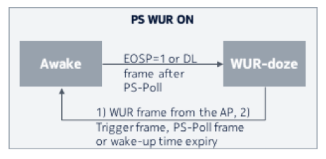
Short recap
In [1] we proposed to specify WUR mode as an integral part of 802.11 PSM (power save mode)
We believe this would enable smooth transitions between active, PS and WUR mode
Essence our proposal in [1] is that WUR mode as a sub mode to PSM
Sub mode means that WUR mode is defined within PSM (if device supports WUR mode it also supports PSM)

Slide 4
References
[1] 11-17-0936-00-00ba-integration-of-wur-to-power-save-mode
[2] 11-17-0575-05-00ba-spec-framework

Slide 5
Straw poll
Do you agree to add to the 11ba SFD, under chapter “4.5 WUR mode” the following:
WUR mode is a sub mode of PSM (power save mode)
Yes/No/Abstain

