Slide 1
Hybrid Beamforming Protocol Design Details
Date: 2017-11-06
Authors:

Slide 2
Introduction
TGay has agreed that 11ay will support hybrid precoding for SU-MIMO and MU-MIMO [1]
Performance of hybrid precoding with the transmission and reception of EDMG Single Carrier Mode PPDUs has been shown in [2], and [3], and on EMDG OFDM PPDUs in [4].
  The results show gains of hybrid precoding over analog precoding in certain scenarios e.g. antenna configuration, transmit power.
A framework for the HBF protocol was agreed to in [4]. In this contribution, we discuss in further detail the difference phases of the HBF protocol.
  Details on associated signaling will be presented in a subsequent contribution.

Slide 3
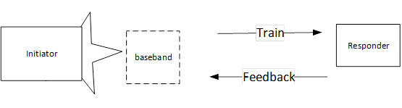
HBF Protocol
  Supports digital baseband training and hybrid precoding information feedback for subsequent Hybrid Precoding transmission
  Performed after MIMO BF setup is completed for both SU-MIMO and MU-MIMO (based on straw poll results).
  Requires sounding and feedback to acquire the HBF information.
Conceptual HBF Protocol

Slide 4
HBF Protocol Details
  The Hybrid Beamforming Protocol comprises the following phases
    Announcement Phase (Optional)
    Sounding Phase
    Feedback Phase
    On completion of the HBF protocol, HBF transmission can take place
HBF protocol

Slide 5
Announcement Phase
  Announcement phase indicates desire to start HBF protocol
    Similar to NDPA in 802.11n/ac [5]
  Used to set up the STAs and the antenna configurations of the selected STAs in the SU/MU-MIMO hybrid beamforming transmission.
  The announcement frame is optional if the transmitter/receiver are already set in the required configuration.
  The feedback parameters are sent during the sounding phase using existing signaling.

Slide 6
Announcement Phase Proposal
  Utilize the SU-MIMO/MU-MIMO channel access procedure (10.36.11.4.3,[1])
    Transmitting STA sends grant frame (or RTS) with a control trailer (CT) to a peer EDMG STA to indicate intent to transmit a MIMO PPDU to the peer STA.
      The transmitted grant frame sets CT to CT_TYPE: GRANT_RTS_CTS2SELF
        CT indicates antenna configuration of upcoming SU-MIMO transmission
    Recipient STA sends Grant ACK (or CTS) to transmitting STA if it is able to perform SU-MIMO reception and configures antennas to requested configuration.
      If it desires a reverse SU-MIMO transmission, it may include a CT with the required reverse configuration.
    Parameters indicated in CT [1]
      Type: SISO/MIMO; SU/MU-MIMO;
      Antenna Configuration : {SU-MIMO} Tx Sector Combination Index, {MU-MIMO} EMDG Group ID MU-MIMO Transmission Configuration, MU-MIMO Transmission Configuration Index

Slide 7
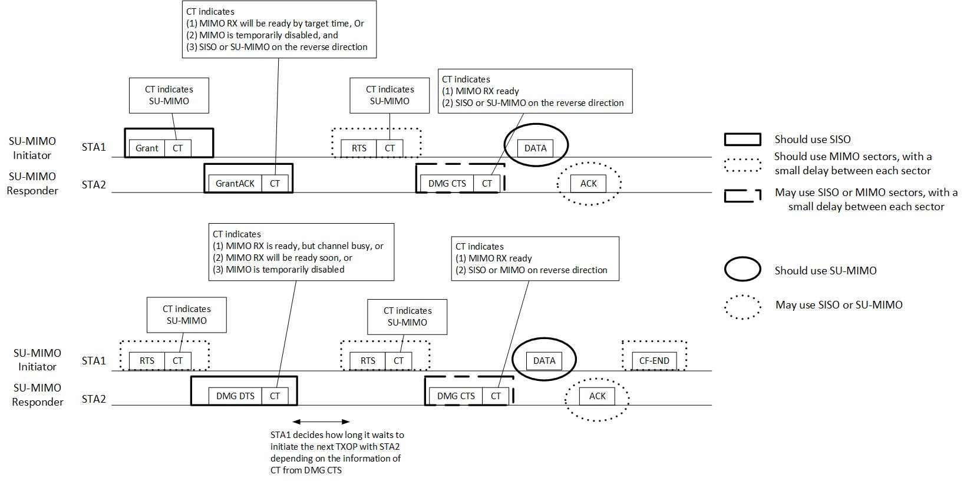
SU MIMO Channel Access [1]
Change from data transmission to HBF Protocol
—SU-MIMO channel access procedure

Slide 8
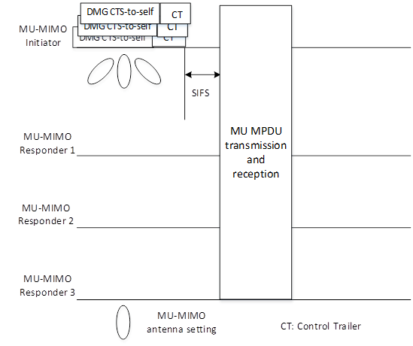
MU MIMO Channel Access [11]
Change from data transmission to HBF Protocol

Slide 9
Sounding Phase
  Sounding Phase enables measurement of the baseband channel
  Uses the TRN subfields to sound the channel.
  Can be implemented with multiple methods within current 11ay framework:
    BRP frame exchange:
      The BRP request may use the TRN field dimensions suitable for the antenna configuration in the announcement i.e. EDMG TRN Length field, P, M , N
    Beam Tracking procedure:
      DMG Header and EDMG Header-A are used to set up the TRN field dimensions for the antenna configuration in the Announcement.
  Operation:
    Use BRP on initial HBF protocol setup.
    Use BRP in scenarios where configuration is fixed but feedback changes.
    Use Digital Beam Tracking in scenarios where configuration and feedback needed do not change.

Slide 10
Feedback Phase
  Feeds back HBF information needed by transmitter for HBF transmission.
  The hybrid Beamforming information differs for SC vs OFDM PPDUs
    EDMG SC Mode: Time domain information:
      Beam Steering Matrices
      Channel Measurement Matrices
    OFDM PPDU : Frequency domain information
      Beam Steering Matrices only
  May be incorporated within a MIMO feedback frame [6]
  Signaling for Feedback incorporated in Sounding Frames

Slide 11
HBF Transmission
  On completion of the HBF protocol, the HBF transmission may take place.
  For EDMG SU PPDUs to which HBF is applied, Q_(Bt,i) is a digital beamforming steering matrix and is derived from the TXVECTOR parameter EXPANSION_MAT.
  For EMDG MU PPDUs to which HBF is applied, Q_(Bt,i) is a digital beamforming steering matrix and is derived from the TXVECTOR parameter EXPANSION_MAT.
  The digital beamforming steering matrices and digital DL-MU-MIMO steering matrices are implementation specific.

Slide 12
Signaling
  Announcement: Use existing CT signaling
  Sounding: Use existing BRP and tracking procedures
  Feedback:
    Add signaling for FB request/response parameters
      SC Request: Digital Beamforming Request, HBF Information Feedback Type (Request)
      SC response: HBF Information Feedback Type (Response)
      OFDM Request: Number of streams, SU/MU
      OFDM Response: OFDM feedback parameters
  Accepted, not defined

Slide 13
Conclusion
In this contribution, we have discussed the details of the HBF protocol design and its associated phases:
  Announcement phase: Use SU/MU MIMO channel access procedure
  Sounding phase: use TRN based sounding with BRP or Digital Baseband Tracking
  Feedback phase:
    EDMG SC Mode: Time domain beam steering feedback or channel measurement feedback.
    EDMG OFDM Mode: Frequency domain beam steering feedback.

Slide 14
References
IEEE P802.11ay™/D0.8
L. Sun, et al, “Link Level Performance Comparisons of Open Loop, Closed Loop and Antenna Selection for SU-MIMO” 11-16/0911r1
K. Oteri et al, “Closed Loop SU-MIMO Performance with Quantized Feedback” 11-16/1446r0 .
K. Oteri, et, al, “Hybrid Beamforming for SC and OFDM Transmission in 11ay” 11-17/1533r1
IEEE 802.11-2016

Slide 15
Straw Poll
Do you agree to the following:
  Include the text proposed in 17/1692r0 for the definition of Hybrid Beamforming Protocol Design Details into the IEEE 802.11ay draft amendment ?
  Y/N/A

