Slide 1
Discussion on WUR duty-cycle
Date: 2017-11-07
Authors:

Slide 2
Introduction
One of the main usage models of WUR is IoT devices
Rarely transmit or receive packets
Operating with coin-battery
For IoT use cases, extending the life time of STA is the foremost consideration
Recommended to have a lifetime in the order of years without recharge
To have better competitiveness against other IoT connectivity techniques (LoRa, Zigbee etc.)
WUR Duty-cycle is proposed for extremely low power STAs
In duty-cycle mode, WUR STA may turn off its WURx following the duty-cycle schedule
WURx on

Slide 3
Duty-cycle and power consumption
In WUR duty-cycle setup, a STA negotiates parameters with AP
Duty-cycle period, on-duration, minimum wake time, start time
The power consumption of a duty-cycle STA will be determined by the duty-cycle period and the length of on-duration
The less frequently and the shorter a STA turns on the WURx, the less power it consumes

Slide 4
Duty-cycle period
Duty-cycle period of a WUR STA depends on the latency requirement of the STA
If the period is longer than the latency requirement, the PCR data can be dropped in the worst case
Duty-cycle period cannot be maintained adaptively
AP cannot predict exactly when a traffic arrives
Once a STA turns off the WURx, it is impossible to wake up the STA
It is not recommended to manipulate the duty-cycle period for power saving purpose

Slide 5
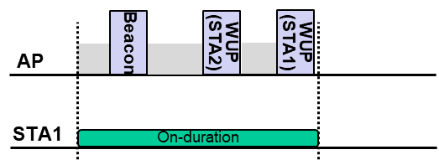
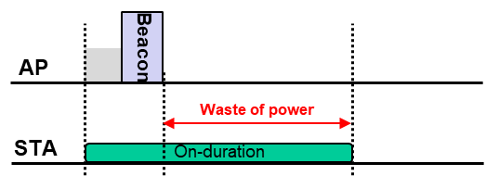
Duty-cycle on-duration
The on-duration should be long enough to receive several wake-up packets
WUR Beacon, WUPs to others, channel access delay
On-duration might be shared with other WUR duty-cycle STAs
Potential time sync shift also needs to be considered
However, if the traffic arrival rate of a WUR STA is low, the STA will waste its power for listening in many on-durations
It will be beneficial if a duty-cycle STA could terminate the current on-duration earlier when there is no additional WUP transmission

Slide 6
Possible approaches
Propose that AP indicates that no WUP will be transmitted until the next duty-cycle on duration
When a duty-cycle STA receives the indication, it may turn off its WURx before the current on-duration ends
Duty-cycle always-on STA ignores the indication
Possible approaches
One bit indication in WUR MAC header (More WUP field)
Beacon
WUP

Slide 7
Summary
In this contribution,
Considerations on duty-cycle parameters in terms of power consumption of WUR STA
Proposing to use 1-bit indication in WUP MAC header to indicate that no WUP will be transmitted until the next duty-cycle on duration
When a WUR duty-cycle STA receives the indication, it may turn off their WURx before the current on-duration ends

Slide 8
Strawpoll 1
Do you support to define a mechanism that enables an early termination of the current duty-cycle on-duration of a WUR STA?

