Slide 1
Partial OOK – Generalizing the Blank GI Idea
Date: 2017-11-06
Authors:

Slide 2
Abstract
As an alternative to textbook Manchester coded OOK, it has in e.g. [1] and [2] been proposed to zero-pad the ON part of the signal to further improve the performance
In this contribution we discuss what this gain comes from, how far this approach can be taken in practice, and what the corresponding gain is
Since the idea basically is to send OOK for only part of the time, and nothing during the remaining part, we refer to this as Partial-OOK

Slide 3
Outline
Motivation
Discussion and estimation of theoretical gain
Discussion of practically achievable gains
Simulation Results
AWGN – Receive window matched to pulse duration
TGn channels – Receive window matched to pulse duration
Discussion of receiver window size
Issues with long blank sequences for carrier sensing based on ED
Conclusions

Slide 4
Motivation
Using “Waveform coding” or blank GI performance gain has been shown, but the potential gain has only been addressed by simulations and the shown results are not entirely consistent
This has motivated us to try to understand what causes the gain and how large the gain can be expected to be in practice
Since the approach allows for very simple implementations, this seems as an attractive approach to explore for TGba

Slide 5
Discussion of the theoretical gain
0
1
0
1
“WFC”
ON
OFF
OFF
ON
$$T_{b}$$
$$T_{Z}$$
$$T_{NZ}$$
In [1] and [2], a gain has been seen by using “wave-form coding” (WFC) or “blank GI”
One reason for this gain can be improved robustness to ISI. However, also for AWGN a substantial gain can be seen
Another point made is that the SNR in the receiver is increased since the noise energy for the decision statistics is reduced for the same signal energy

Slide 6
Discussion of the theoretical gain - ISI
By introducing “guard-intervals” between the times where the signal is ON or OFF, ISI will be reduced
However, as has been shown in [3], ISI is not believed to be a problem. The reason being that the channel delay spread is very small compared to the symbol duration
The impact of ISI will be addressed further when the simulation results are presented

Slide 7
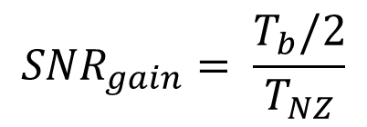
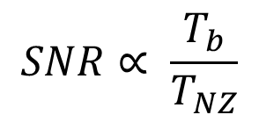
Discussion of the theoretical gain - SNR
0
1
0
1
“WFC”
ON
OFF
OFF
ON
$$T_{b}$$
$$T_{Z}$$
$$T_{NZ}$$
Keeping the sent bit energy constant, the received SNR will be inversely proportional to the accumulated noise. If and denote the time when the ON signal is zero and non-zeros respectively, we have
$$T_{Z}$$
$$T_{NZ}$$
$$SNR∝ \frac{T_{b}}{T_{NZ}}$$
$${SNR}_{gain}= \frac{T_{b}/2}{T_{NZ}}$$
and

Slide 8
The Theoretical Gain - SNR
The problem with this reasoning about increased SNR is that it does not take into account how the decision metric is generated, i.e., non-coherently
Instead, looking at the decision metric as a sum of N samples added non-coherently the loss of using more samples can be interpreted as the so-called non-coherent combining loss
The non-coherent combining loss when using diversity for improving the performance over fading channels have the following interesting properties
It increases with decreased SNR
Asymptotically, for SNR = -infinity dB, the loss is 10 log10(sqrt(N)), i.e., 1.5 dB for every doubling of N
Recall that the WUR is operating at rather low SNR

Slide 9
Simple Estimation of the SNR Gain - 62.5 kb/s
Nsamples = 4*80 = 320
$${1≤NZ≤160}_{}$$
Nsamples = 4*80;
for symbol = 1:nrOfSymbols
s(1:NZ) = 1/sqrt(NZ)*ones(1,NZ); % E[s^2] = 1
s(NZ+1:Nsamples) = zeros(1,Nsamples-NZ);
n = 1/(sqrt(Nsamples))*10^(-SNRdB/20)*(randn(1,Nsamples) + i*randn(1,Nsamples))/sqrt(2);
r = abs(s+n);
decision(symbol) = sum(r(1:NZ))<sum(r(NZ+1:2*NZ));
end
BER = sum(decision)/nrOfSymbols;
$$T_{NZ}$$
$$T_{NZ}$$
8 us

Slide 10
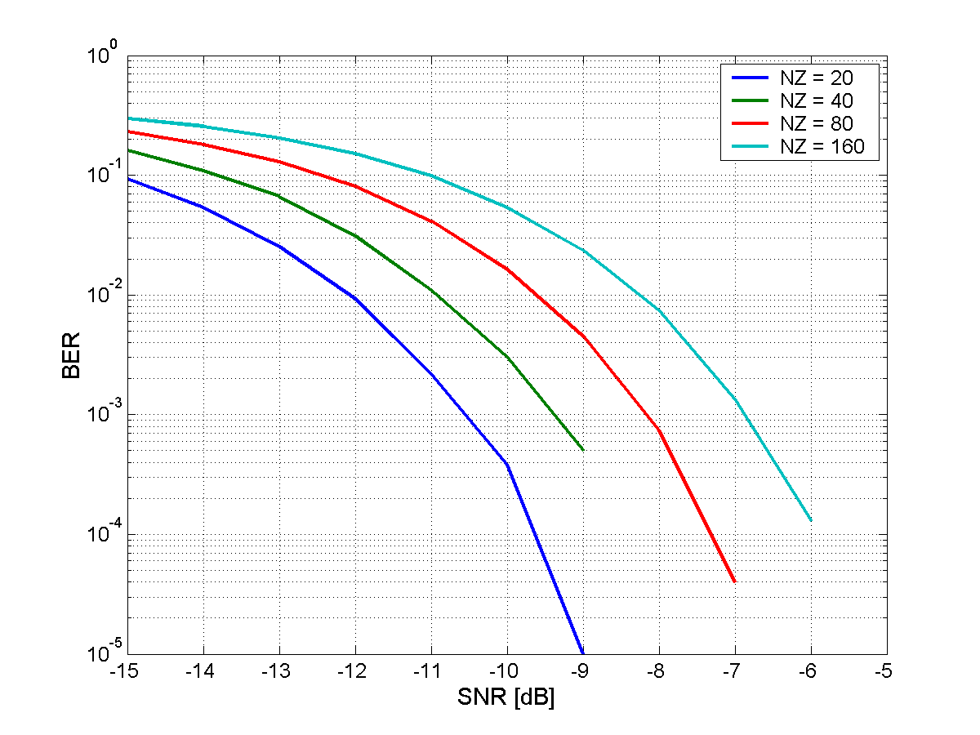
Simple Estimation of the SNR Gain - 62.5 kb/s
The gain by reducing T_NZ 2x is about 1.2 dB
If one would use T_NZ = 40 samples (2us) which is the same as in the 250 kb/s mode, a gain similar to BCC would be obtained
With T_NZ = 20 (1 us) the gain would be even higher, but with small T_NZ things like imperfect sampling will not make it practically feasible to use a correspondingly small receiver window

Slide 11
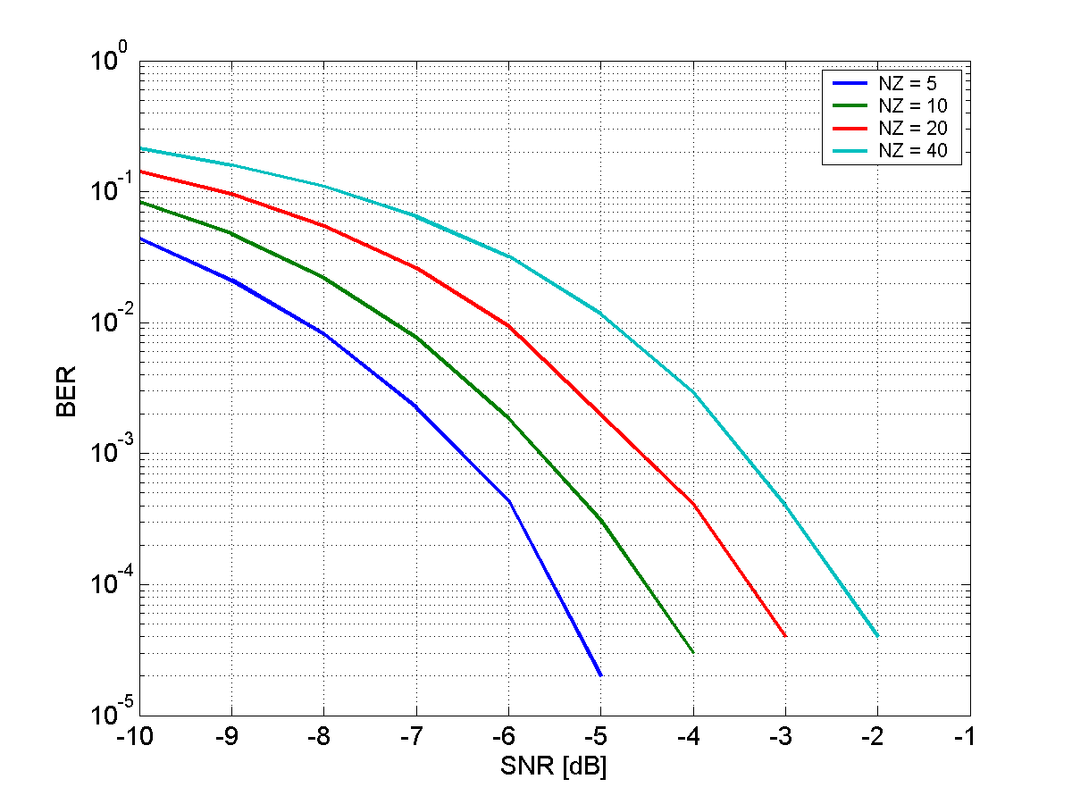
Simple Estimation of the SNR Gain - 250 kb/s
Similar gains are seen since the gain comes from a relative decrease in the number of used samples
Practically, the gain becomes harder to obtain as
Impact of sampling error becomes relatively larger
The impact of delay spread can (eventually) not be ignored when RMS delay spread is not insignificant compared to T_NZ
We believe P-OOK is mainly of interest for the 62.5 kb/s mode

Slide 12
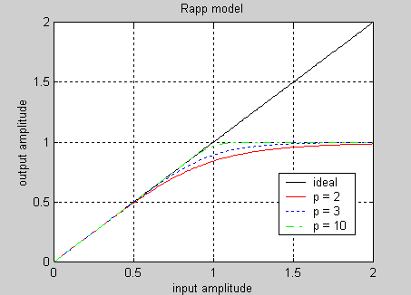
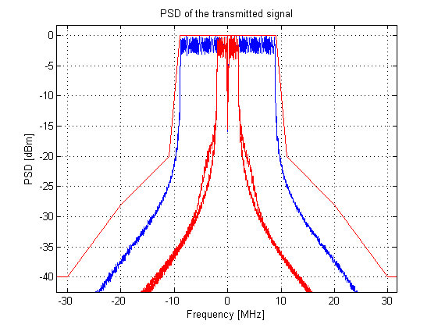
Discussion of Practically Achievable Gains
Spectrum analyzer
OFDM
Shaping
PA
The theoretical gain assumes that the TX power can be increased without limitations. There seems to be at least two reason why this is not possible
Max TX power constraints. The PA designed based on max TX power and linear requirements for the 802.11 user data
ACLR requirements. If the (instantaneous) TX power is increased the spectrum regrowth will eventually not meet the TX spectrum mask

Slide 13
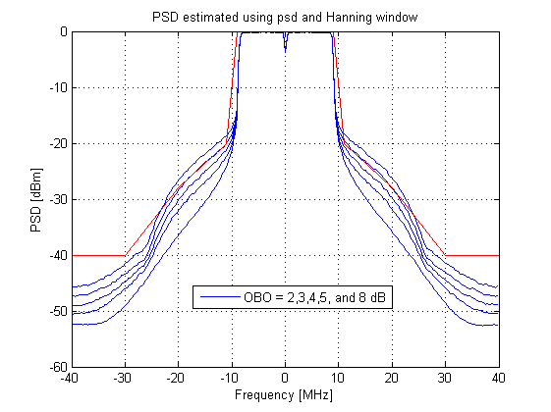
Discussion of PA Model
The Rapp model with p = 3 is used, as agreed in [3]
According to [3], referring back to [4], the assumption is that the PA is designed such that the saturation is at 25 dBm, whereas the TX power should be limited to 17 dBm, resulting in an OBO of 8 dB
Based on simulations of 802.11ax [5], considerably less OBO is possible from a TX mask point of view for 11ax. From an EVM point of view, even larger OBO is needed for large MCS

Slide 14
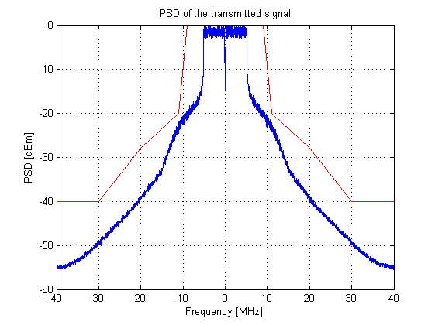
Discussion of practically achievable gains
If it suffice to fulfill the TX mask used for a 20 MHz channel, a 4 MHz wake-up signal will be no issue even with 0 dB OBO, see left figure
If one would take advantage of using a larger BW, as suggested in [6], a BW of 10 MHz is still feasible with 0 dB OBO, see right figure

Slide 15
Discussion of practically achievable gains – 4 MHz BW
For a 4 MHz BW, the maximum average power would for PSD limited transmission be 16 dBm
With plain OOK, 19 dBm can be used for the ON part.
With P-OOK, it seems increasing this to 25 dBm is feasible based on the assumptions
This means T_NZ = 40 samples (2 us) for the 62.5kb/s mode

Slide 16
Discussion of practically achievable gains – 8 MHz BW
8 MHz BW is here just taken as an example, but keeping in mind that this seems to still meet the TX mask also with saturated PA
The maximum average power would for PSD limited transmission be 19 dBm, which is close to the 20 dBm power limitation
With plain OOK, 22 dBm can be used for the ON part.
With P-OOK, it seems increasing this to 25 dBm is feasible based on the assumptions, resulting in T_NZ = 80 samples (4 us) for the 62.5kb/s mode

Slide 17
Discussion of practically achievable gains – power limited
When there regulatory limitations for the average TX power does not result in a practical problem, i.e., the maximum practically TX power can be used irrespective of T_NZ, then plain OOK is preferred

Slide 18
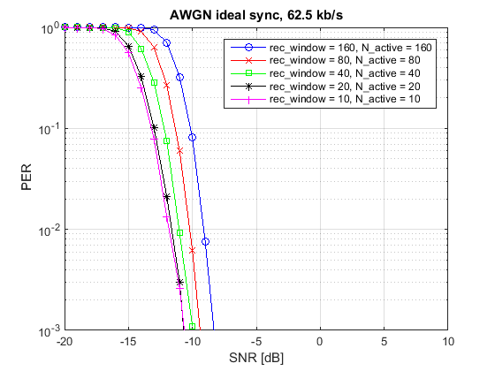
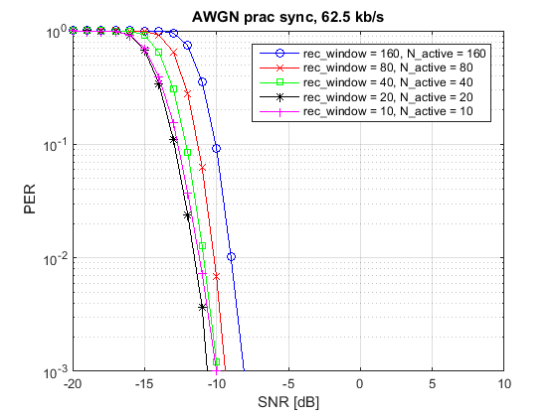
Simulation Results - AWGN
Two different simulations are performed, with ideal synchronization and with a practical synchronization algorithm
For T_NZ = 2us and larger, the performance is almost the same
If T_NZ is reduced too much the gain is diminished and may even cause a loss in the performance

Slide 19
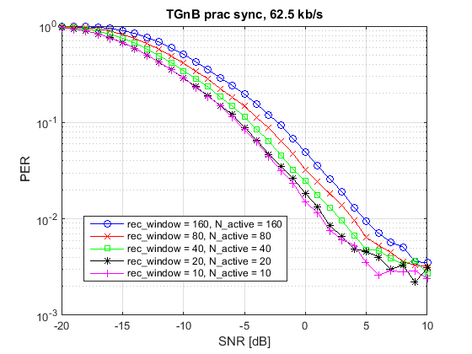
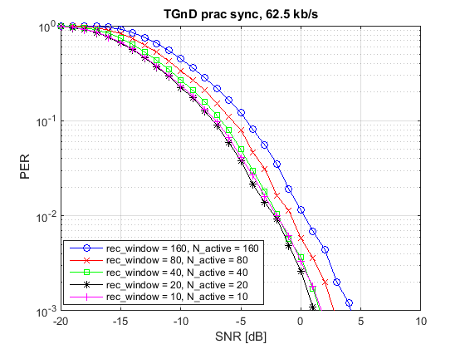
Simulation Results – TGn Channels
Similar performance gains are seen also for the TGnB and TGnD channels

Slide 20
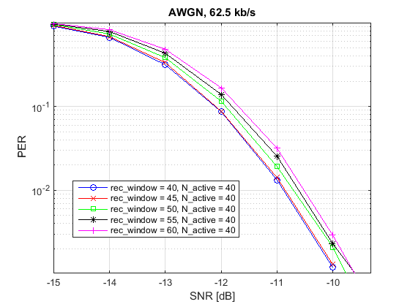
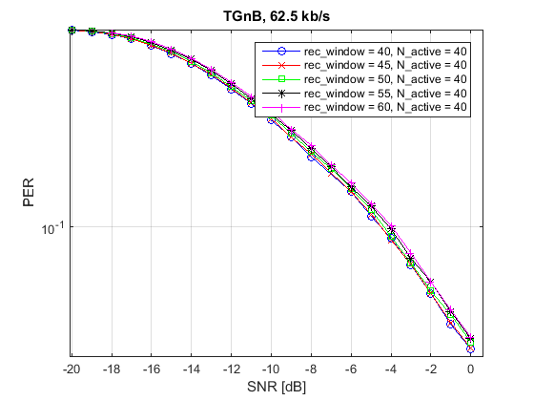
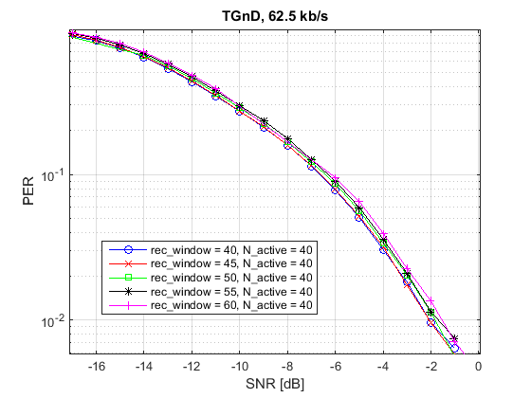
Simulation Results – Increase Receiver Window Size
For perfect synchronization and no delay spread, a receiver window matched to the sent pulse length gives the best result
For a channel with some delay spread, a somewhat increased receiver window may work equally well, and sometimes even better

Slide 21
Problem with channel sensed idle
An argument for not having long sequences with no energy is that the channel maybe found idle by another STA performing ED
However, because the ED threshold is so much higher than the sensitivity of the WUR, this is believed to be just a corner case problem. Only about 1 % of the STAs that potentially will interfere with a wake-up transmission will actually defer using ED. To see this, suppose
PL(d) = 40 + 35log10(d),
TX power = 15 dBm
CCA @ -62dBm => d = 11.4 m
Sensitivity @ -97 dBm => d =114 m

Slide 22
Problem with channel sensed idle
Coverage area for Wake-up signal
Area where STAs will defer using ED
AP
WUR
Area where STAs will NOT defer using ED

Slide 23
Conclusions
The potential gain of using shorter ON periods for OOK, referred to as P-OOK, was discussed also taking practical limitations regarding max TX power as well as non-perfect synchronization into account
A suitable length of the ON part in case of the 62.5 kb/s mode seems to be 2 us, resulting in a gain only slightly less than BCC
To obtain this gain, the signal should preferably be ON only in one portion of the 16us, so a OFF ON OFF ON, where the ON sequence is only 1us is unsuitable for P-OOK as a synchronization error would hit 2x as hard
Ensuring that the wake-up signal does not contain long blank sequences is not believed to solve the problem with other STAs doing CCA based on ED, but will significantly limit the feasibility of gaining from the blank-GI idea

Slide 24
Straw Poll
Do you believe that the idea of shortening the ON time, as discussed in this presentation, in order to allow for improved receiver implementations should be supported in 802.11ba?
Y/N/A:

Slide 25
References
11-17/1390r1 “Blank GI choices under Timing Errors”, Junghoon Suh et al.
11-17/1347r3 “Symbol Structure”, Eunsung Park et al.
11-17/0188r10 “TGba Simulation scenarios and evaluation methodology document”, Shahrnaz Azizi et al.
11-14/0571r12 “11ax Evaluation methodology”, Ron Porat et al.
11-15/0865r0 “Discussion of ACI performance and ACI requirements for IEEE 802.11ax”, Leif Wilhelmsson
11-17/1017r2 “Variable signal bandwidth of the wake-up signal for enhanced WUR performance”, Leif Wilhelmsson

