Slide 1
MAC considerations for the V2P use case
Date: November 8 2017
R0: Posted Nov 6
R1: Posted Nov 8 based on task group discussions Nov 7th and 8th
Authors:
Name | Affiliations | Address | Phone | Email
James Lepp | BlackBerry Limited | 1001 Farrar Road, Ottawa, ON, Canada | (+1) 613-595-4156 | jlepp@blackberry.com

Slide 2
Summary
Recap of the V2P usage model and OCB requirements
Recap of past presentations on IEs
Comment on addressing for OCB
Recommendation for WUR address/identity for OCB
Strawpoll

Slide 3
V2P Usage Model
Device uses the wake-up receiver to power up into the OCB mode (instead of the regular associated to an AP mode)
How is an OCB frame different from a regular 802.11 frame? The BSSID address field is FF-FF-FF-FF-FF-FF (aka all 1s).
Two types of OCB frames can be sent:
Group Addressed (Broadcast) addressed
Unicast between two STAs
OCB = Outside the Context of a BSS (originally from 802.11p)

Slide 4
OCB usage
The operation of OCB and what goes in OCB frames is outside the scope of 802.11.
Other standards and specifications describe both what to put in the frames AND when to send the frames.
The goal with the OCB WUR is to similarly enable a WUR trigger frame to allow a low power wake up of devices that operate in the OCB mode.
Don’t need to specify when to send it, or what to do in response to receiving it in 802.11ba.

Slide 5
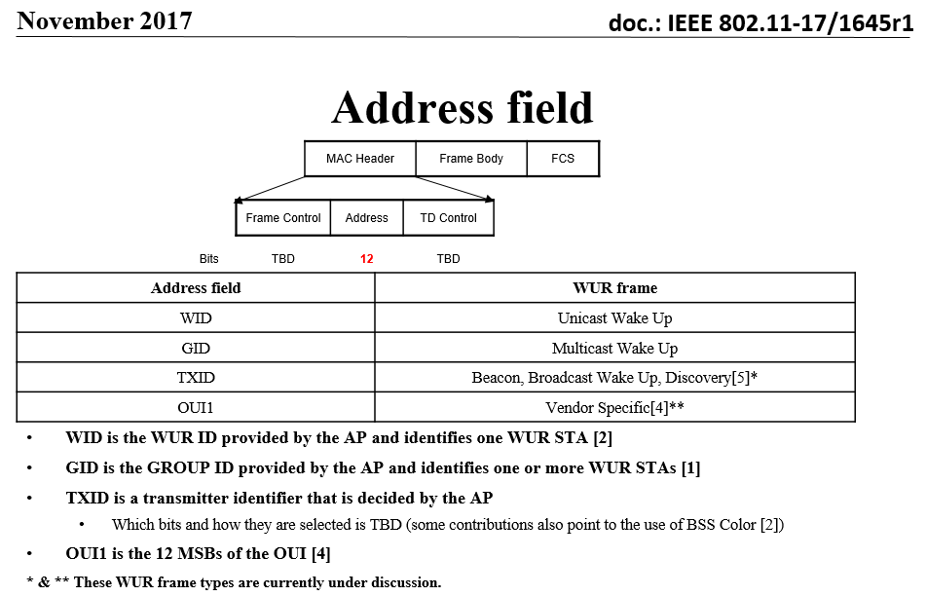
Addressing in WUR frames
From 11-17/1645r1:

Slide 6
Addressing of OCB WUR frames
May be desirable to have two reserved values, one for broadcast OCB, and another for unicast OCB.
The reserved values/addresses may only need to exist in one of the 4 frame “Types”. For example, this does not need to take away an address from the unicast “WID” space.
To enable unicast OCB, an otherwise optional payload will need to contain 2 MAC addresses (or shorthand versions of MAC addresses).
The optional Frame Body described in 11-17/1645r1 can support this.

Slide 7
Strawpoll #1
Do you support the following:
“For indication of 802.11ba OCB, a reserved value for the address/identity field(s) is used.
This reserved value may be limited to apply to only one of the 4 WUR Frame Types.”
Y
N
A

Slide 8
Strawpoll #2
Do you agree to add the following to the 802.11ba SFD:
“The reserved address to indicate 802.11ba OCB operation is twelve 1s”
Y
N
A

