Slide 1
3D Ray-Tracing and Network Performance
Date: 2017-11-08
Authors:

Slide 2
Abstract
WTTx applications at 60 GHz spectrum are a promising use case of 11ay, whilst it introduces critical topics that may impact deployment timeline.
This contribution presents results of an interference analysis, carried on parts of a real city scenarios, supported by a 3D ray tracing SW tool.
Also network capacity and delay evaluations are provided for a specific case.
A particular focus has been put on the new usage model called “mmWave Distribution Network”, Usage Model 10, as recently proposed in July 2017 IEEE 802.11ay meeting in Berlin (see Ref. [ 1 ]).
Presented analysis was conducted by Huawei as input to an interference analysis prepared in ETSI ISG mWT WI#10 (Ref.[2]) which was submitted to CEPT ECC SE19.

Slide 3
Contents
Introduction mmWave applications
3D Ray-Tracing Simulation results
Network Performance Simulation

Slide 4
The Race To Gigabit To Home
By enabling “Gigabit-speed” connectivity, the daily life and the productivity of individuals and organizations shall be transformed significantly and in a positive way.
Known end-user applications will be significantly enhanced, whilst new ones shall become a reality.
The above are also in-line with the Digital Agenda for Europe that aims to facilitate the Gigabit connectivity for all main of socio-economic drivers, including access to connectivity offering at least 100 Mbps for all European households.

Slide 5
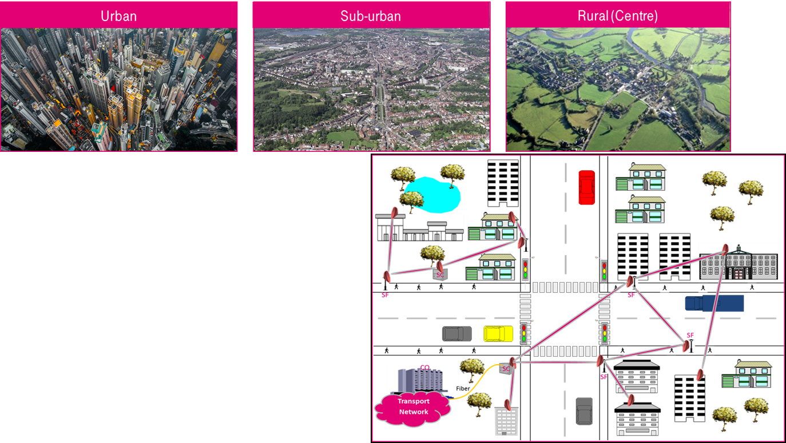

WTTx at 60 GHz Solution Targets¹
Deliver Gigabit services at reduced TTM & on lower cost vs. FTTx.
Rooftop-to-rooftop, rooftop-to-street, street-to-street deployments.
LOS plus nLOS/NLOS connectivity capabilities.
Real-time performance assurance & optimization (technology-assisted).
Re-use of mobile/fixed infrastructure and/or other available fibre-enabled PoP.
¹In-line with the mmWave distribution node network, new usage model in IEEE 802.11ay

Slide 6
Critical Topics Impacting WTTx at
60 GHz Deployment Timeline
Interference due to 60 GHz unlicensed spectrum?
CEPT regulatory status w.r.t. 60 GHz spectrum and in particular about 802.11ad (and in future 802.11ay) technologies?
Standardization roadmap, w.r.t. ETSI BRAN, IEEE 802.11ay?

Slide 7
3D Ray-Tracing Simulation

Slide 8
System Model
Parameters | Value
EIRP | 40 dBm
TX power level | 17.5 dBm
Noise figure | 7 dB
Bandwidth | 2160 MHz
Front to back separation | 90 dB
Net Filter Discrimination (NFD) | 20 dB
Receiver sensitivity (for IEEE 802.11ad MCS 8) | -61 dBm
Antenna main lobe gain | 22.5 dBi
Max steering angle (range) | 45° only on azimuth plane
HPBW azimuth | ± 5°
HPBW elevation | ± 10°
Installation Height | 3-5 m
Reference modulation and coding scheme | MCS 8
SINR (BER 10⁻⁶) | 7 dB

Slide 9
Antenna RPE behavior with steering
Antenna array: 60 elements (12x5 array was used, with phase shifters for each element) with 6.5 dBi gain/element.

Slide 10
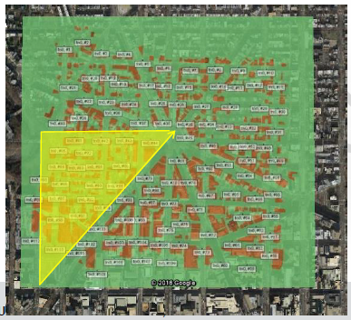
Washington Map
The examined area is a portion of Washington D.C., a typical dense urban clutter.
The green square is the map available to the tool but, due to symmetry of the topology and buildings shielding, only the yellow sector has been analyzed in detail.
Equipment with antennas placed at height ranging between 3 m to 5 m have been used.
mmWave distribution network topologies have been considered.

Slide 11
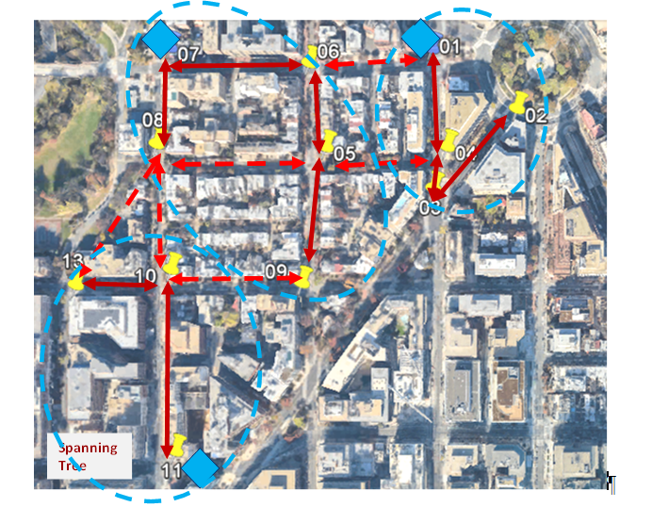
mmWave Distribution Network Topology
The analyzed mesh network has 3 fiber Points of Presence (PoP) depicted as blue diamonds (node 1, 7 & 11) and several Access Points (AP), depicted with yellow placeholders (nodes) and other APs are also placed in same positions of PoPs.
A specific graph has been selected, among the possible ones allowed to connect PoPs and APs, with solid arrows, where each PoP is assumed to reach some AP by means of a preferential path resulting in 3 different “network island” (blue dashed ellipses).
The three different network islands are based on network topology, in relation with simulated traffic flow through network nodes (such as spanning tree).
Alternative paths are represented by dashed arrows but not simulated.
Simulations have been carried on only for the preferential path (solid line).
Transmission direction from the PoP onwards is assumed as “downlink” (DL), the opposite is considered as “uplink” (UL) in the whole document.

Slide 12
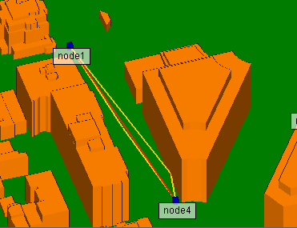
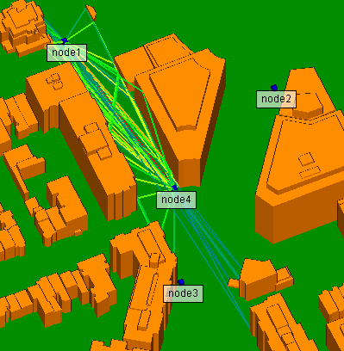
3D Ray-Tracing
Node 1 to node 4 top 3 paths
Node 1 to node 4 all paths
Material = Concrete for building, roughness = 1 mm
Material = Concrete for street and terrain, roughness = 1 mm
Fast Ray Tracing Mode = X3D
Ray tracing models transmission, reflection, diffraction, and atmospheric absorption plus roughness correction

Slide 13
Results 1/3
For each link and for each direction (UL / DL), the wanted received signal (S) and the aggregated level of interference coming from all other links in the network (I) are computed by means of a 3D ray-tracing tool.
Results are shown in terms of Signal to Interference Noise Ratio (SINR) and the 7 dB figure reported in slide 8 is the reference target value.
Also simulated SNR is reported in order to show the interference effect in the network.

Slide 14
Results 2/3
Single vs. two radio performance
Single radio channel
Two radio channels
AP | AP | Length [m] | SINR_DL [dB] | SINR_UL [dB] | SNR [dB]
AP02 | AP03 | 140 | 22,6 | 18,4 | 22,6
AP10 | AP11 | 221 | 4,88(*) | 9,07 | 9,07
AP08 | AP07 | 118 | 21,5 | 21,6 | 21,6
AP09 | AP05 | 167 | 13,1 | 10,1 | 14,3
AP06 | AP05 | 105 | 20,1 | 19,6 | 24,3
AP06 | AP07 | 161 | 8,28 | 12,5 | 12,5
AP01 | AP04 | 120 | 9,94 | 11,7 | 14,1
AP03 | AP04 | 51,6 | 13 | 14,1 | 18,3
AP10 | AP13 | 117 | 19,1 | 15 | 19,1
AP | AP | Length [m] | SINR_DL [dB] | SINR_UL [dB] | SNR [dB]
AP02 | AP03 | 140 | 22,6 | 22,5 | 22,6
AP10 | AP11 | 221 | 9,07 | 9,07 | 9,07
AP08 | AP07 | 118 | 21,5 | 21,6 | 21,6
AP09 | AP05 | 167 | 14,2 | 14,2 | 14,3
AP06 | AP05 | 105 | 24,2 | 24,2 | 24,3
AP06 | AP07 | 161 | 12,4 | 12,5 | 12,5
AP01 | AP04 | 120 | 14,1 | 14,1 | 14,1
AP03 | AP04 | 51,6 | 18,2 | 18,2 | 18,3
AP10 | AP13 | 117 | 19,1 | 15 | 19,1
(*) In this case MCS 8 can not work but a lower MCS.

Slide 15
Results 3/3
Results show that the availability of a single channel in the network is enough to guarantee the use of MCS 8.
The addition of a second channel exhibits a SINR improvement on average of 2-3 dB.

Slide 16
Network Performance Simulation

Slide 17
Network Analysis
Simulations regarding network traffic capacity (i.e. aggregate goodput) and End-to-End (network) delay have been carried on based on Washington setup reported in Slide 8 and in case of use of single channel.
The 1.65 Gbps achieved by MCS 8 for a single link results in a maximum network goodput of approximately 6.6 Gbps since we have four wireless links to the three fiber access locations.

Slide 18
Assumptions for Goodput evaluation
No transmission collision happens
No channel error happens
No re-transmission
No transmit or receive training field (TRN-T/R) is added to any MPDU (MAC layer protocol data unit)
The channel idle time that may exist at the end of a DTI is neglected
The current simulation results are based on the scheduling scheme of the IEEE 802.11ad.

Slide 19
Aggregate Goodput
Comparison MCS8 vs MCS5 mode
Goodput is defined as the rate of successful delivery of information [bit/s] arriving at the medium access control (MAC) layer access point (AP) of a certain station.

Slide 20
End-to-End Delivery Delay
The blue and orange bars correspond to the left and right y axis, respectively.

Slide 21
Network Analysis Result Comments
The value of the traffic generation rate indicates the value of each of the uplink and downlink traffic arrival rates at the node.
For example when the rate is set to 200 Mbps, the uplink traffic generated at each AP is 200 Mbps, and the downlink traffic generated at the fiber for each AP is also 200 Mbps.
Thus, in a three-hop set (i.e., such as in fiber point 1, connecting APs 2, 3, and 4 in Slide 8), the aggregate generated traffic results in 1.2 Gbps. When the rate/link increases to 300 Mbps, the total traffic generated is 1.8 Gbps, exceeding the maximum goodput that can be achieved by the last-hop link (01-04) to the fiber using MCS 8. Hence, the delay increases significantly when the traffic arrival rate increases from 200 Mbps to 300 Mbps.
For a low traffic arrival rate (up to 200 Mbps), the MAC layer queue of an AP is stable, resulting in a low average value of the end-to-end packet delivery delay. When the traffic arrival rate increases, the queuing delay at each AP increases accordingly, resulting in a significant increase in the average end-to-end packet delivery delay.

Slide 22
Summary
This contribution presents results of an interference analysis and network capacity/delay evaluations in support of regulatory/standardization activities in Europe (see Ref. [ 2 ]) .
A particular focus has been put on the new 11ay usage model called “mmWave Distribution Network”(see Ref. [ 1 ]).
The simulation results upon the above network model are positive. In particular it is shown that it is possible to run a network with only one frequency channel with high throughput (i.e. 1.6 Gbps per link and a total 6.6 Gbps when the traffic generated from four equipment reach the fiber point of presence) and relative small delay.

Slide 23
References
Ref.[1] mmWave distribution node network, new usage model in IEEE 802.11ay http://www.ieee802.org/11/Reports/tgay_update.htm
https://mentor.ieee.org/802.11/dcn/17/11-17-1019-02-00ay-mmwave-mesh-network-usage-model.pptx
Ref.[2] ETSI ISG mWT WI#10 report: “millimetre Wave Transmission (mWT); 3D Ray-Tracing Interference Analysis in V-Band”
https://docbox.etsi.org/ISG/MWT/Open/0010

