Slide 1
Use of 802.11 for
5G Millimeter Wave Systems
Date: 2017-11-03
Authors:

Slide 2
Contents
Background: 5G Discussions in IEEE 802
Proposed Way forward and Why: 802.11ac/ax for 5G Candidate
mmW Band operation using 802.11 waveform
Suggested Timeline for IMT-2020 activities
Summary + Strawpoll

Slide 3
5G Activities in IEEE 802 (1 of 3)
The 802 EC commissioned a 5G/IMT-2020 Standing Committee (Feb – July 2016) with a charter to report on the following items:
  Costs and benefits of creating an IEEE 5G specification
    Scope of an “IEEE 5G specification” would likely differ from the scope of other 5G endeavors.
  Costs and benefits of providing a proposal for IMT-2020, considering possible models of a proposal:
    (i) as a single technology OR
    (ii) as a set of technologies, OR
    (iii) as one or more technologies within a proposal from external bodies (e.g., 3GPP)

Slide 4
5G Activities in IEEE 802 (2 of 3)
Cost/benefit analysis for the following
  Action A: creating an IEEE 5G specification
  Action B: providing a proposal for IMT-2020 – For this 3 distinct sub-classes were identified
    B1: Direct IMT-2020 – single technology
      Develop and submit an IEEE proposal to adopt some IEEE 802.11 radio interface technology into IMT-2020 RIT.
    B2: Direct IMT-2020 – set of technologies
      Develop and submit an IEEE proposal to adopt coherent set of IEEE 802 radio interface technologies into IMT-2020 RIT, possibly integrated in an IEEE 802 Access Network.
    B3: IMT-2020 – external body proposal
      Support development of a 3GPP proposal incorporating references to the use of IEEE 802.11, or an IEEE 802 Access Network.
  Actions A and B are not contradictory or exclusive

Slide 5
5G Activities in IEEE 802 (3 of 3):
What the SC concluded
Key Conclusion:
  “preference for Action B3, with a secondary desire to progress Action A”
Action B3: Ensure IEEE 802 tech(s) are a part of mobile operator 5G universe
  Complementary - Recommend only world class winning technologies.
  Focus on specific environments (e.g. in-home entertainment, in/out-door hotspots)
  Liaise with 3GPP as the Rel. 13/14 features and specs evolve
  IMT-2020 requirements will evolve in ITU-R and need to be tracked
  Ensure that a 5G network incl. 3GPP and IEEE tech(s) support IMT-2020 req.
Action A: Ensure IEEE 802 technologies interface with networks of new wireless operators as well as incumbent mobile operators

Slide 6
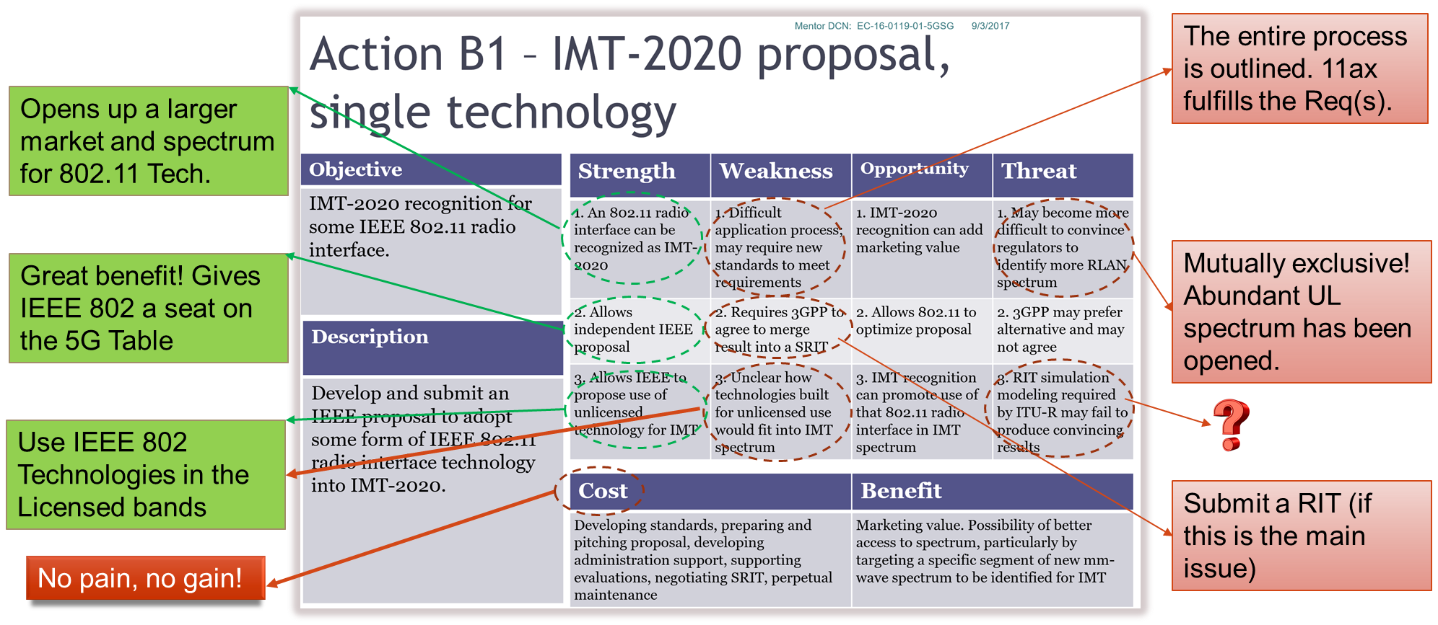
5G SC’s SWOT analysis Revisited

Slide 7
Contents
Background: 5G Discussions in IEEE 802
Proposed Way forward and Why: 802.11ac/ax for 5G Candidate
mmW Band operation using 802.11 waveform
Suggested Timeline for IMT-2020 activities
Summary + Strawpoll

Slide 8
Proposed Way forward
IEEE 802 should propose 802.11ac/ax as a candidate IMT-2020 (5G) technology
The technology has already been trialed and tested in the field with various major Tier-1 operators in the US and the EU.

Slide 9
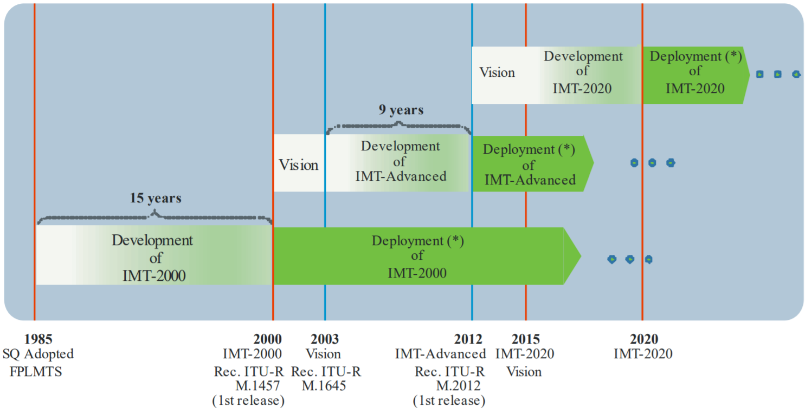
IMT development and deployment timeline
5G
4G
3G
Source: Recommendation ITU-R M.2083-0

Slide 10
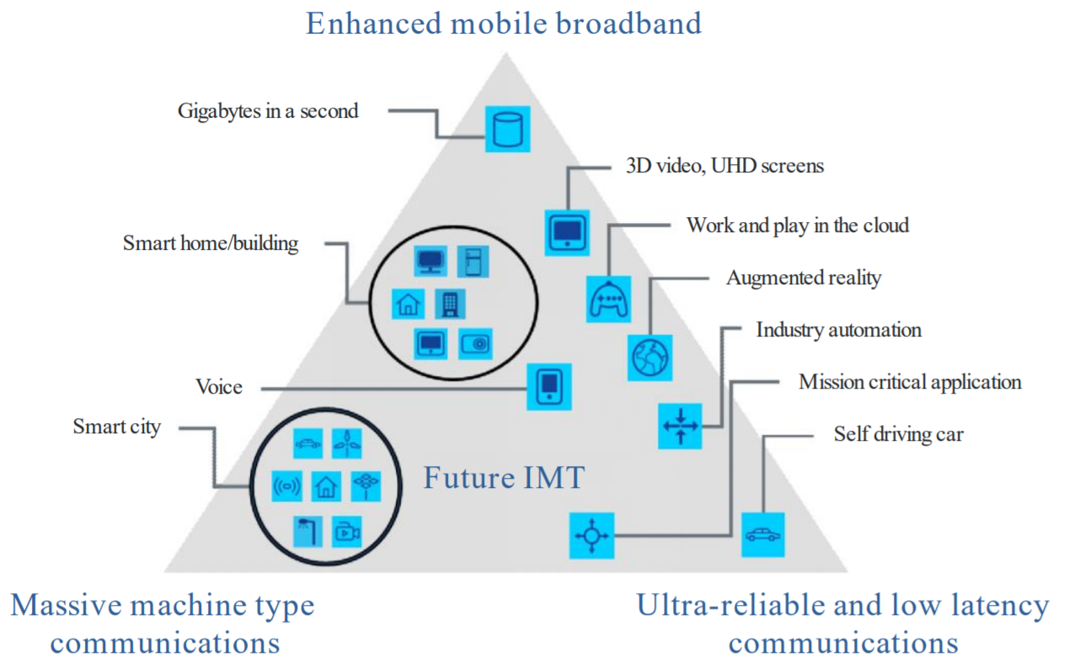
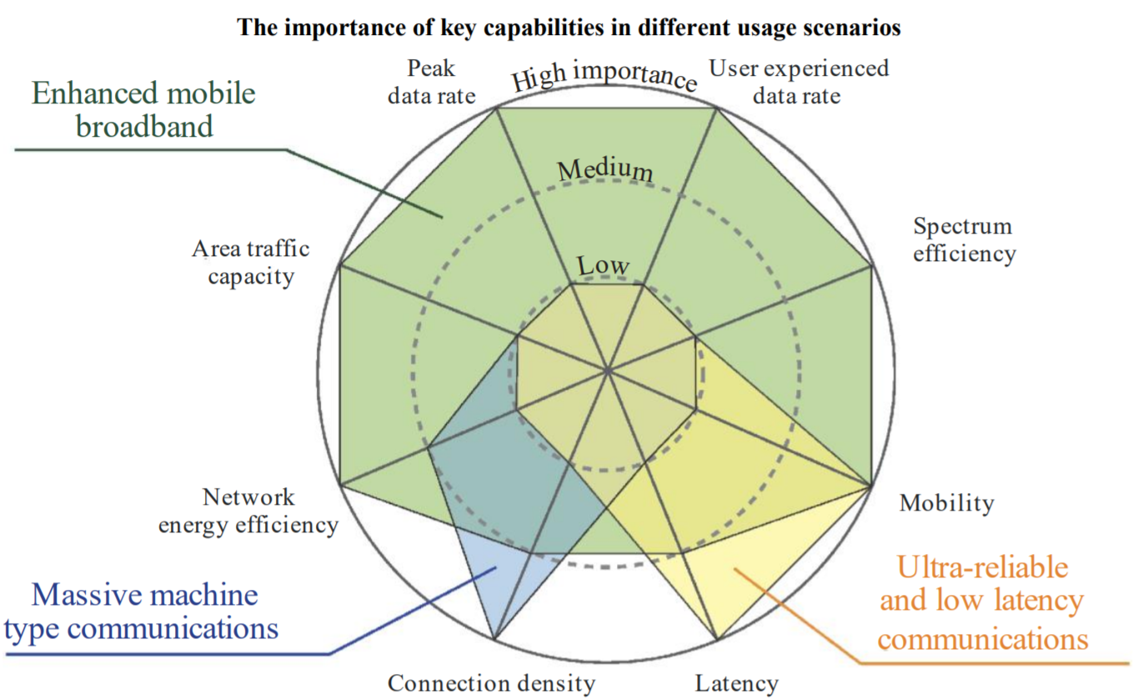
Targeted Usage Scenarios and Key Capabilities
Focus on the eMBB Usage Scenario
Source: Recommendation ITU-R M.2083-0

Slide 11
Why get 802.11 Technology endorsed as an IMT-2020 Technology?
Being a recognized 5G technology (esp. if endorsed for operation in the licensed band) will increase the total market size for the application of 802.11 technologies (for chip vendors, equipment vendors, device manufacturers, … for everyone involved in the ecosystem).
Those using Wi-Fi technology outside 5G will also benefit because higher volumes will drive down costs and attract more R&D investment, resulting in a more diverse range of products and features for all
11ac/ax numerology is quite powerful and scales elegantly to support millimeter wave operation
  Back in 2015, it was unclear what the 5G waveforms will look like in other forums.
  See next slide for a side-by-side comparison of the 802.11 versus 5G-NR numerology!

Slide 12
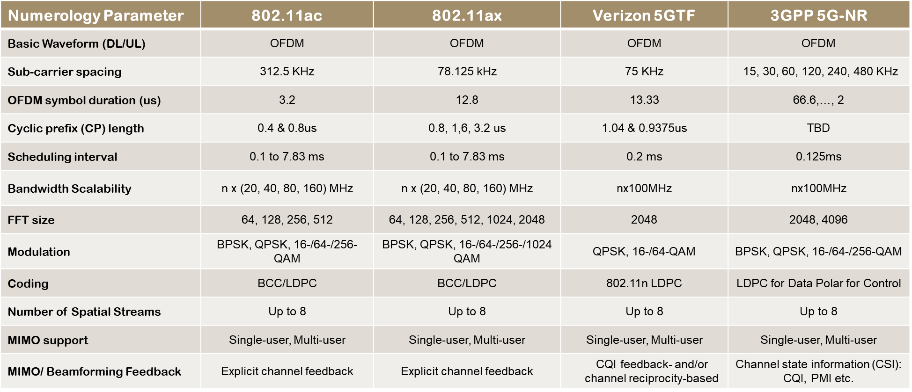
802.11 Waveforms vs. 5G Waveforms

Slide 13
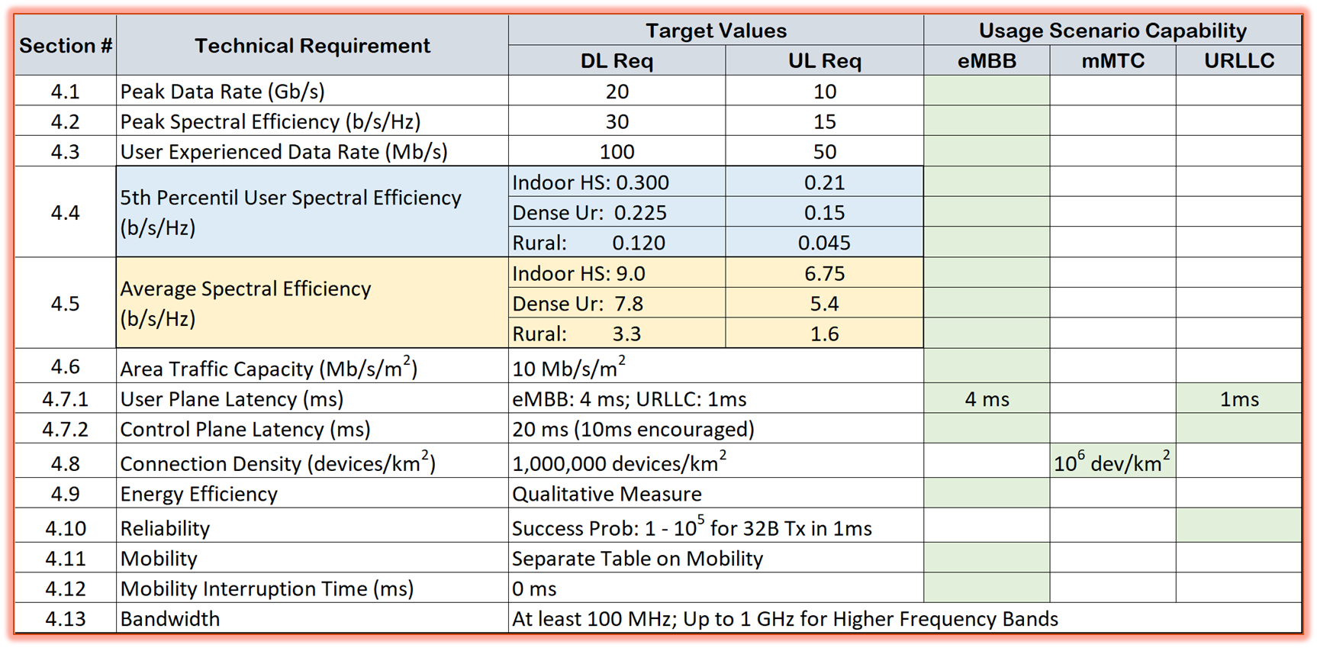
IMT-2020 eMBB Requirements

Slide 14
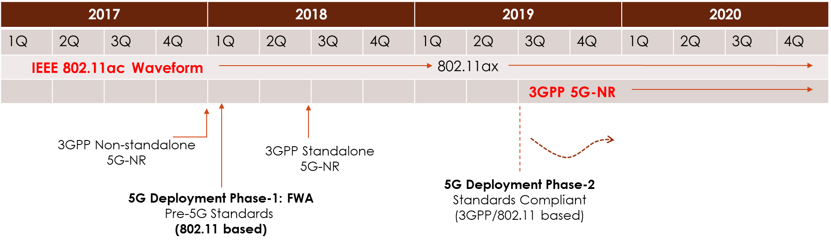
Let the market decide!

Slide 15
Contents
Background: 5G Discussions in IEEE 802
Proposed Way forward and Why: 802.11ac/ax for 5G Candidate
mmW Band operation using 802.11 waveform
Suggested Timeline for IMT-2020 activities
Summary + Strawpoll

Slide 16
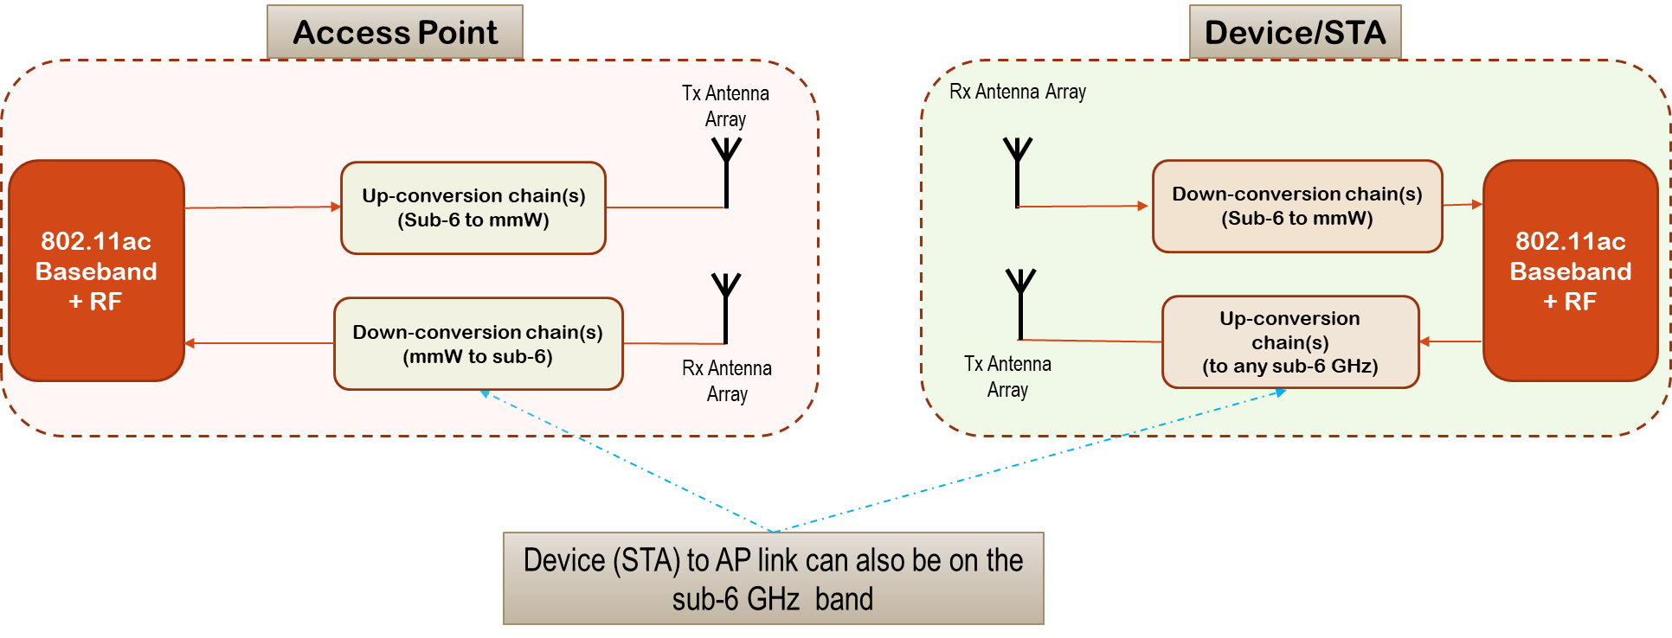
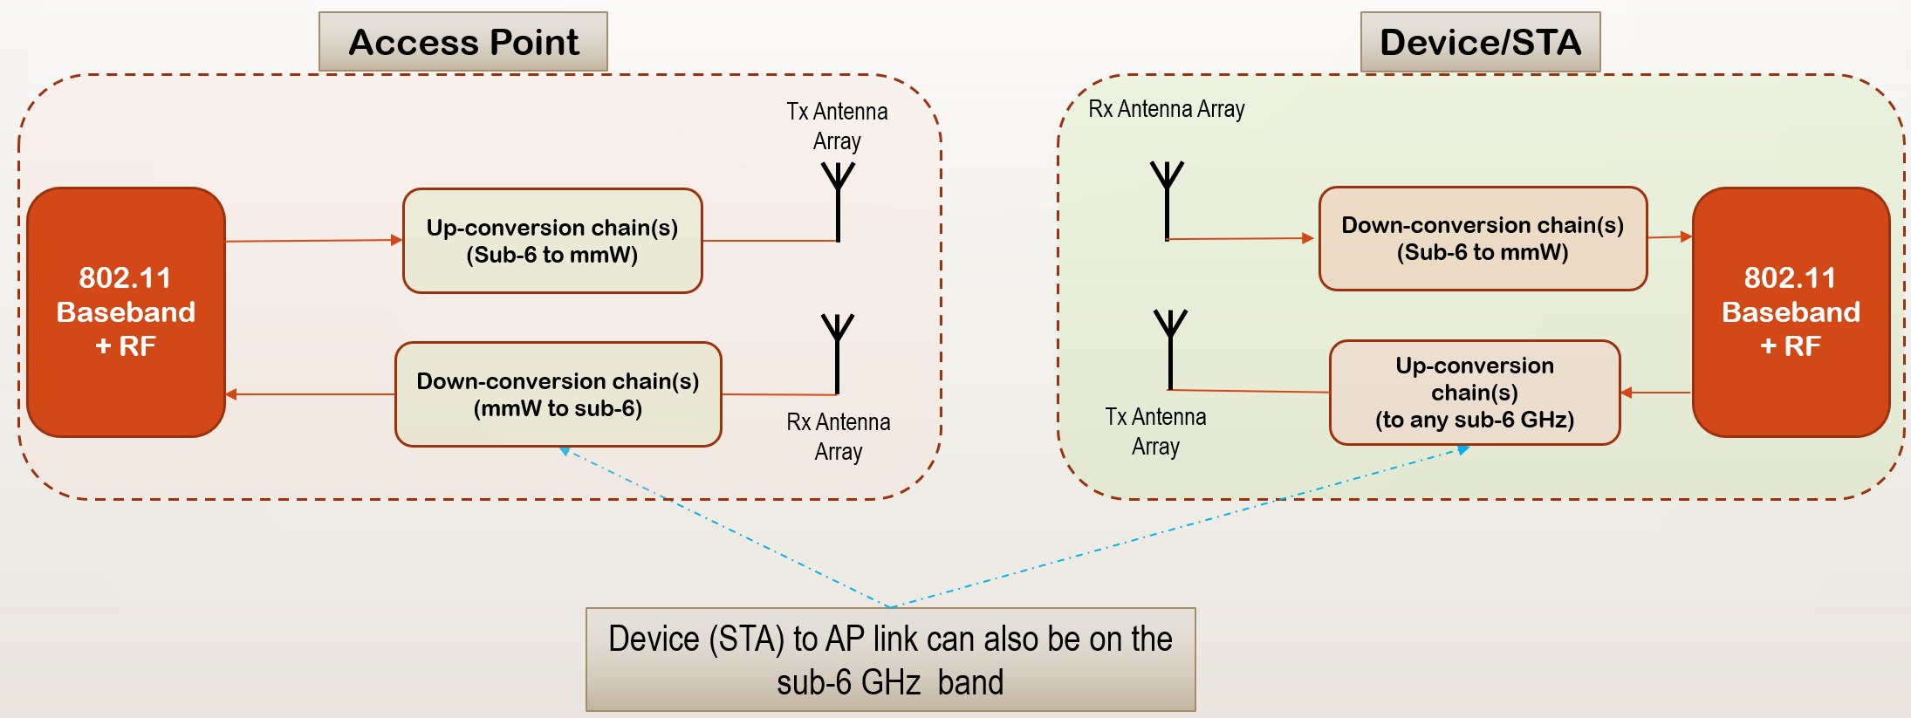
Propelling 802.11 waveform to 5G mmWave bands

Slide 17
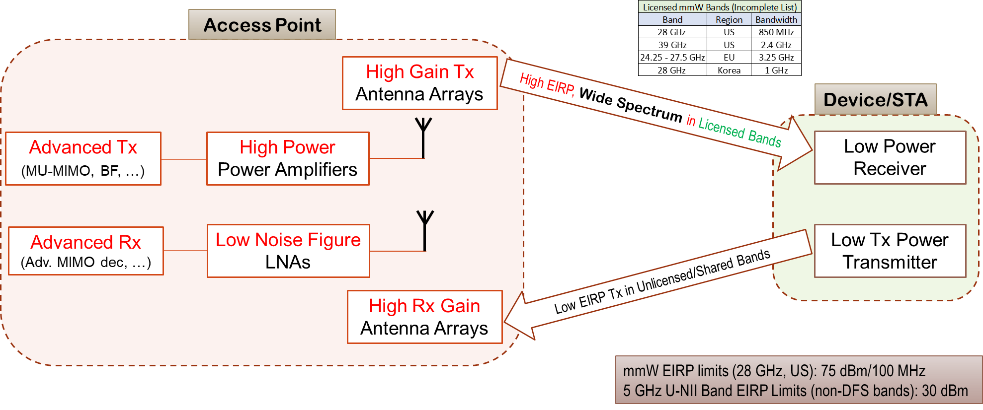
High-Level Illustration of the Concept Enabling mmW systems today

Slide 18
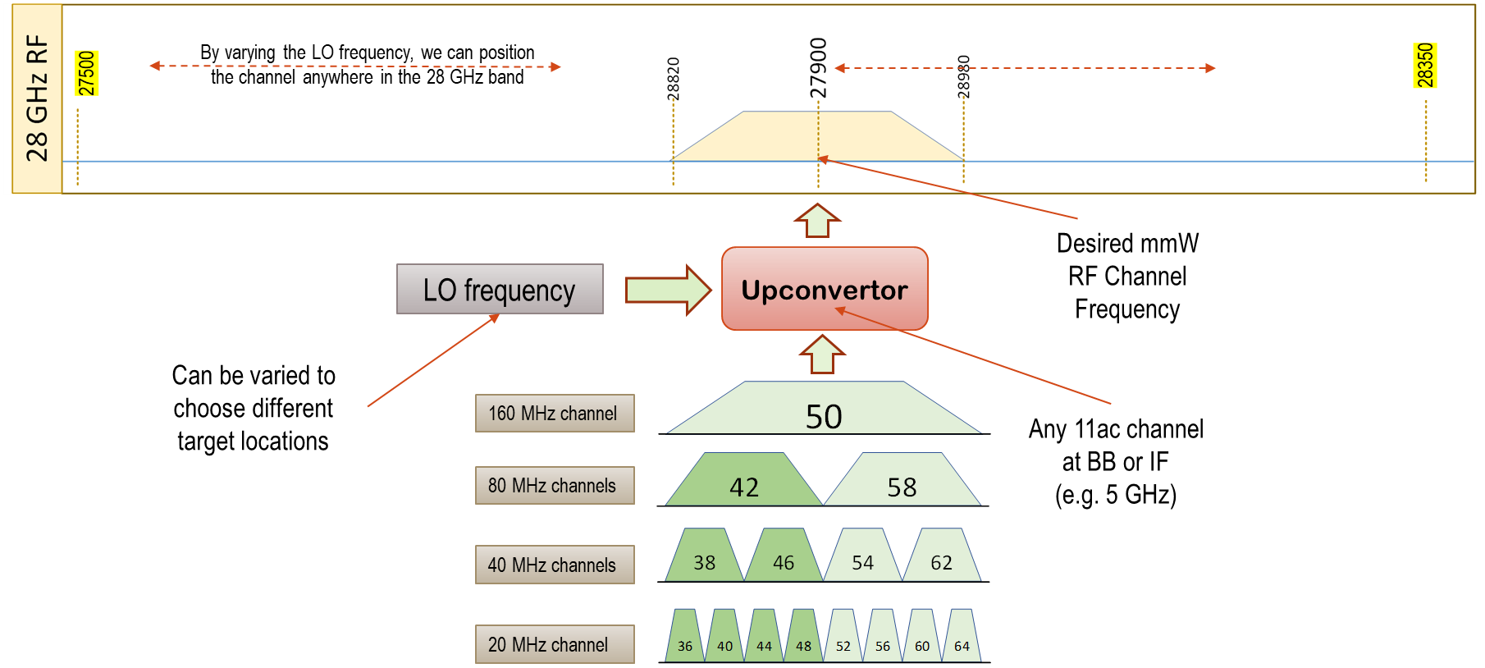
Mapping between 28 GHz and 802.11 Channels - Example

Slide 19
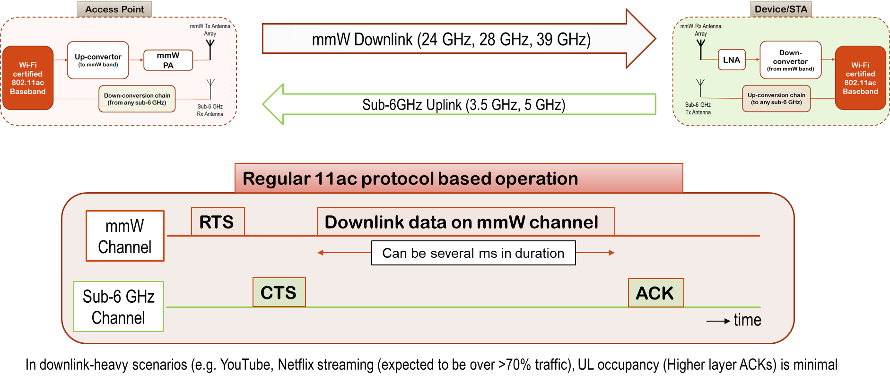
802.11 based system operation

Slide 20
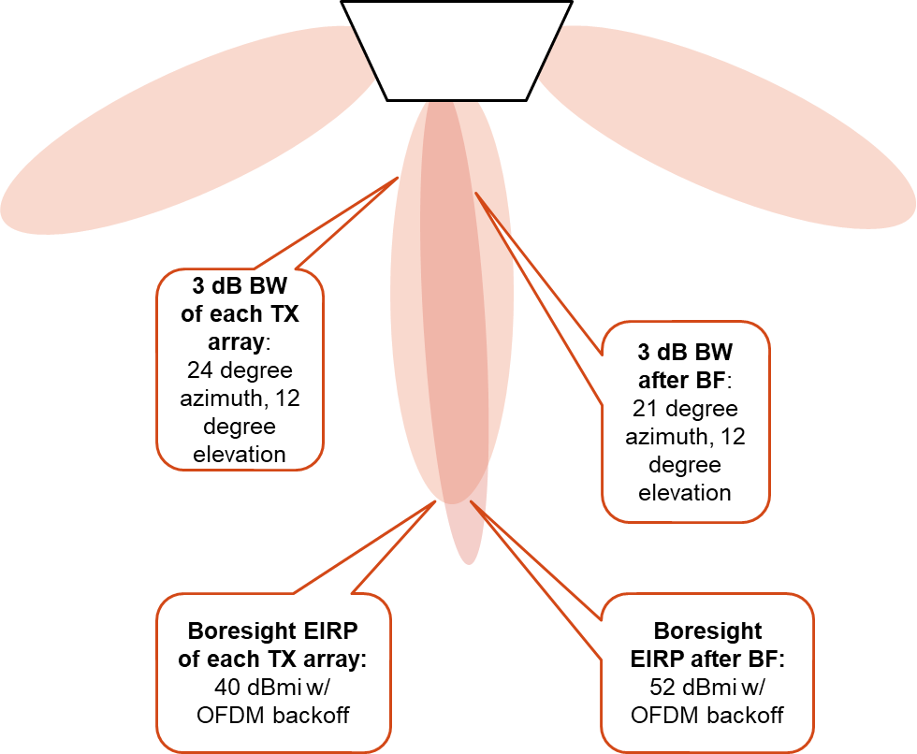
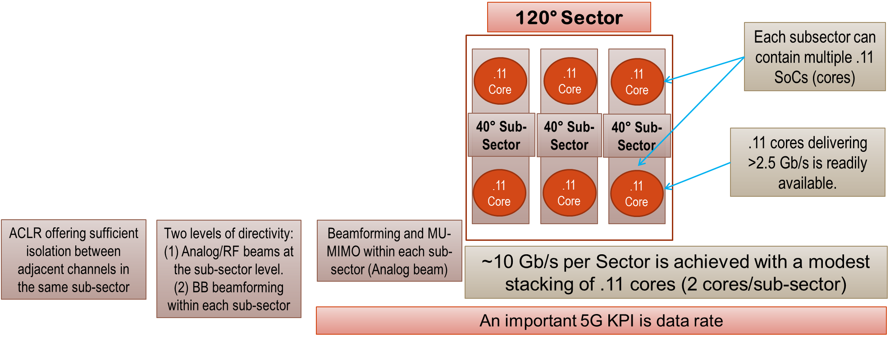
Stacking 802.11 cores to provide 10s of Gb/s capability

Slide 21
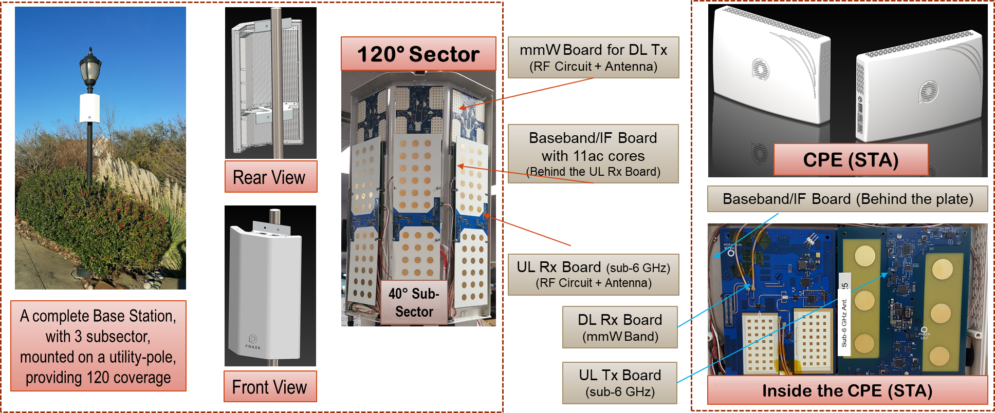
A practical 5G mmWave System built using 802.11 SoCs

Slide 22
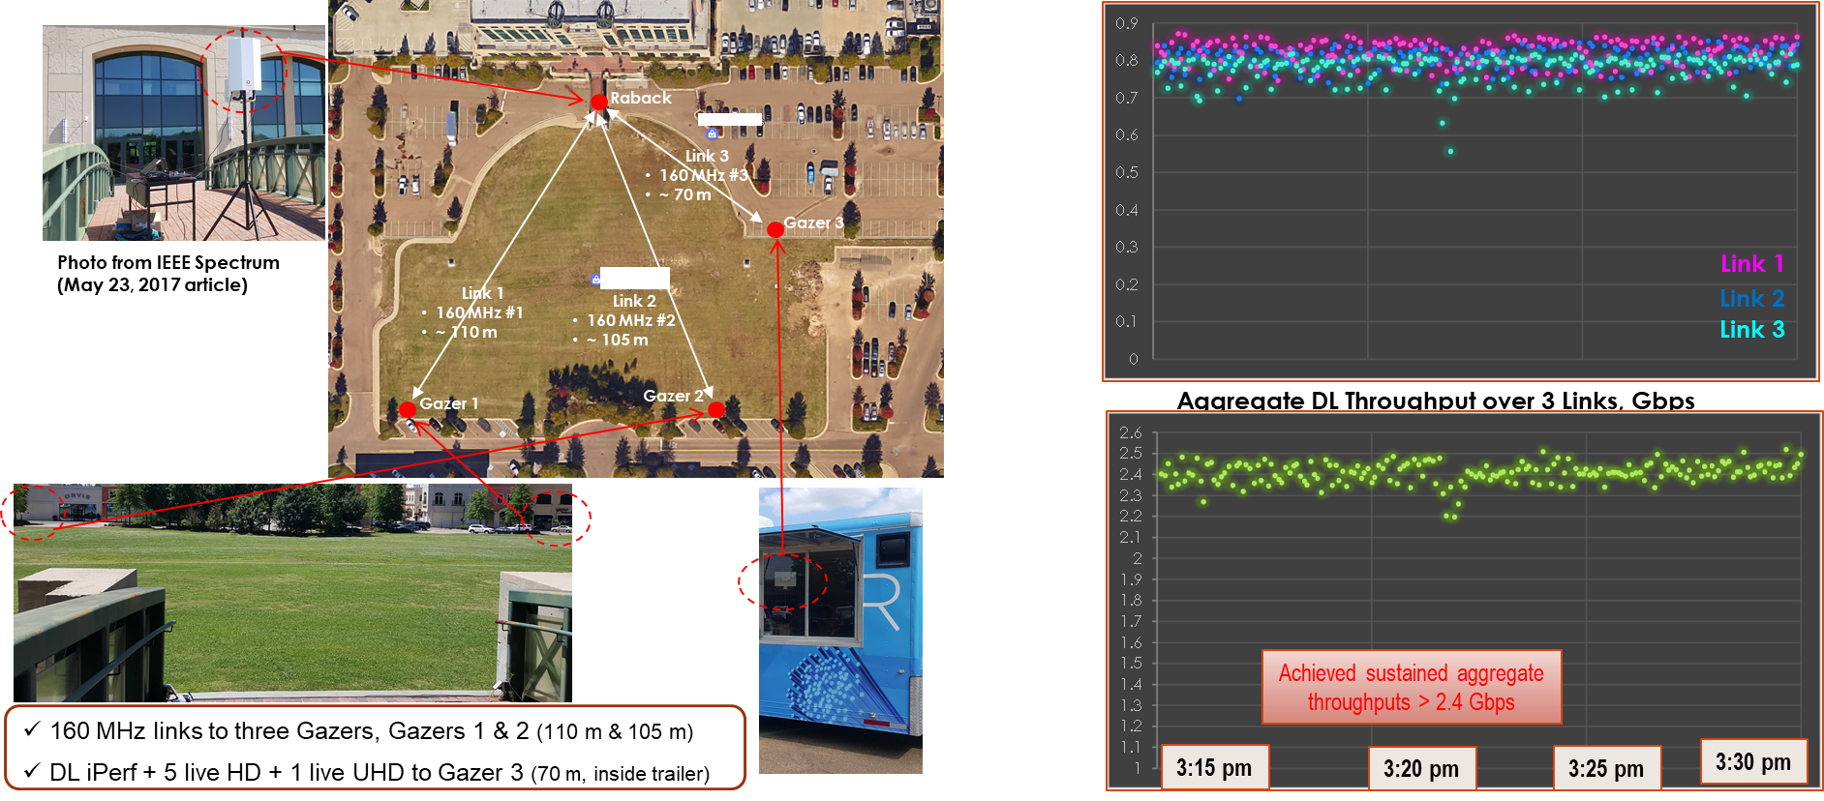
An 802.11 based mmWave system in the field

Slide 23
Contents
Background: 5G Discussions in IEEE 802
Proposed Way forward and Why: 802.11ac/ax for 5G Candidate
mmW Band operation using 802.11 waveform
Suggested Timeline for IMT-2020 activities
Summary + Strawpoll

Slide 24
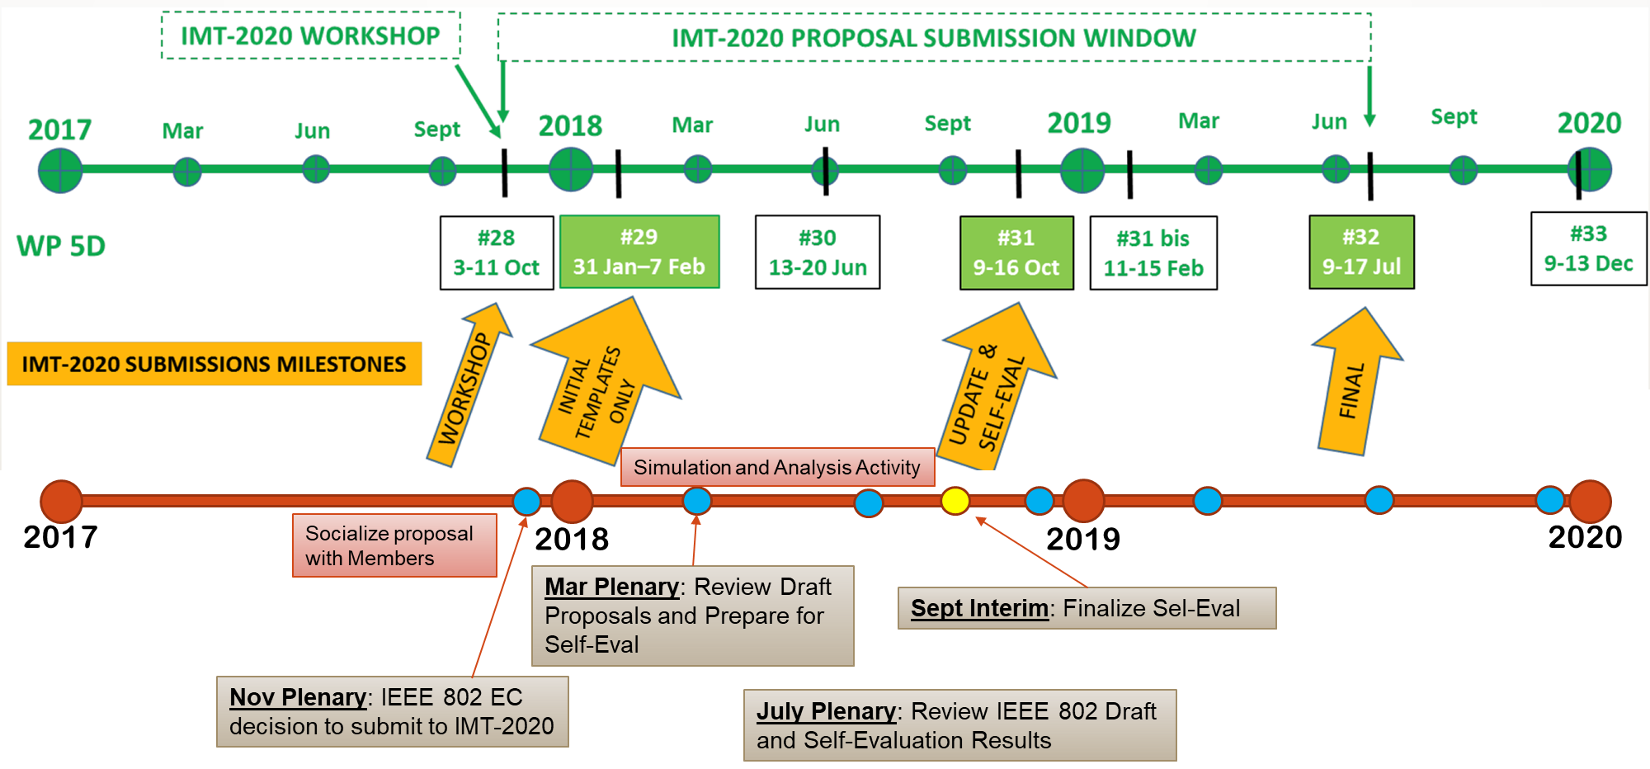
Suggested Timeline for IMT-2020 Activities in IEEE 802

Slide 25
Contents
Background: 5G Discussions in IEEE 802
Proposed Way forward and Why: 802.11ac/ax for 5G Candidate
mmW Band operation using 802.11 waveform
Suggested Timeline for IMT-2020 activities
Summary + Strawpoll

Slide 26
Summary
802.11ax is a capable technology and IEEE 802 should consider submitting 802.11ax 5G RIT for IMT-2020
This is just an example illustration

Slide 27
Strawpoll (1 of 2)
IEEE 802 should consider expanding scope of IEEE 802.11 WG to develop wireless technologies for operation in the licensed millimeter wave bands
Support:
Opposed:
Abstain:
Results: S/O/A: 40/5/54

Slide 28
Strawpoll (2 of 2)
IEEE 802 should consider submitting 802.11ac/ax as a 5G RIT for IMT-2020
Support:
Opposed:
Abstain:
Results: S/O/A: 32/10/54

Slide 29
Appendix

Slide 30
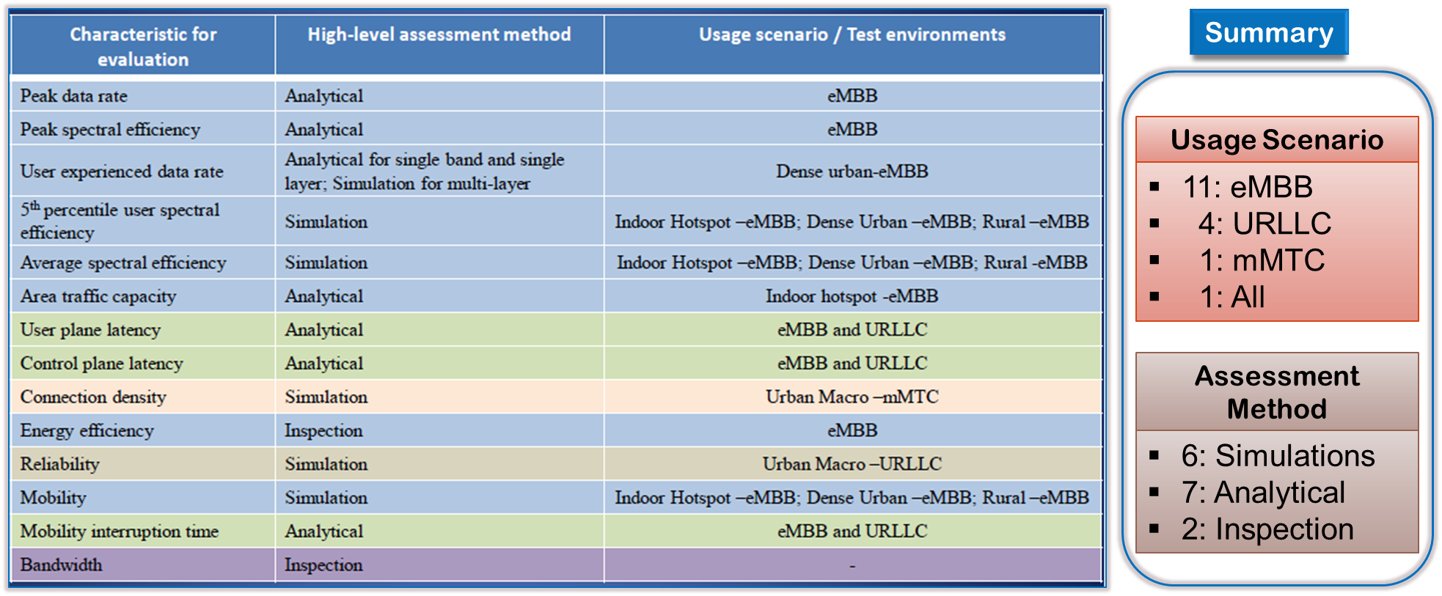
IMT-2020 Evaluation methodology

Slide 31
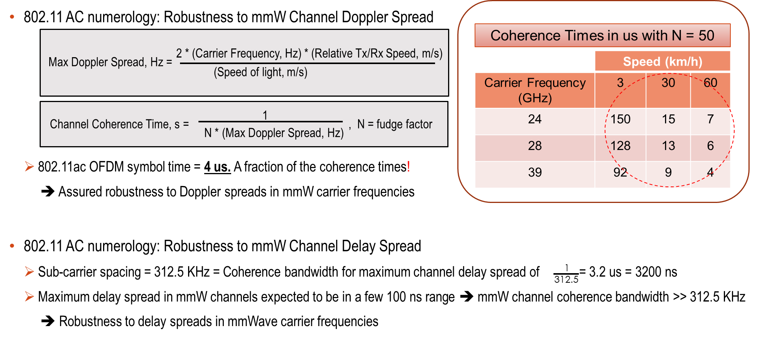
802.11ac Numerology: Robustness to millimeter wave (mmW) Channel Characteristics

Slide 32
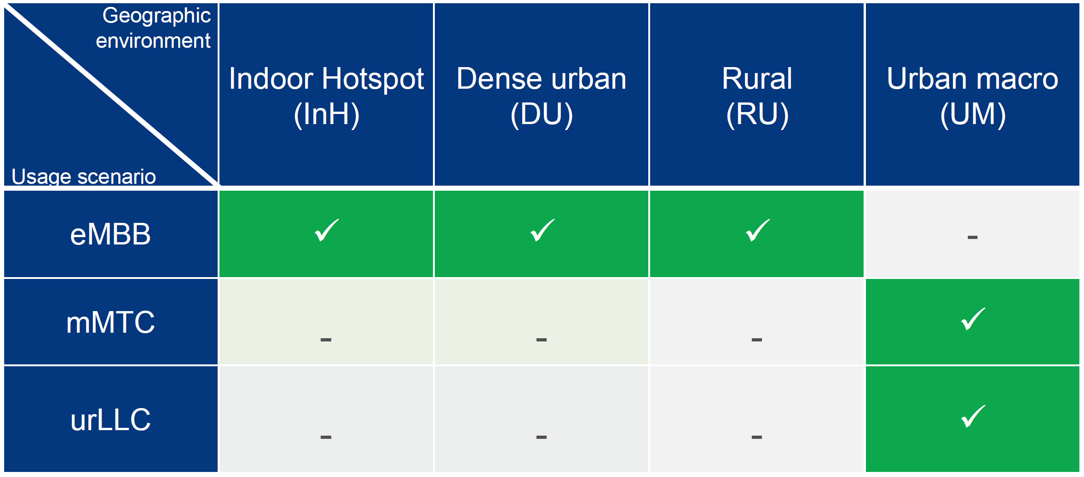
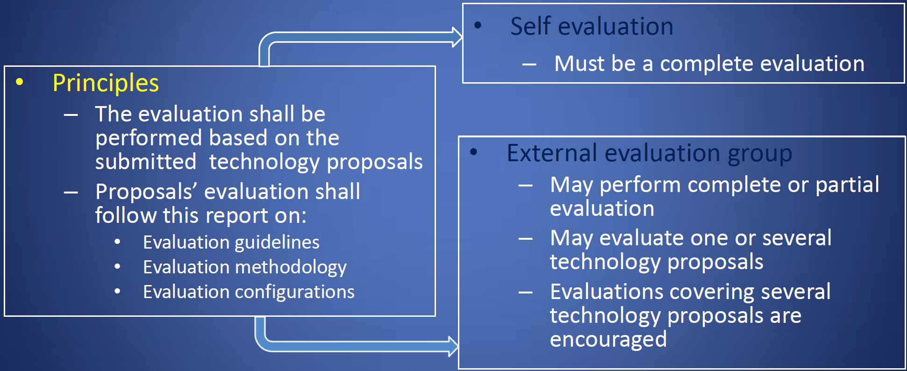
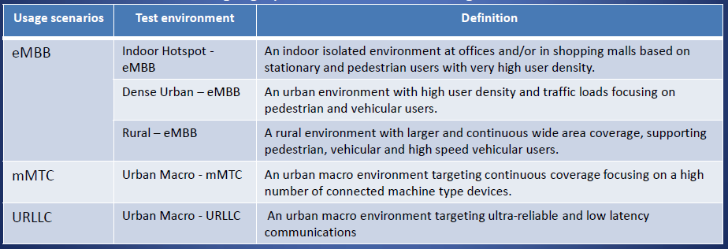
Summary of “Guidelines for Evaluation” (Doc 5/57)
Test Environments
High-Level Evaluation Guideline

