Slide 1
LiFi from the perspective of an enterprise AP vendor
7 November 2017
Authors:
Name | Company | Phone | email
Andrew Myles | Cisco | +61 418 656587 | amyles@cisco.com

Slide 2
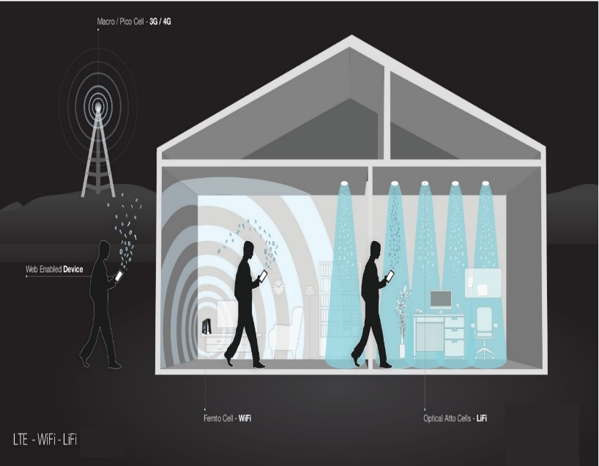
LiFi is the potential basis of huge industry
LiFi is high speed, bidirectional and networked wireless communications using light
Modulating intensity of light from LED bulbs for data transmission and use photoreceptors to receive data
Infrared in upstream direction
Some market research indicates that LiFi may become a $75 billion industry by 2023
Over 1 Billion LED lights sold annually with 13% CAGR
Every light can be LiFi enabled

Slide 3
Why LiFi? (from the perspective of an enterprise AP vendor)
Why?
LiFi can enable Secure Wireless Communications
LiFi can enable RF-sensitive Environments
LiFi can enable Indoor Communications
LiFi leverages LED Lighting
LiFi leverages light spectrum

Slide 4
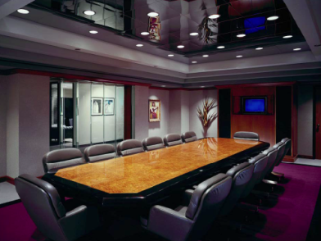
LiFi can enable Secure Wireless Communications
Many industries avoid the use of Wi-Fi due to fear of illicit network access and hacking
Even eavesdropping is motivation to ban radio frequency
Li-Fi signal contained within illuminated area, no possibility of external access
Additional security protocols enabled
Data Containment and Near Zero Leakage are inherent LiFi Properties
Primary Requirement for Verticals like Finance and Government Agencies

Slide 5
LiFi can enable RF-sensitive Environments
Many industries where RF communications are either disallowed or not possible
Due to safety or interference
Inherent lack of electromagnetic interference of light allows Li-Fi to provide wireless communications
Useful in: Hospitals and Labs which need zero RF interference

Slide 6
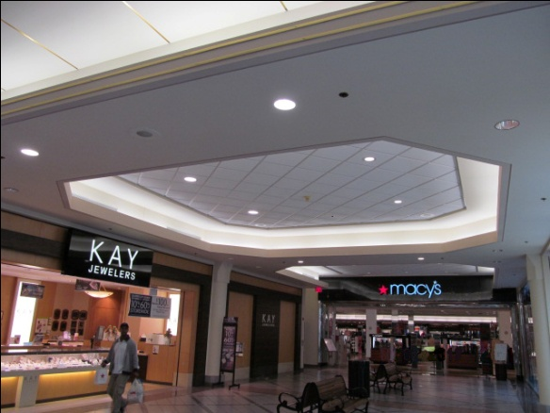
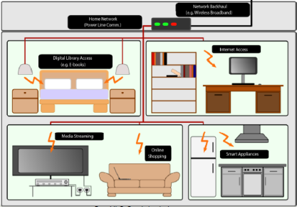
LiFi can enable Indoor Communications
The demand for wireless data is growing exponentially, approximately 16 Exabytes/month by 2016
70% of data generated indoors
Ability to supply data is saturating
Li-Fi presents complementary indoor wireless communications

Slide 7
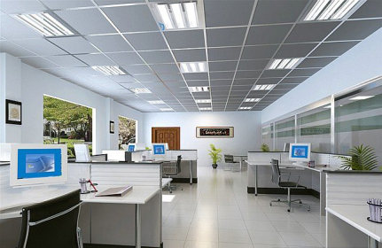
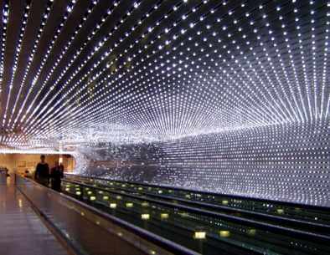
LiFi leverages LED Lighting
Lighting business model changing due to LED lifetimes
No longer based on unit sales
Moving to services and “value-adds”
Li-Fi provides powerful value-add by merging lighting and communications infrastructure
Allow lighting companies to move into ICT industry
Fits into new digital building architectures
Smart not just in lighting but improves RoI by becoming a Data Access Medium

Slide 8
LiFi leverages light spectrum
Unlike RF spectrum which is heavily licensed, visible light is completely unlicensed
Spectrum is complementary and non-interfering to all existing and emerging 802.11 technologies
Wider Spectrum → Less Congestion → More Bandwidth

Slide 9
Where LiFi? (from the perspective of an enterprise AP vendor’s customers)
Where?
LiFi solves nuclear power plant complexities
LiFi solves use cases for a (French) electricity utility
LiFi solves European country Department of Defense security issues
LiFi solves use case of devices that need wireless but not mobility

Slide 10
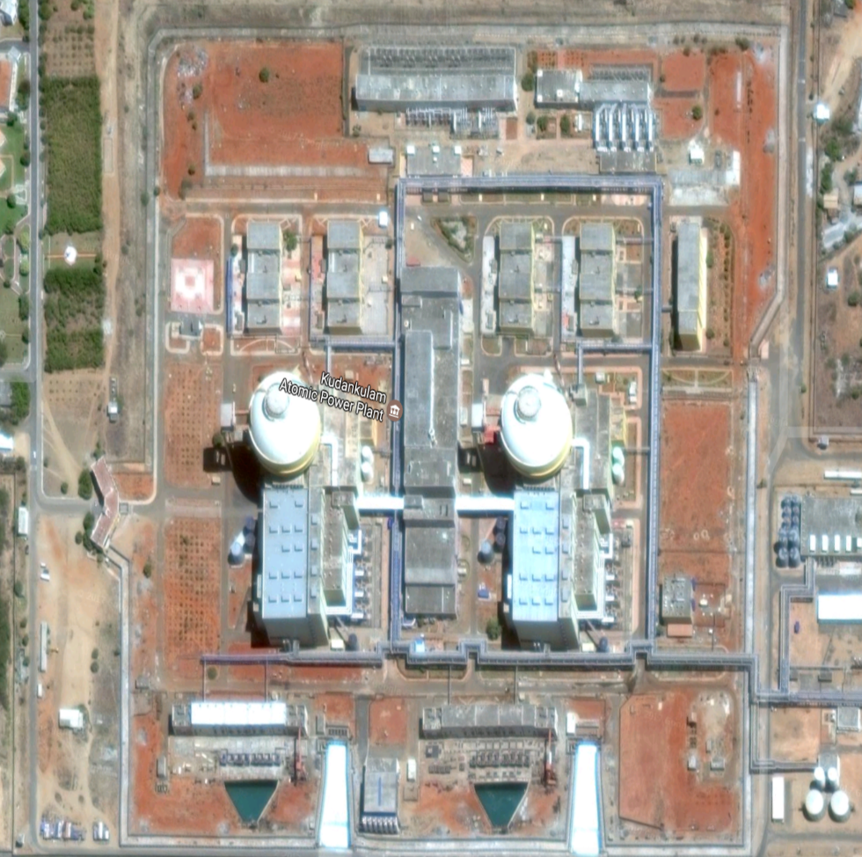
LiFi solves nuclear power plant complexities
WiFi not allowed within Reactor Complex.
Multiple Symmetric & Interconnected Reactor Complexes in the same facility
Maze like structures makes it difficult to get geopositioning within Reactor Complex

Slide 11
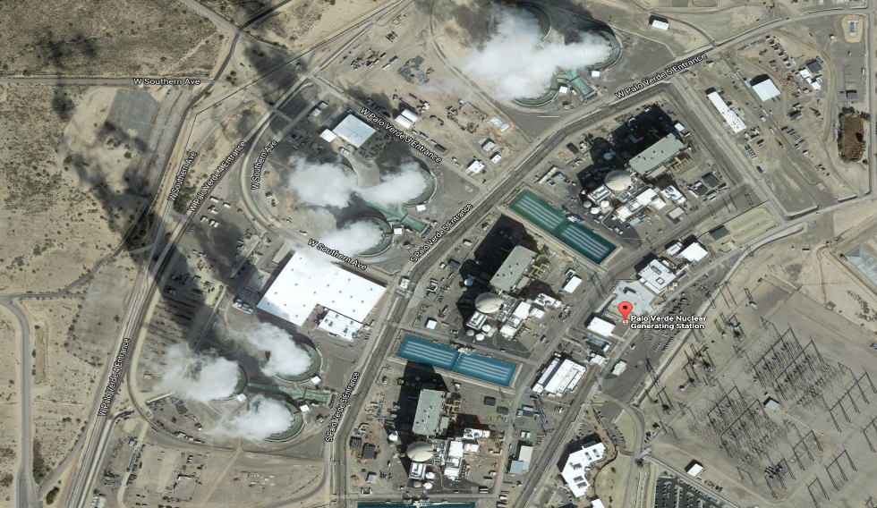
LiFi solves use cases for a (French) electricity utility
Enterprise Wi-Fi Infrastructure already deployed in Administrative Offices
Primary Requirement is for LiFi based positioning
Secondary Use case is low bandwidth uplink for taking notes and meter readings.

Slide 12
LiFi solves European country Department of Defense security issues
Considered for Sensitive Compartmentalized Information Facility
Sensitive to RF leakage
Bandwidth not important in this case – just security

Slide 13
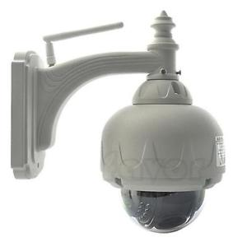
LiFi solves use case of devices that need wireless but not mobility
Helps offload wireless to mobile users
Provide connectivity to devices that require wireless but are not mobile (e.g. cameras)
Cameras placed in locations which are hard-to-reach

