Slide 1
DCM SQPSK for channel aggregation in OFDM mode
Date: 2017-11-06
Authors:

Slide 2
Introduction
SQPSK modulation for channel aggregation is not defined in current draft
This presentation investigate several options for DCM SQPSK modulation for channel aggregation (2.16GHz+2.16GHz or 4.32GHz+4.32GHz) in OFDM mode and propose a method with better performance

Slide 3
Simulation Assumption
Channel aggregation(2.16GHz+2.16GHz or 4.32GHz+4.32GHz)
SISO transmission
11ad CR, CB NLOS channel model
Ideal channel estimation
11ad LDPC code(1/2)
PPDU length 8192 bytes
Static Tone Pairing(STP) subcarriers mapping
Receiver Algorithm : MRC in frequency domain

Slide 4
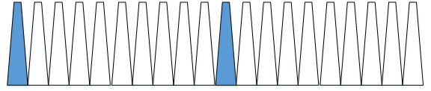
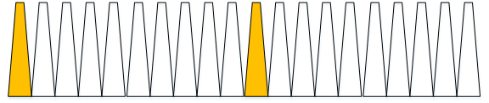
Option 1 :
SQPSK in each aggregated channel
The first half of data symbols are mapped to the first half of channel 1. Its conjugated repetitions are mapped to second half of the channel 1
The second half of data symbols are mapped to the first half of channel 2. Its conjugated repetitions are mapped to the second half of the channel 2
168 data symbols
168 data symbols
Bits[2m, 2m+1]
S(m)
conj(S(m))
S(n)
conj(S(n))
168 subcarriers
168 subcarriers
168 subcarriers
168 subcarriers
Aggregated channel 1
Aggregated channel 2

Slide 5
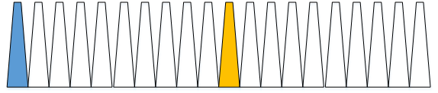

Option 2 :
SQPSK across the aggregated channels
The data symbol $S(m)$ is mapped to the aggregated channel 1.
Its conjugated repetition ${S(m)}^{∗}$ is mapped to aggregated channel 2.
336 data symbols
Bits[2m, 2m+1]
conj(S(m))
S(n)
S(m)
conj(S(n))
336 subcarriers
336 subcarriers
Aggregated channel 1
Aggregated channel 2

Slide 6
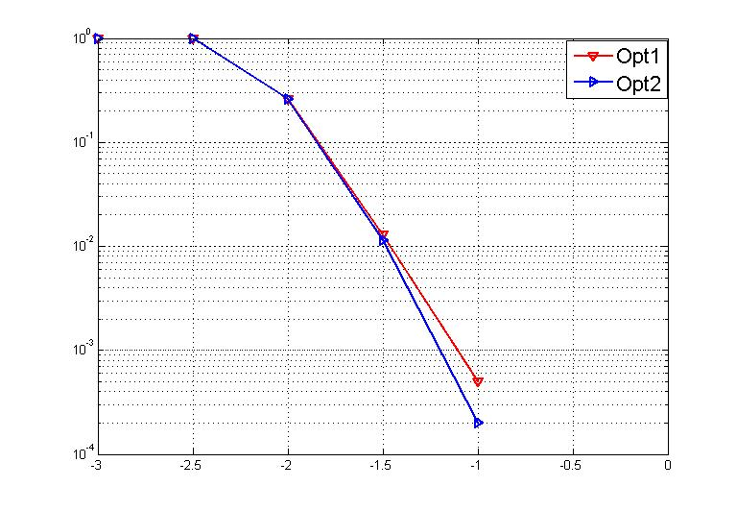
Simulated PER of DCM SQPSK
11ad CB channel
SNR gain at 1% and 0.1% PER
PER | Option2 | Option1 | Gain
1% | -1.48dB | -1.46dB | ~0.02dB
0.1% | -1.2dB | -1.1dB | ~0.1dB

Slide 7
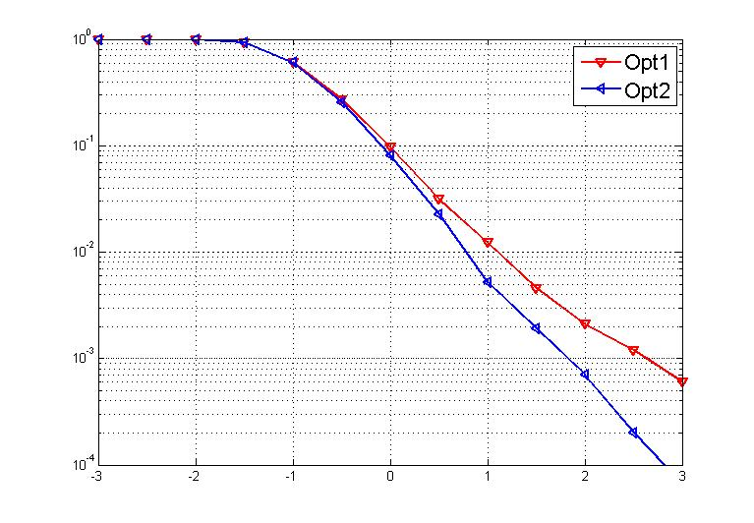
Simulated PER of DCM SQPSK
11ad CR channel
SNR gain at 1% and 0.1% PER
PER | Option2 | Option1 | Gain
1% | 0.75dB | 1.07dB | ~ 0.4dB
0.1% | 1.87dB | 2.63dB | ~0.8dB

Slide 8
Conclusion
In this contribution, we compared the performance of
  Option1 : SQPSK modulation in each aggregated channel
  Option2 : SQPSK modulation across the aggregated channels
Based on simulation, option2 have better performance
  11ad CB : 0.02dB @ 1% PER, 0.1dB @ 0.1% PER
  11ad CR : 0.4dB @ 1% PER, 0.8dB @ 0.1% PER
We propose that DCM SQPSK modulation across the aggregated channels may be used for OFDM transmission mode

Slide 9
SP
Do you agree
  to define DCM SQPSK across aggregated channels as described in (11-17-1656-00-00ay-Draft text for DCM SQPKS for channel aggregation in OFDM mode)?

