Slide 1
Further Consideration on Smart Scanning Usage Model
Date: 2017-11-08
Authors:
Name | Affiliations | Address | Phone | email
Roger Marks | Huawei | Denver, CO, USA | 1-802-capable | roger@ethair.net
Lyu Yunping (Lily) | Huawei | Nanjing, PRC |  | lvyunping@huawei.com
Chenhe Ji | Huawei | Nanjing, PRC |  | jichenhe@huawei.com

Slide 2
Abstract
This contribution, intended for presentation to IEEE 802.11 TGba, proposing additional details to apply Usage Model 9 (“Smart Scanning”) of the WUR Usage Model Document (IEEE 802.11-17/0029r10), consistent with the Specification Framework for TGba (IEEE 802.11-17/0575r04).
The key points are:
advertisement of the WUR discovery channel
benefits of implementing with a shared discovery channel

Slide 3
Background
The WUR Usage Model Document, in Revision 10 (IEEE 802.11-17/0029r10), introduced a new Usage Model 9 (“Smart Scanning”), with two use cases, based on IEEE 802.11-17/1386r7.
  “discovering nearby APs on main radio requires the STA to do passive or active scan which consumes quite some power…Since WUR is an ultra-low power receiver, offloading some of the passive background scans to WUR can significantly save even more power” [17/1386r7]

Slide 4

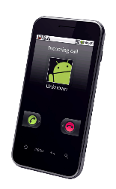
Usage Model 9: Smart Scanning
Sept 2017
Use case 1: Ultra-low power location scan
Mobile devices sometimes scan through multiple channels for nearby APs, and use the measured Wi-Fi signal strength for improved location services. Scanning on main radio consumes higher power than WUR radio. In addition, scanning on main radio has the risk of conflicting with regular data exchange.
In WUR-facilitated location scan, the mobile device scans through the channels using the WUR receiver, and uses the signal strength measured from WUR packets received from adjacent APs to provide additional information to the location services on the mobile device. In other words, some of the location scan on main radio can be offloaded to WUR radio.
Because WUR consumes much less power than main radio, WUR facilitated location scan provides an ultra-low power location scan mechanism.
Use case 2: Ultra low power roam scan
Mobile devices sometime scan for roaming purposes. These roam scan sometimes is triggered when link quality degrades. These roam scan takes time because the scan is typically done on multiple channels, and on each channel the device either conducts active scan during which it sends a probe request and typically stays awake until it receives a probe response, or passive scan during which it dwells on each channel for at least a Beacon interval to receive a Beacon. As a consequence, scanning through multiple channels introduces roaming latency and consumes power. Sometimes, it runs into conflict with regular data exchange.
In WUR-facilitated roam scan, the mobile device passively scans through multiple channels using WUR, and collects basic information about nearby APs. The collected info can be used to facilitate the devices’ roaming decisions.
Because WUR consumes much less power than main radio, WUR-facilitated roam scan provides an ultra-low power roam scan. In addition, due to the low power operation, WUR scan can be performed quite frequently in the background, and thus roaming information can be readily available whenever needed, i.e., it reduces roaming latency.

Slide 5
Smart Scanning Usage Model is Distinctive
As explained in IEEE 802.11-17/1386r7, Smart Scanning differs from the other usage models:
Intended for smart phones, etc., rather than IoT.
Does not attain power saving from main radio sleep.
    “for mainstream devices, the main radio cannot be turned off completely” [17/1386r7]
    “scanning on main radio has the risk of conflicting with regular data exchange” [17/0029r10, Usage Model 9]
    Note: Consistent with PAR (which says “The reception of the wake-up frame by the WUR can trigger a transition of the primary connectivity radio out of sleep.”)

Slide 6
Usage Model 9: Key Aspects
“devices sometimes scan through multiple channels for nearby APs, and use the measured Wi-Fi signal strength for improved location services.”
  “scanning on main radio has the risk of conflicting with regular data exchange”
    implies that scanning on WUR does not conflict
    implies that WUR transmission and reception are simultaneous with primary (PCR) radio
  “In WUR-facilitated location scan, the mobile device scans through the channels using the WUR receiver, and uses the signal strength measured from WUR packets received from adjacent APs”
“roam scan takes time because … scanning through multiple channels introduces roaming latency and consumes power.”
  “In WUR-facilitated roam scan, the mobile device passively scans through multiple channels using WUR, and collects basic information about nearby APs.”
  “WUR scan can be performed quite frequently in the background, and thus roaming information can be readily available whenever needed, i.e., it reduces roaming latency”

Slide 7
Usage Model 9: Some Open Questions
“802.11ba should define frame format… that allows unassociated STAs to interpret the AP’s identity” [per 17/1386r7]
What is the WUR discovery channel, and how does the mobile know it?
How do we deal with legacy APs and mobiles?
Should active scanning be included?
Can we improve the latency and efficiency further by using a shared WUR channel?

Slide 8
Drawing from a Prior Contribution on Smart Scanning
Prior TGmd contribution IEEE 802.11-17/0666r2 proposed to improve scanning efficiency and latency, without WUR
17/0666r2 concepts address the gaps in Usage Model 9
Key points of IEEE 802.11-17/0666r2
  the 802.11ai Reduced Neighbor Report (RNR) advertises the channel on which neighbors provide scanning info
  the advertisement is flagged using a reserved value the RNR
    in the TBTT Information Field Type (TIFT) subfield
      three of the four values are currently reserved
  suggests reducing scanning latency by providing scanning info in a single shared channel

Slide 9
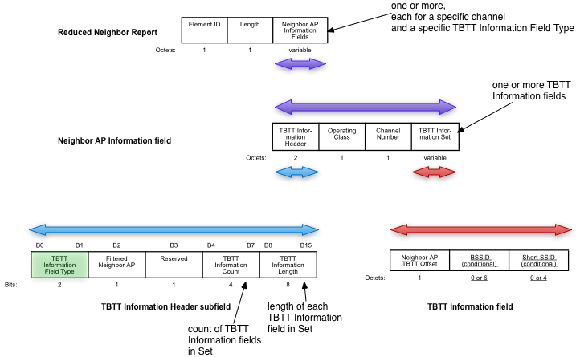
What is TBTT Information Field Type (TIFT)?

Slide 10
Usage Model 9: Some Directions
“802.11ba should define frame format… that allows unassociated STAs to interpret the AP’s identity” [17/1386r7]
  We agree with 17/1386r7. The AP’s PCR channel should be part of its identity.
2. What is the WUR channel, and how does the mobile know it?
  The AP can advertise the WUR discovery channel in the reduced neighbor report (RNR), identifying it as WUR using a specified value of the TIFT parameter.
3. How do we deal with legacy APs and mobiles?
  Legacy scanning procedures can remain in place.
  Mobile knows from RNR whether WUR scanning is enabled.
4. Should active scanning be included?
  Possible; probe request can use main radio or WUR.
  Improves latency but adds complexity.
5. Can we improve the latency and efficiency further if multiple APs share a WUR discovery channel?
  Yes; if APs use a shared WUR discovery channel, then mobile needs to probe only that channel instead of the channel of each AP. Reduces both latency and energy.

Slide 11
WUR Channel Considerations
Per contribution IEEE 802.11-17/1333r2, TGba agreed that “AP decides the WUR operating channel”
17/1333r2 presented these views:
  operating channel of primary radio (PCR) and WUR may differ
  STA may only support WUR in 2.4 GHz band for low power/cost implementation, and a dual-band concurrent AP can use 2.4 GHz band and channel as the operating channel of WUR even if PCR operating channel is in 5 GHz band
  AP can indicate [WUR operating channel] in beacon
  for other applications like AP discovery… a common channel may be required for simplifying the scan requirement
17/1608r0 proposed to define Discovery Channel concept for WUR transmitter to send out WUR discovery frames
17/0666r2 presented the same views regarding the use of a dedicated scanning channel

Slide 12
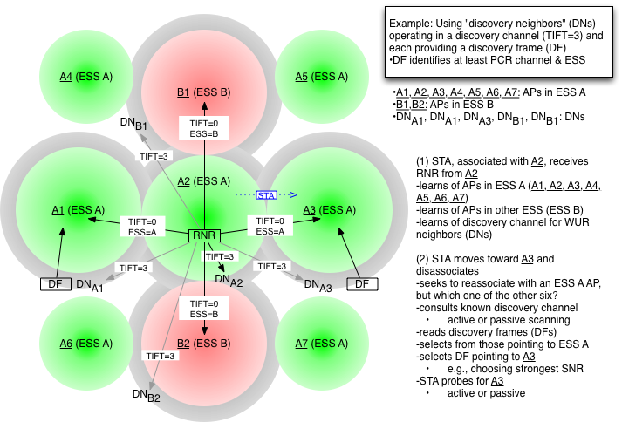
Smart Scanning with RNR Identification

Slide 13
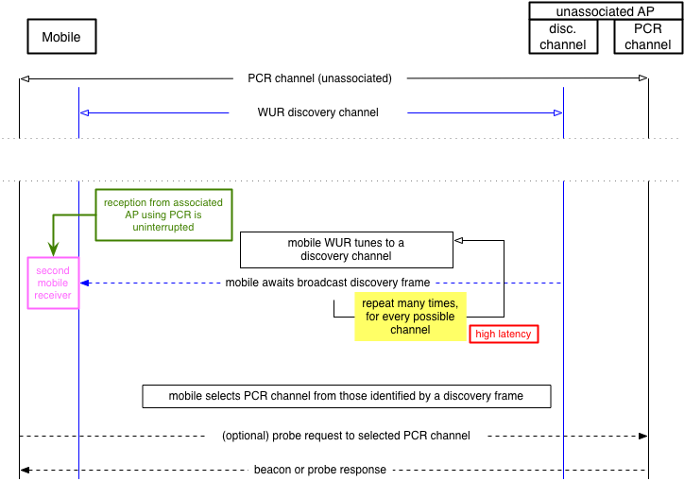
Usage Model 9: Basic

Slide 14
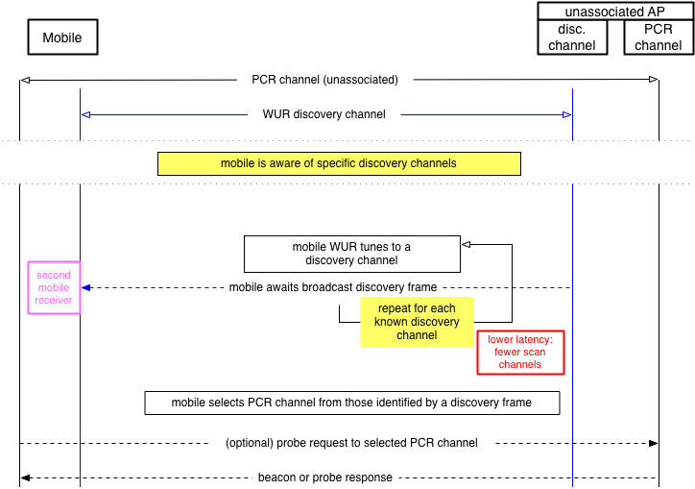
Usage Model 9, Known Discovery Channels

Slide 15
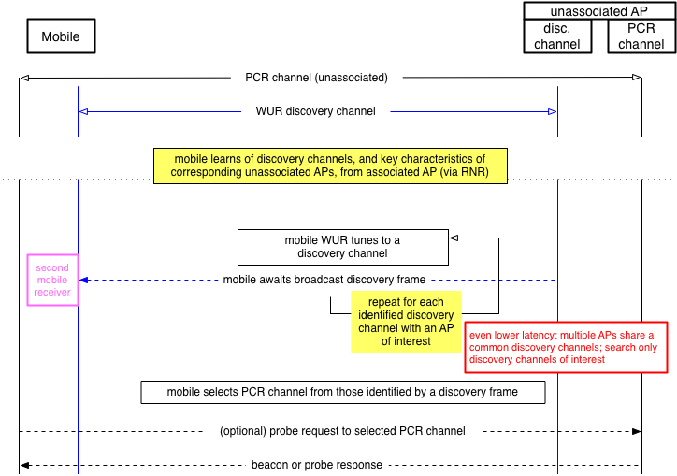
Usage Model 9, Advertised Discovery Channels

Slide 16
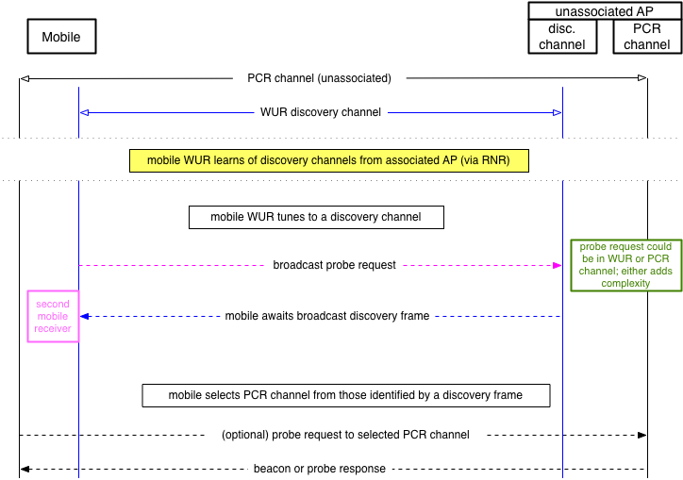
Usage Model 9: Active Scan alternative

Slide 17
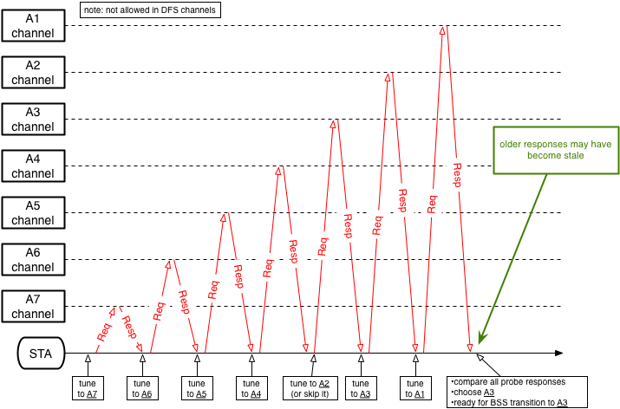
Usage Model 9 with Multiple Discovery Channels

Slide 18
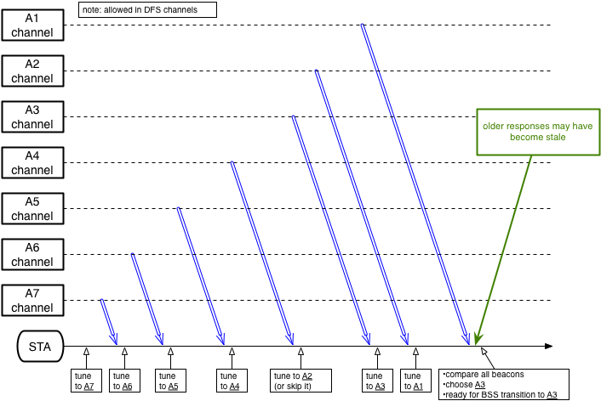
Usage Model 9 with Multiple Discovery Channels

Slide 19
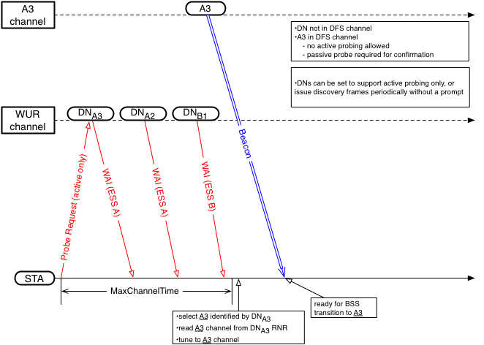
Usage Model 9 with Shared Discovery Channel

Slide 20
Congestion in the Discovery Channel
Per IEEE 802.11-17/1386r7, Use Case 1 (location scan) of Usage Model 9, discovery frame period can be on the order of seconds
  passive scanning with low discovery frame repetition rate
In Use Case 2 (roam scan) of Usage Model 9, latency is critical
    passive scanning with high discovery frame repetition rate (~100 ms), or active
discovery frame duration can be around 1-2 ms
  frame data content could be as little as ~12 bytes
    identify the operating channel and the ESS
    0.4 ms at 250 kbit/s or 1.5 ms at 62.5 kbit/s
    probably can be made short enough to be practical

Slide 21
Summary
Usage Model 9 stands in need of further detail
  IEEE 802.11-17/1333r2 and IEEE 802.11-17/0666r2 provide useful guidance
Needs a means to inform mobile of a discovery channel and key info regarding corresponding discovered APs
  the RNR element is a good basis
  need to add a tag to identify WUR discovery
If multiple APs use a common shared WUR discovery channel, then scanning will be much faster
Note: How APs choose their discovery channels need not be standardized here. Perhaps they listen over the air; perhaps they are coordinated by a controller. Standardized guidance could be provided.

Slide 22
References
[1] IEEE 802.11-17/0029r10 (“WUR Usage Model Document”)
[2] IEEE 802.11-17-0575r04 (“Specification Framework for TGba”)
[3] IEEE 802.11-17/1386r7 (“Examining 11ba usage models for mainstream devices”)
[4] IEEE 802.11-17/0666r2 (“TBTT Information Field Type (TIFT): Proposed content for 802.11REVmd”)
[5] IEEE 802.11-17/1333r2 (“WUR Operating Channel”)
[6] IEEE 802.11-17/1608r0(“WUR Discovery Frame for Smart Scanning”)

