Slide 1
A Simple WUR Preamble Design
Date: 2017-11-03
Authors:
Name | Affiliation | Address | Phone | Email
Justin Jia Jia | Huawei |  |  | justin.jia@huawei.com
Ming Gan | Huawei

Slide 2
Introduction
WUR preamble design was proposed to incorporate data rate info in [1][2][3]
  No extra signal field to indicate data rates
  Two SYNC sequences of different lengths in [1] require two synchronization correlators at the receiver side, complicating the WUR design
  This presentation aims to outperform the timing acquisition and false alarm rate of the method in [3] that requires detecting more than one peak
  In this contribution, we provide a simple WUR preamble design
  Only one synchronization correlator at the receiver side is required
  WUR preamble still contains data rate info

Slide 3
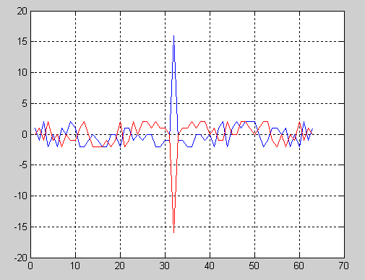
Complementary preamble sequences
Complementary preamble sequences are proposed for WUR preamble
  use two sequences of the same length, which are logical Complements/NOT of one another
  Packet acquisition is determined by the maximum magnitude of the cross-correlator output
  Data rate for the payload part is determined by judging the sign of the cross-correlator output which has the maximum magnitude
E.g., the output of correlator with only one local sequence
  The right figure shows two relative different
  outputs under two possible inputs

Slide 4
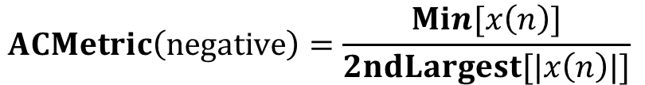
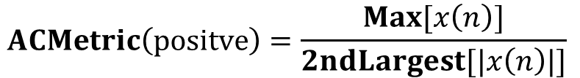
Performance Metrics
Auto and cross correlation metrics for the Long and Short Sequences is proposed in [1]
  The larger the metric, the lower the false alarm rate and the better the timing estimate
Based the characteristic of complementary WUR preamble sequences, we propose two metrics for choosing the best preamble sequence.
$$ACMetric\left(positve\right)=\frac{Max⁡[x\left(n\right)]}{2ndLargest[|x\left(n\right)|]}$$
$$ACMetric\left(negative\right)=\frac{Min⁡[x\left(n\right)]}{2ndLargest[|x\left(n\right)|]}$$

Slide 5
Performance Metrics
Cross-correlation can not be used for scenario where there is one correlator at the receiver side.
  It is impossible to have the mixture of two outputs of two correlators
Auto-correlation is very important as the time acquisition and date detection are directly related to the auto-correlation peaks condition:
  When the first peak is positive/negative, large positive/negative side peaks would degrade the time acquisition performance
  When the first peak is positive/negative, large negative/positive side peaks would degrade the date rate detection processing

Slide 6
Performance Metrics and detector
Other metrics for WUR Preamble sequence
  The duration of continuous zeroes/ones in the preamble sequence shall be less than PIFS
  The number of zeroes and ones in the preamble sequence is equal
  The detector for complementary preamble sequences at the receiver side is as follows
  Assume complementary preamble sequences are S and S
  The local reference sequence at the receiver side is 2xS-1
  If the output of the correlator at the maximum absolute value is greater than positive threshold, detect that the received WUR PPDU is modulated by data rate 1
  If the output of the correlator at the maximum absolute value is less than negative threshold, detect that the received WUR PPDU is modulated by data rate 2
  Received samples
Correlator
  2*S-1

Slide 7
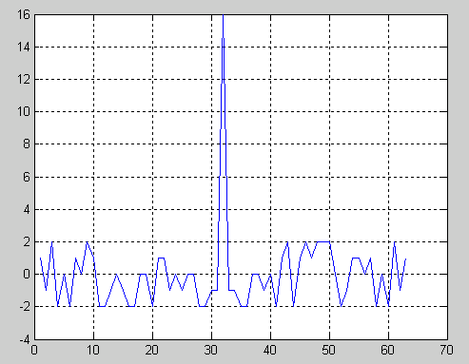
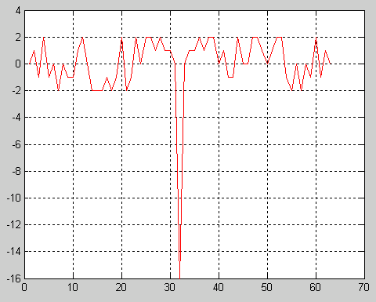
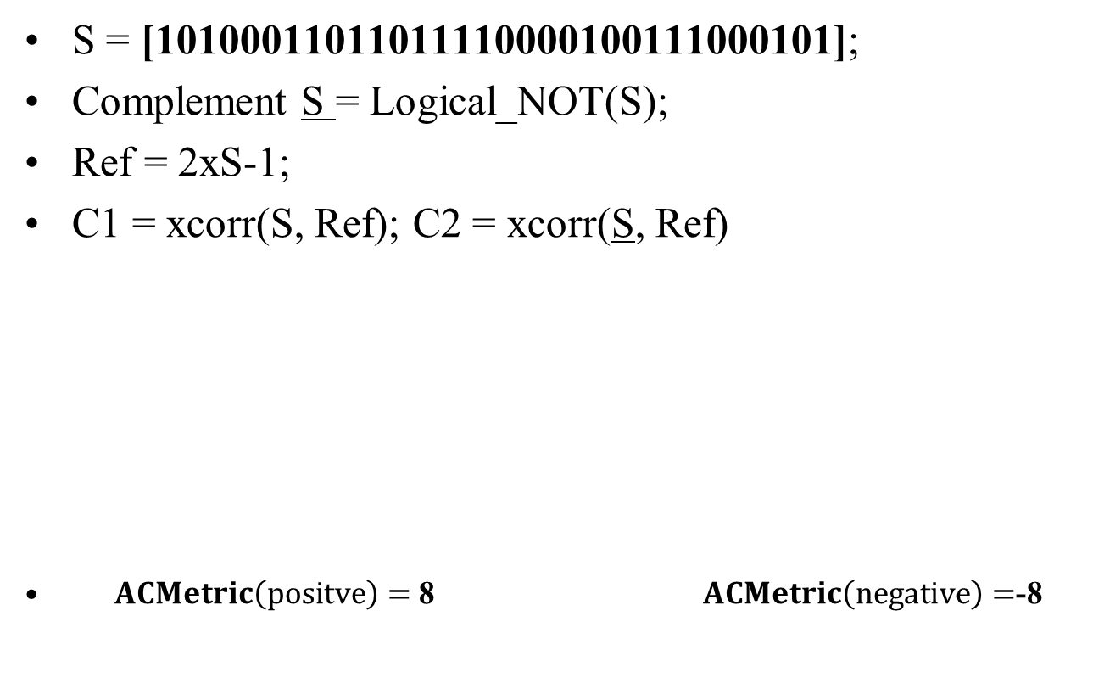
Proposed WUR preamble sequence
S = [10100011011011110000100111000101];
Complement S = Logical_NOT(S);
Ref = 2xS-1;
C1 = xcorr(S, Ref); C2 = xcorr(S, Ref)
$ACMetric\left(positve\right)=$ 8 $ACMetric\left(negative\right)=$-8

Slide 8
Simulation Settings
Symbol Form: 4us/250kbps ON/OFF OOK(conventional) symbol representing each bit
Baseband Sampling: 5MHz—20 samples per OOK symbol
Channel Upsampling Rate.: 20x—@100MHz
Channels: Ch.D NLOS
CFO: +/-200ppm[4]
Tx/Rx Filter: 5th-order Butterworth @ 2.5MHz Fc and 50MHz Fs[3]
SNR Measurement: @20MHz by upsampling the baseband 5MHz(SNR is calculated with the inserted zeros)[4]
Front Silent Period: 2ms
False alarm rate is slightly less than 1% @all SNR
Binary Sequences[5]:
  S1 = [01110101000010010110011111000110];
  S2 = [10110000111001101011110100010010];
  S3 = [10100011011011110000100111000101];
Tx randomly transmits the complementary sequences S and S to Rx

Slide 9
Simulation Results-Preamble Sync Error 1
Sync Error Definition:
  Max(abs(Correlation Result))< Threshold
  S is detected as S, vice versa
  Time acquisition error @5MHz fs samplings>0

Slide 10
Simulation Results-Preamble Sync Error 2
Sync Error Definition:
  Max(abs(Correlation Result))< Threshold
  S is detected as S, vice versa
  Time acquisition error @5MHz fs samplings>2

Slide 11
Simulation Results-Packet Error
Packet Error Definition:
  Max(abs(Correlation Result))< Threshold
  S is detected as S, vice versa
  Bit error >0

Slide 12
Reference
[1] IEEE 802.11-17/1343r0, “WUR Preamble SYNC Field Design”, Sep. 2017
[2] IEEE 802.11-17/1345r5, “PHY Frame Format Proposal”, Sep. 2017
[3] IEEE 802.11-17/1442r1 , “WUR Preamble Performance Study with Phase Noise and ACI”, Sep. 2017
[4] IEEE 802.11-17/0188r9, “Simulation Scenario and Evaluation Methodology”, Jul. 2017
[5] IEEE 802.11-17/1343r0, “WUR Preamble SYNC Design and Performance”, Sep. 2017

