Slide 1
11ba PHY Frame Format—Length Discussions
Date: 2017-11-06
Authors:

Slide 2
Review
In [1], PHY format was proposed: 2 rates, 2 synchronization (SYNC) fields for the two PHY rates, No PHY Header.
Continue discussions on length of data fields.
62.5Kbps
LSTF
LLTF
LSIG
BPSK
Symbol
SYNC-1
Data Field
250Kbps
LSTF
LLTF
LSIG
BPSK
Symbol
SYNC-2
Data Field

Slide 3
Length of Data Field—1
In WUR, MAC frame type determines the LENGTH of Data field, or Duration of the WUR PPDU!
Rx PHY requires the PPDU Duration to decode the packet;
Rx MAC requires the PPDU Duration to set (WUR-)NAV
“L” Portion
SYNC
TYPE
MAC Header
MSDU
FCS
RX: Compute PPDU Duration
Set NAV

Slide 4
Length of Data Field—2
As in legacy 802.11 networks, for robust EDCA network the packet length should be protected by CRC, to avoid arbitrary PPDU duration assumption or NAV settings.
Example: a STA detects a weak WUR packet over the air but decode its Frame Type incorrectly without awareness, i.e. assuming an incorrect PPDU duration or NAV duration.
Gain collision or missing intended WUR packets.
Since we prefer no separate PHY header to indicate PPDU duration, the Frame Type Field need to be protected by a CRC (e.g. 1 bit parity).
Meaning Rx PHY still needs decode Type Field and check CRC and calculate the PPDU duration.
TYPE
CRC
MAC Header
MSDU
FCS

Slide 5
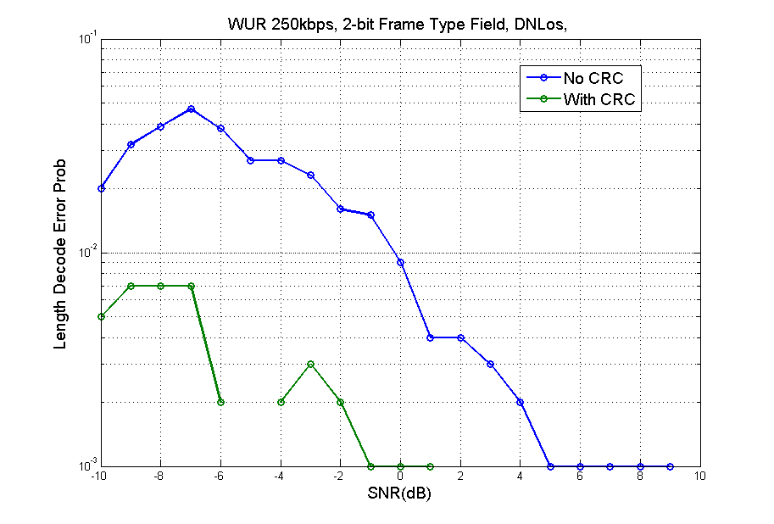
Simulation-1
DNLoS, 2-bit Frame Type Field,
Probability of: {SoP found} && {Timing found} && {Frame Type Decode Error}
250Kbps:
A large range of incorrect
packet duration calculations

Slide 6
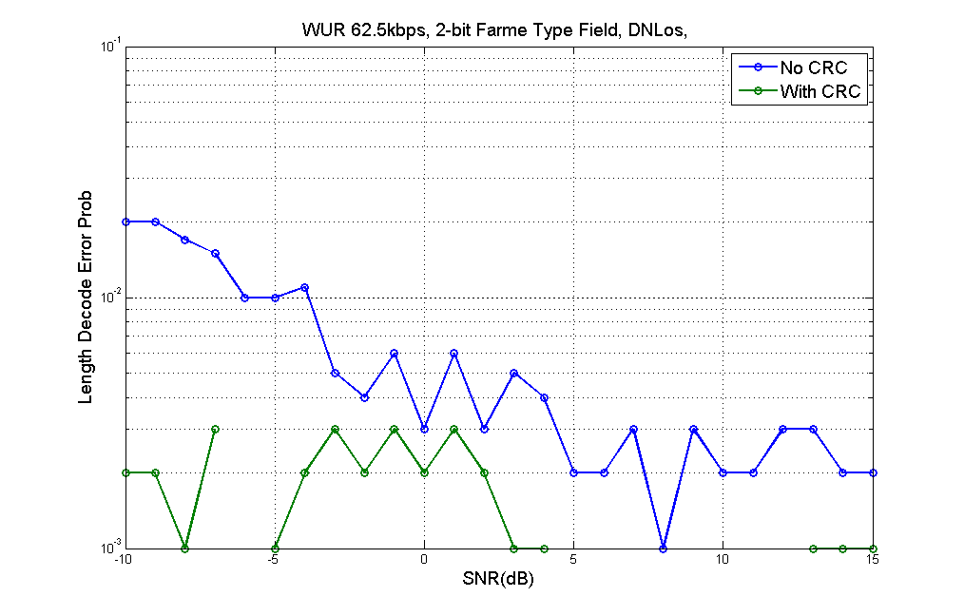
Simulations-2
62.5Kbps:
A large range of incorrect
packet duration calculations

Slide 7
Alternative Method: Fixed LENGTH for ALL frame types
If MAC can unify the length of all frame types, then it is easier for PHY Rx and no CRC needed on Frame Type field.
However, there might be a large variation on length?
Shorter length for basic unicast/broadcast wake-up, WUR-beacon
Longer for other types? –e.g. multicast wake-up, TSF timing, discovery frame for scanning.

Slide 8
Length Issues in Low Rate (62.5Kbps) PHY
Example: a 48 bit Data field will take ~1ms duration!
Much less mkt value for 11ba if WUR may potentially congest the media by frequently sending PPDUs of mili-sec durations.
While the main BSS traffic is with short packets for most of time (refer to 11ax/HEW presentations).
May be hard to unify Length across types if the unified length is long.
Propose to limit the Length (number of bits in Data field) for the Low Rate PHY.
Meaning exclude some frame types for low rate if it is too long.
It is better if we can fix the LENGTH at least for the Low Rate PHY.
Simpler PHY Rx state machine
Faster adoption of 11ba if Low Rate PHY can cover all the mandatory/basic WUR functions (e.g. wake-up, and beacon)

Slide 9
Reference
[1] 11-17-1345-05-00ba-phy-frame-format-discussions

Slide 10
Straw Poll 1
Do you agree to either add a CRC for Frame Type field in MAC header, or fix the length of Data Field for all WUR packets?

Slide 11
Straw Poll 2
Do you agree to define an upper limit on the length of Data field (to a TBD value) for the Low Rate (62.5Kbps)?

Slide 12
Straw Poll 3
Do you agree to fix the length of Data field (to a TBD value) for the Low Rate (62.5Kbps)?

